Slide 1
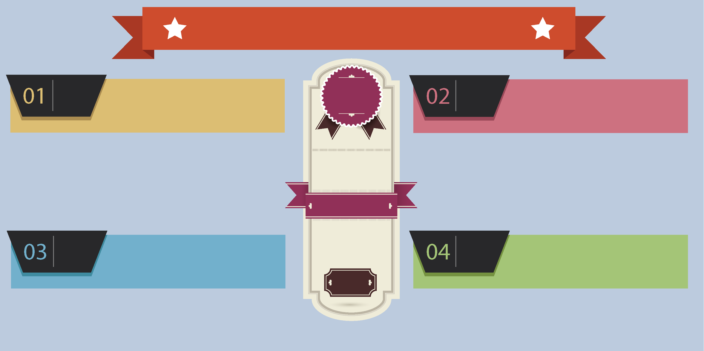
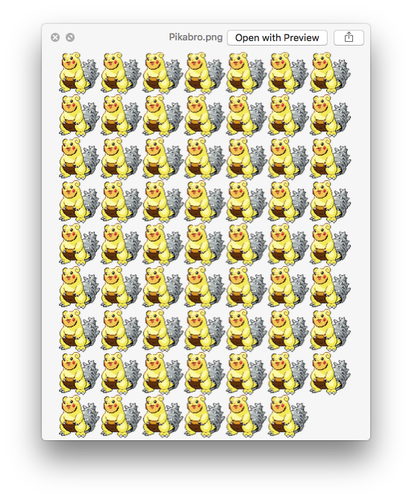
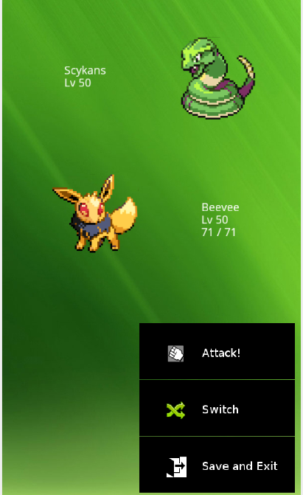
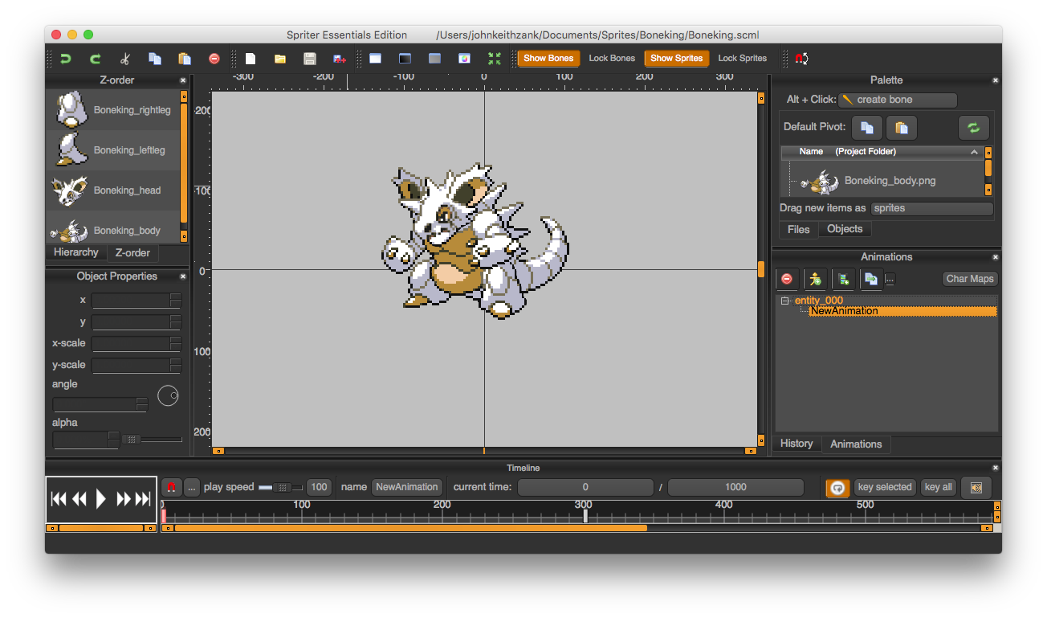
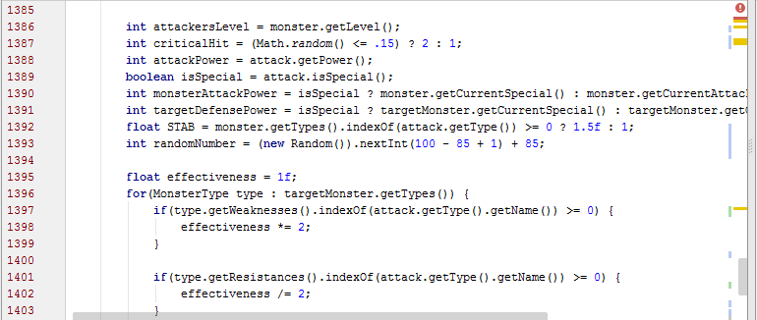
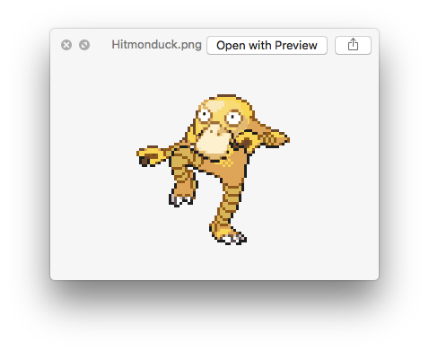
Mobile Monsters
This project is designed to be a monster battle simulator in which the user selects a team of three monsters to do battle against a team of monsters controlled by an AI
Players can choose from several attacks based on the monster’s elemental type, the attacks type and strength, and the defending monster’s type.
We have been inspired by the immensely popular Nintendo game, Pokemon. We chose to simulate the turn-based battles and game mechanics on Android devices utilizing the AndEngine development framework.
We created custom animated sprites and utilized freeware music, art assets, and sound effects to style the game.
Introduction
Objectives
Development of Gaming and Mobile Applications
CEN 4535C
Developed and Designed by
Nicolas Pickering
John Zank
Coding Challenges
Determining the results of a player’s action is easy to process, however the results must be revealed to the player slowly in order to provide suspense to the player. An output stack was developed to display results.
The “Hard” AI opponent utilizes the information it knows about the monsters on the field to determine its next actions, while the “Easy” AI simply ‘mashes buttons’.
University of North Florida
The development of this project resulted in experience in several facets of game development including sprite-based animation, the game cycle, user input on mobile devices, asset creation and allocation, multimedia, resource management, user interface, usability and legal/ethic issues, and artificial intelligence.
Conclusion
Fall 2015

