Slide 1

Welcome TO MY Presentation Name : Tofyael Ahmed id: 201-15-3053 Section :PC-I

Slide 2


Slide 3

What is GitHub Copilot

Slide 4
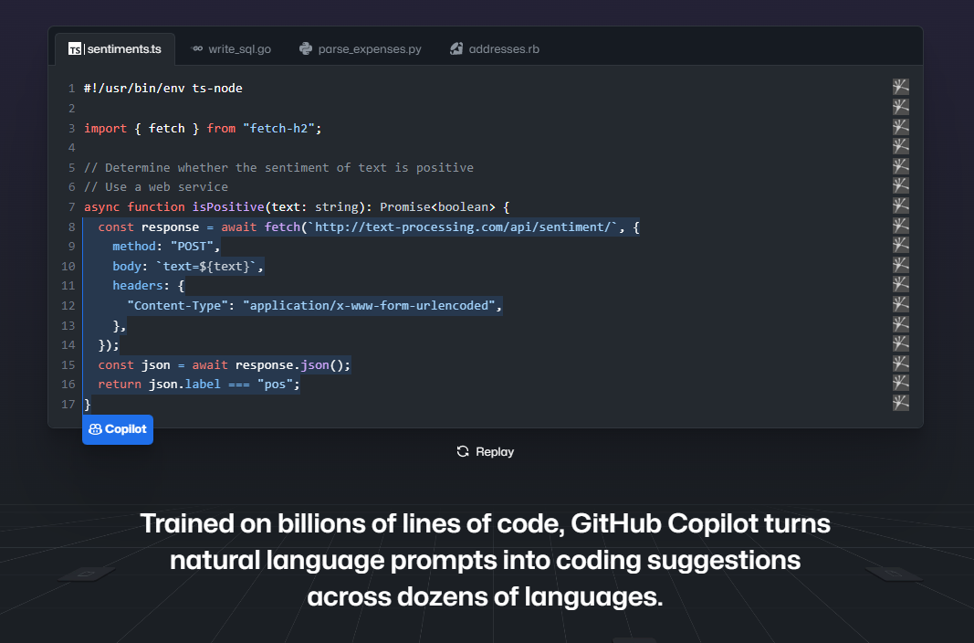
How it Works

Slide 5
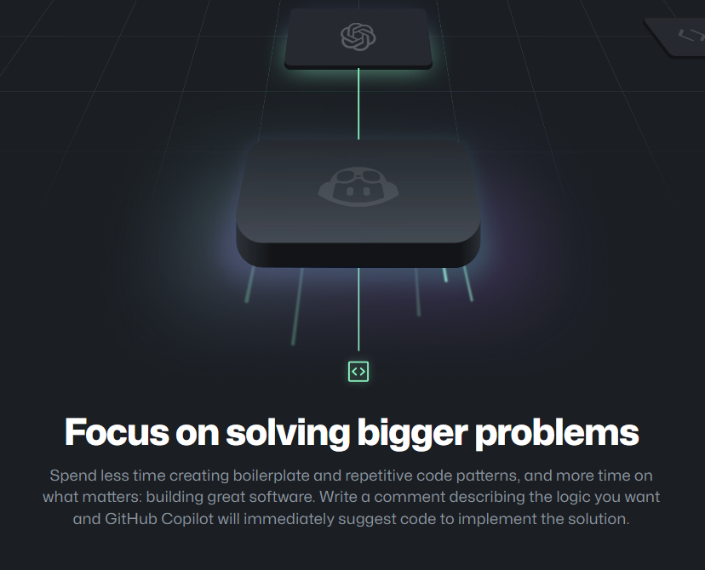
Why it needs

Slide 6
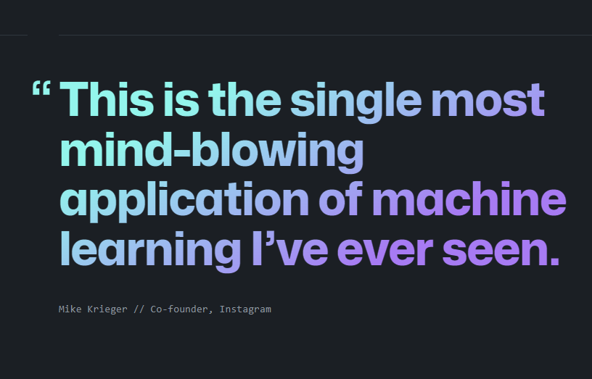
What is it’s efficiency ?

Slide 7
Is it Replace Programmer ?

Slide 8
Future of Copilot

Slide 9
THANK YOU

Slide 10
Any question ?

