Slide 1
Welcome To Our Presentation

Slide 2
What is our project
It is a simple web based Contact Book

Slide 3
What is features of our project ?
1/Cloud based.
2/Cross Platform .
3/Multifunctional .
4/ User based Log in .
5/ Elegant UI and UX .
6/Data Recovery and privacy .
7/ Automatic data backup .

Slide 4
Project Review

Slide 5
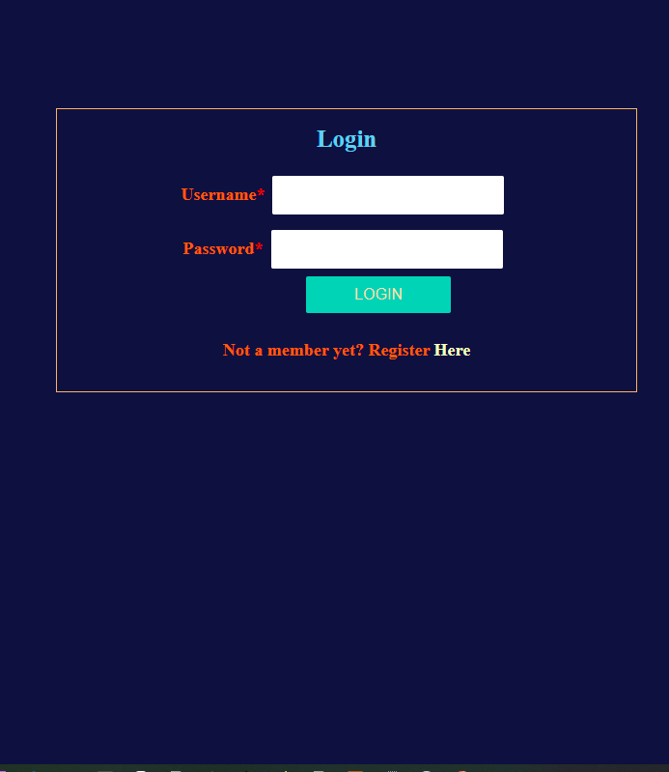
User Log in

Slide 6
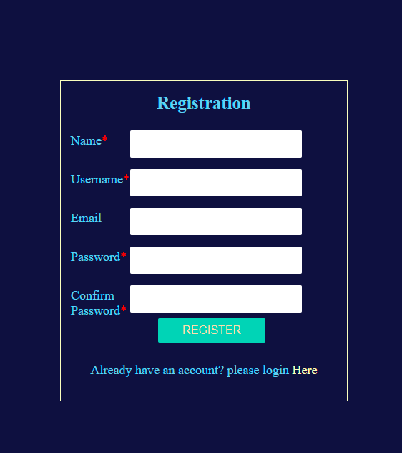
User Registration

Slide 7
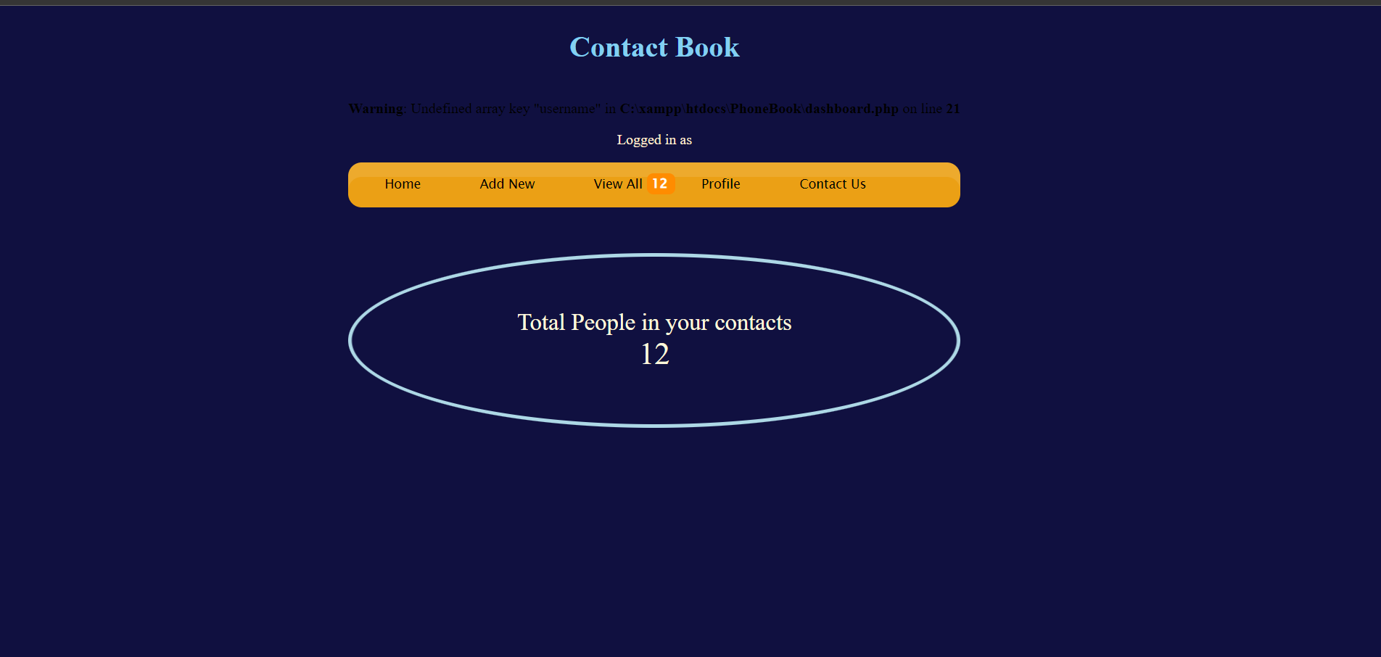
Home Page

Slide 8

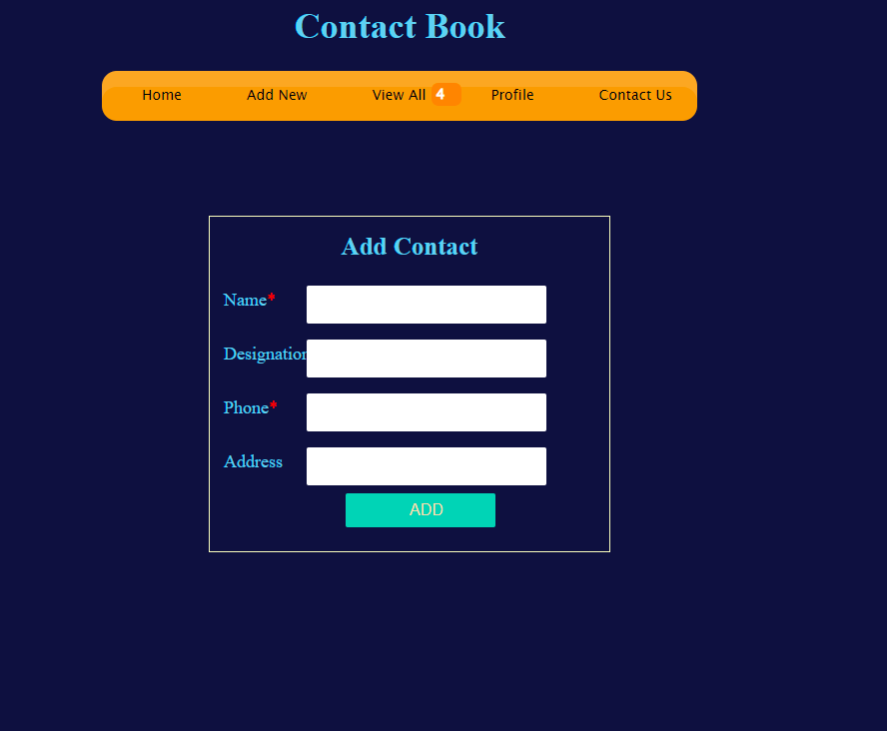
Add Contact

Slide 9
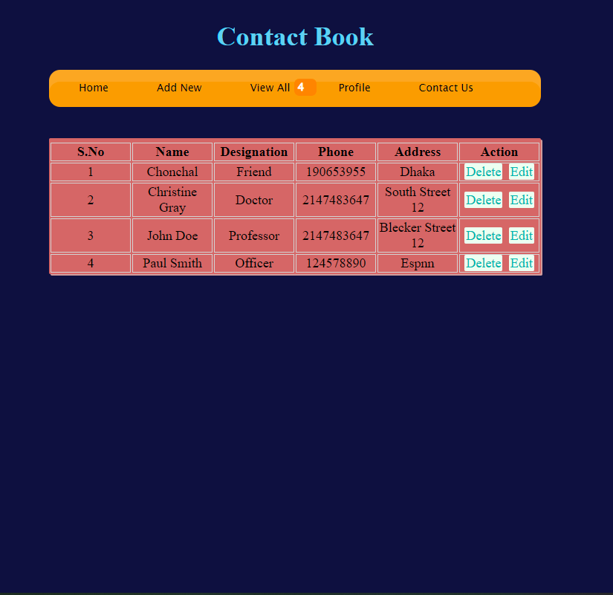
Contact List

Slide 10
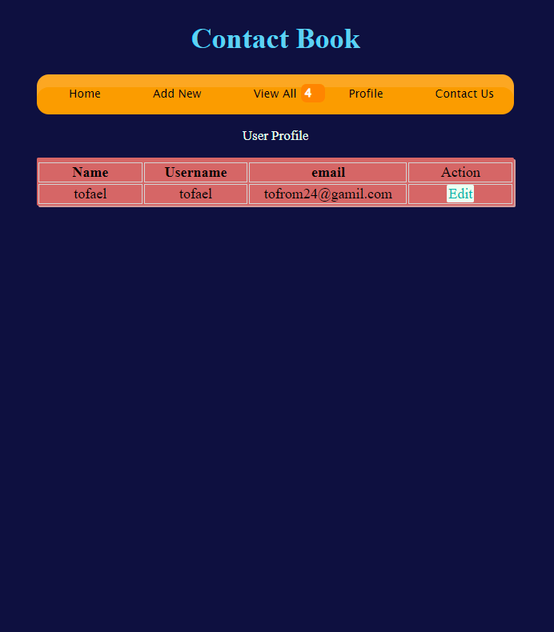
User Profile

Slide 11
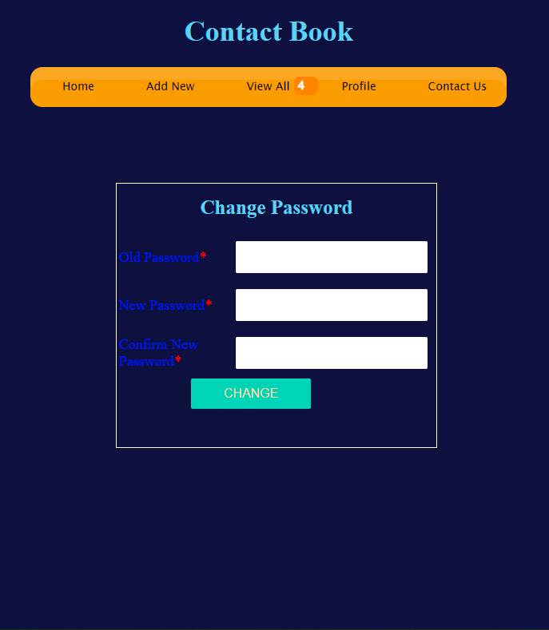
User Password Recovery

Slide 12
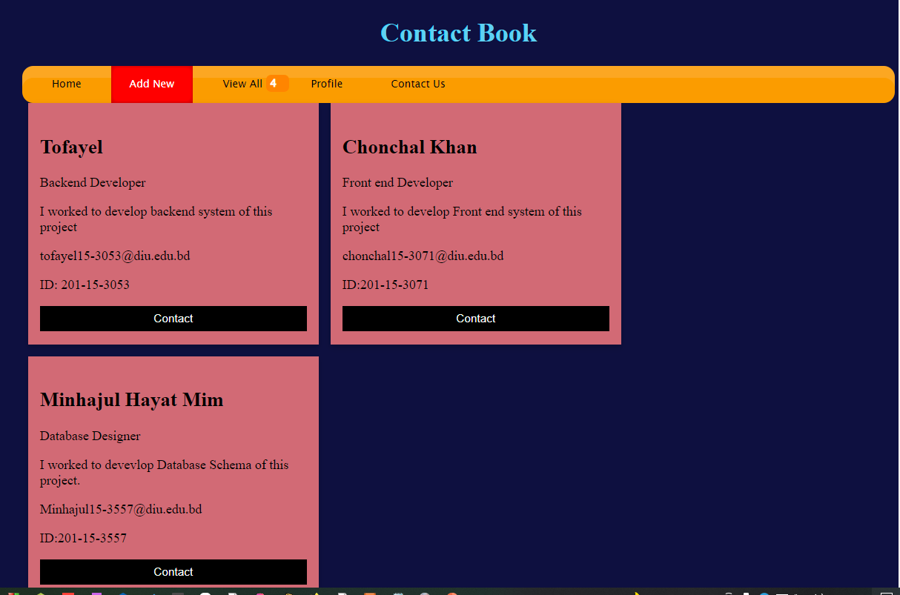
Developer Team Contacts

Slide 13
Database Schema
Contact_details ( contact_id, F_name, L_name, destination, phone, address )
User_details ( contact_id, name ,user_name , email, passward )

Slide 14
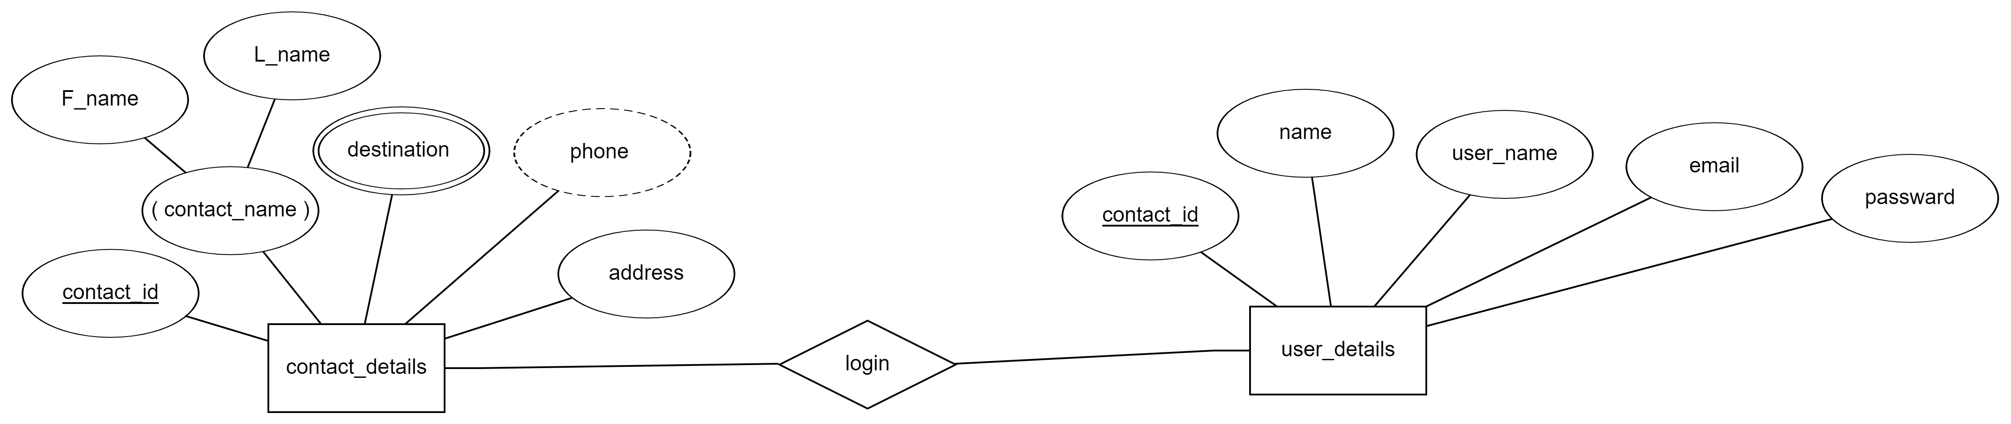
Er diagram

Slide 15
Which Technology used in this project .
Backend : PHP .
Front End : HTML , CSS , JavaScript .
Data Base : MySql Server .
Web Server : Apache Web Server .
Utility Development Tools : Visual Studio , Xampp , Chrome

Slide 16
Name : Tofayel Ahmed
Id : 201-15-3053
Name : Chonachal Khan
ID:201-15-3053
Name : Minhajul Hayat Mim
ID :201-15-3053

Slide 17
THANK YOU EVERYONE
Any Question ?

Slide 18
END

