Slide 1
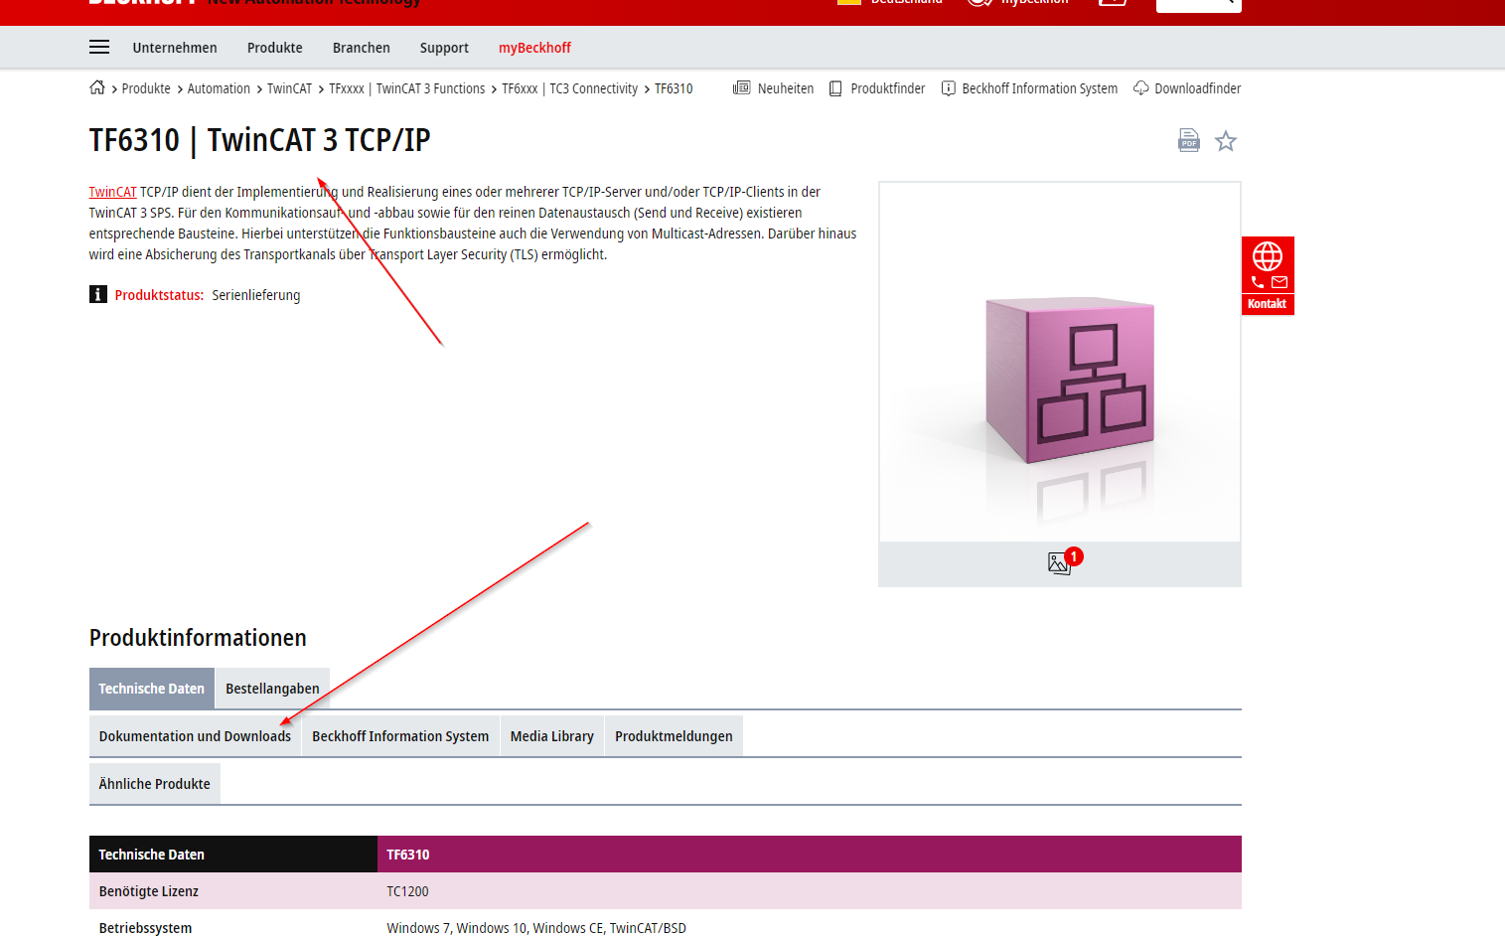
TF6310
Before Using the UR example you have to install for all socket communications the tcp/ip library

Slide 2
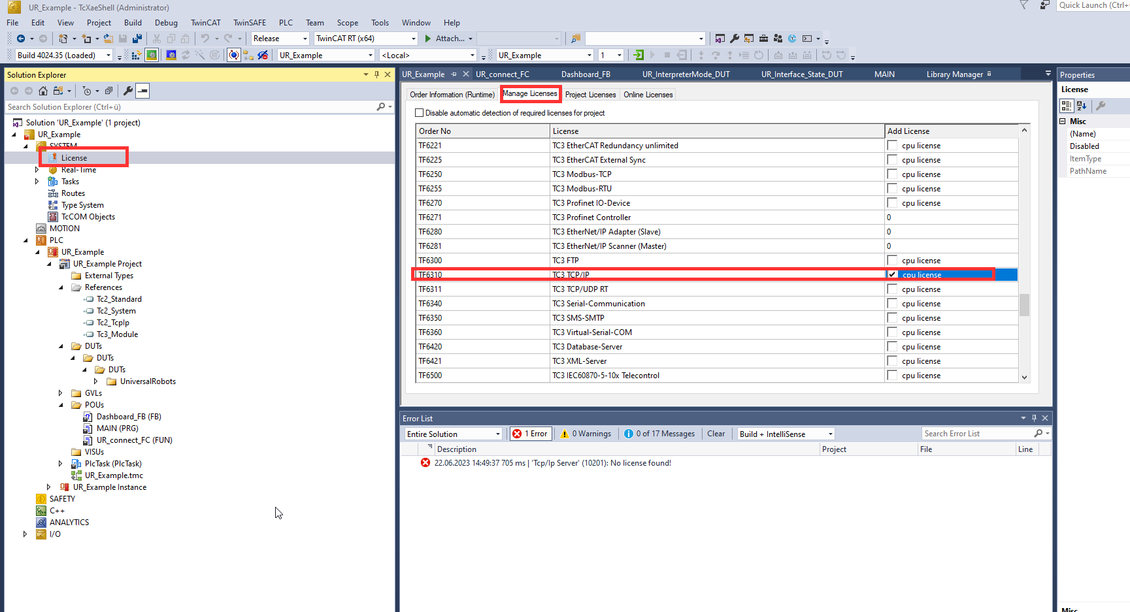
Get Trial license for if needed

Slide 3
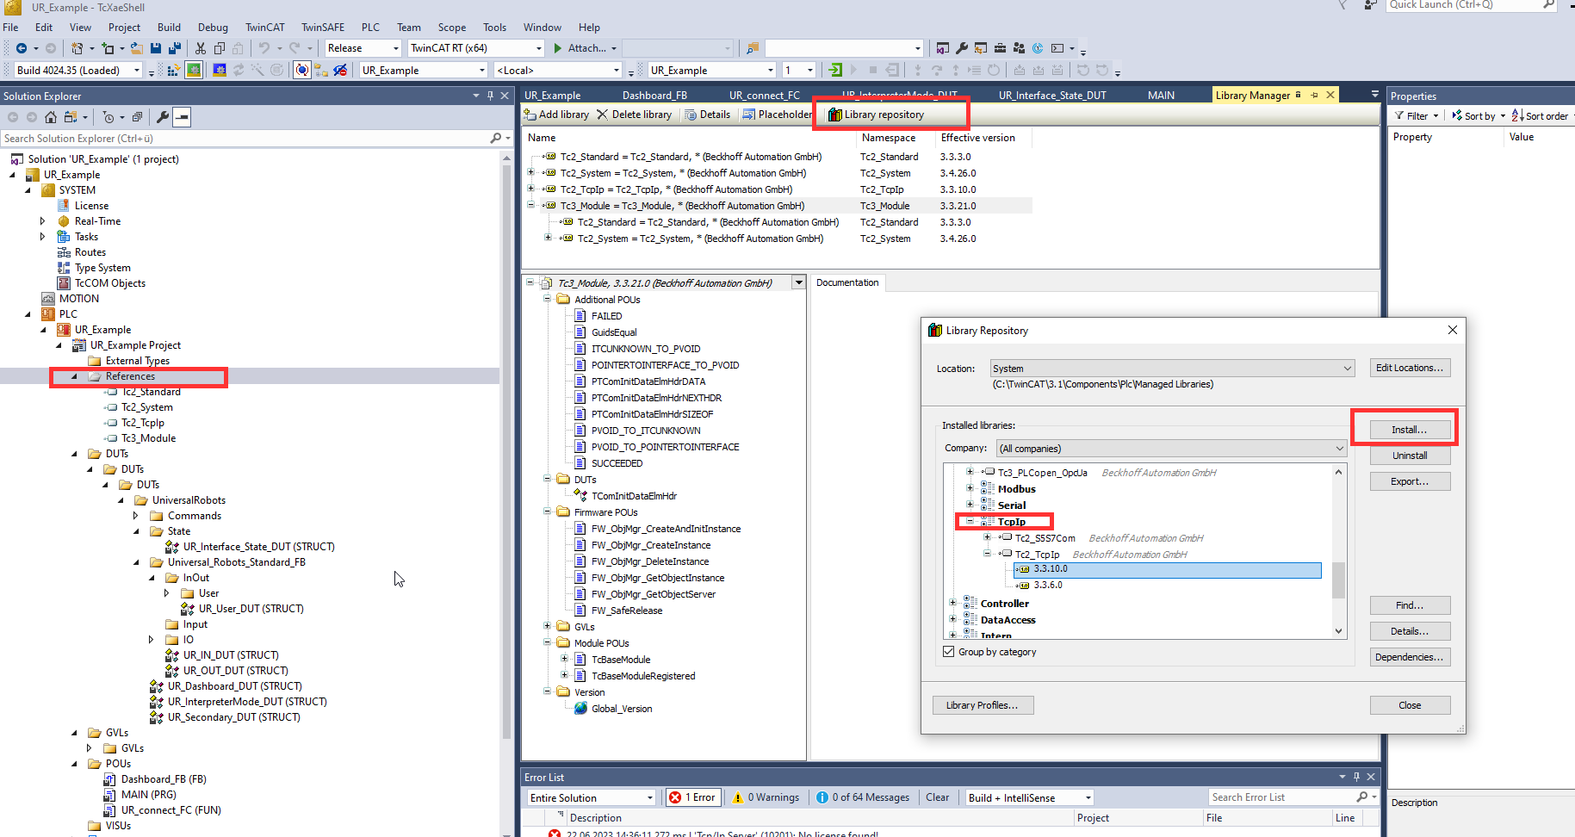
Install library Tc2_TcpIp (Communication)

Slide 4
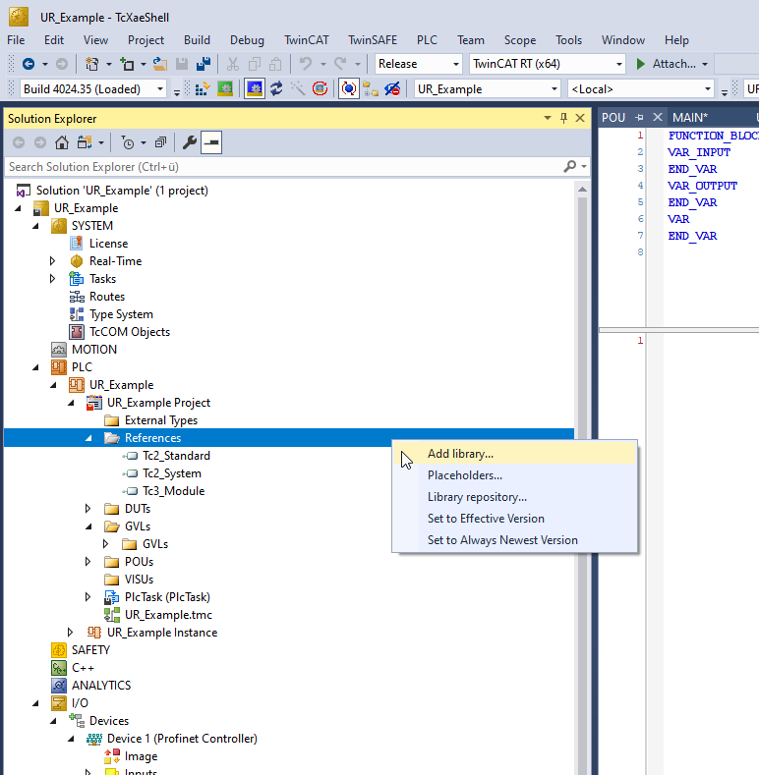
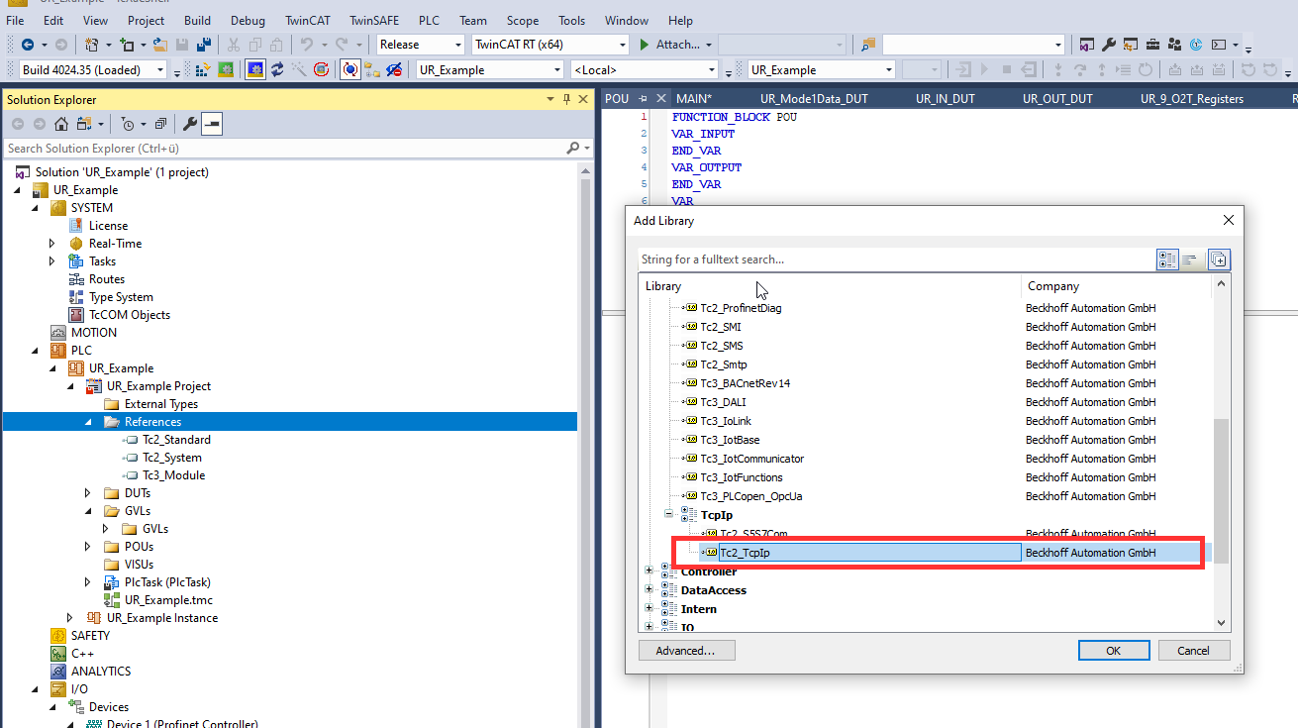
add Tc2_TcpIp (Communication) library it is necessary for all TCP communications

Slide 5
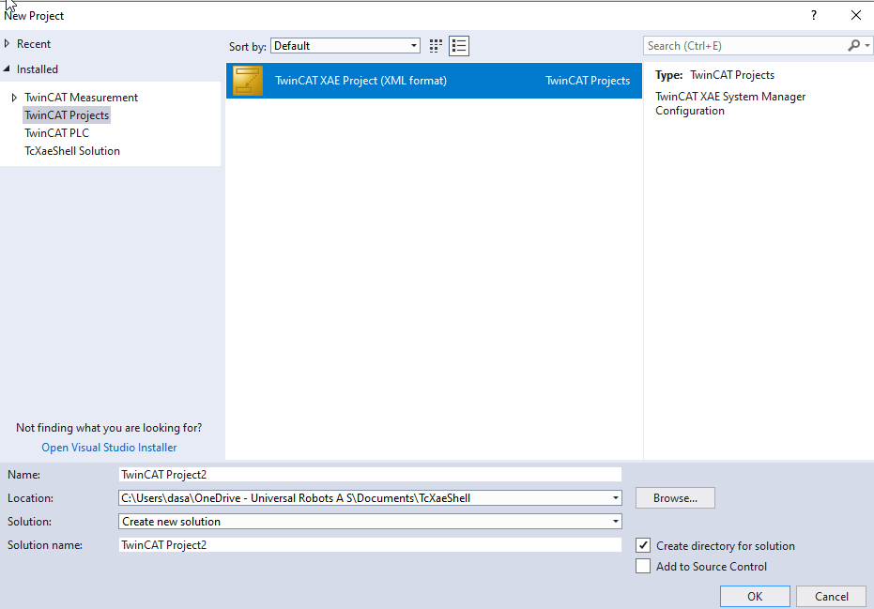
Create new project

Slide 6
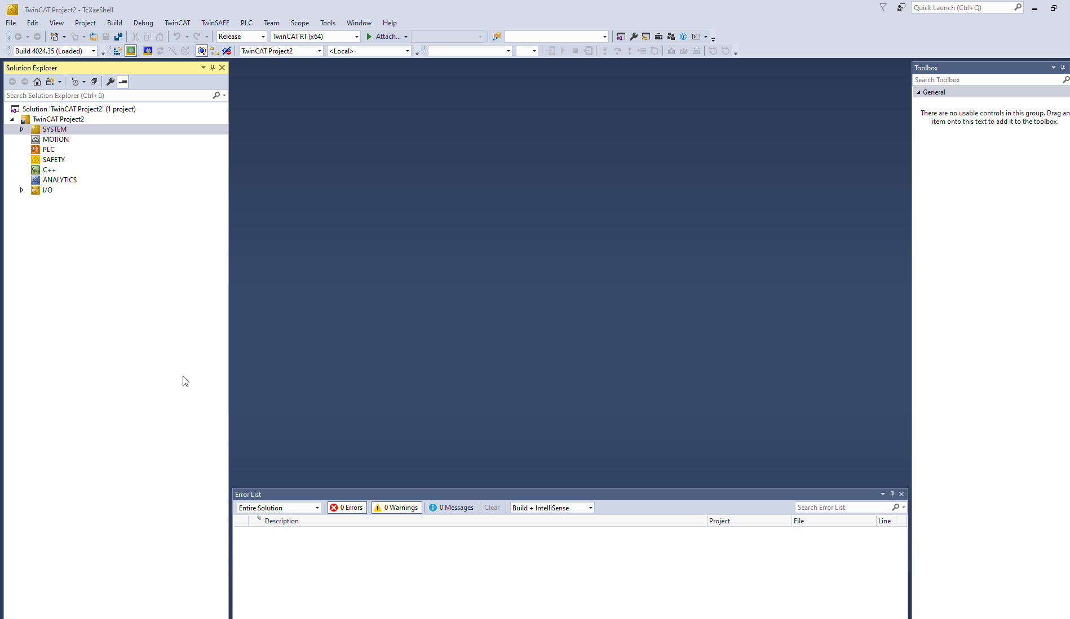

Slide 7
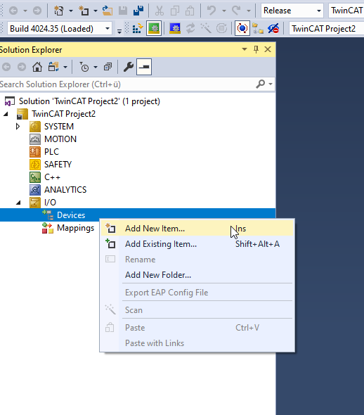
Config for profinet controller (RT)
Add new item to devices

Slide 8
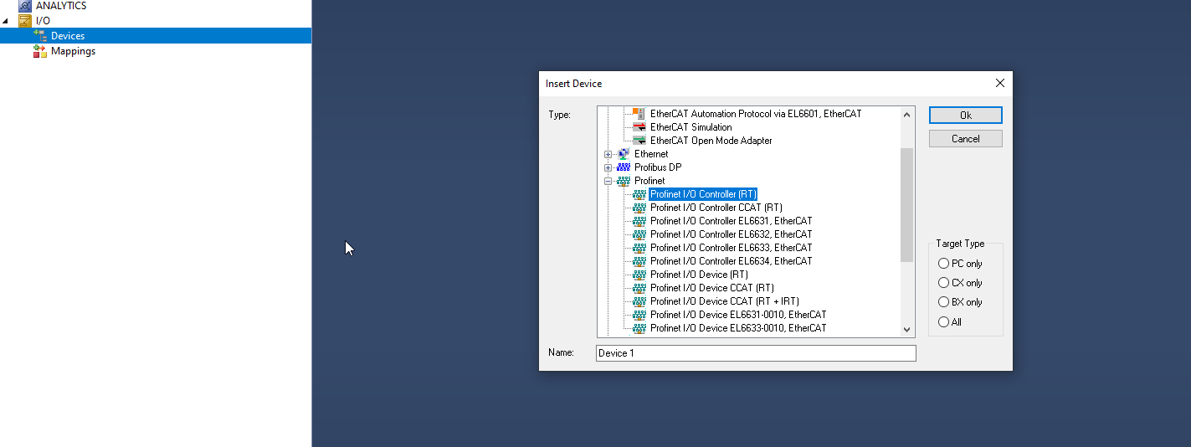
Add profinet IO controller RT

Slide 9
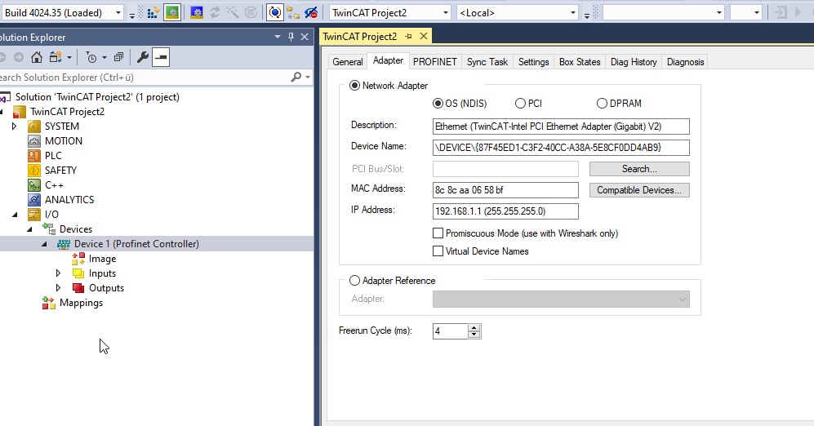
If ethernet driver already installed choose your prefered ethernet slot (PLC/Laptop) and skip next slide
In case it is not installed check next slide.

Slide 10
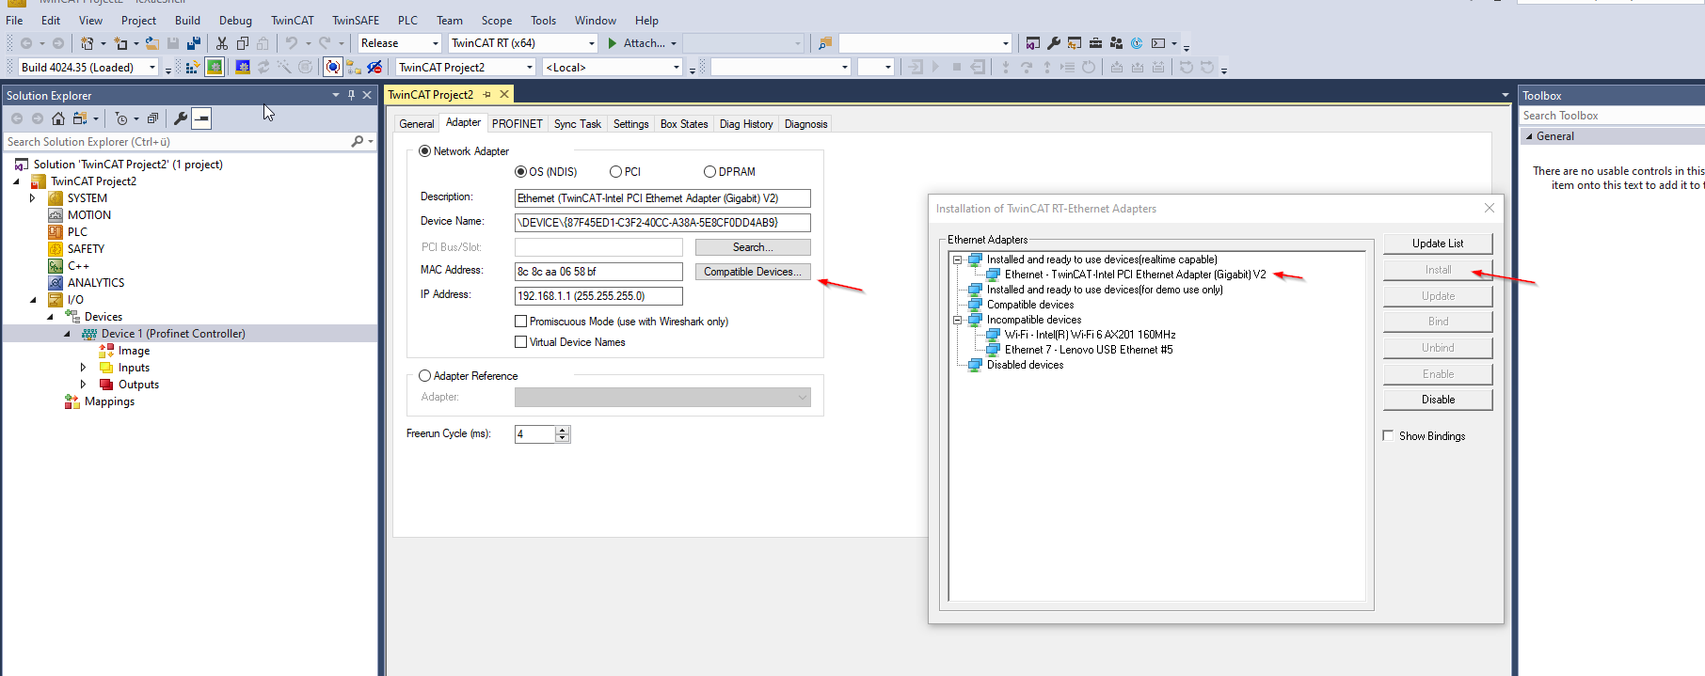
in case driver is not installed

Slide 11
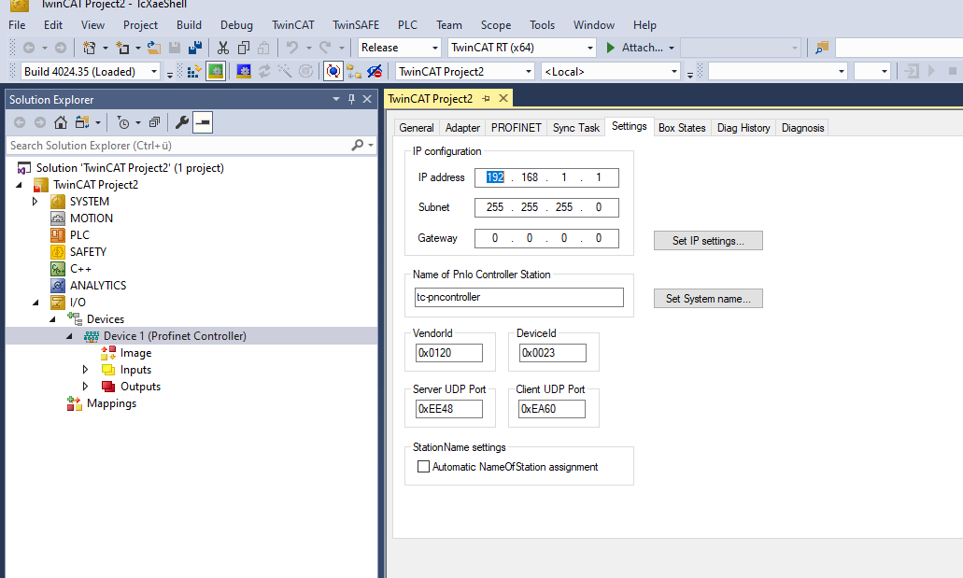
First setup ip configs of PN Controller

Slide 12
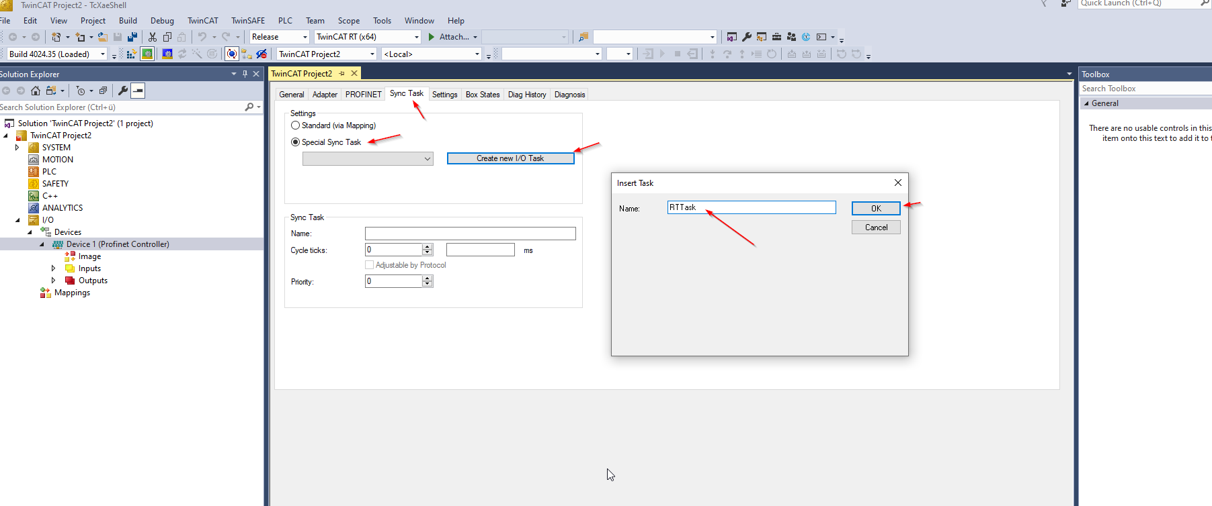
Create new task

Slide 13
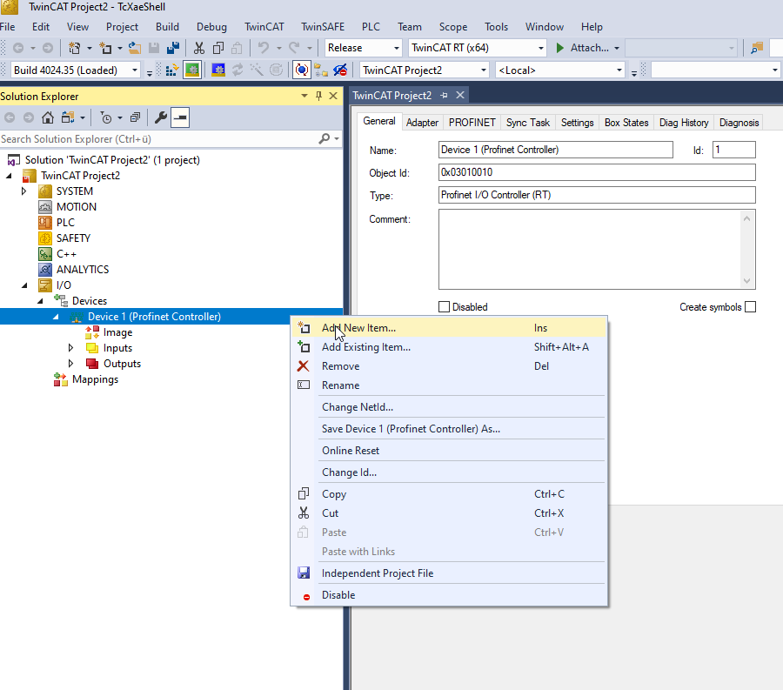
Add new IO Device (UR robot)

Slide 14
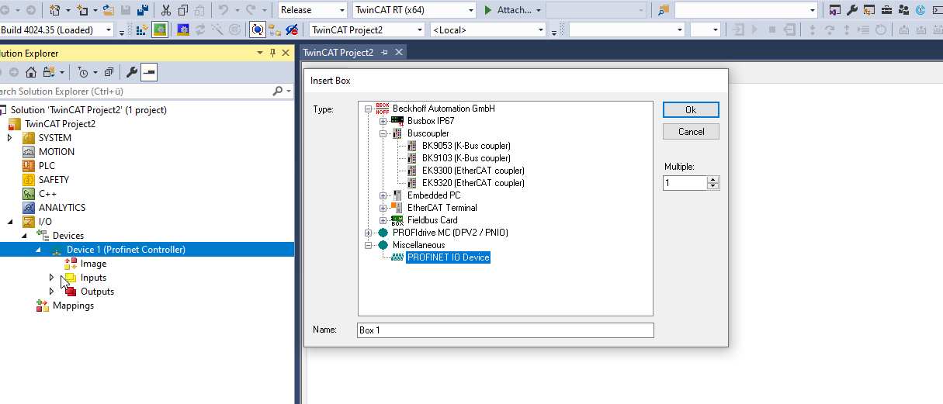

Slide 15
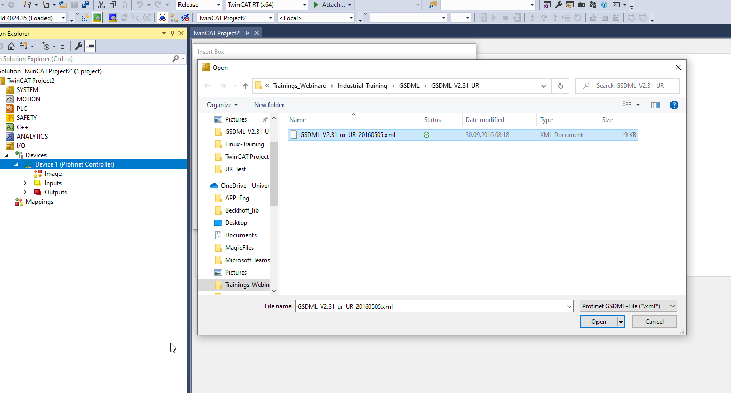
UR GSDML

Slide 16
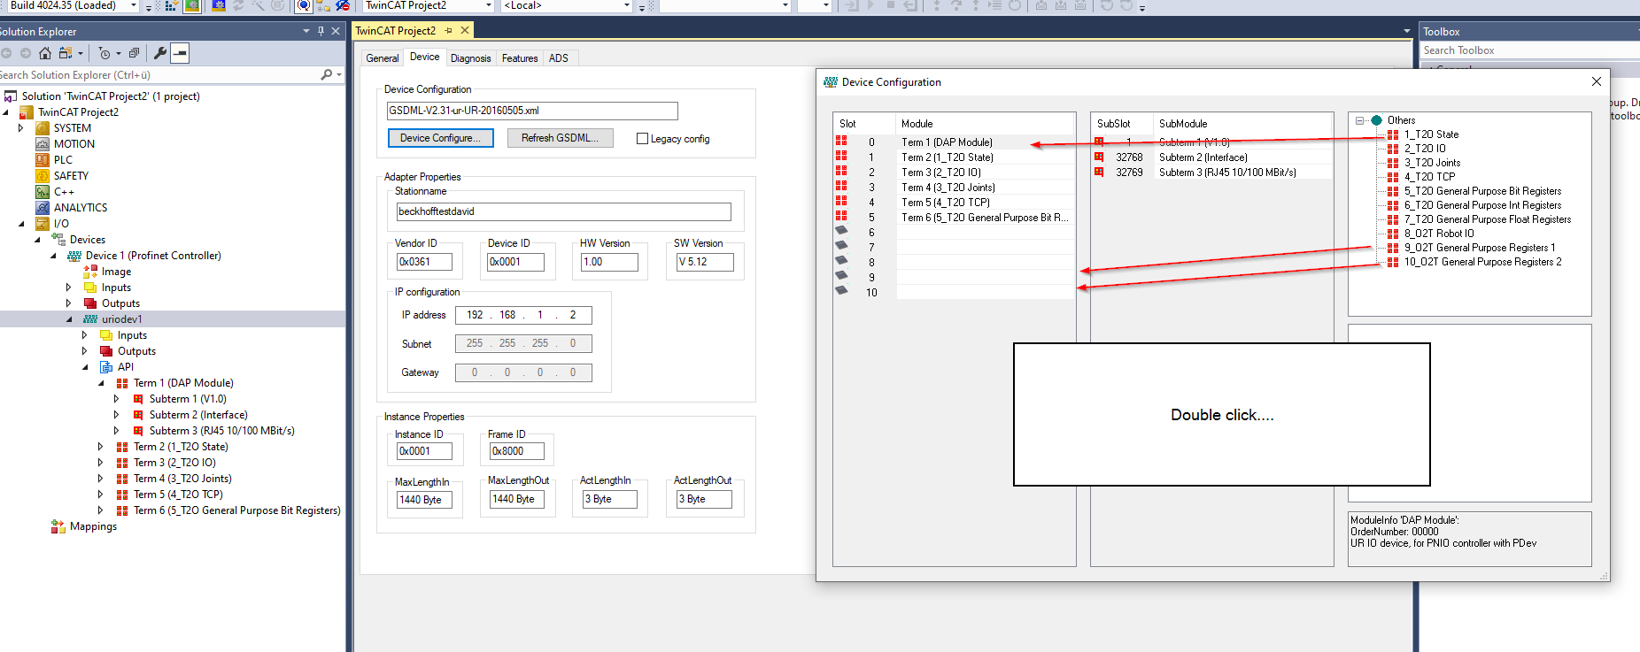
Device config. Choose all of them

Slide 17
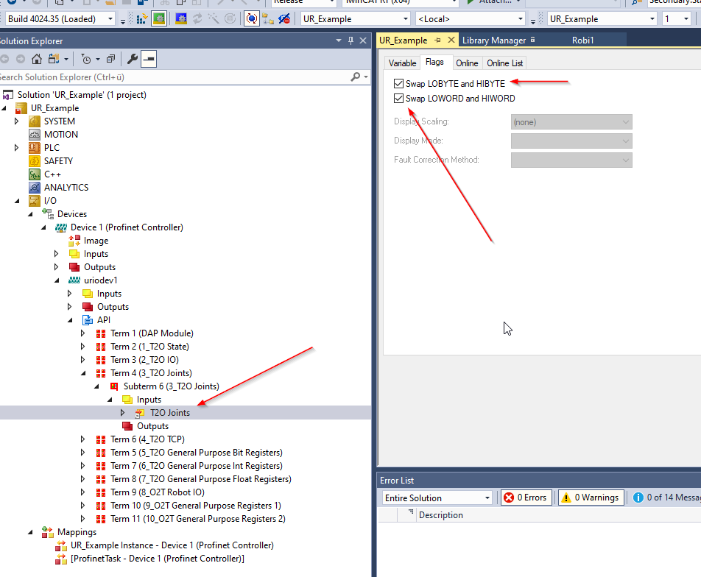
Due to the Intel standard some registers have to be swapped to the motorola standard
Please set byte swap and word swap for the following terms. Otherwise this example will not work properly:
Term 4 – Joints
Term 6 – TCP
Term 7 – Int Registers
Term 8 – Float Registers

Slide 18
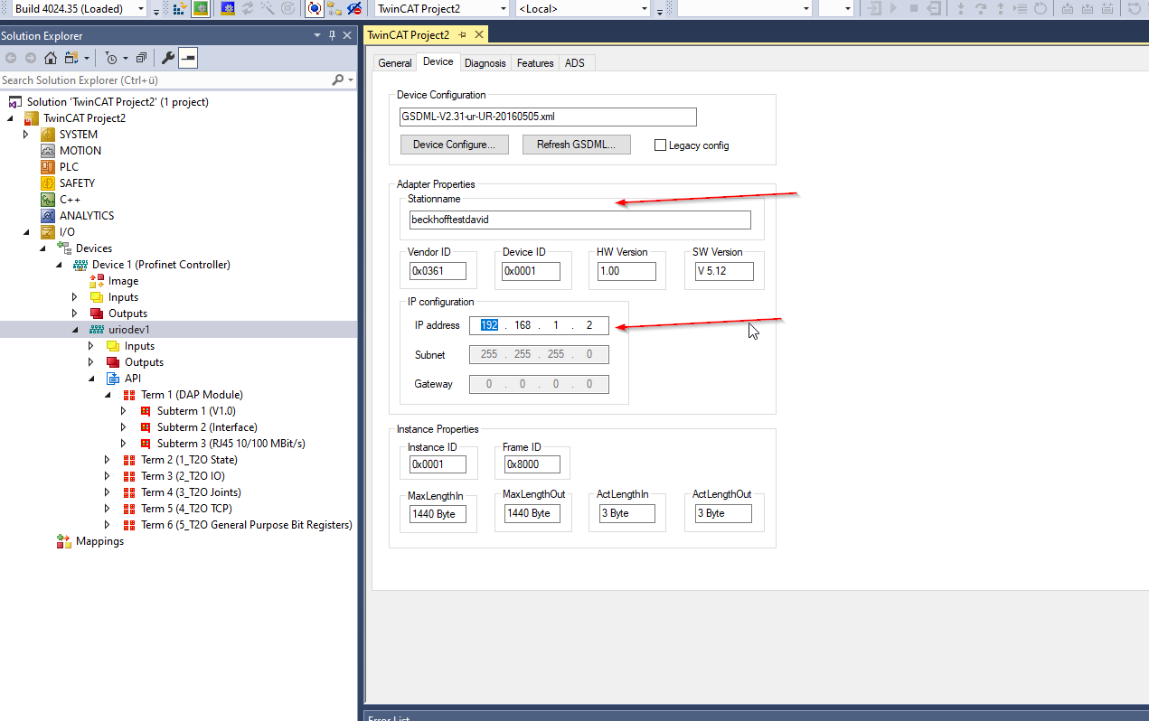
IP config and choose stationname

Slide 19
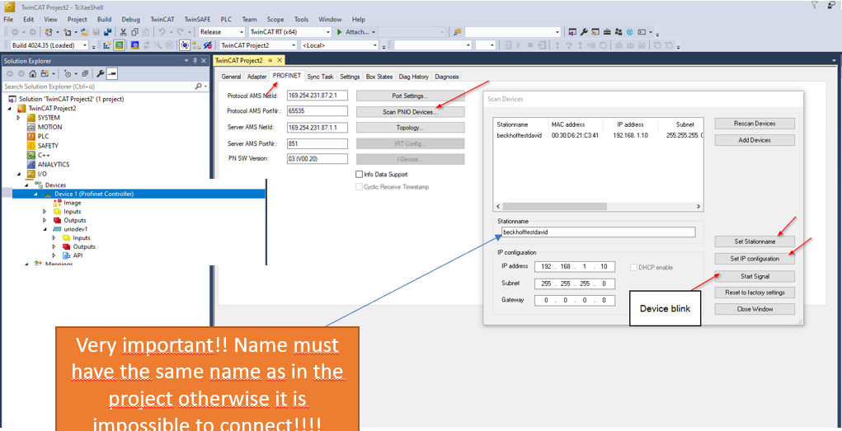
Search for your Robot and set configs

Slide 20
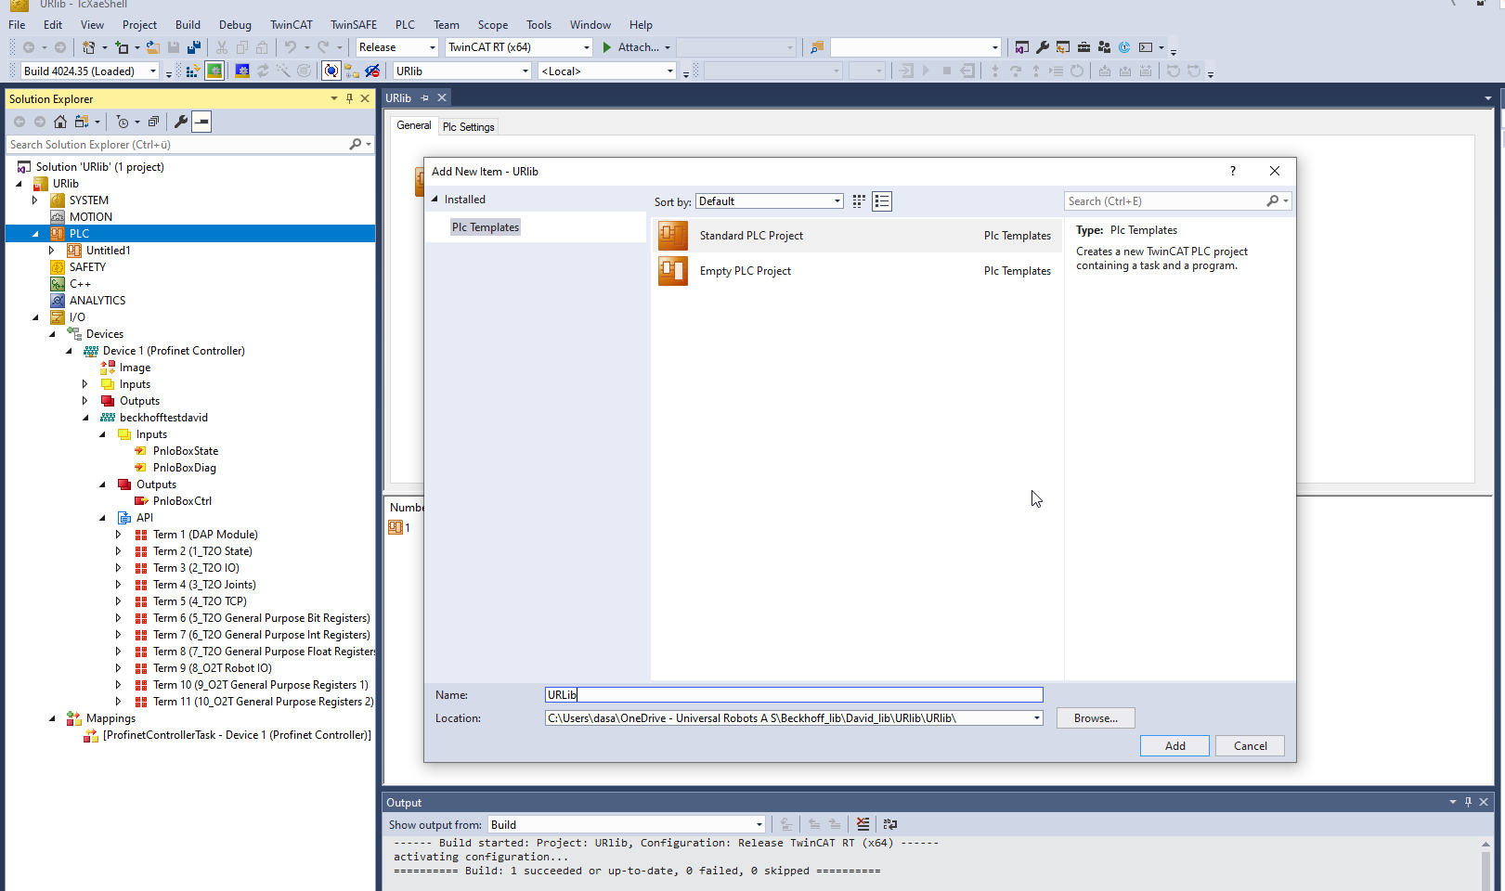
Right click on plc and create new standard project

Slide 21
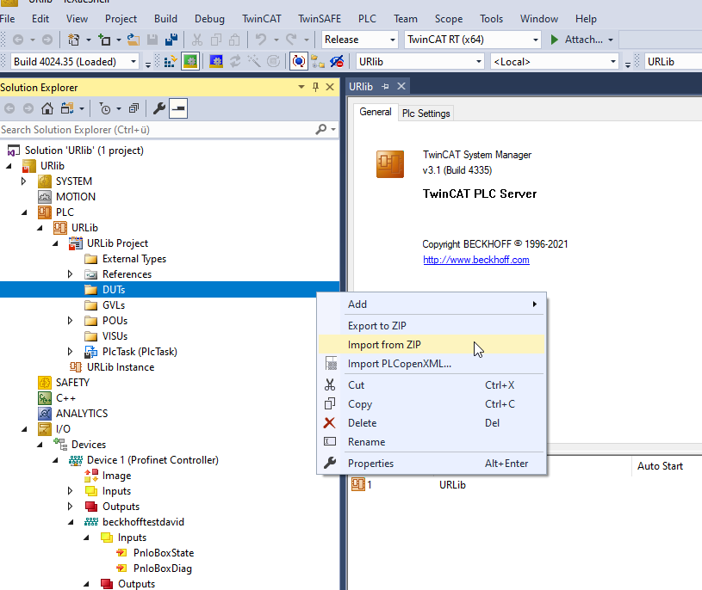
UDT / DUTS import

Slide 22
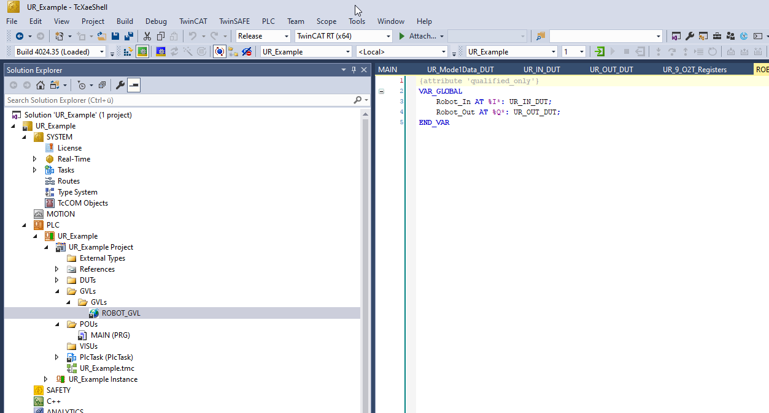
Create some variables for example in GVL

Slide 23
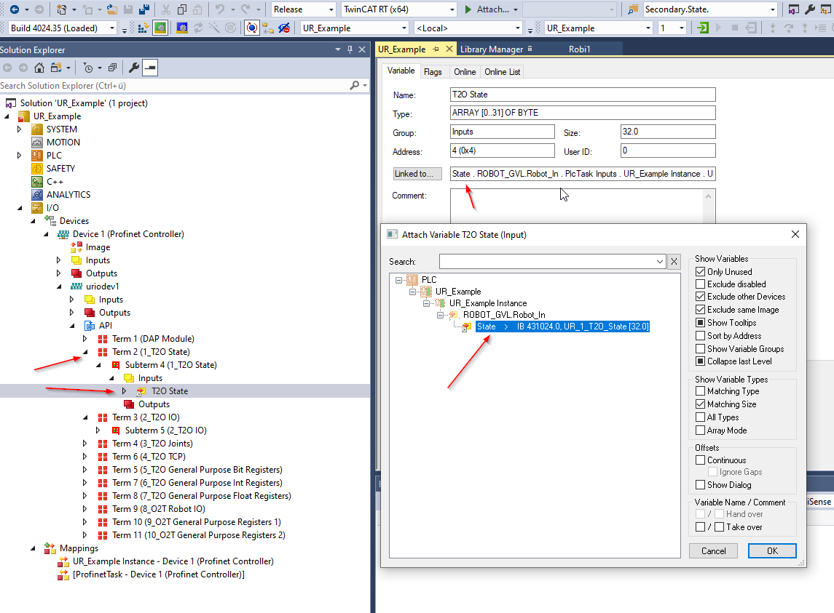
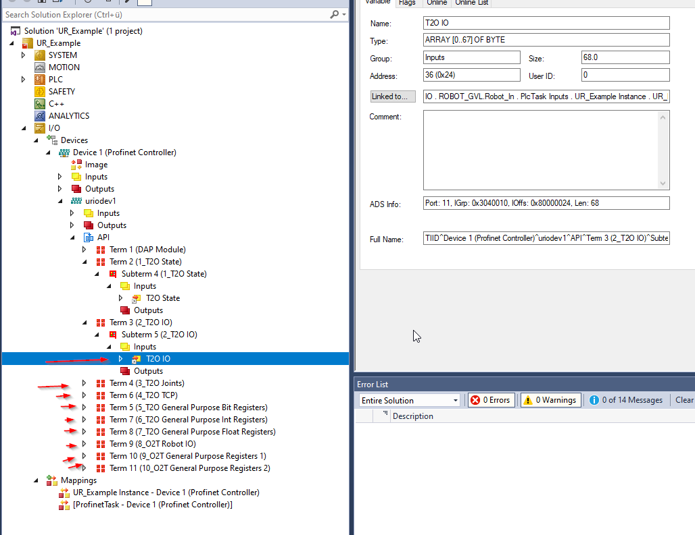
Map all robot API Terms

Slide 24
How to use UR-Example
1. Install TF6310 as shown in (0. TCP/IP Beckhoff info)
2. enable Profinet at your Robot
3. set robot to remote control
4. open the project
5. Set up IP configuration as showed in (2. Profinet Controller settings with UR)
6. start the project

Slide 25
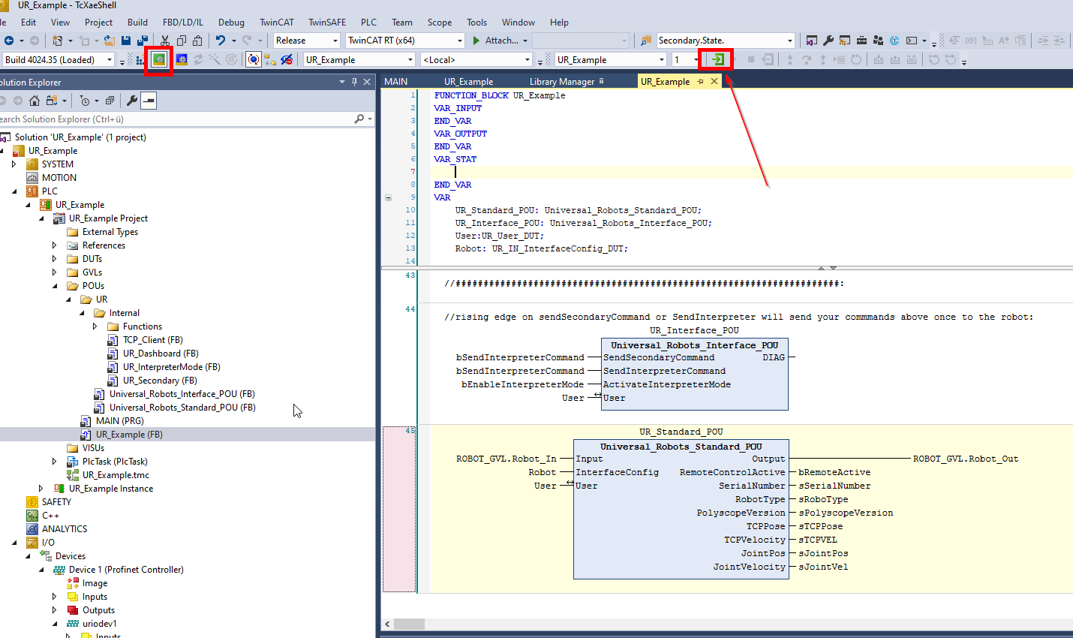
Start project

Slide 26
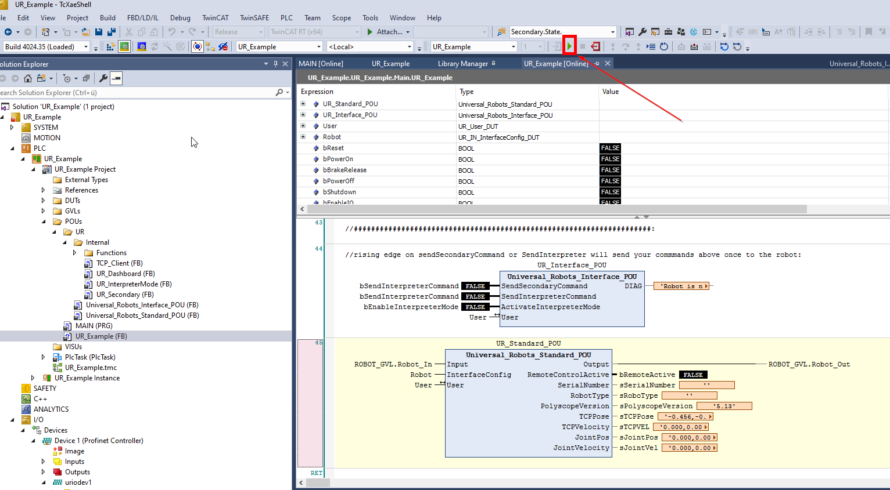
Start project

Slide 27
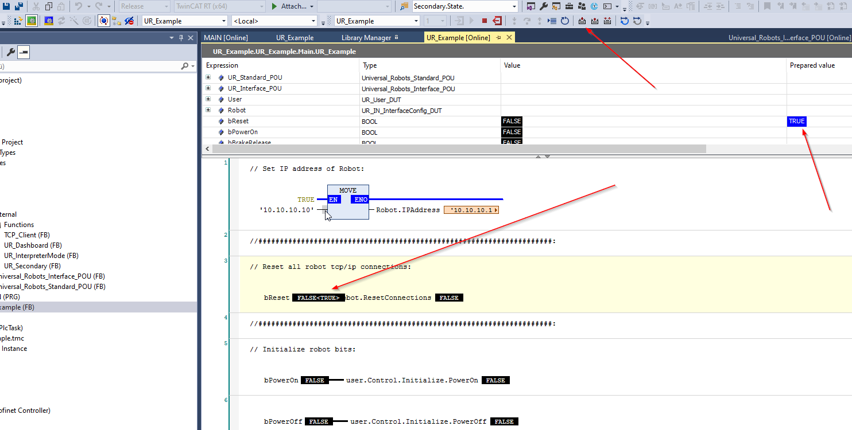
Reset all connections

Slide 28
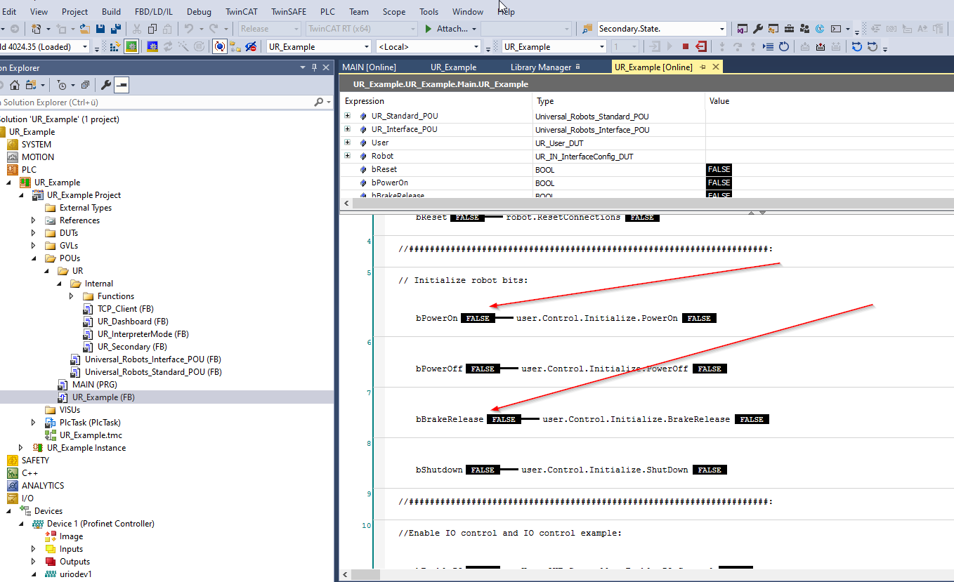
Power on robot ( only in remote control)

Slide 29
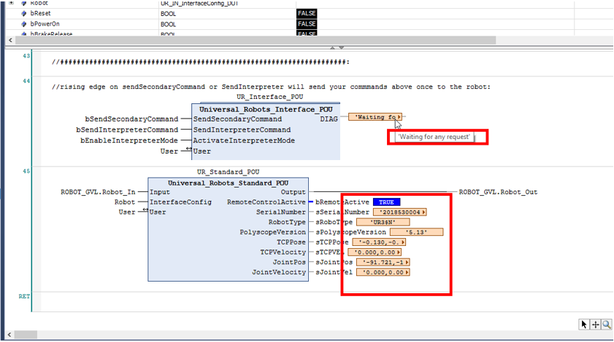

Connected and ready to use

