Slide 1
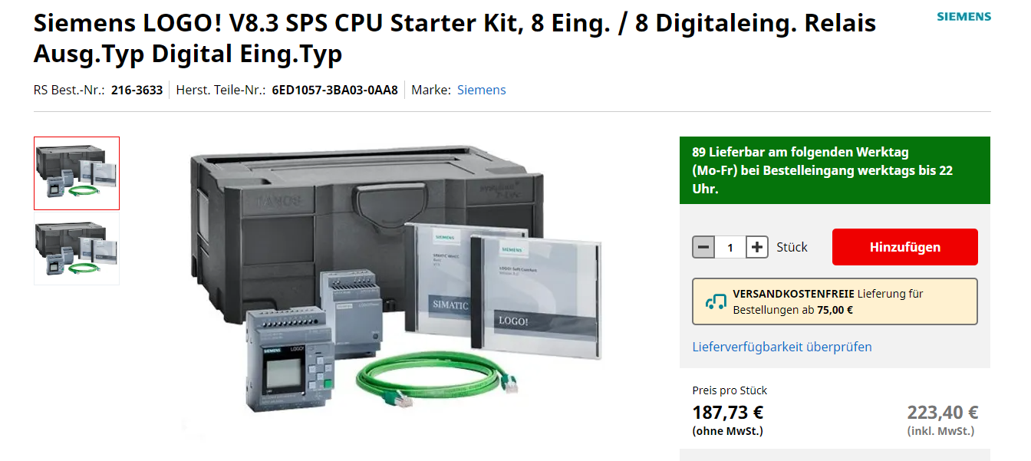
Siemens LOGO 8!
Only the new Siemens LOGO8! Has got a Modbus Client/Server

Slide 2
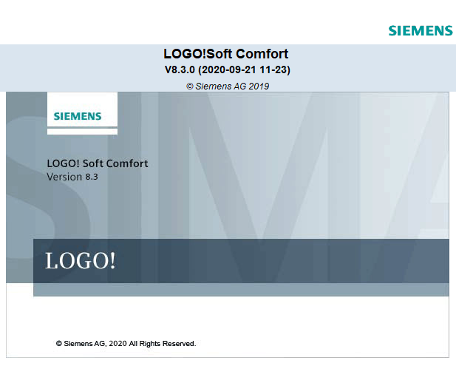
Install the Logo Soft Comfort software

Slide 3
Important to know!
It is not possible to use any other interface in combination with LOGO!
Dashboard Server
Primary/Secondary/RT Interface
Interpreter mode
RTDE

Slide 4
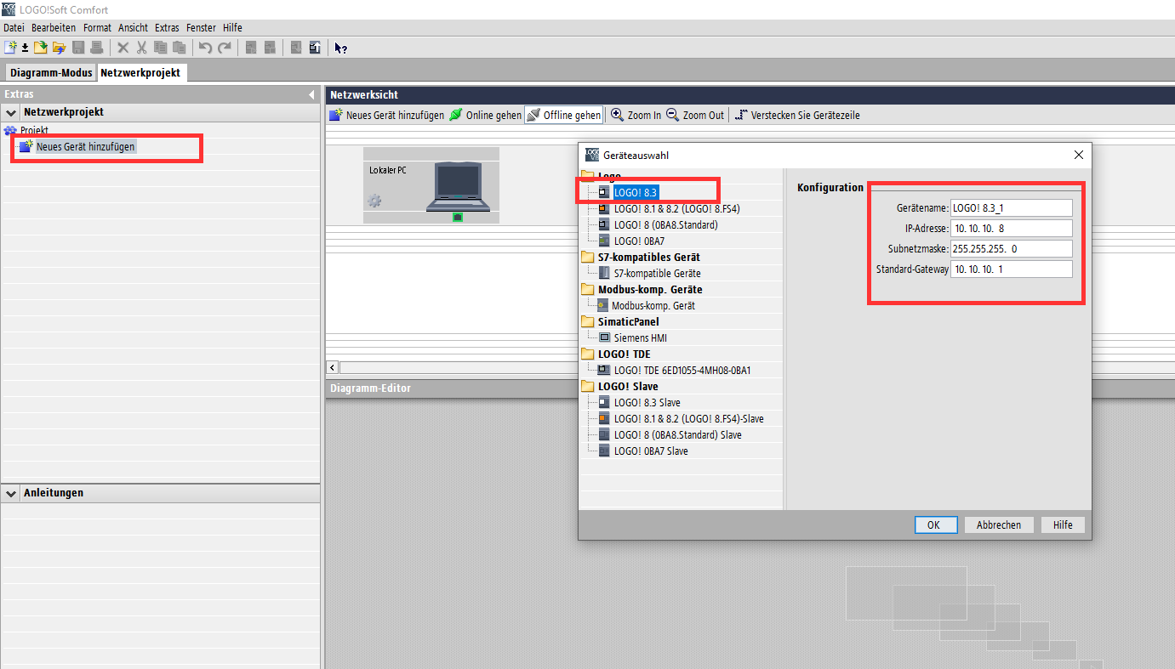
Create new project and choose your Logo!

Slide 5
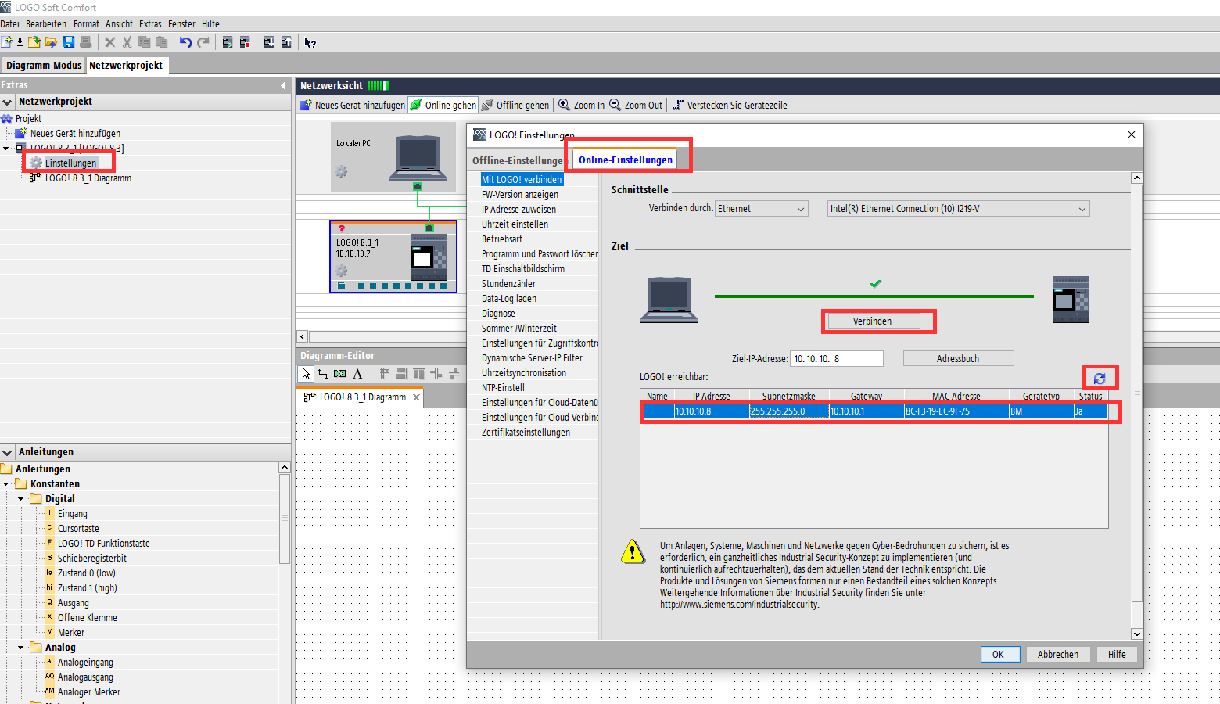
If the LOGO has another IP, change the IP in the properties
Click on properties to the left. -> click on online properties -> search for the logo and connect

Slide 6
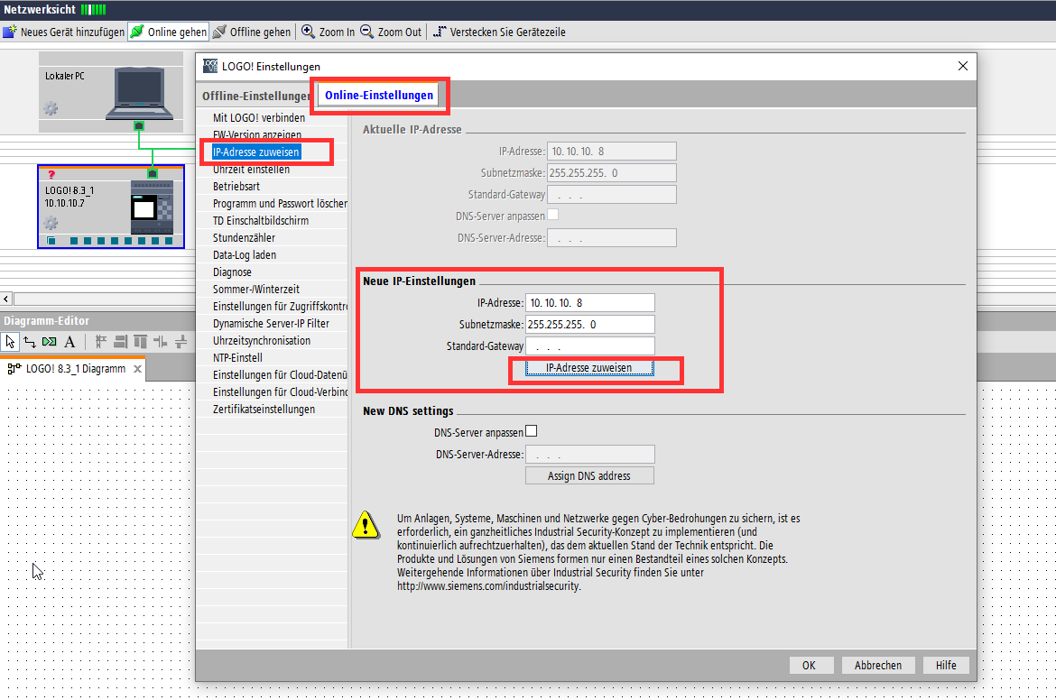
Change the IP adress

Slide 7
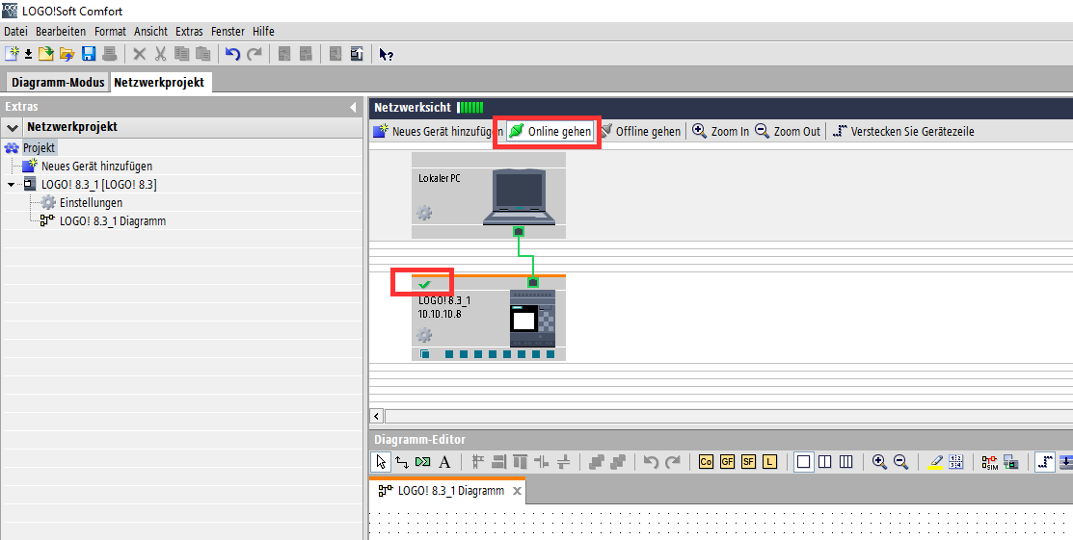
After connecting to Logo it should look like this

Slide 8
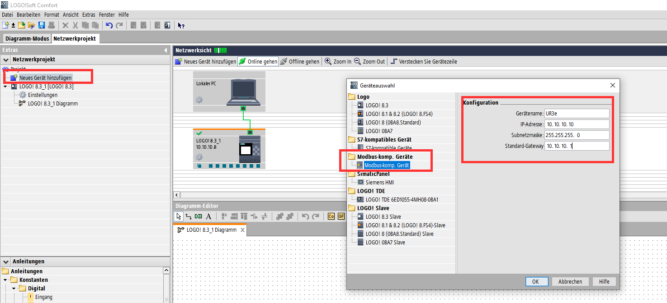
Create a new Modbus Client/Server

Slide 9
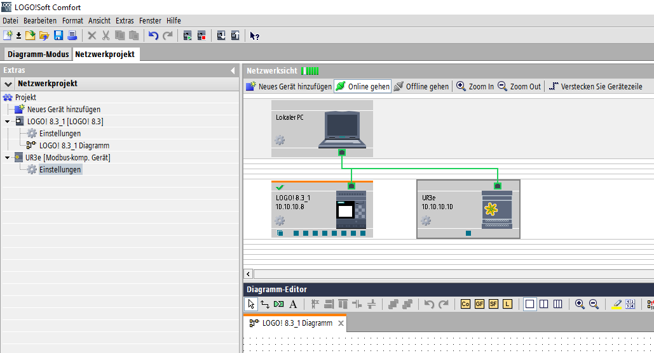
It should look like this now

Slide 10
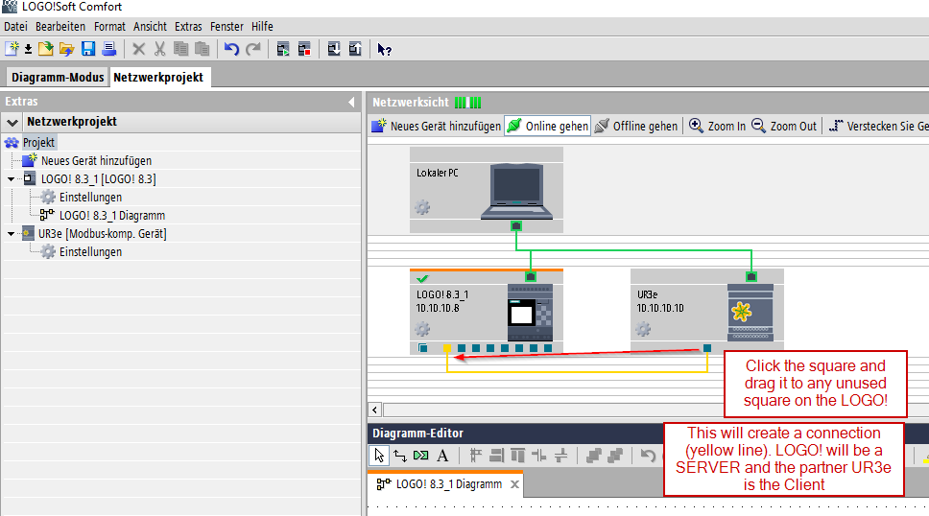
Logo! As a Server

Slide 11
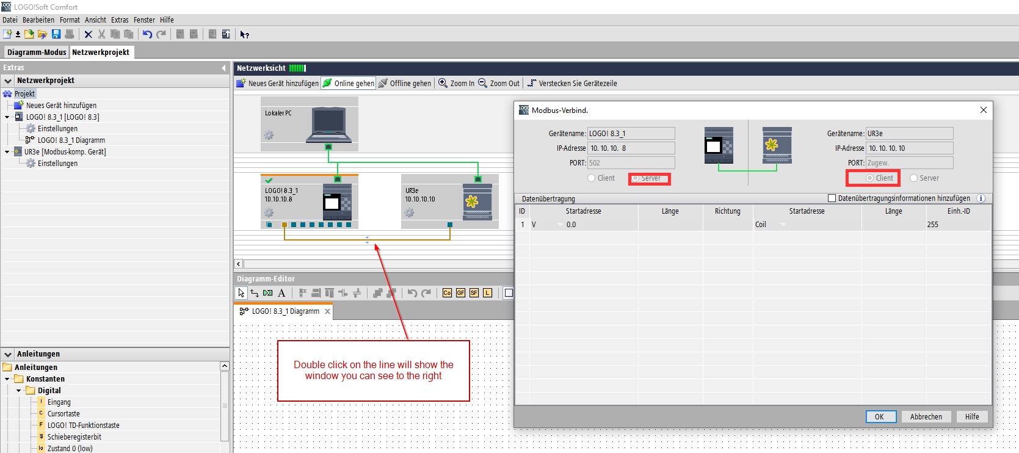
LOGO -> Server and UR -> Client

Slide 12
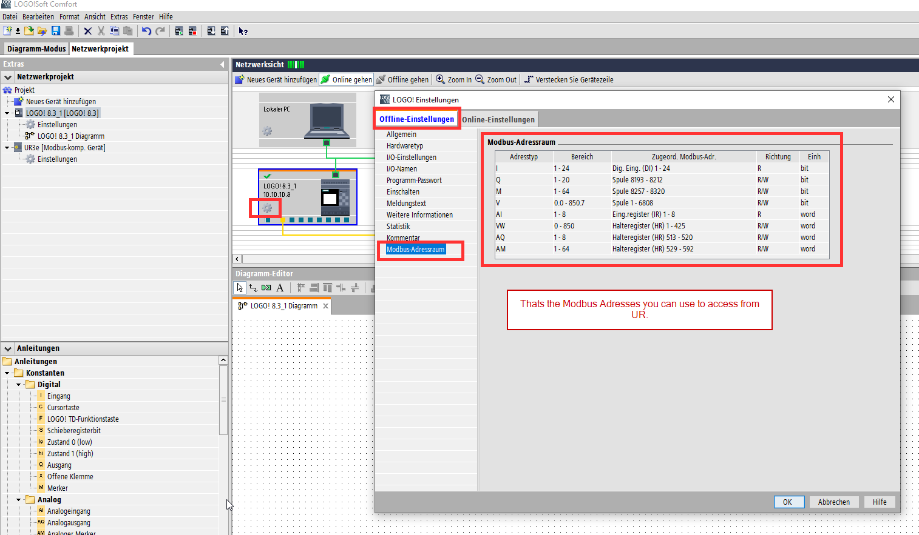
Thats how you can find Logo Modbus Server adress

Slide 13
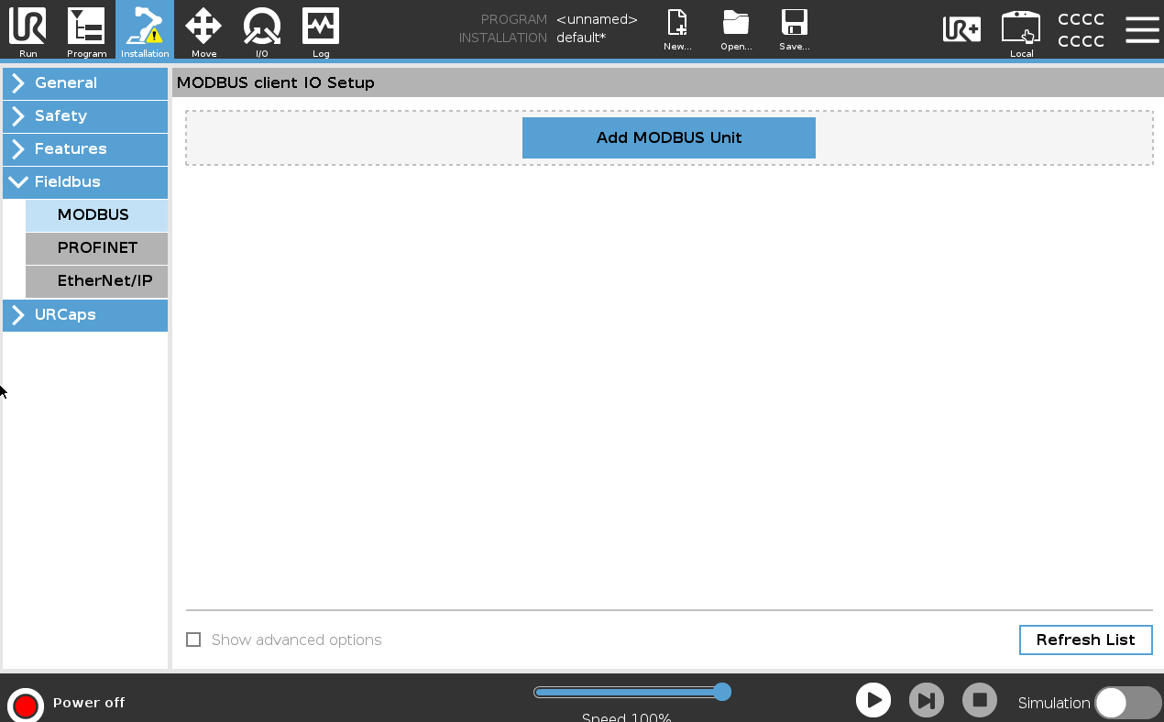
Switch to UR Modbus Client

Slide 14
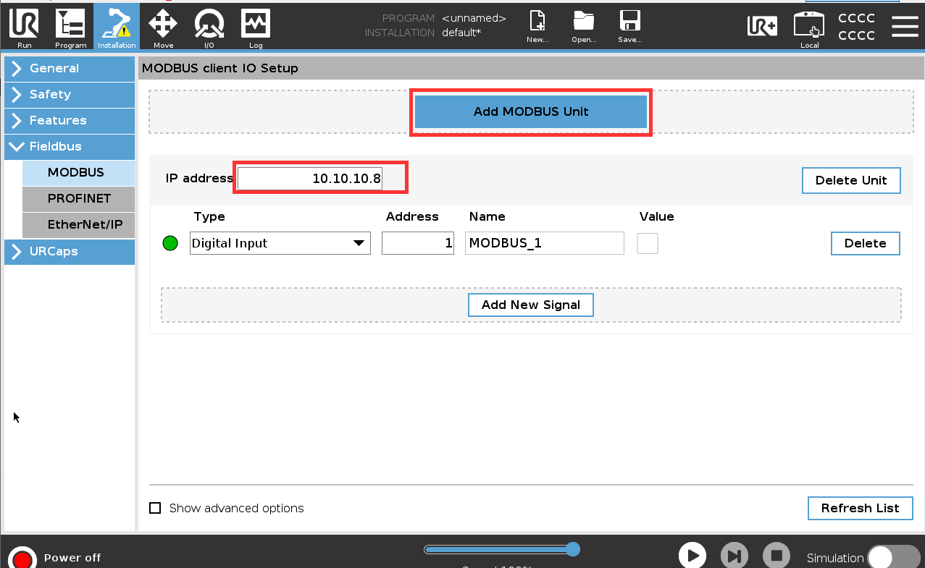
Connect to LOGO! with the IP of the LOGO! device

Slide 15
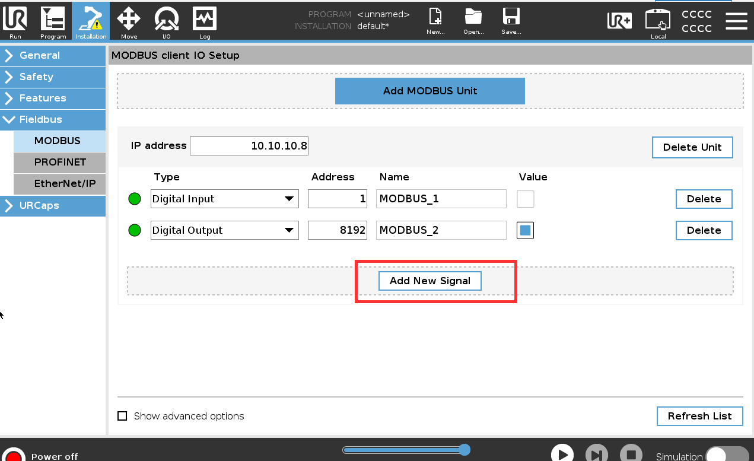
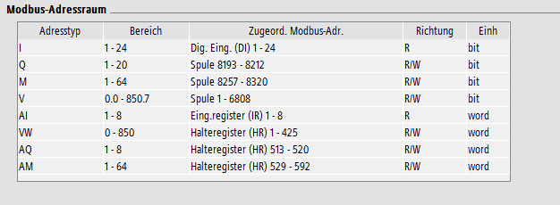
Add new Signals
Always -1 to all adress of logo

Slide 16
LOGO! Server Index

Slide 17
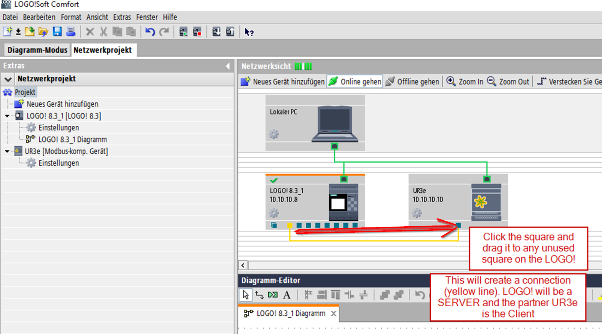
Logo! As a Client

Slide 18
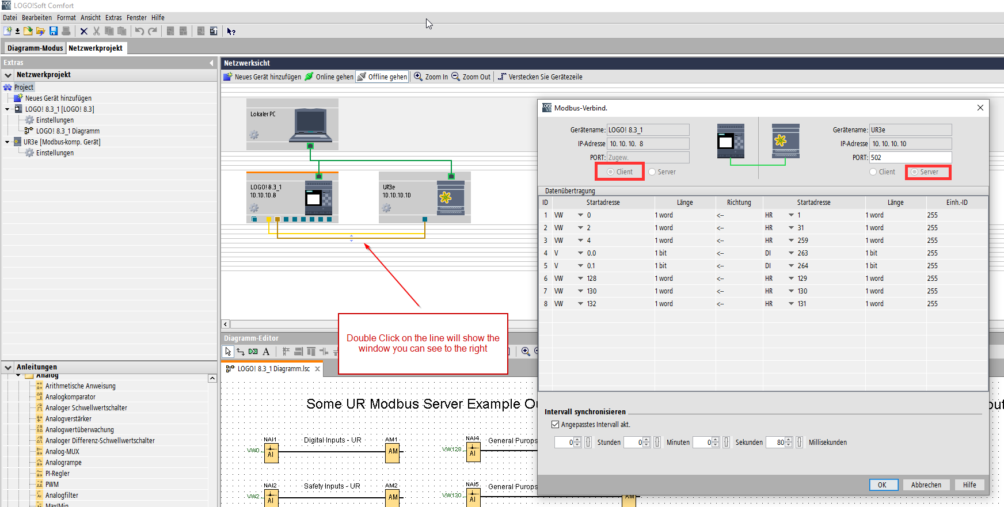
LOGO -> Client and UR -> Server
Port 502 Modbus UR - standard

Slide 19
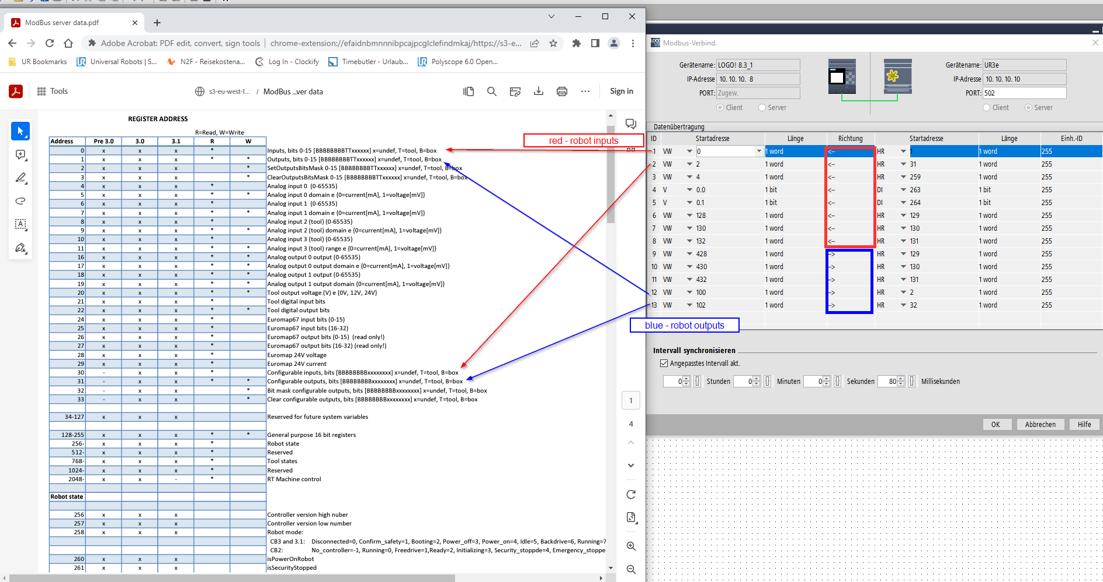
https://www.universal-robots.com/articles/ur/interface-communication/modbus-server/
How to conifgurate In- and Outputs
Always add +1 to the Startadress / Index of UR to all
Link to Modbus UR-Server

Slide 20
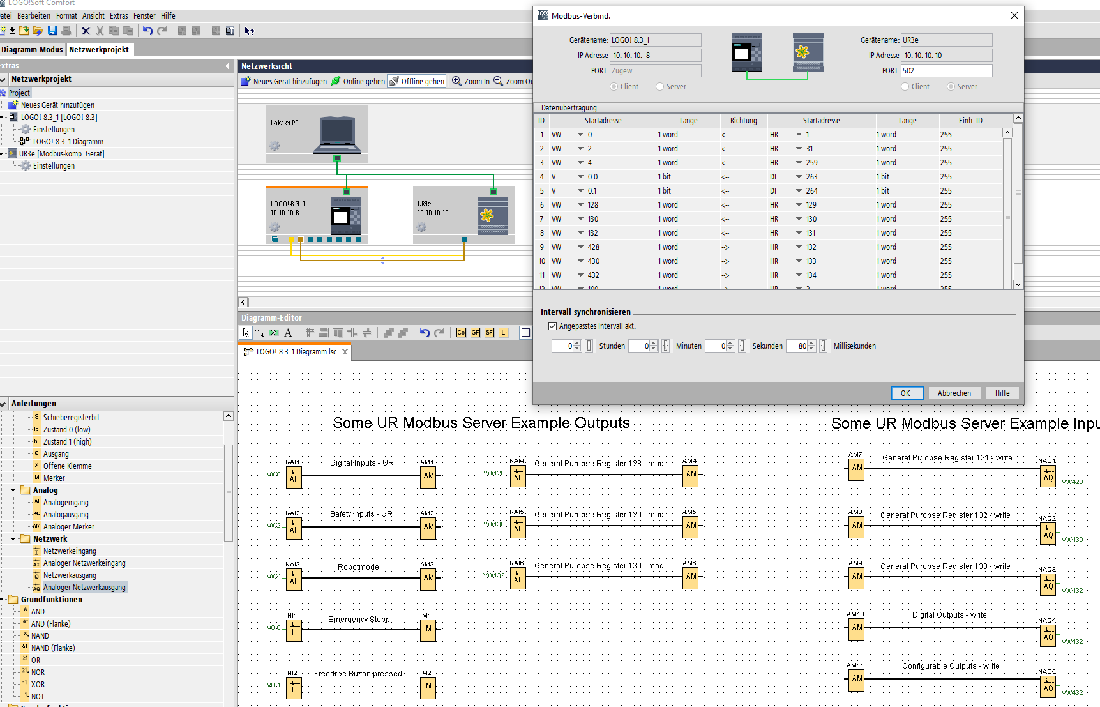
This is an example how to read an write some register from UR Modbus Server

Slide 21
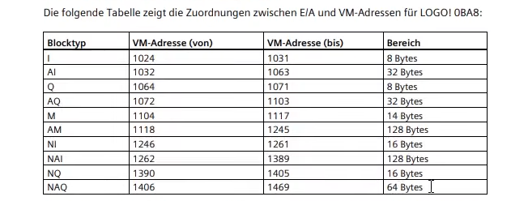
This table shows the VM index to check in variables

Slide 22
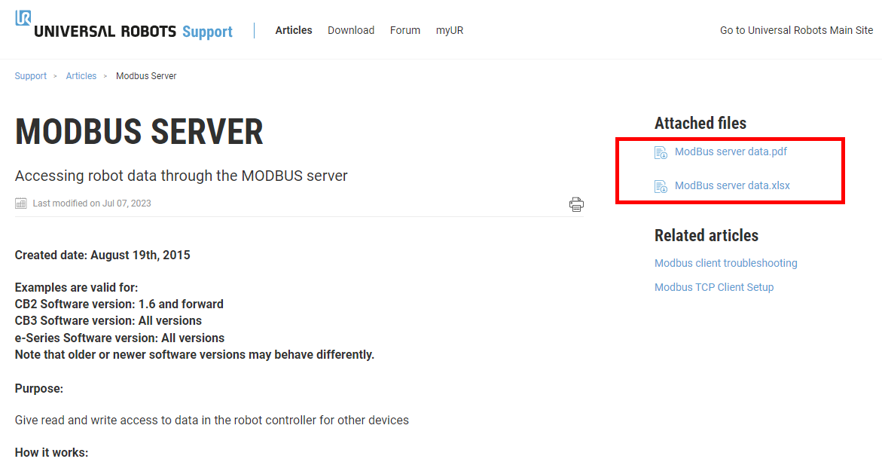
UR Modbus Server is always active. Please find all index in the .pdf or .xlsx
https://www.universal-robots.com/articles/ur/interface-communication/modbus-server/

