Slide 1
Population

Slide 2
INTRODUCTION
We cannot denied that population is the biggest issues in all countries. This module will discuss the attribute in population and discuss different growth forms. A population is the entire group that you want to draw conclusion about. Population is a particular section group or type of people or animals living in an area or country.

Slide 3
Objectives
At the end of this module, the students must be able to:
a. define population
b. describe the human population
c. improve their knowledge about the attributes of the population

Slide 4
POPULATION A population has several characteristics or attributes which are a function of the whole group and not of the individual. A particular section, group, or type of people or animals living in an area or country.

Slide 5
Human population in over the world in 2018
Population in the world is currently 7,669,124,850 in (2018) growing at a rate of around 1.09% per year (down from 1.12% in 2017 and 1.14% in 2016). The current average population increase is estimated at 83 million people per year. With some 108 million people in 2019, the Philippines is now the 13th most populous country in the world.

Slide 6
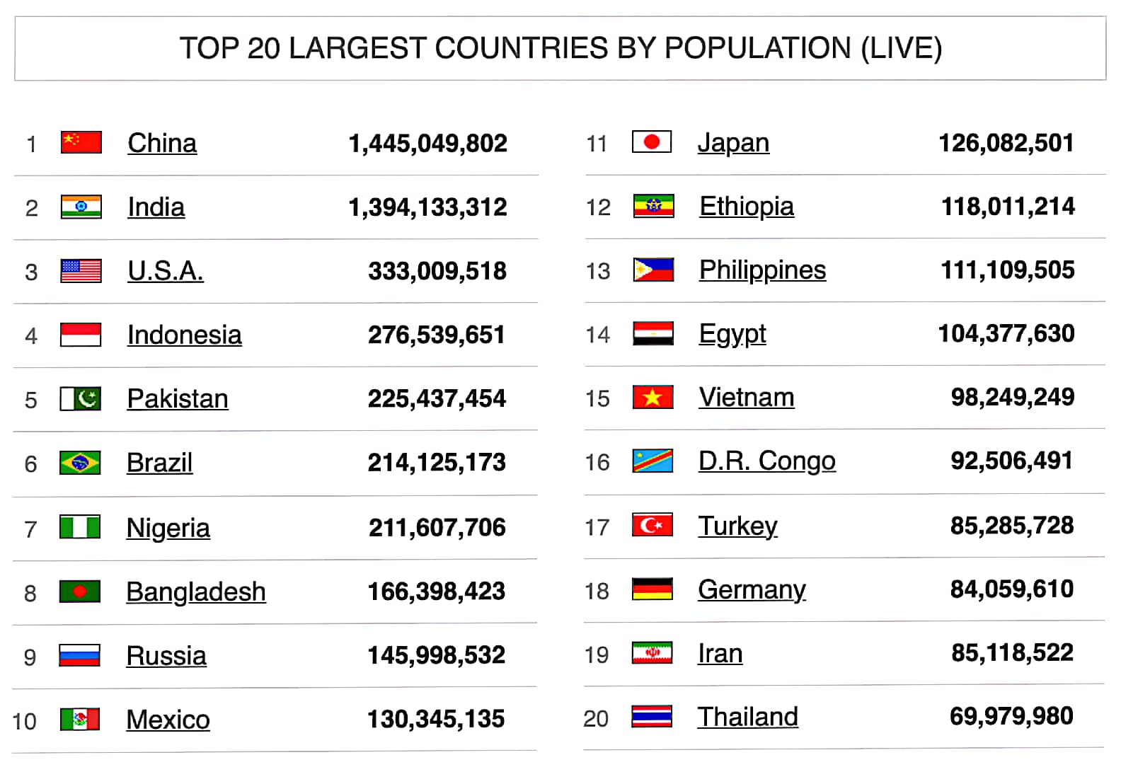

Slide 7
Human Population Growth
Should we worry about human population growth or not? Why? Man is relatively new in this world, although there are already animals of millions of years, modern man evolved only four hundred thousand years ago. During most of this period people lived from hunting and gathering of food. Our planet could feed about ten million people living in this way. Estimations say that ten thousand years ago between five and ten million people lived on earth. Our planet was at that time at or near the maximum population it could support. The average growth rate until then was almost zero then 0.005 percent per year.

Slide 8
There are three components of change:
Birth rate
Death rate
Migration rate
The number of live births
per 1,000 people in a year
is called birth rate.
The number of deaths per 1,000 people is called death rate.
The movement of people from one place to another for work or to live is called migration.

Slide 9
The change in the population from births and deaths is often
combined and referred to as natural increase or natural change.
Population Growth – Population growth refers to an increase in
the population of a given area. When birth rate is more than
death rate, it leads to the growth of population. The natural
growth rate of population is the difference between birth and
death rates.

Slide 10
ATTRIBUTES OF POPULATION
GROWTH FORMS
Exponential Growth
The exponential growth refers to a growth of a population whose rate is proportional to the size of the population over a specific period of time.
Logistic growth
The logistics growth refers to the gradual growth of the population in the beginning and then increases when the number of people grows.

Slide 11
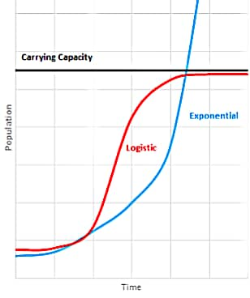

Slide 12
Population Distribution
Is the pattern of where the people live.
There are three basic patter of population distribution:
Uniform distribution, individuals are equally spaced apart
Random distribution, individuals are spaced at unpredictable distances from each other.
Clumped distribution, individuals are grouped together.

Slide 13
Effect of population in our ecosystem:
SIZE
A population’s size is the most potent factor affecting an ecosystem. The bigger the population, the more strain it puts on the ecosystem. If a population grows too large, the ecosystem could collapse.

Slide 14
CYCLES
Populations go through cycles of growth and contraction. If a population grows too big too fast then the lack of resources usually results in a population crash. This gives the species and the ecosystem time to recover so there’s no permanent damage.

Slide 15
LIMITING FACTORS
A certain number of limiting factors keep populations from growing too large. One is physical space, which is especially important for plant populations. Another is food stock.

Slide 16
RESISTANCE If the environmental resistance (lack of food, water and other resources) is greater than the species’ ability to reproduce, than the population will shrink.

Slide 17
LIFE TABLES ➤ Are created to summarize the age specific pattern of birth and death of a particular population in a particular environment. Cohort – ecologist utilized the fate of group of new born individuals until the last one dies.

Slide 18
POPULATION REGULATION AND COMMUNITY INTERACTIONS Habitat – is a place where a population or an individual of a given species lives. Niche – the full range of the abiotic and biotic conditions under which a species can live and reproduce.

Slide 19
THANK YOU!

