Slide 1
Drone Detection using
RF signals
ddgg
Group Members : Supervisor : Dr. Shrivishal Tripathi Date : 25 Nov 2025
Sujal Kumar Singh
Vivaan Bagga
Pranjal Agrawal
International Institute of Information Technology, Naya Raipur

Slide 2
Content
Introduction
Motivation: Issues and Challenges
Literature Review
Problem definition
Objectives
Proposed Framework/Model/System/Methodology
  Explain with a block diagram and others
Experimental results and discussion
Plan of action for the project

Slide 3
Introduction
Drones have rapidly grown in popularity for commercial, recreational, and defense purposes, but they also pose significant security and privacy threats.
Limitations of Traditional Methods - Vision-based, radar, and acoustic detection systems suffer from challenges like high cost, line-of-sight dependency, or environmental noise.
RF-Based Approach - Since drones rely on radio signals for control and communication, analyzing their RF emissions provides a low-cost, passive, and effective detection method.
Our Project Goal - To design a complete RF-based drone detection system using SDR for acquisition, signal processing for feature extraction, and machine learning/CNN models for accurate classification and real-time detection.

Slide 4
Motivation
Growing Threat of Drones - Unauthorized or malicious drone activity poses risks to airports, sensitive areas, and public safety.
Limitations of Existing Detection - Vision, radar, and acoustic methods are often expensive, line-of-sight dependent, and susceptible to environmental noise.
Need for a Reliable, Low-Cost Solution - A passive approach using RF signals can detect drones without requiring line-of-sight and at a fraction of the cost of conventional systems.
Signal-Based Fingerprinting - Each drone emits unique RF patterns due to hardware imperfections, enabling identification and classification.

Slide 5
Literature Review
Reference | Technique Used | Dataset Used
DroneRC-RF-Dataset.pdf (Martins Ezuma, Fatih Erden, Chethan K. Anjinappa, Ozgur Ozdemir, Ismail Guvenc, "Drone Remote Controller RF Signal Dataset", IEEE Dataport) | RF signal processing, feature extraction | MPACT Drone RC RF Dataset
RFUAV: A Benchmark Dataset for Unmanned Aerial Vehicle Detection and Identification (https://arxiv.org/abs/2503.09033) | Deep learning, preprocessing methods | RFUAV Dataset
Machine Learning Framework for RF-Based Drone Detection and Identification (10.48550/arXiv.2003.02656) | XGBoost, machine learning models | Low-band RF signals
RF-Enabled Deep-Learning-Assisted Drone Detection | Deep learning, RF signal analysis | DroneRF Dataset

Slide 6
Problem Definition/Problem statement
Limited Generalization of Existing Models - Many RF-based drone detection systems perform well on controlled datasets but fail to generalize across different drone types, remote controllers, and environmental conditions.
Inefficient Feature Extraction - Prior works often rely on hand-crafted features or simple time/frequency representations, which may miss subtle device-specific signal characteristics.
Underutilization of CNNs for RF Signals - While spectrograms and IQ data can be used for CNN classification, few studies fully exploit deep learning to capture both temporal and spectral patterns.
Small or Biased Datasets - Many previous studies used small datasets or datasets lacking diversity in drone models and controllers, limiting real-world applicability.

Slide 7
Research Gap
Limited Use of Deep Temporal and Frequency Features: Some approaches focus on feature extraction from raw RF signals but do not fully leverage advanced signal representations (like Hilbert transform, wavelet, or spectrogram-based methods).
Gap: There is scope for richer feature engineering or end-to-end deep learning that captures both temporal and frequency-domain characteristics.
Model Selection and Comparative Analysis Studies often use a single model type (e.g., CNN, XGBoost) without comprehensive comparison across different machine learning and deep learning techniques.
Gap: Need systematic evaluation of multiple models to identify the optimal approach for accuracy, robustness, and computational efficiency.

Slide 8
Objective (s) of the Project
Develop a robust RF-based drone detection system using the MPACT Drone RC dataset.
Acquire and process IQ signals from drone remote controllers using Software Defined Radio (SDR).
Extract meaningful features from RF signals using Hilbert transform, statistical measures, and spectrogram representations.
Design and train CNN models to classify drone signals with high accuracy across different devices and controllers.
Ensure the system can handle noisy and interference-prone environments effectively. Compare model performance against classical machine learning approaches like Random Forest to validate improvements.

Slide 9
Proposed Framework/Methodology
SDR Signal Acquisition
IQ Signal Preprocessing (Filtering/Noise)
Feature Extraction (Hilbert, Statistical,
Spectrogram)
Dataset Creation
(CSV / NumPy, Spectrogram Images)
Drone Detection & Classification
Model Training (CNN/ Random Forest)

Slide 10
Database description
Dataset Name: MPACT Drone RC RF Signal Dataset
Description:
  Contains IQ signals captured from multiple drone remote controllers.
  Used for RF-based drone detection and classification.
Source / Reference:
  IEEE DataPort: Drone Remote Controller RF Signal Dataset
Usage in Project:
  Used as input signals for preprocessing, feature extraction, and model training.

Slide 11
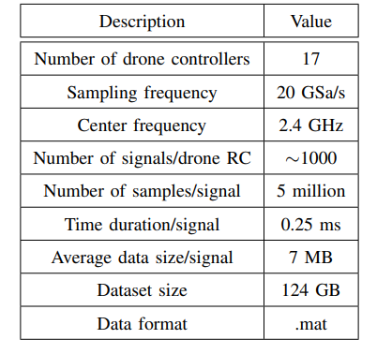
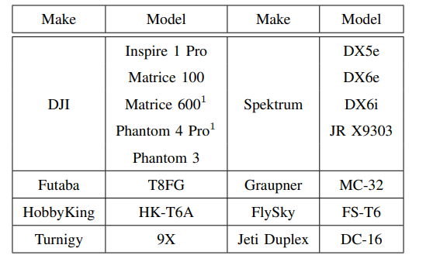
Database description
Table 1: METADATA
Table 2: DRONE CATALOGUE

Slide 12
Experimental Results and Discussion
We processed the MPACT Drone RC,RF IQ dataset, applying Hilbert transform to extract amplitude and phase information.
Features extracted included statistical, spectral, and burst-related characteristics from I/Q signals.
Random Forest classifier was applied on these features, effectively capturing non-linear patterns and transient bursts.
The model achieved ~97.7% accuracy in classifying different devices.
Simpler models like SVM or logistic regression performed worse, likely missing the complex correlations present in the data.
Visualization of I/Q distributions, magnitude/phase spectrograms, and constellation plots confirmed clear separability between classes.

Slide 13
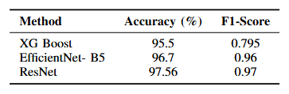
Experimental Results and Discussion
Model Performance Overview
Replaced Random Forest with XGBoost, achieving an accuracy of 95.5%.
Evaluated two deep learning models — EfficientNet-B5 and ResNet — obtaining accuracies of 96.7% and 97.56%, respectively.
Transfer Learning Setup
Used transfer learning with pretrained and frozen weights for both EfficientNet-B5 and ResNet.
Added five custom Dense layers on top of the base models and trained them on our dataset.
Training Configuration
Optimizer: Adam
Batch size: 32

Slide 14
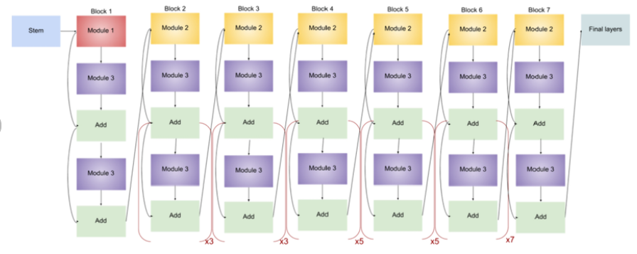
Experimental Results and Discussion
CNN Architecture Details
Designed a multi-input CNN, receiving 9 input images per sample.
EfficientNet-B5 architecture diagram

Slide 15
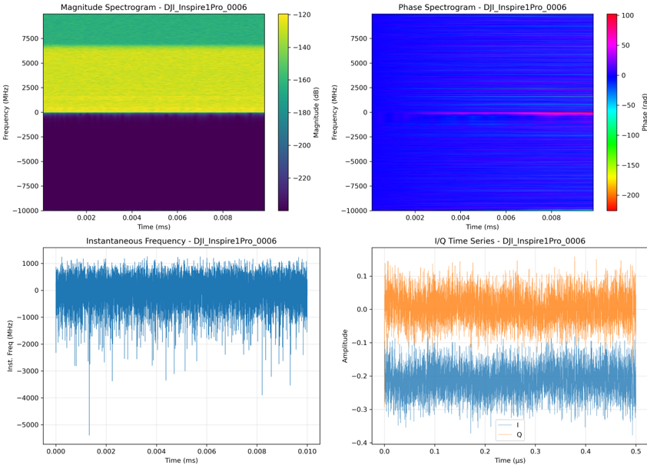
Experimental Results and Discussion

Slide 16
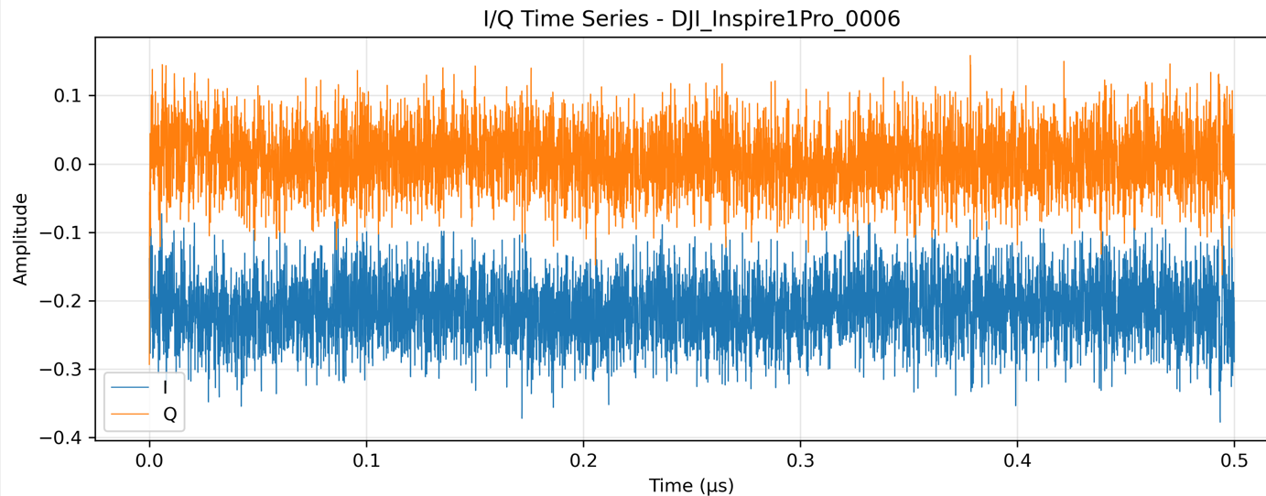
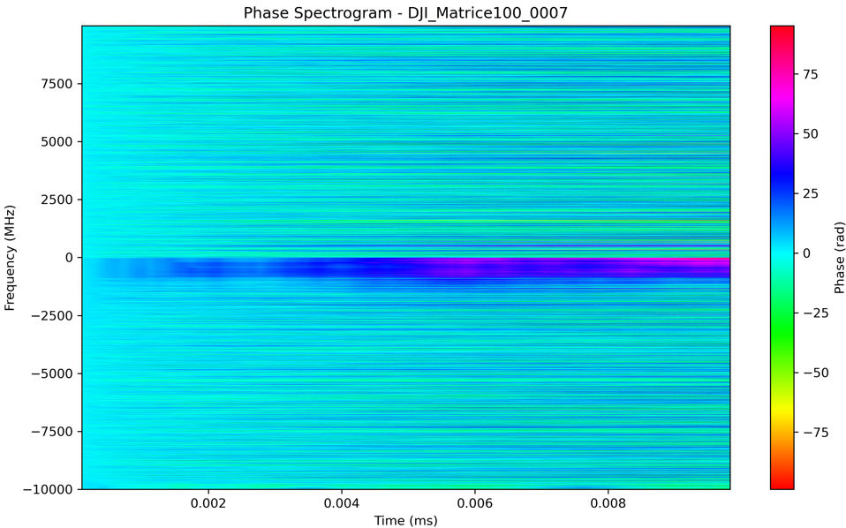
Experimental Results and Discussion

Slide 17
Conclusion and Future Directions
Explore additional machine learning models (XGBoost, LSTM, Transformers) for improved performance.
Incorporate more signal processing techniques (wavelets, STFT, MFCC) to enhance feature representation.
Collect larger and more diverse datasets covering various drones and environmental conditions.
Implement real-time detection on hardware using SDR and embedded systems.
Combine RF signals with other modalities (acoustic, radar) for multi-sensor fusion detection.
Optimize feature extraction and preprocessing techniques to further improve model efficiency and accuracy.

Slide 18

Thank You
..
Dr. Shyama Prasad Mukherjee International Institute of Information Technology, Naya Raipur

