Slide 1

MAC and IP Anti-Spoofing
NetFPGA Summer Camp 2012
Presented by:
Insop Song
Stanford, CA
August 3, 2012
http://netfpga.org/netfpgawiki/index.php/SummerCamp2012
http://NetFPGA.org

Slide 2
Background
What is Spoofing?
  An attempt to masquerades as another entity
Why?
  If B spoofs A for
    B seeks the privileges of A
    B intends to hide its tracks
    B wants to attack on A
Type of spoofing?
  IP spoof
  MAC spoof
  ARP spoof
Notes:
BRAS setup

Slide 3
Example system
Typical broadband access network
DSLAM
Or GPON
Home gate way
Home gate way
L3 network
Home gate way
Notes:
Various Spoof description

Slide 4
MAC spoofing
Change the source MAC to an illegitimate address
DSLAM
Or GPON
MAC A
Attacker
Change source mac and flood the traffic
MAC Table max limit reached

Slide 5
IP spoofing
Change the source IP to an illegitimate address
DSLAM
Or GPON
Replies flooded to IP A
IP A
Attacker
Sends traffic with IP A

Slide 6
Proposed solution
Maintains a table with source MAC and source IP
Filters the packet if source MAC and IP are not matched
Entry (smac and sip) configuration
  Static: manual provisioning
  Dynamic: triggered by DHCP, PPPoE session establishment
Notes:
Solution, such as IPAS

Slide 7
Design
MAC
RxQ
CPU
RxQ
MAC
RxQ
CPU
RxQ
MAC
RxQ
CPU
RxQ
MAC
RxQ
CPU
RxQ
Input Arbiter
Anti_spoof
ADD
Output Port Lookup (ref. sw)
Output Queues
MAC
TxQ
CPU
TxQ
MAC
TxQ
CPU
TxQ
MAC
TxQ
CPU
TxQ
MAC
TxQ
CPU
TxQ
Notes:
Design, high level, piplining

Slide 8
Implementation
MAC and IP parser
Source MAC and IP look up
  Anti spoof look up entry
Drop decision FSM
Source port | Source IP | Source MAC
MAC & IP parser
Anti spoof LUT
Drop decision FSM
Notes:
details

Slide 9
Implementation 2
Anti spoof look up entry
  Added by first packet, for simplicity
  can be done
    By register write or
    By dynamic session establishment (DHCP or PPPoE)

Slide 10
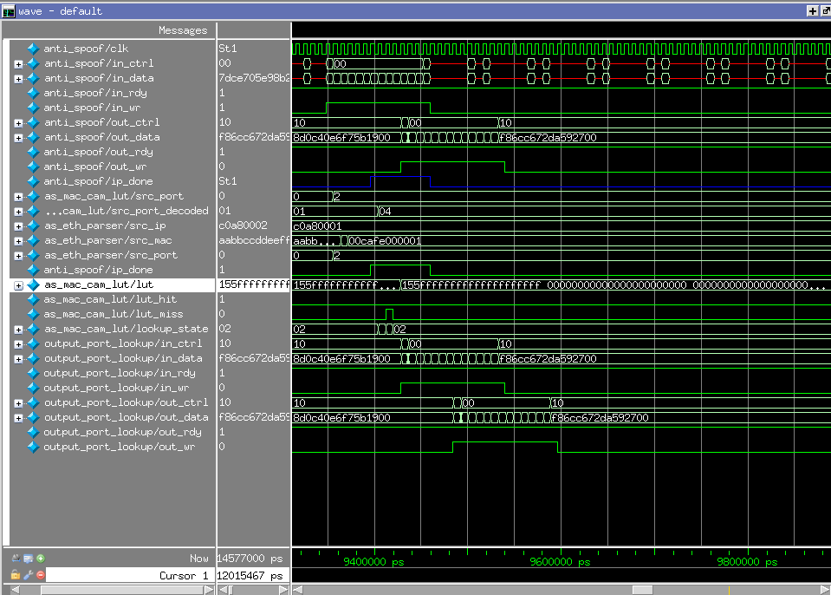
Simulation
Ingress packet to Anti_spoof
On normal case (pass)
Egress packet from output port lookup
Notes:
Simulation results

Slide 11
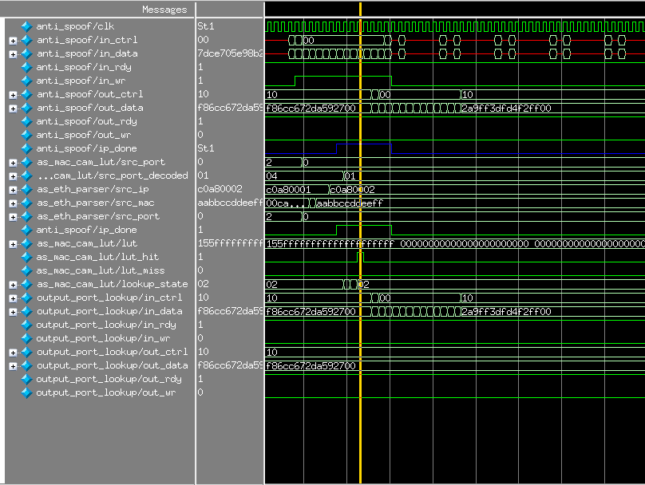
Simulation 2
Ingress packet to Anti_spoof
On spoof case (drop)
NO egress packet from output port lookup
Notes:
Simulation results

Slide 12
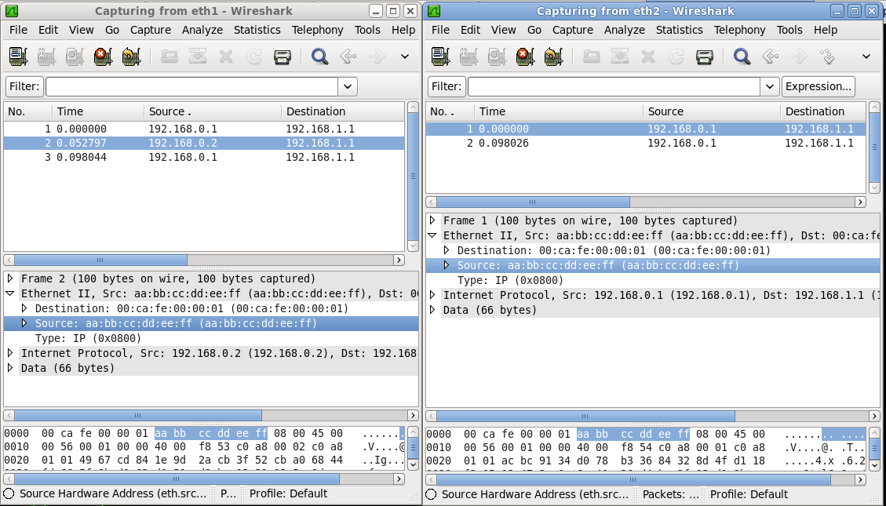
Demo
Second packet (IP spoof) from eth1 is dropped
Dropped
Not reached to eth2
Notes:
h/w simulation
And real testing

Slide 13
What’s next?
Configuration
  Process to update the table upon DHCP session is bound
Alarm reporting
  Triggers alarm to management system upon spoof detection
Add more entities to anti_spoof look up entry
  Lease time for aging out
ARP anti spoof
Source port | Source IP | Source MAC | Lease time
Notes:
Git
What’s next?

Slide 14
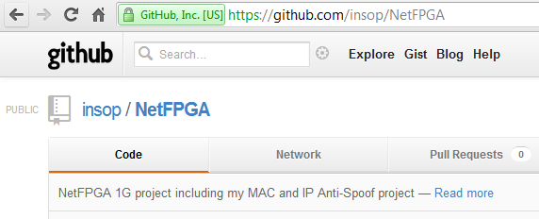
Conclusion
Learn and understand network equipment design using NetFPGA
  Good development framework
  Good testing environment
  Very valuable
Implement a proof of concept MAC IP Anti spoof block
  Proved the concept and could be improved and uploaded on the wiki
  https://github.com/insop/NetFPGA
Notes:
Git
What’s next?

Slide 15
References
Tackling Spoofing Attacks in Broadband Access Networks
MAC-IP Anti-Spoof
IP address spoofing
https://github.com/insop/NetFPGA

Slide 16
Acknowledgements
Adam, Glen, James, Cesar
NetFPGA group
Fellow summer campers

Slide 17

Thank you!
Question?

