Slide 1
U
S

Slide 2
Klass
a
b

Slide 3
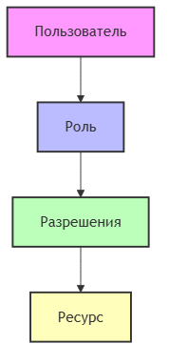
STRIDE
Spoofing...
Рис. 1 - STRIDE diagram

