Slide 1

Web Services Introduction to Computer Systems 25th Lecture, Dec. 14, 2015
Instructors:
Xiangqun Chen，Junlin Lu
Guangyu Sun，Xuetao Guan

Slide 2
Chapter 11 Networking Programming
程序员视角 ≠ 网络研究者
如何实现协议、算法？∈{程序员任务}
如何设计协议、算法？∈{研究者任务}
What is computer network? 基本网络知识
学习网络架构：proc2proc, 层级结构, IP, DNS, 协议
Socket interface 基本接口知识
学习已有协议、接口：socket, connect, listen, fd, etc
Web server 通过编程架设网页服务器
遵循HTTP协议

Slide 3
Outline
Web history
Web and HTTP overview
Proxy
Tiny web server
Two examples
了解HTTP、写一个简单网页服务器程序

Slide 4
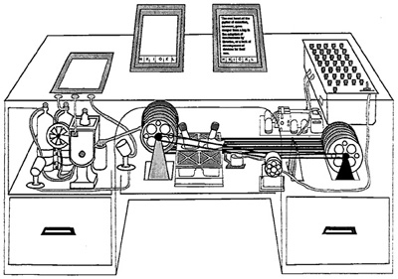
Web History (seminal)
“Consider a future device for individual use, which is a sort of mechanized private file and library. It needs a name, and to coin one at random, "memex" will do. A memex is a device in which an individual stores all his books, records, and communications, and which is mechanized so that it may be consulted with exceeding speed and flexibility. It is an enlarged intimate supplement to his memory.”
1945:
Vannevar Bush, “As we may think”, Atlantic Monthly, July, 1945
Describes the idea of a distributed hypertext system
A “memex” that mimics the “web of trails” in our minds
储存、查询个人文件

Slide 5
Web History
1989:
Tim Berners-Lee (CERN) writes internal proposal to develop a distributed hypertext system
Connects “a web of notes with links”
Intended to help CERN physicists in large projects share and manage information
1990:
Tim BL writes a graphical browser for NeXT machines
共享信息：查询别人的文件
如何查询个人文件：browser

Slide 6
Web History (cont)
1992
NCSA server released
26 WWW servers worldwide
1993
Marc Andreessen releases first version of NCSA Mosaic browser
Mosaic version released for (Windows, Mac, Unix)
Web (port 80) traffic at 1% of NSFNET backbone traffic
Over 200 WWW servers worldwide
1994
Andreessen and colleagues leave NCSA to form “Mosaic Communications Corp” (predecessor to Netscape’94)

Slide 7
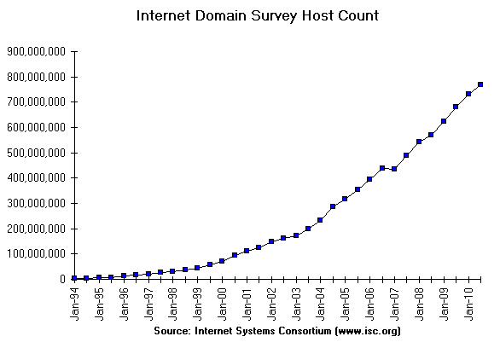
Internet Hosts
18.6%
How many of the 2³² IP addresses have registered domain names?

Slide 8
Outline
Web history
Web and HTTP overview
Proxy
Tiny web server
Two examples

Slide 9
Web Servers
Web
client
(browser)
HTTP request
Web
server
Clients and servers communicate using the HyperText Transfer Protocol (HTTP)
Client and server establish TCP connection
Client requests content
Server responds with requested content
Client and server close connection (eventually)
Current version is HTTP/1.1
RFC 2616, June, 1999.
标准：规定协议内容
HTTP response
(content)
HTTP
Web content
TCP
Streams
IP
Datagrams
http://www.w3.org/Protocols/rfc2616/rfc2616.html

Slide 10
Web Servers (cont)
Web
client
(browser)
HTTP request
Web
server
HTTP response
(content)
HTTP
去哪里看什么热闹？去哪个网站看什么帖子？
Web content
TCP
流量怎么控制？端到端网络流量控制
Streams
IP
Datagrams
具体在哪，怎么走？数据包按什么路径走？

Slide 11
Web Content
Web servers return content to clients
content: a sequence of bytes with an associated MIME (Multipurpose Internet Mail Extensions) type
服务器将多媒体数据类型包含在response中告诉客户端浏览器
Example MIME types
text/html HTML document
text/plain Unformatted text
application/postscript Postcript document
image/gif Binary image encoded in GIF format
image/jpeg Binary image encoded in JPEG format
You can find the complete list of MIME types at:
http://www.iana.org/assignments/media-types/media-types.xhtml

Slide 12
Web and HTTP
Web page consists of objects
Object can be HTML file, JPEG image, Java applet, audio file,…
Web page consists of base HTML-file which includes several referenced objects
一个网页文本，包含若干被引用的文件对象
Each object is addressable by a URL
Example URL:
www.someschool.edu/someDept/pic.gif
host name
path name
类似于本地文件访问 C:\someDept\pic.gif

Slide 13
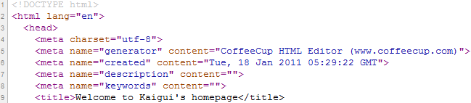
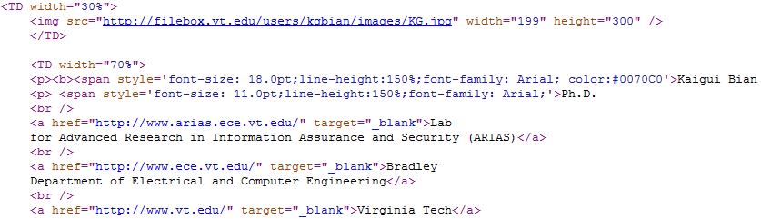
HTML file
<title>……</title>
<img src = “……”>
<p>……</p>

Slide 14
HTTP overview
HTTP: hypertext transfer protocol
Web’s application layer protocol
client/server model
client: browser that requests, receives, “displays” Web objects 把需求发给服务器，输入URL回车即发送出去
server: Web server sends objects in response to requests 把用户需要的html 文件发给客户端
HTTP request
PC running
Explorer
HTTP response
HTTP request
Server
running
Apache Web
server
HTTP response
Mac running
Navigator

Slide 15
Static and Dynamic Content
The content returned in HTTP responses can be either static or dynamic
Static content: content stored in files and retrieved in response to an HTTP request 个人主页展示静态内容
Examples: HTML files, images, audio clips
Request identifies which content file
Dynamic content: content produced on-the-fly in response to an HTTP request 搜索引擎页面展示动态内容
Example: content produced by a program executed by the server on behalf of the client
Request identifies which file containing executable code
Bottom line: (most) Web content is associated with a file that is managed by the server 动态内容、可执行程序也是文件
人人网主页、微博主页、浏览页面内容分别算什么？

Slide 16
URLs and how clients and servers use them
Unique name for a file: URL (Universal Resource Locator)
Example URL: http://www.cmu.edu:80/index.html
Clients use prefix (http://www.cmu.edu:80) to infer:
What kind (protocol) of server to contact (HTTP)
Where the server is (www.cmu.edu)
What port it is listening on (80)
Servers use suffix (/index.html) to:
Determine if request is for static or dynamic content.
No hard and fast rules for this
One convention: executables reside in cgi-bin directory
Find file on file system
Initial “/” in suffix denotes home directory for requested content.
Minimal suffix is “/”, which server expands to configured default filename (usually, “/” = “/index.html”)
文件在服务器端文件系统内的地址

Slide 17
GET Request to Apache Server From Firefox Browser
URI is just the suffix, not the entire URL
GET /~bryant/test.html HTTP/1.1
Host: www.cs.cmu.edu
User-Agent: Mozilla/5.0 (Windows; U; Windows NT 6.0; en-US; rv:1.9.2.11) Gecko/20101012 Firefox/3.6.11
Accept: text/html,application/xhtml+xml,application/xml;q=0.9,*/*;q=0.8
Accept-Language: en-us,en;q=0.5
Accept-Encoding: gzip,deflate
Accept-Charset: ISO-8859-1,utf-8;q=0.7,*;q=0.7
Keep-Alive: 115
Connection: keep-alive
CRLF (\r\n)

Slide 18
GET Response From Apache Server
HTTP/1.1 200 OK
Date: Fri, 29 Oct 2010 19:48:32 GMT
Server: Apache/2.2.14 (Unix) mod_ssl/2.2.14 OpenSSL/0.9.7m mod_pubcookie/3.3.2b PHP/5.3.1
Accept-Ranges: bytes
Content-Length: 479
Keep-Alive: timeout=15, max=100
Connection: Keep-Alive
Content-Type: text/html
<html>
<head><title>Some Tests</title></head>
<body>
<h1>Some Tests</h1>
. . .
</body>
</html>

Slide 19
HTTP Requests
HTTP request is a request line, followed by zero or more request headers
Request line: <method> <uri> <version>
<method> is one of GET, POST, OPTIONS, HEAD, PUT, DELETE, or TRACE
<uri> is typically URL for proxies, URL suffix for servers
A URL is a type of URI (Uniform Resource Identifier)
Web上可用的每种资源 - HTML文档、图像、视频片段、程序等 - 由一个通用资源标识符（URI）进行定位。
See http://www.ietf.org/rfc/rfc2396.txt
<version> is HTTP version of request (HTTP/1.0 or HTTP/1.1)
GET /index.shtml HTTP/1.1
URL是URI 的一个子集。

Slide 20
HTTP Requests (cont)
组成HTTP命令中的具体内容
HTTP methods:
GET: Retrieve static or dynamic content
Arguments for dynamic content are in URI
Workhorse method (99% of requests)
POST: Retrieve dynamic content
Arguments for dynamic content are in the request body
OPTIONS: Get server or file attributes
HEAD: Like GET but no data in response body
PUT: Write a file to the server!
DELETE: Delete a file on the server!
TRACE: Echo request in response body
Useful for debugging
Request headers: <header name>: <header data>
Provide additional information to the server

Slide 21
HTTP Versions
Major differences between HTTP/1.1 and HTTP/1.0
HTTP/1.0 uses a new connection for each transaction
HTTP/1.1 also supports persistent connections
multiple transactions over the same connection
Connection: Keep-Alive
HTTP/1.1 requires HOST header
Host: www.cmu.edu
Makes it possible to host multiple websites at single Internet host
HTTP/1.1 supports chunked encoding (described later)
Transfer-Encoding: chunked 分段获取网页内容，不用一次发完
HTTP/1.1 adds additional support for caching 网页cache

Slide 22
Method types
HTTP/1.0
GET
POST
HEAD
Similar to GET
asks server to leave out the requested object in response
For debugging
HTTP/1.1
GET, POST, HEAD
PUT
uploads file in entity body to path on server specified in URL field
DELETE
deletes file specified in the URL field

Slide 23
HTTP response message
status line
(protocol
status code
status phrase)
HTTP/1.1 200 OK
Connection close
Date: Thu, 06 Aug 1998 12:00:15 GMT
Server: Apache/1.3.0 (Unix)
Last-Modified: Mon, 22 Jun 1998 …...
Content-Length: 6821
Content-Type: text/html
data data data data data ...
header
lines
data, e.g.,
requested
HTML file

Slide 24
HTTP Responses
HTTP response is a response line followed by zero or more response headers, possibly followed by data
Response line:
<version> <status code> <status msg>
<version> is HTTP version of the response
<status code> is numeric status
<status msg> is corresponding English text
200 OK Request was handled without error
301 Moved Provide alternate URL
403 Forbidden Server lacks permission to access file
404 Not found Server couldn’t find the file
Response headers: <header name>: <header data>
Provide additional information about response
Content-Type: MIME type of content in response body
Content-Length: Length of content in response body

Slide 25
HTTP response status codes
In first line in server->client response message.
A few sample codes:
200 OK
request succeeded, requested object later in this message
301 Moved Permanently
requested object moved, new location specified later in this message (Location:)
400 Bad Request
request message not understood by server
404 Not Found
requested document not found on this server
505 HTTP Version Not Supported

Slide 26
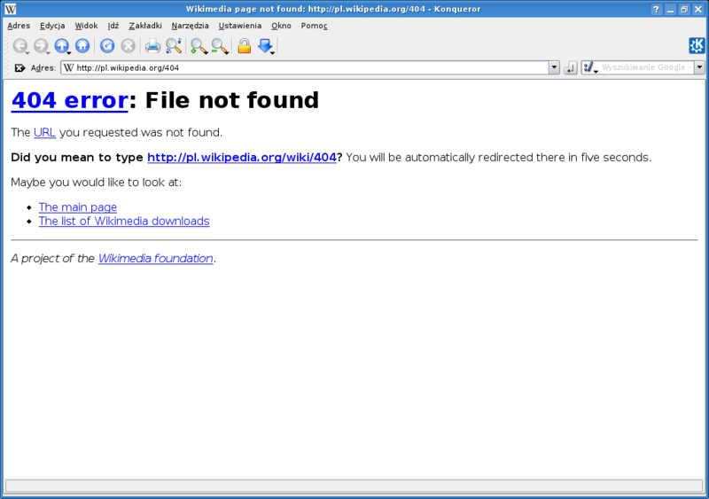
HTTP response status codes – 404 error

Slide 27
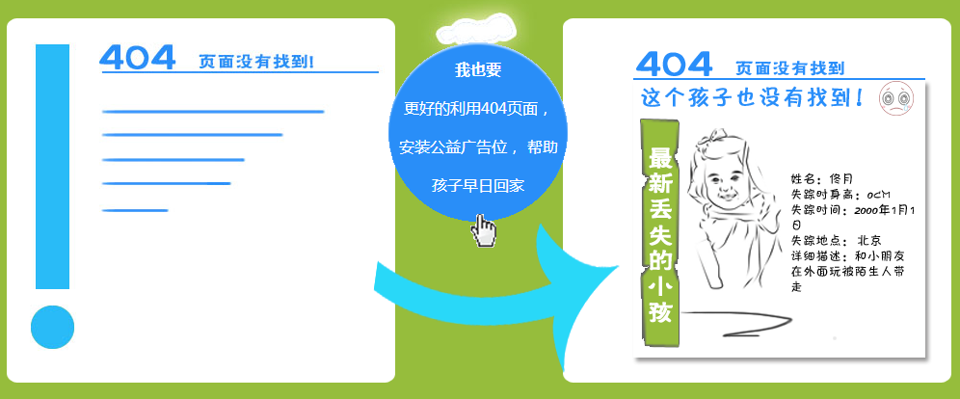
HTTP 404 公益
NotFound Project公益项目：利用闲置网络资源 发挥公益的力量让更多人帮忙寻找失踪儿童。

Slide 28
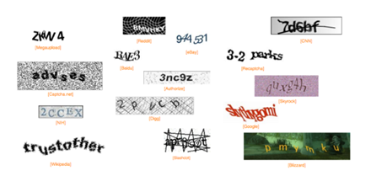
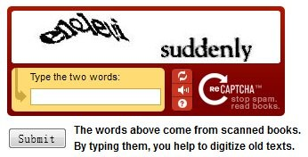
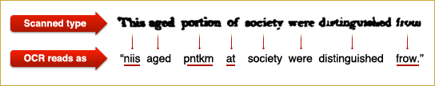
群智计算
CAPTCHA：Completely Automated Public Turing Test to Tell Computers and Humans Apart (全自动区分计算机和人类的图灵测试)
reCAPTCHA是利用CAPTCHA的原理，借助于人类大脑对难以识别的字符的辨别能力，进行对古旧书籍中难以被OCR识别的字符进行辨别的技术。

Slide 29
Example HTTP Transaction
whaleshark> telnet www.cmu.edu 80 Client: open connection to server
Trying 128.2.42.52... Telnet prints 3 lines to terminal
Connected to WWW-CMU-PROD-VIP.ANDREW.cmu.edu.
Escape character is '^]'.
GET / HTTP/1.1 Client: request line
Host: www.cmu.edu Client: required HTTP/1.1 header
Client: empty line terminates headers
HTTP/1.1 301 Moved Permanently Server: response line
Date: Wed, 05 Nov 2014 17:05:11 GMT Server: followed by 5 response headers
Server: Apache/1.3.42 (Unix) Server: this is an Apache server
Location: http://www.cmu.edu/index.shtml Server: page has moved here
Transfer-Encoding: chunked Server: response body will be chunked
Content-Type: text/html; charset=... Server: expect HTML in response body
Server: empty line terminates headers
15c Server: first line in response body
<HTML><HEAD> Server: start of HTML content
…
</BODY></HTML> Server: end of HTML content
0 Server: last line in response body
Connection closed by foreign host. Server: closes connection
HTTP standard requires that each text line end with “\r\n”
Blank line (“\r\n”) terminates request and response headers

Slide 30
Example HTTP Transaction, Take 2
whaleshark> telnet www.cmu.edu 80 Client: open connection to server
Trying 128.2.42.52... Telnet prints 3 lines to terminal
Connected to WWW-CMU-PROD-VIP.ANDREW.cmu.edu.
Escape character is '^]'.
GET /index.shtml HTTP/1.1 Client: request line
Host: www.cmu.edu Client: required HTTP/1.1 header
Client: empty line terminates headers
HTTP/1.1 200 OK Server: response line
Date: Wed, 05 Nov 2014 17:37:26 GMT Server: followed by 4 response headers
Server: Apache/1.3.42 (Unix)
Transfer-Encoding: chunked
Content-Type: text/html; charset=...
Server: empty line terminates headers
1000 Server: begin response body
<html ..> Server: first line of HTML content
…
</html>
0 Server: end response body
Connection closed by foreign host. Server: close connection

Slide 31
Data Transfer Mechanisms
Transfer-Encoding: standard
Transfer-Encoding: chunked
Standard
Specify total length with content-length
Requires that program buffer entire message
Chunked
Break into blocks
Prefix each block with number of bytes (Hex coded)

Slide 32
Chunked Encoding Example
HTTP/1.1 200 OK\n
Date: Sun, 31 Oct 2010 20:47:48 GMT\n
Server: Apache/1.3.41 (Unix)\n
Keep-Alive: timeout=15, max=100\n
Connection: Keep-Alive\n
Transfer-Encoding: chunked\n
Content-Type: text/html\n
\r\n
d75\r\n
<html>
<head>
.<link href="http://www.cs.cmu.edu/style/calendar.css" rel="stylesheet" type="text/css">
</head>
<body id="calendar_body">
<div id='calendar'><table width='100%' border='0' cellpadding='0' cellspacing='1' id='cal'>
. . .
</body>
</html>
\r\n
0\r\n
\r\n
First Chunk: 0xd75 = 3445 bytes
Second Chunk: 0 bytes (indicates last chunk)

Slide 33
Outline
Web history
Web and HTTP overview
Proxy
Tiny web server
Two examples

Slide 34
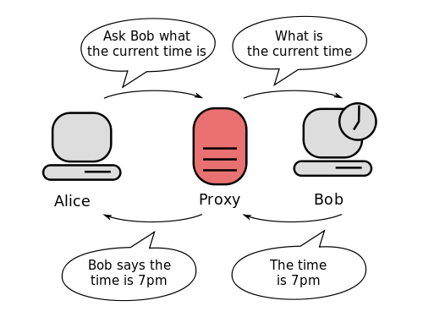
Proxies
A proxy is an intermediary between a client and an origin server
To the client, the proxy acts like a server
To the server, the proxy acts like a client
1. Client request
2. Proxy request
Client
Proxy
Origin
Server
4. Proxy response
3. Server response
中间人，代理人
自己不方便出面的时候

Slide 35
Why Proxies?
Can perform useful functions as requests and responses pass by
Examples: Caching, logging, anonymization, filtering, transcoding
Client
A
Request foo.html
foo.html
Request foo.html
Origin
Server
Proxy
cache
foo.html
Request foo.html
Slower more
expensive
global network
Client
B
foo.html
Fast inexpensive local network

Slide 36
Two types of web proxy
Explicit (browser-known) proxies
用户知情、需要设置
Used by configuring browser to send requests to proxy
Each request specifies entire URL
allowing proxy to know target server
Transparent proxies
用户不知情
Browser/client behaves as though there is no proxy
Proxy runs on network component in route between client and server
intercepting and interposing on web requests

Slide 37
Outline
Web history
Web and HTTP overview
Proxy
Tiny web server
Two examples

Slide 38
Tiny Web Server
Tiny Web server described in text
Tiny is a sequential Web server
Serves static and dynamic content to real browsers
text files, HTML files, GIF and JPEG images
226 lines of commented C code
Not as complete or robust as a real web server
You can break with poorly-formed HTTP requests (e.g., terminate lines with “\n” instead of “\r\n”)

Slide 39
Tiny Operation
Accept connection from client
Read request from client (via connected socket)
服务器如何区分需求的是动态、还是静态内容
Split into <method> <uri> <version>
If method not GET, then return error
If URI contains “cgi-bin” then serve dynamic content
(Would do wrong thing if had file “abcgi-bingo.html”)
Fork process to execute program
Otherwise serve static content
Copy file to output
不再是简单Echo
而是区分发过来什么内容，什么request
再决定如何回复，回复什么内容

Slide 40
Tiny Serving Static Content
/* Send response headers to client */
get_filetype(filename, filetype);
sprintf(buf, "HTTP/1.0 200 OK\r\n");
sprintf(buf, "%sServer: Tiny Web Server\r\n", buf);
sprintf(buf, "%sContent-length: %d\r\n", buf, filesize);
sprintf(buf, "%sContent-type: %s\r\n\r\n",
buf, filetype);
Rio_writen(fd, buf, strlen(buf));
/* Send response body to client */
srcfd = Open(filename, O_RDONLY, 0);
srcp = Mmap(0, filesize, PROT_READ, MAP_PRIVATE, srcfd, 0);
Close(srcfd);
Rio_writen(fd, srcp, filesize);
Munmap(srcp, filesize);
From tiny.c
Serve file specified by filename
Use file metadata to compose header
“Read” file via mmap
Write to output

Slide 41
Serving Dynamic Content
Client sends request to server
If request URI contains the string “/cgi-bin”, then the server assumes that the request is for dynamic content
我有一个任务（非静态文件）
明确告诉服务器是任务
提供参数
等待、读取结果
GET /cgi-bin/env.pl HTTP/1.1
Client
Server
有人提交一个任务
确认是任务
获取参数
找个员工去执行
将结果返回给客户

Slide 42
Serving Dynamic Content (cont)
The server creates a child process and runs the program identified by the URI in that process
Client
Server
fork/exec
env.pl

Slide 43
Serving Dynamic Content (cont)
Client
Server
The child runs and generates the dynamic content
The server captures the content of the child and forwards it without modification to the client
Content
Content
env.pl

Slide 44
Issues in Serving Dynamic Content
How does the client pass program arguments to the server?
How does the server pass these arguments to the child?
How does the server pass other info relevant to the request to the child?
How does the server capture the content produced by the child?
These issues are addressed by the Common Gateway Interface (CGI) specification.
1:Request
Client
Server
4:Content
3:Content
2:Create
env.pl

Slide 45
CGI
Because the children are written according to the CGI spec, they are often called CGI programs.
Because many CGI programs are written in Perl, they are often called CGI scripts.
However, CGI really defines a simple standard for transferring information between the client (browser), the server, and the child process.
CGI is the original standard for generating dynamic content. Has been largely replaced by other, faster techniques:
E.g., fastCGI, Apache modules, Java servlets, Rails controllers
Avoid having to create process on the fly (expensive and slow).

Slide 46
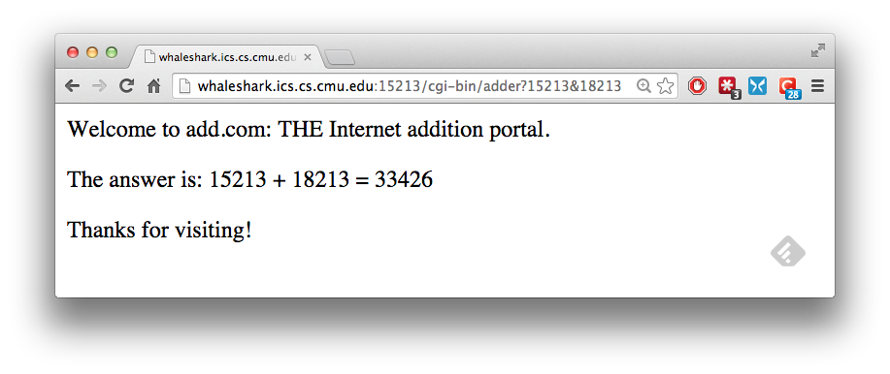
The add.com Experience
host
port
CGI program
arguments
Output page

Slide 47
Serving Dynamic Content With GET
Question: How does the client pass arguments to the server?
Answer: The arguments are appended to the URI
Can be encoded directly in a URL typed to a browser or a URL in an HTML link
http://add.com/cgi-bin/adder?15213&18243
adder is the CGI program on the server that will do the addition.
argument list starts with “?”
arguments separated by “&”
spaces represented by “+” or “%20”

Slide 48
Serving Dynamic Content With GET
URL suffix:
cgi-bin/adder?15213&18213
Result displayed on browser:
Welcome to add.com: THE Internet addition portal.
The answer is: 15213 + 18213 = 33426
Thanks for visiting!

Slide 49
Serving Dynamic Content With GET
Question: How does the server pass these arguments to the child?
Answer: In environment variable QUERY_STRING
A single string containing everything after the “?”
For add: QUERY_STRING = “15213&18213”
/* Extract the two arguments */
if ((buf = getenv("QUERY_STRING")) != NULL) {
p = strchr(buf, '&');
*p = '\0';
strcpy(arg1, buf);
strcpy(arg2, p+1);
n1 = atoi(arg1);
n2 = atoi(arg2);
}
adder.c

Slide 50
Additional CGI Environment Variables
General
SERVER_SOFTWARE
SERVER_NAME
GATEWAY_INTERFACE (CGI version)
Request-specific
SERVER_PORT
REQUEST_METHOD (GET, POST, etc)
QUERY_STRING (contains GET args)
REMOTE_HOST (domain name of client)
REMOTE_ADDR (IP address of client)
CONTENT_TYPE (for POST, type of data in message body, e.g., text/html)
CONTENT_LENGTH (length in bytes)
In addition, the value of each header of type type received from the client is placed in environment variable HTTP_type
Examples (any “-” is changed to “_”) :
HTTP_ACCEPT
HTTP_HOST
HTTP_USER_AGENT

Slide 51
Serving Dynamic Content with GET
Question: How does the server capture the content produced by the child?
Answer: The child generates its output on stdout. Server uses dup2 to redirect stdout to its connected socket.
void serve_dynamic(int fd, char *filename, char *cgiargs)
{
char buf[MAXLINE], *emptylist[] = { NULL };
/* Return first part of HTTP response */
sprintf(buf, "HTTP/1.0 200 OK\r\n");
Rio_writen(fd, buf, strlen(buf));
sprintf(buf, "Server: Tiny Web Server\r\n");
Rio_writen(fd, buf, strlen(buf));
if (Fork() == 0) { /* Child */
/* Real server would set all CGI vars here */
setenv("QUERY_STRING", cgiargs, 1);
Dup2(fd, STDOUT_FILENO); /* Redirect stdout to client */
Execve(filename, emptylist, environ); /* Run CGI program */
}
Wait(NULL); /* Parent waits for and reaps child */
}
Fork child to execute CGI program
Change stdout to be connection to client
Execute CGI program with execve
tiny.c

Slide 52
Serving Dynamic Content with GET
Notice that only the CGI child process knows the content type and length, so it must generate those headers.
/* Make the response body */
sprintf(content, "Welcome to add.com: ");
sprintf(content, "%sTHE Internet addition portal.\r\n<p>", content);
sprintf(content, "%sThe answer is: %d + %d = %d\r\n<p>",
content, n1, n2, n1 + n2);
sprintf(content, "%sThanks for visiting!\r\n", content);
/* Generate the HTTP response */
printf("Content-length: %d\r\n", (int)strlen(content));
printf("Content-type: text/html\r\n\r\n");
printf("%s", content);
fflush(stdout);
exit(0);
adder.c

Slide 53
Serving Dynamic Content With GET
bash:makoshark> telnet whaleshark.ics.cs.cmu.edu 15213
Trying 128.2.210.175...
Connected to whaleshark.ics.cs.cmu.edu (128.2.210.175).
Escape character is '^]'.
GET /cgi-bin/adder?15213&18213 HTTP/1.0
HTTP/1.0 200 OK
Server: Tiny Web Server
Connection: close
Content-length: 117
Content-type: text/html
Welcome to add.com: THE Internet addition portal.
<p>The answer is: 15213 + 18213 = 33426
<p>Thanks for visiting!
Connection closed by foreign host.
bash:makoshark>
HTTP request sent by client
HTTP response generated
by the server
HTTP response generated
by the CGI program

Slide 54
URLs
Each file managed by a server has a unique name called a URL (Universal Resource Locator)
URLs for static content:
http://www.cs.cmu.edu:80/index.html
http://www.cs.cmu.edu/index.html
http://www.cs.cmu.edu 缺省访问 index.html
Identifies a file called index.html, managed by a Web server at www.cs.cmu.edu that is listening on port 80
URLs for dynamic content:
http://www.cs.cmu.edu:8000/cgi-bin/proc?15000&213
Identifies an executable file called proc, managed by a Web server at www.cs.cmu.edu that is listening on port 8000, that should be called with two argument strings: 15000 and 213

Slide 55
For More Information
W. Richard Stevens et. al. “Unix Network Programming: The Sockets Networking API”, Volume 1, Third Edition, Prentice Hall, 2003
THE network programming bible.
Michael Kerrisk, “The Linux Programming Interface”, No Starch Press, 2010
THE Linux programming bible.
See the HTTP/1.1 standard:
http://www.w3.org/Protocols/rfc2616/rfc2616.html

Slide 56
Outline
Web history
Web and HTTP overview
Proxy
Tiny web server
Two examples

Slide 57
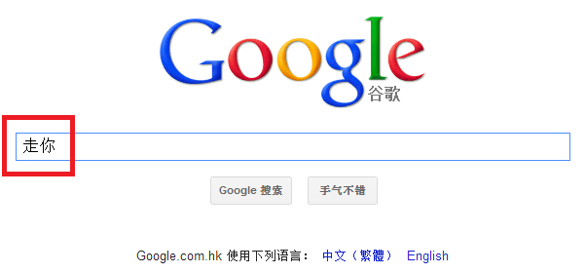
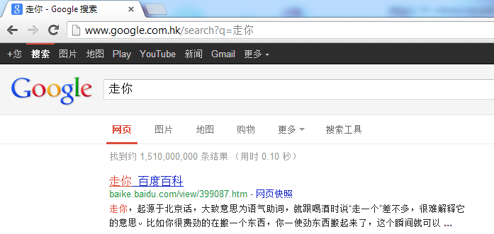
Input via URL
URL method:
Uses GET method
Input is uploaded in URL field of request line:

Slide 58
Get Google PageRank score
Send a HTTP GET request to a Google server (www.google.com) with a query command:
/search?client=navclient-auto
appended with parameters \&ch=61658376380\&features=Rank\&q=info:http://www.yahoo.com.
The string “61658376380" is transformed from http://www.yahoo.com by a transformation function that accepts a URL as input.
The returned results of the GET request contains the score

Slide 59
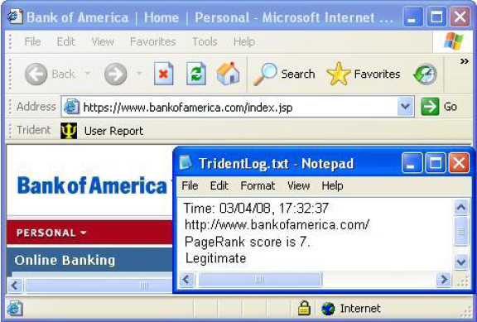
Get Google PageRank score

