Slide 1


Task Mangement Software
Mentored By: Debhasree
Presented By : Group 2

Slide 2

MEMBERS
Memory and documentation - Rohitha
Task - Kavya
CSV.file and PPT- Harika Assignment - Pranavika User - Maneesha

Slide 3
TIMELINE OF THE PROJECT
18.11.2022
SRS RELEASE
20.11.2022
CODE IMPLEMENTING
19.11.2022
DESIGNING
28.11.2022
SPLINT ASSESMENT

Slide 4
Table Of Content
INTRODUCTION
NON-FUNCTIONAL REQUIREMENTS
APPLICATIONS AND CHALLENGES FACED
FLOWCHARTS
FUNCTIONS & CODE EXECUTION
CONCLUSION

Slide 5
Introduction

Slide 6
Introduction :
What is Task Management Software ?
This project is intended to implement the Task management software. This TMS can be easily used by all the users . A Task Management system is a self-service tool for users to manage their task. This project is used in creating tasks to the user and they no longer have to be worried about their task’s details and deadlines. In this project the user and task database is stored in the assignment file so that there couldn’t be any confusion or loss in the data.

Slide 7
System Requirements Specifications (SRS)
01
TMS shall support CRUD (Create/Read/Update/Delete) operations on Tasks
02
TMS shall support CRUD (Create/Read/Update/Delete) operations on Users
03
TMS shall use text-file CSV (comma separated values) format for Tasks.csv and Users.csv
04
The files shall be loaded in memory, and all CRUD operations shall happen in memory. On commanded by user, the data shall be committed to files.
05
In case one Task/User record is in format error, TMS shall still load and process the other records.
06
Task record shall comprise of atleast following fields : task_id,task_name, task_description, task_deadline.
07 | User record shall comprise of atleast user_id,user_name, user_designation . | following | fields | :
08
To store Task-to-User assignment, another file named Assignment shall be maintained. Each record in this file shall comprise of at least following fields : task id, user id

Slide 8
FLOWCHARTS

Slide 9
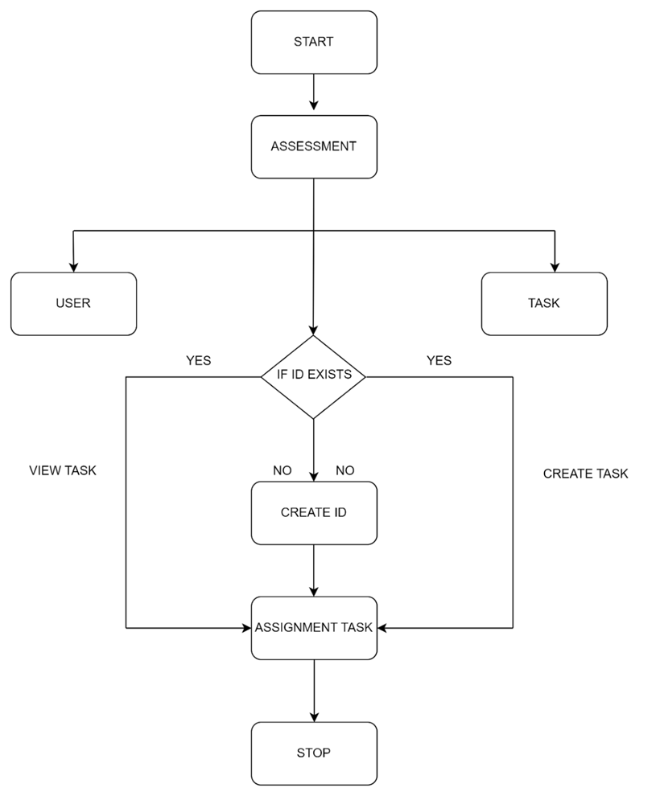
Flowchart For the Process

Slide 10
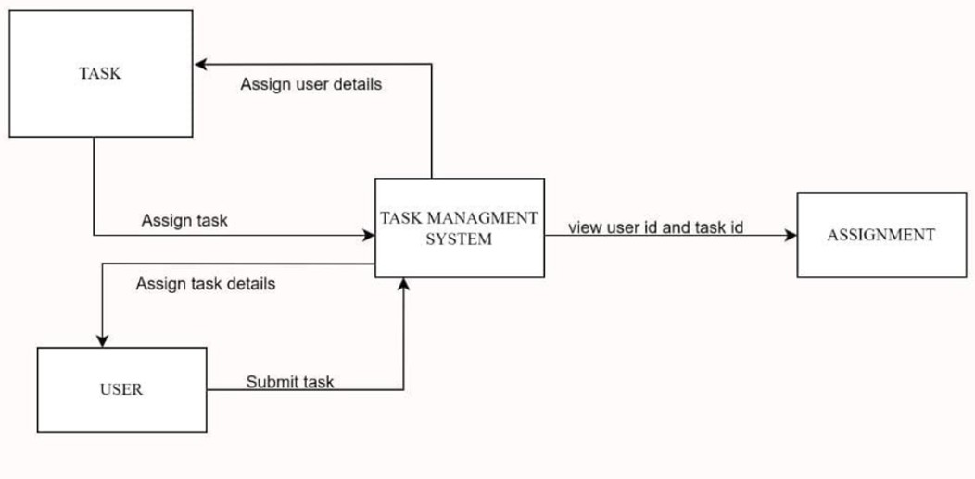
Architectural Overview

Slide 11
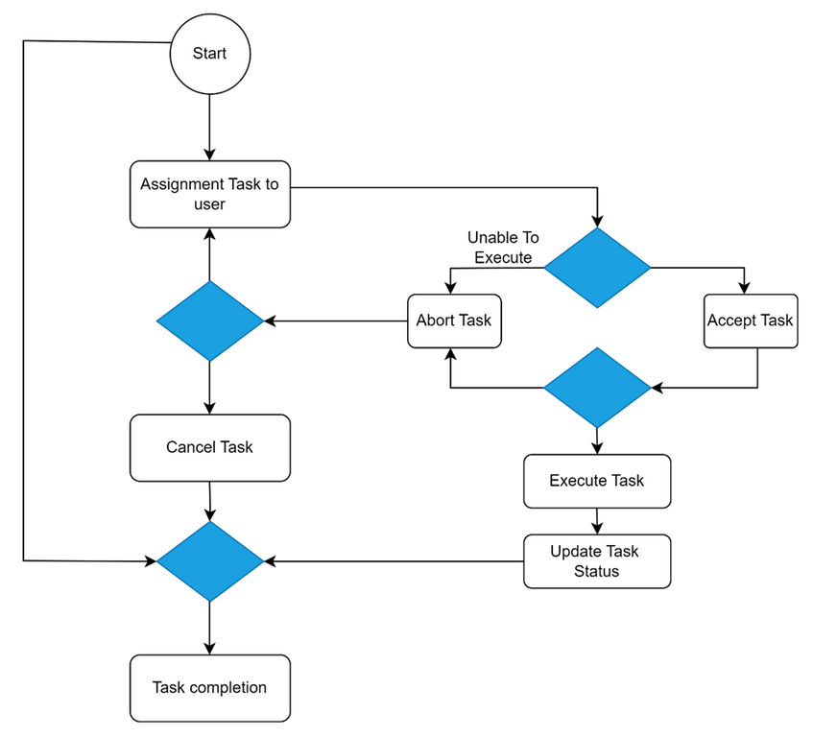
Class Diagram

Slide 12
FUNCTIONS & CODE EXECUTION

Slide 13
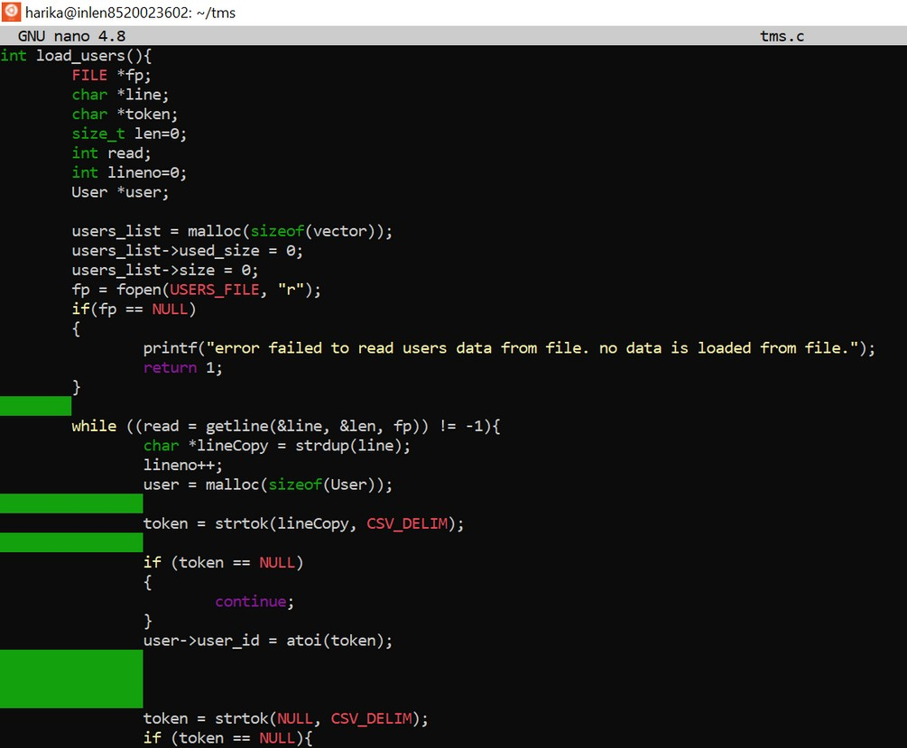
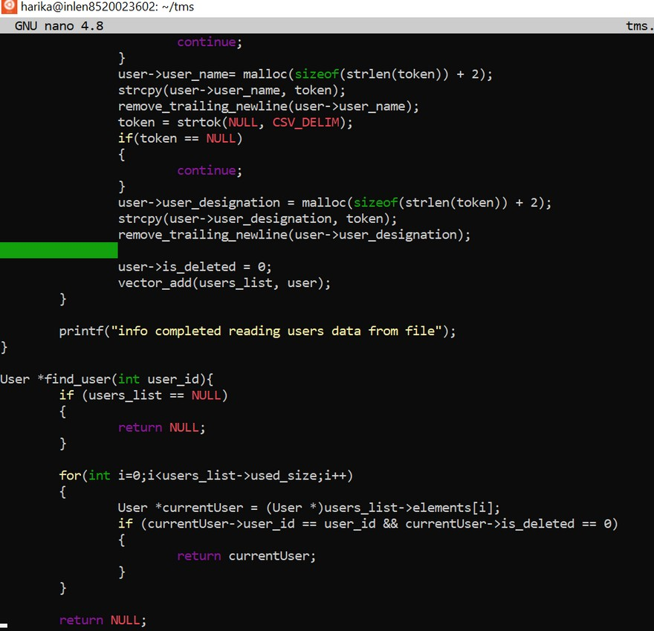
User CRUD Operations

Slide 14
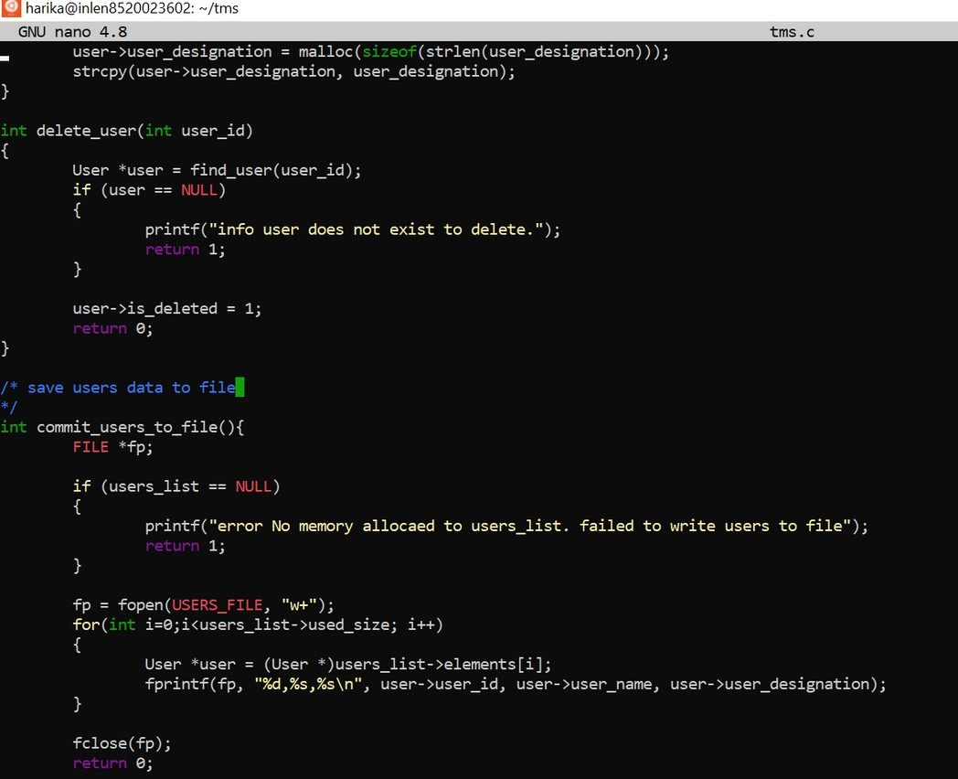

User CRUD Operations Create the User Data in the file Read the User Data from the file Update the User Data in the file Delete the User Data from the file

Slide 15
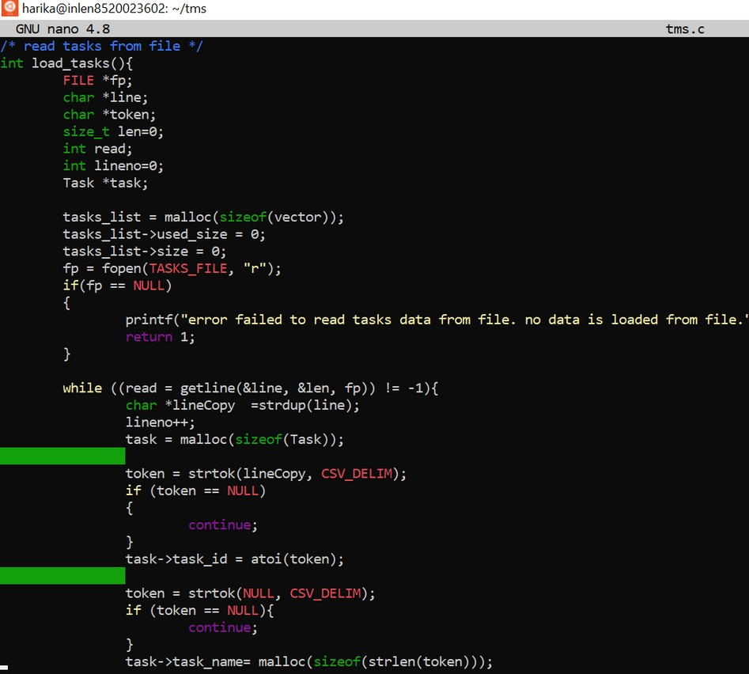
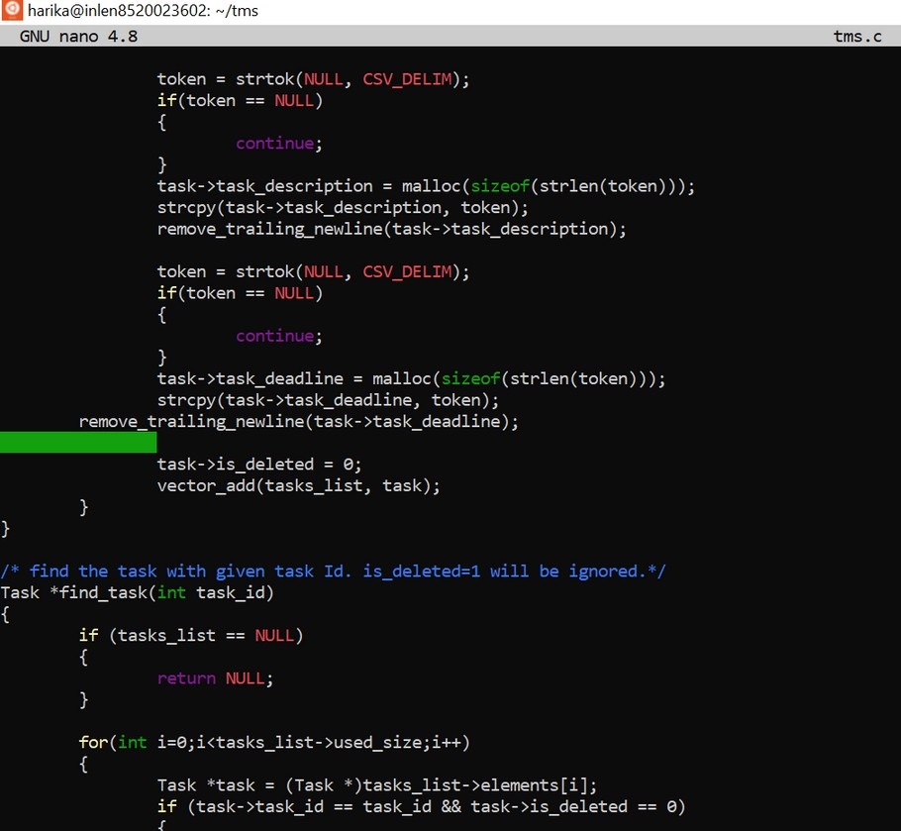
Task CRUD Opertions

Slide 16
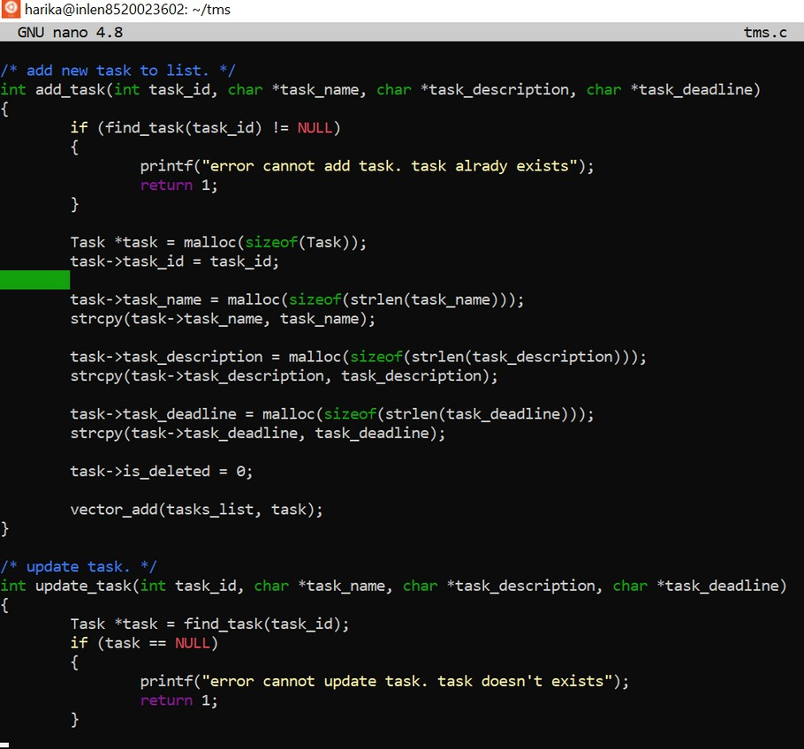
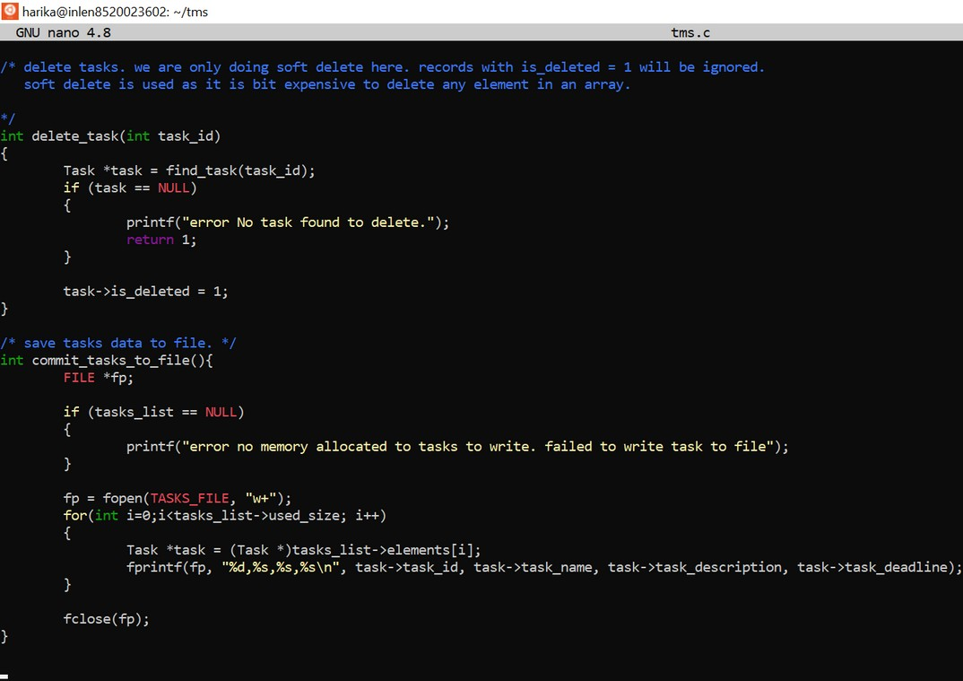
Task CRUD Operations Create the Task Data in the file Read the Task Data from the file Update the Task Data in the file Delete the Task Data from the file

Slide 17
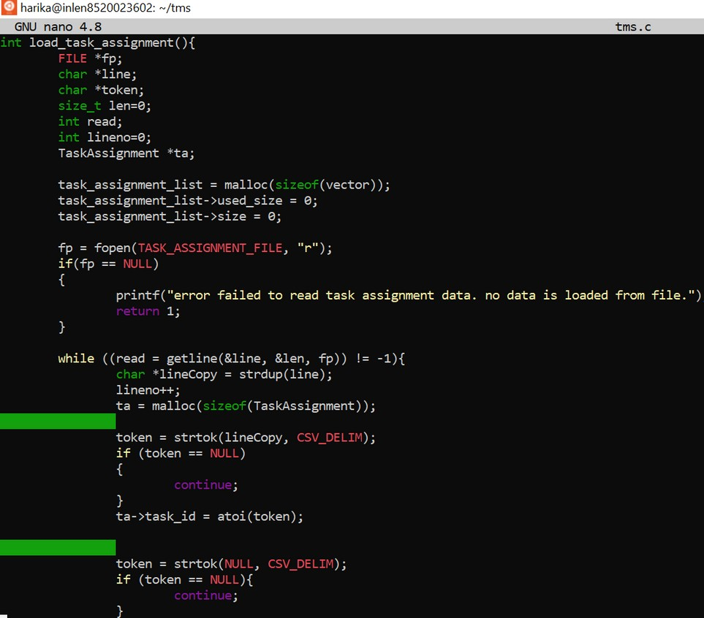
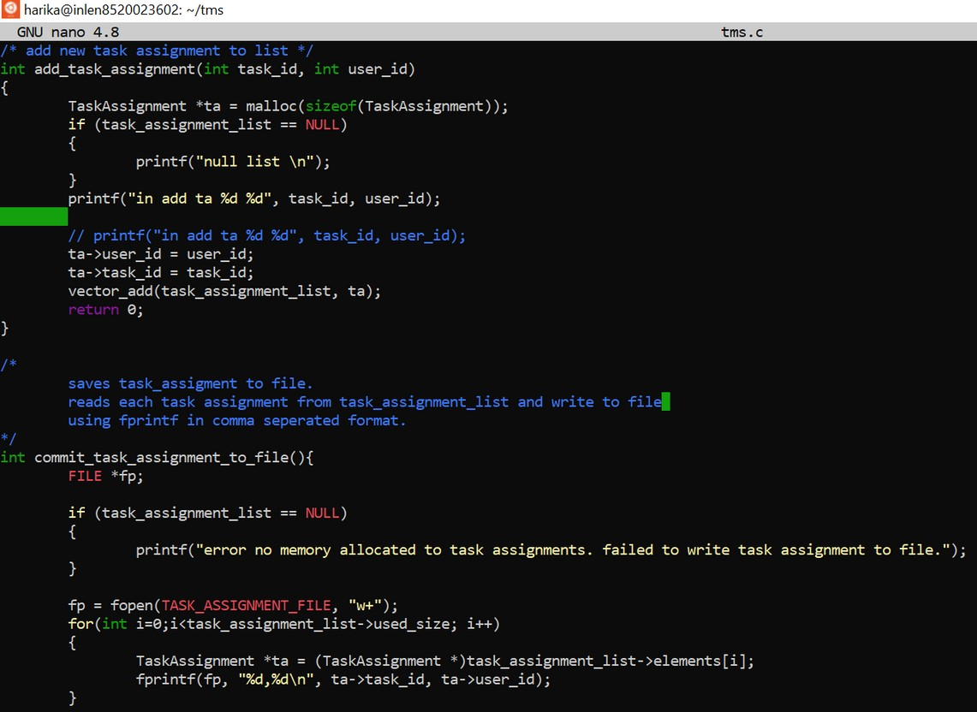
Assignment

Slide 18
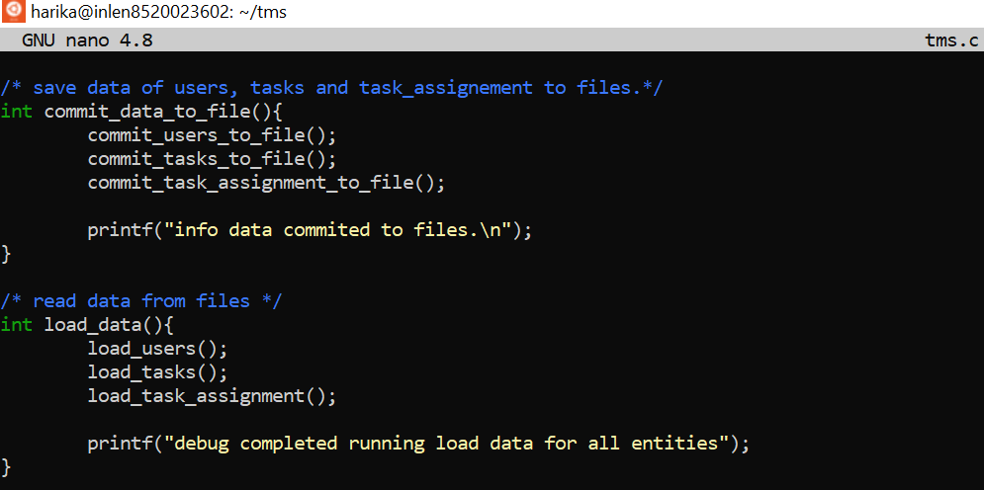
Assignments are used to store the users data and task data in it .

Slide 19
NON-FUNCTIONAL REQUIREMENTS

Slide 20
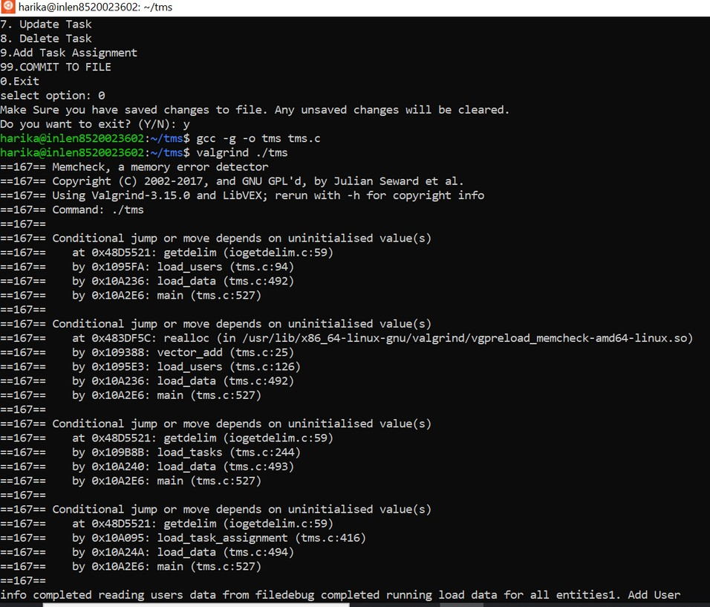
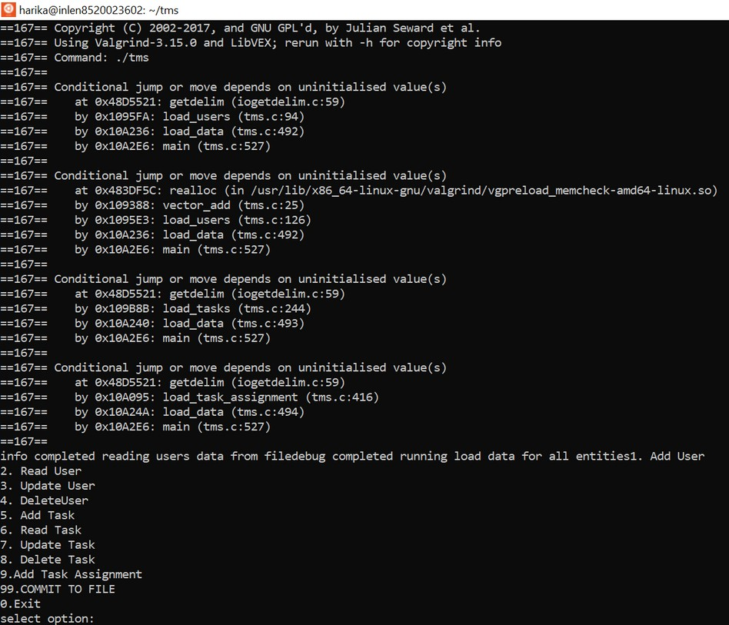
Valgrind
VALGRIND: It is a tool for finding memory access errors to heap memory in c programs.

Slide 21
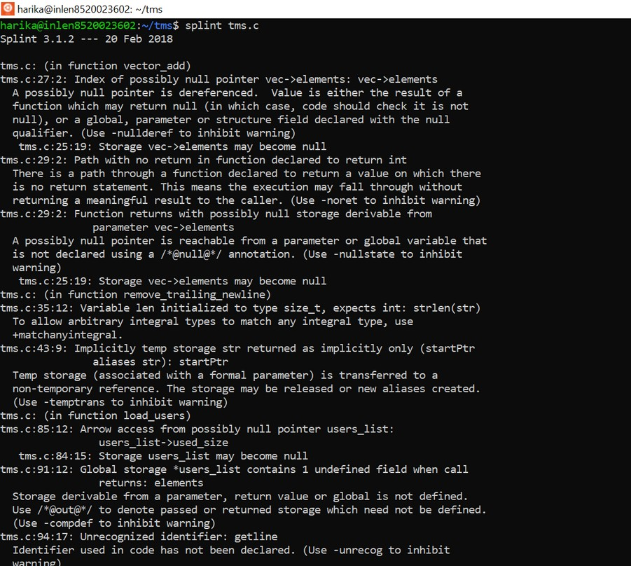
Splint
Splint : It is a programming tool for statistically checking c programs for security vulnerabilities and coding mistakes.

Slide 22
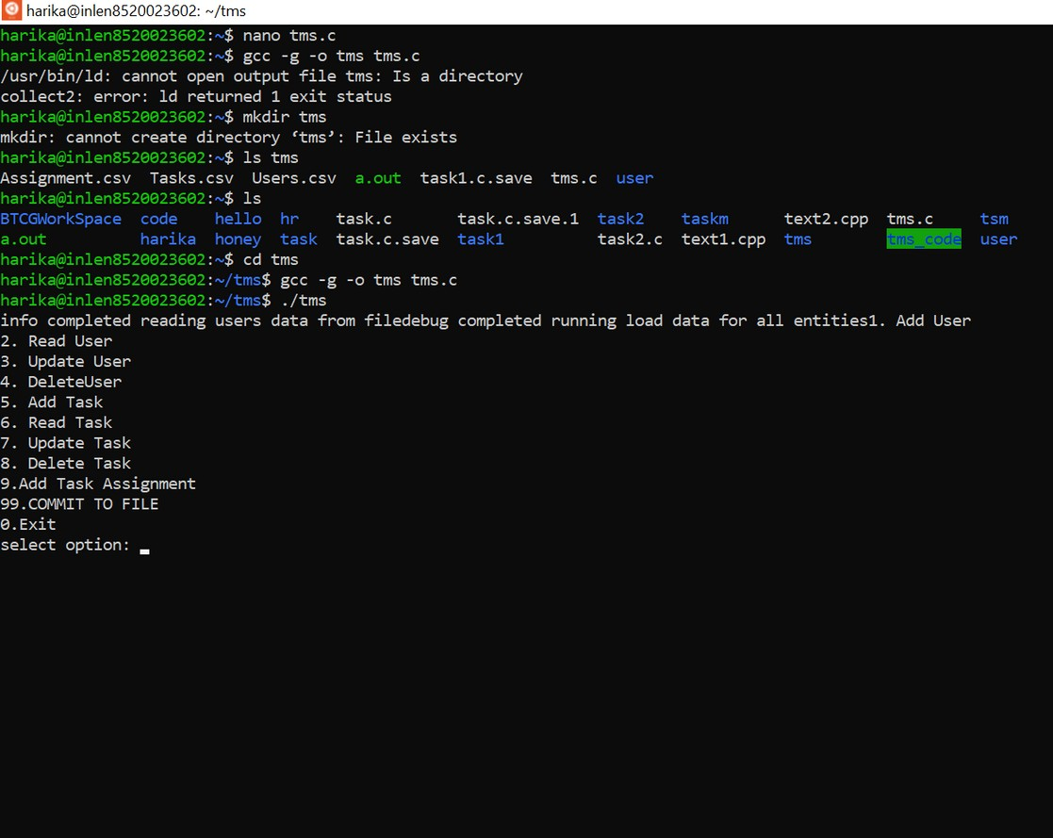
GCC : It's nothing but GNU complier collection
GCC

Slide 23
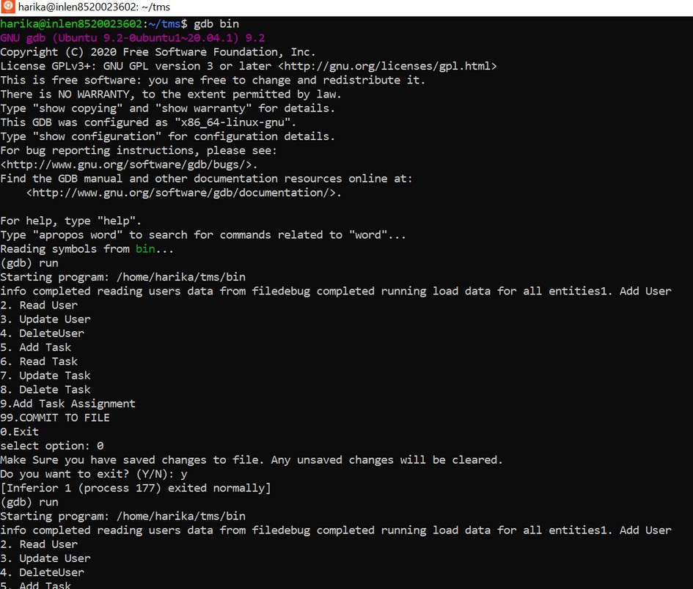
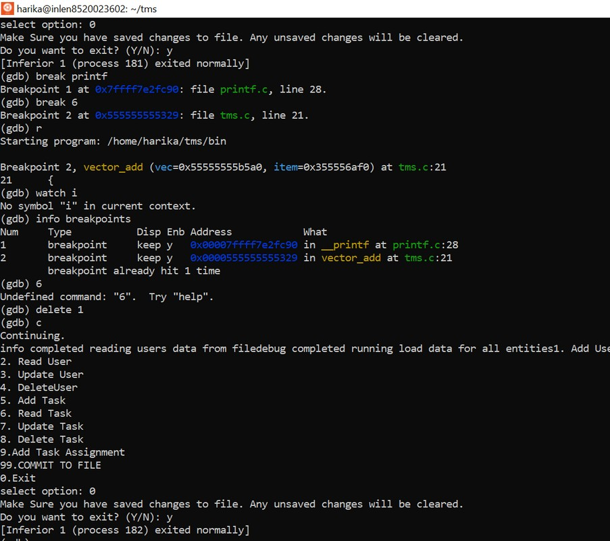
GDB: GNU Debugger
GDB

Slide 24
APPLICATIONS AND CHALLENGES FACED

Slide 25


APPLICATIONS OF THE PROJECT
The project aims to create the Task Management Software application in which user can check the details of the task they need to be do. Another file named ‘Assignment’ has been created, in this the user and task details can be stored. This file has been created so that the viewer/user can have a clear idea on the number of tasks which have been completed by the user.
The task management software is made in such a way that it means tracking tasks details by the user. It also sets deadlines to make sure tasks get done on time. This is a software which can be used by many organizations to manage tasks among its employees.

Slide 26

DEVELOPMENTS IN PROJECT CODE
We can make an advancement such that we can also add "N" number of files as per the requirement .
Add More detailation part to the user, task, assignment in the files .

Slide 27

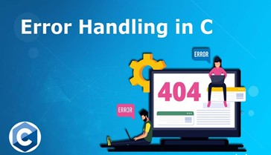

CHALLENGES FACED
Error management
Pointers operations in C
File handling

Slide 28
CONCLUSION

Slide 29
CONCLUSION
Successfully completed the coding and testing phases as per the given problem statement.
Got the expected results for the automated system with efficient and time saving methods.

Slide 30

REFERENCES
https://www.geeksforgeeks.org/program-for-employee- management-system/
https://www.studytonight.com/c-projects/employee-management- system-project-using-c-language
https://www.codeproject.com/Articles/36511/Task-Management-
System
https://youtu.be/67X7jjhL9Sw

Slide 31


