Slide 1
Final Presentation for Analysts
EMC Education Services
Data Science & Big Data Analytics
Credit card fraud
Kirichenko Vitaly
18.01.2017
Notes:
EMC Ed Services CA and DCA Launch Master V8

Slide 2
Project Goals
Build an effective model, which allows to find bank transaction frauds by it`s characteristics.

Slide 3
Situation & Project Goals
Situation
There can be enormous amount of transactions each second, so it is almost impossible to check if some of them are illegal.
Goals of our Laboratory work
Build an effective model, which can suggest highly suspicious transactions.

Slide 4
Executive Summary
Building effective model for credit card fraud.
Trying simple models to achieve highest efficiency possible.
  Setting Decision Tree model
  Setting Logical Regression model
Analyzing and comparing models
Figuring out future improvement possibilities

Slide 5
Approach
Data set was provided by Bank. Almost all the transaction features were renamed as V1,V2,…
Data set was divided into test and train subsets. So our score was to maximize AUC/ROC metrics on test data set.
By varying parameters in Decision Tree model we didn`t succeed to achieve score higher then 90%(in several cross-validation scenarios we always had at least one which leads to 90% or less score). As a result we manage to find out, that time and amount of transaction are useless features and can`t impact or decision algorithm.
Logistic regression model performed way better, so we managed to achieve ~97% accuracy at random cross-validation scenario at average.

Slide 6
Model Description
Overview of Basic Methodology: predict the likelihood of fraud transactions. Divide basic dataset into training and testing one. Calculate the model for training data and then investigate her performance on test one.
Model: Logistic regression model
Dependent variable: Binary variable Class
Scope:
  The datasets contains transactions made by credit cards in September 2013 by european cardholders. This dataset present transactions that occurred in two days, where we have 492 frauds out of 284,807 transactions
  Training sample: 210 000 transactions
  Testing sample: 74,807 subscribers
The model developed has predictive power at least 95% AUC score.

Slide 7
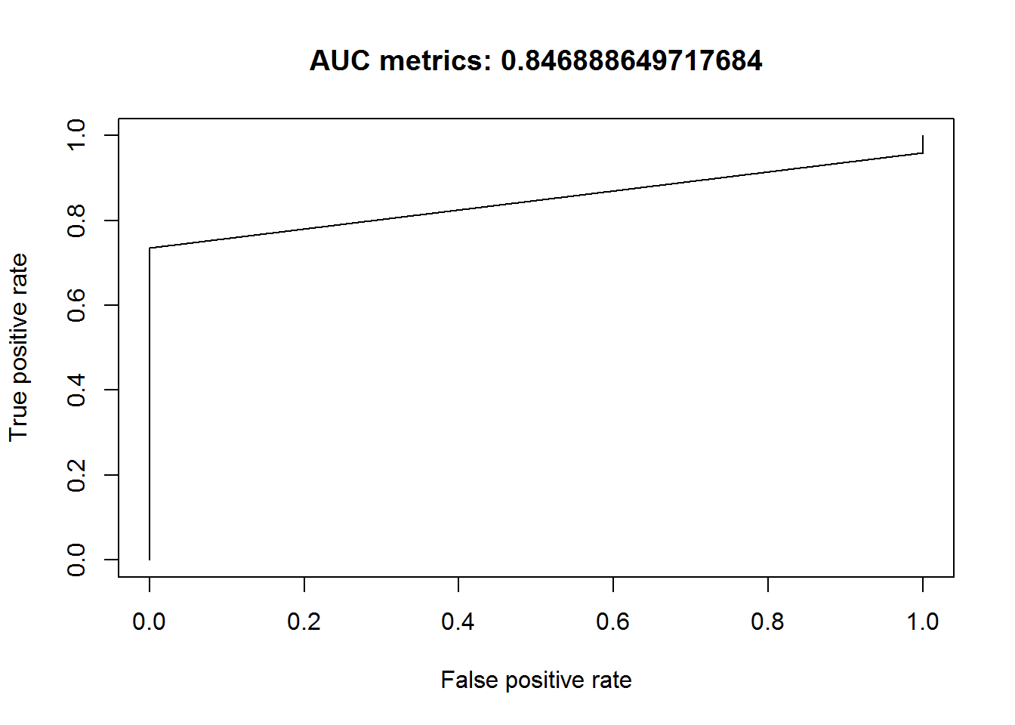
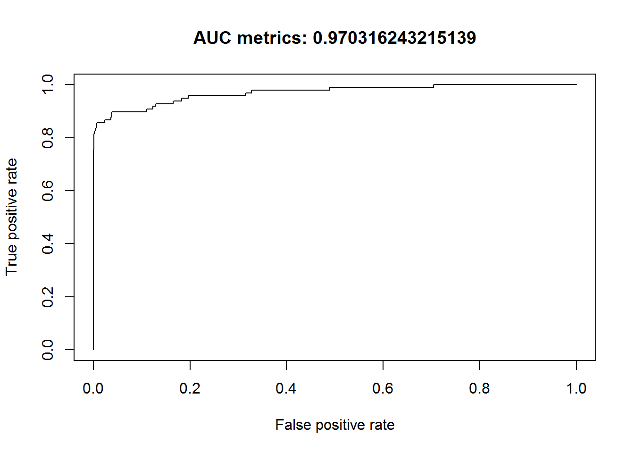
Key Points
Comparing Logical regression and Decision Tree models
Decision Tree
Logical Regression

Slide 8
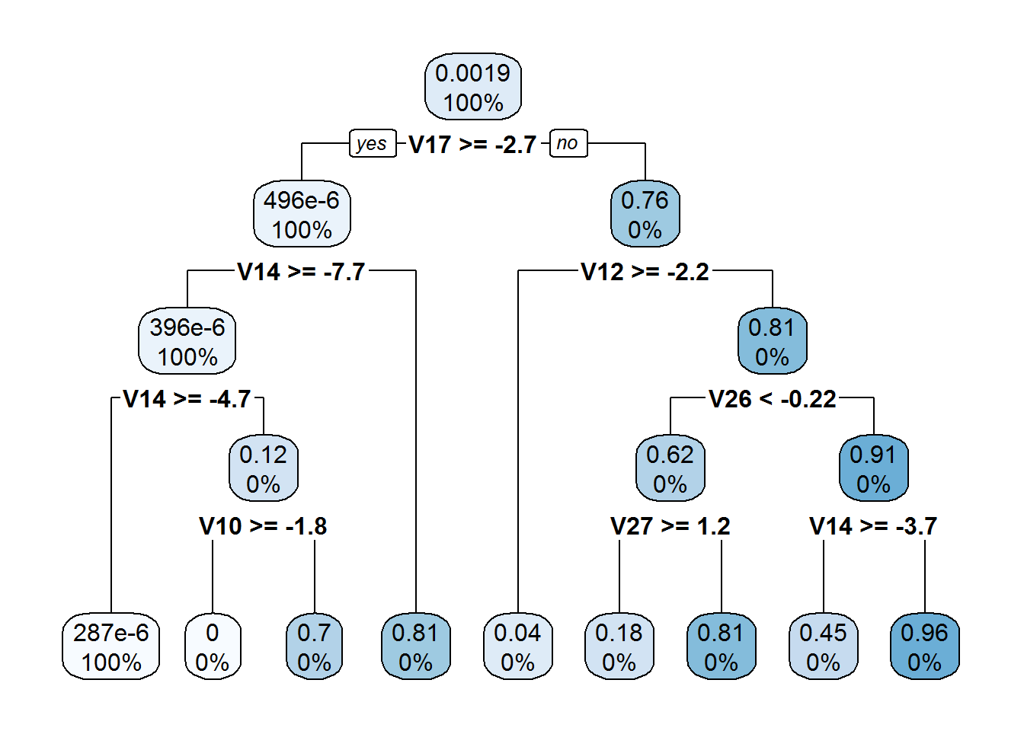
Model Details
Example of Key Points Using Yoyodyne Scenario
Decision tree always set V17 and V14 as highly important features. Most of trees have descision in root comparing V17 and V14.
Regression model state the V14 and V22 has
greatest impact on transaction to be fraud
one as at average they had greatest
coefficients.

Slide 9
Recommendations
Implement the model as a pilot, before more wide-scale rollout – test and learn from initial pilot on performance and precision.
  As soon as simple model was used, it maybe necessary to builder more complex one above simple and fast to get higher score.
Best option for improving model would be balancing the data set – it can be useful to collect data over greater period of time then 2 day. It might be not all the transactions, but it should be as balance as possible.

