Slide 1
Final Presentation for Project Sponsors
EMC Education Services
Data Science & Big Data Analytics
Credit card fraud
Vitaly Kirichenko
18.01.2017
Notes:
EMC Ed Services CA and DCA Launch Master V8

Slide 2
Project Goals
Investigate transactions dataset in order to improve credit card fraud detection.

Slide 3
Situation & Project Goals
Situation
There can be millions of money transactions in average bank. However, this huge dataset is unmanageable to check for fraud aspect.
It is great point start up developing effective tool in order to at least filter significant part of transactions to detect illegal actions.
In long term run this instrument may help to detect and effectively react to a lot of illegal money transactions
Goals our project
To set up effective model which is as effective as it can be in order to detect as much fraud transactions as possible.

Slide 4
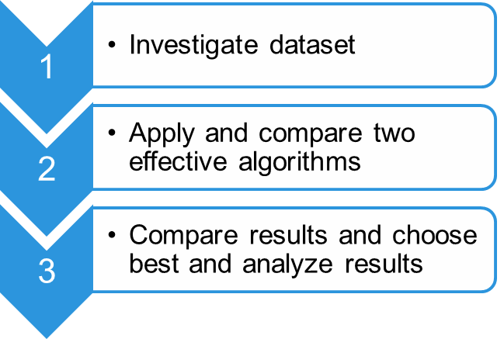
Executive Summary
Research credit card transactions for aspect of fraud.
Find effective and precision enough algorithm.
  Decision Tree
  Logical Regression

Slide 5
Approach
Example for Sponsors, using Yoyodyne scenario
During period in a past a lot of transaction information were collected.
Bank workers decided to share dataset on Kaggle platform in order to find effective solution.
Develop simple model to investigate most important features and most effective models.
  Testing out Decision Tree
  Testing out Logistical Regression
Made available visualization of results in order to choose one most precision.
Create a basis for more precision and sophisticated models.

Slide 6
Model Description
Overview of Basic Methodology: predict the likelihood of fraud transactions. Divide basic dataset into training and testing one. Calculate the model for training data and then investigate her performance on test one.
Model: Logistic regression model
Dependent variable: Binary variable Class
Scope:
  The datasets contains transactions made by credit cards in September 2013 by european cardholders. This dataset present transactions that occurred in two days, where we have 492 frauds out of 284,807 transactions
  Training sample: 210 000 transactions
  Testing sample: 74,807 subscribers
The model developed has predictive power at least 95% AUC score.

Slide 7
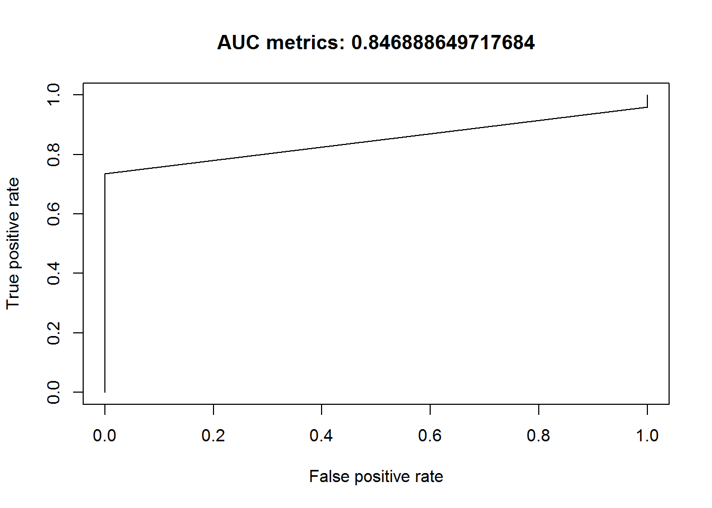
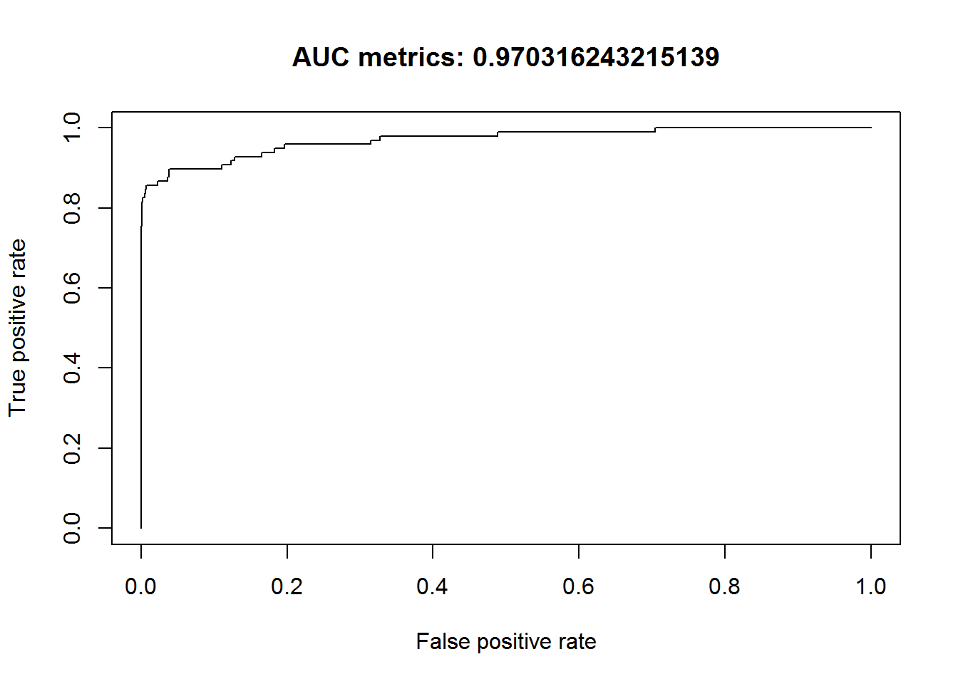
Key Points
Comparing two models results.
Decision Tree
Logical Regression

Slide 8
Recommendations
Implement the model as a pilot, before more wide-scale rollout – test and learn from initial pilot on performance and precision.
  As soon as simple model was used, it maybe necessary to builder more complex one above simple and fast to get higher score.
Best option for improving model would be balancing the data set – it can be useful to collect data over greater period of time then 2 day. It might be not all the transactions, but it should be as balance as possible.

