Slide 1
Philadelphia’s Favorite Cuisine According to Sentiment of Yelp User Reviews
Group 15
Leader: Aidan Wiktorowicz; Members: Rishi Raghavan, Ananya Goel
DS 4002 – Spring 2024

Slide 2
Project Overview
Goal:
Explore Philadelphia's favorite cuisine based on the sentiment of Yelp user reviews.
Motivation:
Explore differences in user review sentiment across cuisines to inform restaurant owners about Philadelphia’s preferences.
Hypothesis:
The compound sentiment score of Yelp restaurant user reviews will have a statistically significant difference across cuisines.
Research Question:
Which cuisine in Philadelphia has the greatest proportion of positive to negative Yelp user reviews and how does this compare to Yelp’s numeric ratings?
Modeling Approach:
Utilize the VADER Package to determine average sentiment of user reviews by cuisine; Run an ANOVA test for statistical significance.

Slide 3
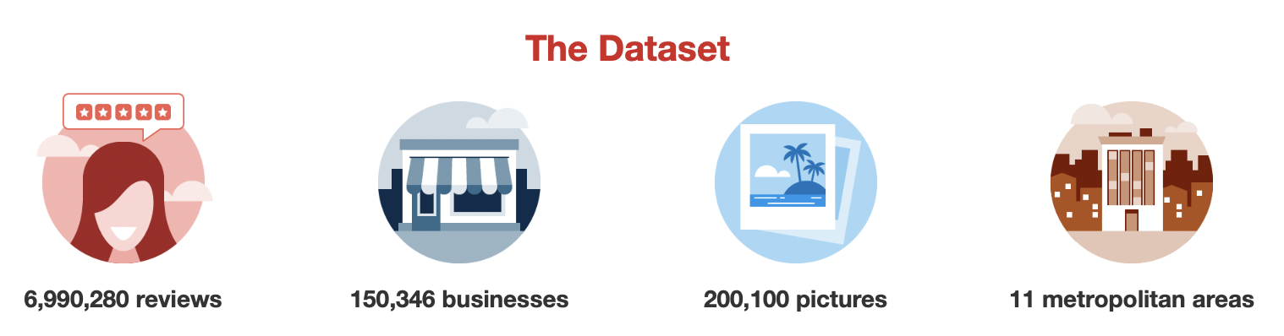
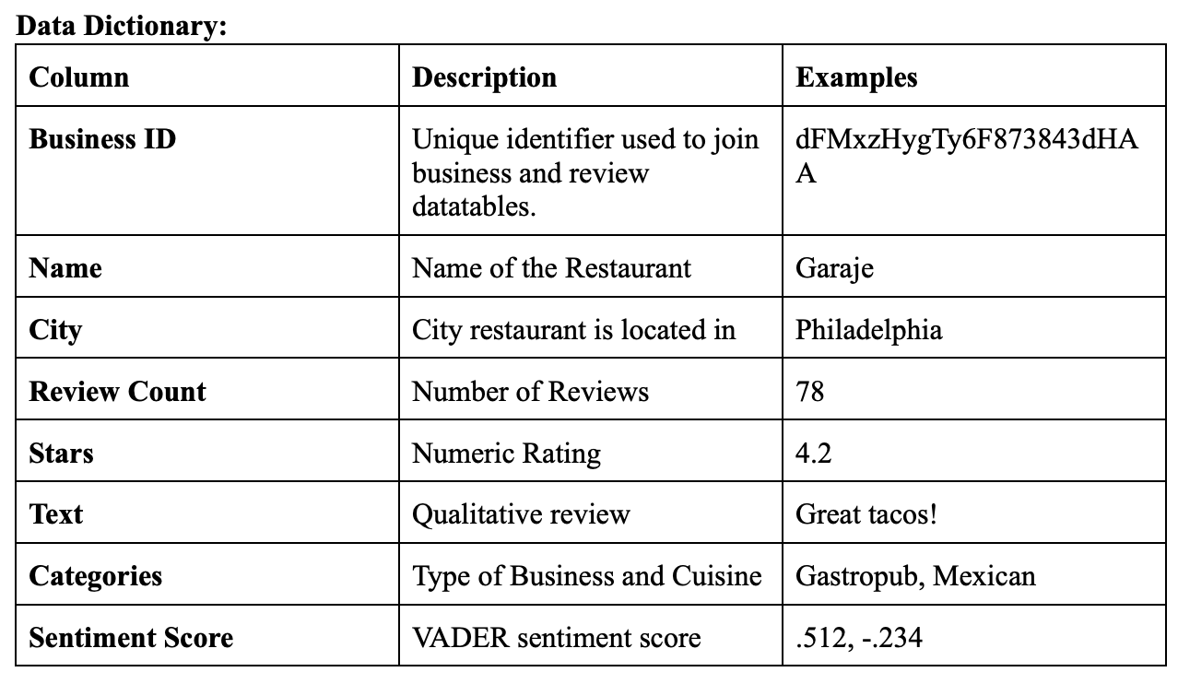
Data Acquisition and Explanation
Source:
Yelp Dataset (published by Yelp for academic use)
Type:
Text, Metadata, and Numeric Data
Size:
9 GB+, 6.9 million reviews
Data Filtering:
Combined multiple JSON tables on Business ID after filtering for relevant columns and restaurants in Philadelphia

Slide 4

Analysis Plan and Justification
After initial cleaning, we tried to understand our data better by conducting EDA and ran into some problems
After solving these problems we ran our sentiment analysis and calculated mean sentiment score for each cuisine
We then ran an ANOVA test to see if these mean scores were statistically different

Slide 5
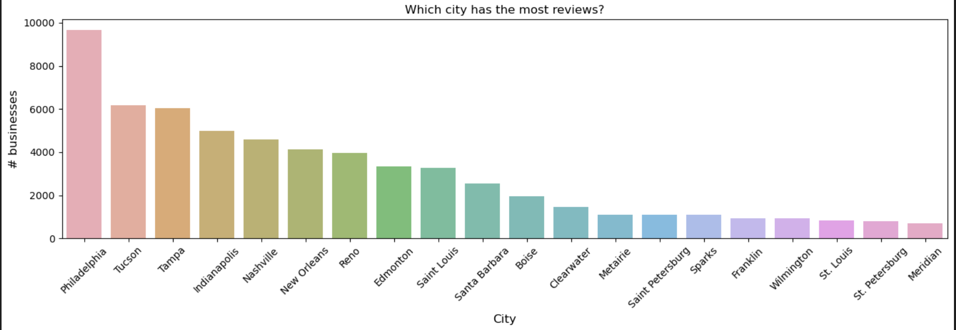
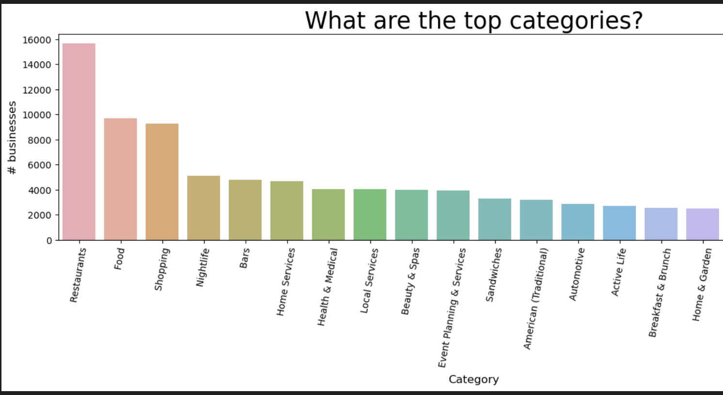
Tricky Analysis Decision
Upon initial EDA we noticed that our dataset had the most restaurants in Philadelphia so we chose to focus on that city (instead of NYC)
The dataset also included categories other than restaurants so we filtered out our data for just restaurants
Lastly, we had to separate the various cuisines in the categories column, which was tricky

Slide 6
Bias and Uncertainty Validation
Our dataset may be biased as we are only using data from one city and the number of restaurants+reviews of each cuisine are not equal.
Our data is likely only useful for Philadelphia as different cities have different populations with unique preferences.
Additionally, Yelp data presents selection bias, as individuals who choose to leave reviews are likely those driven by a positive or negative experience.

Slide 7
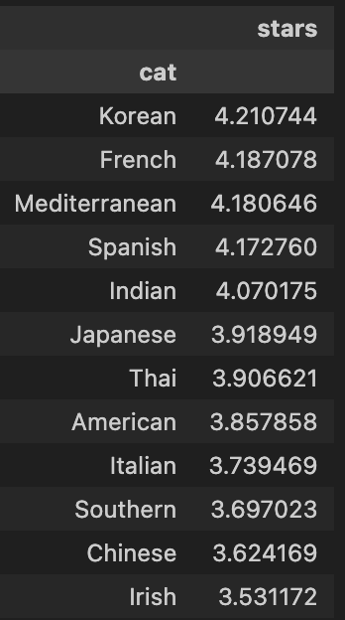
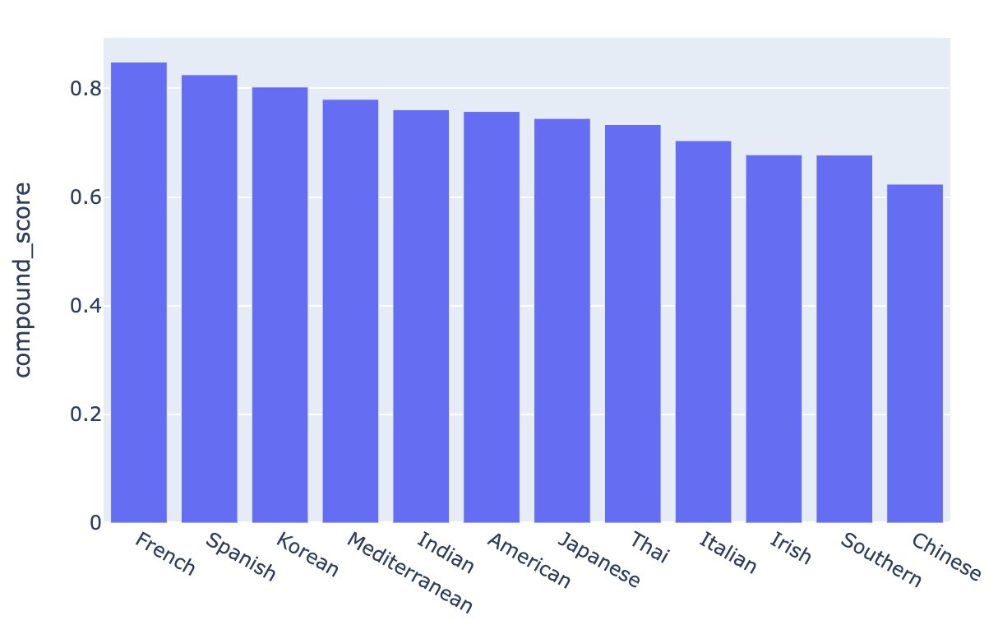

Results and Conclusions
French, Spanish, and Korean cuisine ranked highest by sentiment score.
Sentiment scores and numeric Yelp star rating exhibit a strong, albeit imperfect, correlation.
ANOVA test shows means to be statistically different
Mean Sentiment Score by Cuisine

Slide 8
Next Steps
Expanded Sampling:
Additional analysis could be done to look into consumer preferences/reviews in additional cities. We could do analysis into the impact of demographics on review patterns.
New Questions:
We could use advanced sentiment analysis to determine the key drivers of negative and positive reviews. This may help restaurants prioritize decisions in order to maximize customer satisfaction and positive reviews.

Slide 9
References
[1]“Loading Yelp json Data and Visualization,” kaggle.com. https://www.kaggle.com/code/ravijoe/loading-yelp-json-data-and-visualization/notebook (accessed Feb. 13, 2024).
[2]“Sentiment Analysis of the Yelp Reviews Data,” kaggle.com. https://www.kaggle.com/code/suzanaiacob/sentiment-analysis-of-the-yelp-reviews-data (accessed Feb. 13, 2024).
[3]“Yelp Dataset,” www.yelp.com. https://www.yelp.com/dataset/documentation/main (accessed Feb. 01, 2024).

Slide 10
Questions?

Slide 11
Appendix

Slide 12
Yelp Dataset Designed for Analysis – Significant in Scale+Scope.

Slide 13
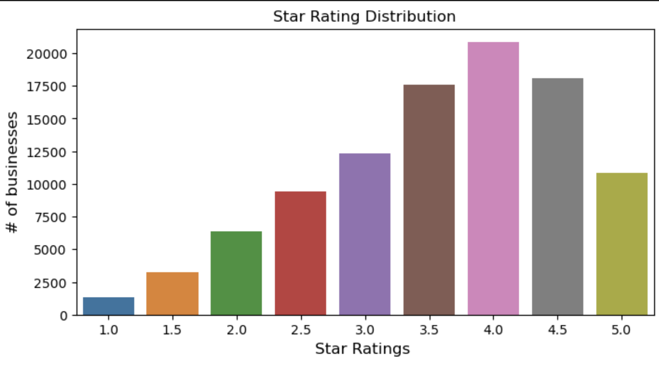
Star Rating distribution across all cuisines.

Slide 14

Philadelphia Has Greatest Number of Businesses in Dataset.
Number of Businesses by City

Slide 15

Restaurants + Food Comprise Majority of Reviews.
Number of Businesses by Function

Slide 16
Mean Compound Sentiment Score by Cuisine.

Slide 17
Mean Star Rating by Cuisine.

