Slide 1
JEOPARDY

Slide 2
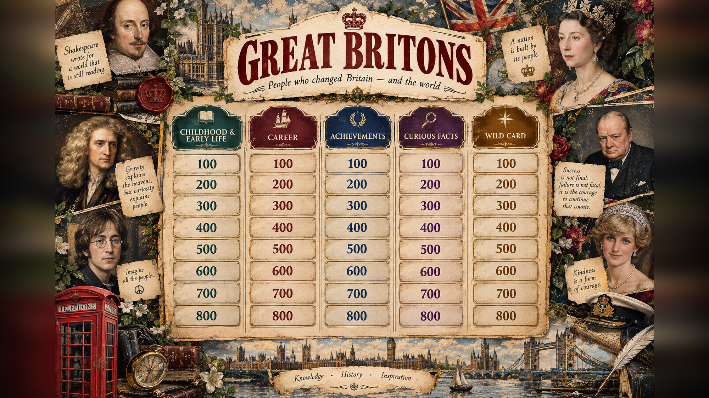

Slide 3
CHILDHOOD & EARLY LIFE • 100 POINTS
Who was born in Liverpool in 1940?
SHOW ANSWER
← BACK TO BOARD

Slide 4
ANSWER • Childhood & Early Life • 100
John Lennon.
← BACK TO BOARD

Slide 5
CHILDHOOD & EARLY LIFE • 200 POINTS
Who was born in England on 29 September 1758?
SHOW ANSWER
← BACK TO BOARD

Slide 6
ANSWER • Childhood & Early Life • 200
Horatio Nelson.
← BACK TO BOARD

Slide 7
CHILDHOOD & EARLY LIFE • 300 POINTS
Who was raised by a strict aunt called Mimi?
SHOW ANSWER
← BACK TO BOARD

Slide 8
ANSWER • Childhood & Early Life • 300
John Lennon.
← BACK TO BOARD

Slide 9
CHILDHOOD & EARLY LIFE • 400 POINTS
Who was left with a grandmother as a small child?
SHOW ANSWER
← BACK TO BOARD

Slide 10
ANSWER • Childhood & Early Life • 400
Isaac Newton.
← BACK TO BOARD

Slide 11
CHILDHOOD & EARLY LIFE • 500 POINTS
Who was a quiet and shy child and liked dancing and music?
SHOW ANSWER
← BACK TO BOARD

Slide 12
ANSWER • Childhood & Early Life • 500
Diana Spencer.
← BACK TO BOARD

Slide 13
CHILDHOOD & EARLY LIFE • 600 POINTS
What did John Lennon get from his mother when he was 15?
SHOW ANSWER
← BACK TO BOARD

Slide 14
ANSWER • Childhood & Early Life • 600
His first guitar.
← BACK TO BOARD

Slide 15
CHILDHOOD & EARLY LIFE • 700 POINTS
What did Newton's grandmother want him to become?
SHOW ANSWER
← BACK TO BOARD

Slide 16
ANSWER • Childhood & Early Life • 700
A farmer.
← BACK TO BOARD

Slide 17
CHILDHOOD & EARLY LIFE • 800 POINTS
Where did Newton live when he was 12 and discovered a library?
SHOW ANSWER
← BACK TO BOARD

Slide 18
ANSWER • Childhood & Early Life • 800
At the house of a pharmacist, Mr. Clark.
← BACK TO BOARD

Slide 19
CAREER • 100 POINTS
What was Nelson's job?
SHOW ANSWER
← BACK TO BOARD

Slide 20
ANSWER • Career • 100
He was a naval officer / sailor.
← BACK TO BOARD

Slide 21
CAREER • 200 POINTS
What band did John Lennon help create?
SHOW ANSWER
← BACK TO BOARD

Slide 22
ANSWER • Career • 200
The Beatles.
← BACK TO BOARD

Slide 23
CAREER • 300 POINTS
What did Diana do before becoming a princess?
SHOW ANSWER
← BACK TO BOARD

Slide 24
ANSWER • Career • 300
She worked with children.
← BACK TO BOARD

Slide 25
CAREER • 400 POINTS
When did Nelson join the Royal Navy?
SHOW ANSWER
← BACK TO BOARD

Slide 26
ANSWER • Career • 400
When he was 12.
← BACK TO BOARD

Slide 27
CAREER • 500 POINTS
What did John Lennon do after The Beatles broke up?
SHOW ANSWER
← BACK TO BOARD

Slide 28
ANSWER • Career • 500
He started a solo career.
← BACK TO BOARD

Slide 29
CAREER • 600 POINTS
What did Queen Elizabeth love very much?
SHOW ANSWER
← BACK TO BOARD

Slide 30
ANSWER • Career • 600
The theatre.
← BACK TO BOARD

Slide 31
CAREER • 700 POINTS
What did Newton do at Cambridge to pay for his studies?
SHOW ANSWER
← BACK TO BOARD

Slide 32
ANSWER • Career • 700
He worked as a servant.
← BACK TO BOARD

Slide 33
CAREER • 800 POINTS
What did Diana use her fame for?
SHOW ANSWER
← BACK TO BOARD

Slide 34
ANSWER • Career • 800
To help people and talk about important problems.
← BACK TO BOARD

Slide 35
ACHIEVEMENTS • 100 POINTS
Who discovered gravity?
SHOW ANSWER
← BACK TO BOARD

Slide 36
ANSWER • Achievements • 100
Isaac Newton.
← BACK TO BOARD

Slide 37
ACHIEVEMENTS • 200 POINTS
Who wrote and recorded the song Imagine?
SHOW ANSWER
← BACK TO BOARD

Slide 38
ANSWER • Achievements • 200
John Lennon.
← BACK TO BOARD

Slide 39
ACHIEVEMENTS • 300 POINTS
Who became a national hero in Britain?
SHOW ANSWER
← BACK TO BOARD

Slide 40
ANSWER • Achievements • 300
Horatio Nelson.
← BACK TO BOARD

Slide 41
ACHIEVEMENTS • 400 POINTS
What did Nelson do at the Battle of the Nile?
SHOW ANSWER
← BACK TO BOARD

Slide 42
ANSWER • Achievements • 400
He defeated a large French fleet.
← BACK TO BOARD

Slide 43
ACHIEVEMENTS • 500 POINTS
What did Newton prove about white light?
SHOW ANSWER
← BACK TO BOARD

Slide 44
ANSWER • Achievements • 500
White light is a combination of all colours.
← BACK TO BOARD

Slide 45
ACHIEVEMENTS • 600 POINTS
What did Newton create to explain how objects move?
SHOW ANSWER
← BACK TO BOARD

Slide 46
ANSWER • Achievements • 600
Three laws of motion.
← BACK TO BOARD

Slide 47
ACHIEVEMENTS • 700 POINTS
What important work did Diana do for people with serious problems?
SHOW ANSWER
← BACK TO BOARD

Slide 48
ANSWER • Achievements • 700
She did charity work and helped people in need.
← BACK TO BOARD

Slide 49
ACHIEVEMENTS • 800 POINTS
What famous monument in London remembers Nelson?
SHOW ANSWER
← BACK TO BOARD

Slide 50
ANSWER • Achievements • 800
Nelson's Column in Trafalgar Square.
← BACK TO BOARD

Slide 51
CURIOUS FACTS • 100 POINTS
Who lost an arm in a battle?
SHOW ANSWER
← BACK TO BOARD

Slide 52
ANSWER • Curious Facts • 100
Horatio Nelson.
← BACK TO BOARD

Slide 53
CURIOUS FACTS • 200 POINTS
Who wore a big orange wig?
SHOW ANSWER
← BACK TO BOARD

Slide 54
ANSWER • Curious Facts • 200
Queen Elizabeth I.
← BACK TO BOARD

Slide 55
CURIOUS FACTS • 300 POINTS
What happened to Newton's pigs?
SHOW ANSWER
← BACK TO BOARD

Slide 56
ANSWER • Curious Facts • 300
They escaped and destroyed the crops.
← BACK TO BOARD

Slide 57
CURIOUS FACTS • 400 POINTS
What unusual thing did Newton see in a garden?
SHOW ANSWER
← BACK TO BOARD

Slide 58
ANSWER • Curious Facts • 400
An apple falling from a tree.
← BACK TO BOARD

Slide 59
CURIOUS FACTS • 500 POINTS
Who said that The Beatles were more popular than Jesus?
SHOW ANSWER
← BACK TO BOARD

Slide 60
ANSWER • Curious Facts • 500
John Lennon.
← BACK TO BOARD

Slide 61
CURIOUS FACTS • 600 POINTS
What was special about Sean Lennon's birthday?
SHOW ANSWER
← BACK TO BOARD

Slide 62
ANSWER • Curious Facts • 600
He was born on John's birthday.
← BACK TO BOARD

Slide 63
CURIOUS FACTS • 700 POINTS
Why did Queen Elizabeth wear thick white make-up?
SHOW ANSWER
← BACK TO BOARD

Slide 64
ANSWER • Curious Facts • 700
To hide marks from smallpox.
← BACK TO BOARD

Slide 65
CURIOUS FACTS • 800 POINTS
What did Newton keep on the roof of his house?
SHOW ANSWER
← BACK TO BOARD

Slide 66
ANSWER • Curious Facts • 800
A telescope.
← BACK TO BOARD

Slide 67
WILD CARD • 100 POINTS
Which person was a queen?
SHOW ANSWER
← BACK TO BOARD

Slide 68
ANSWER • Wild Card • 100
Elizabeth I.
← BACK TO BOARD

Slide 69
WILD CARD • 200 POINTS
Who was killed in a car accident?
SHOW ANSWER
← BACK TO BOARD

Slide 70
ANSWER • Wild Card • 200
Diana Spencer.
← BACK TO BOARD

Slide 71
WILD CARD • 300 POINTS
Who died on a ship?
SHOW ANSWER
← BACK TO BOARD

Slide 72
ANSWER • Wild Card • 300
Horatio Nelson.
← BACK TO BOARD

Slide 73
WILD CARD • 400 POINTS
Who became famous for helping people through charity work?
SHOW ANSWER
← BACK TO BOARD

Slide 74
ANSWER • Wild Card • 400
Diana Spencer.
← BACK TO BOARD

Slide 75
WILD CARD • 500 POINTS
Who fought against war?
SHOW ANSWER
← BACK TO BOARD

Slide 76
ANSWER • Wild Card • 500
John Lennon.
← BACK TO BOARD

Slide 77
WILD CARD • 600 POINTS
Put these in order from oldest to youngest: Diana, Newton, Lennon, Nelson, Elizabeth.
SHOW ANSWER
← BACK TO BOARD

Slide 78
ANSWER • Wild Card • 600
Elizabeth I → Newton → Nelson → Lennon → Diana.
← BACK TO BOARD

Slide 79
WILD CARD • 700 POINTS
Which person had a son with the same birthday?
SHOW ANSWER
← BACK TO BOARD

Slide 80
ANSWER • Wild Card • 700
John Lennon.
← BACK TO BOARD

Slide 81
WILD CARD • 800 POINTS
Which person continued working after losing an eye and an arm?
SHOW ANSWER
← BACK TO BOARD

Slide 82
ANSWER • Wild Card • 800
Horatio Nelson.
← BACK TO BOARD

Slide 83
FINAL JEOPARDY
Which person showed the most courage? Give one reason from the text.
No single correct answer!
← BACK TO BOARD

Slide 84
TEACHER NOTES
• Students choose a category and points. • 100–500: answer without the texts. • 600–800: allow students to check the texts. • Give 30 seconds for harder questions. • Final Jeopardy: students must explain their choice. • Award 100–800 points for correct answers.

