Slide 1
Phylogenetic Analysis of the Spirochetes

Slide 2
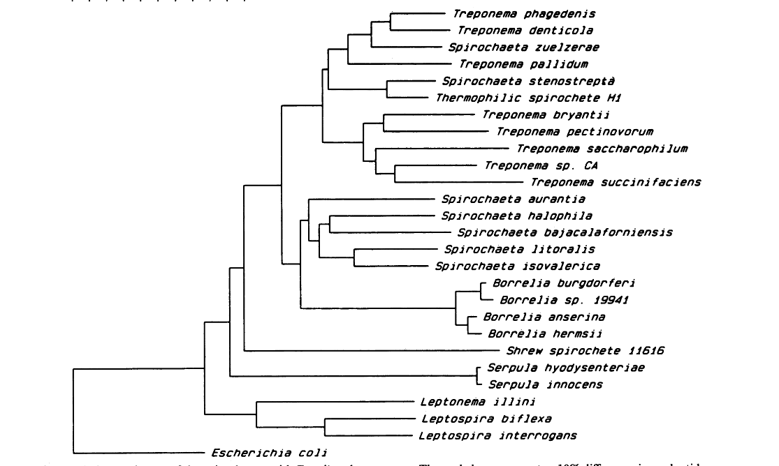


Slide 3
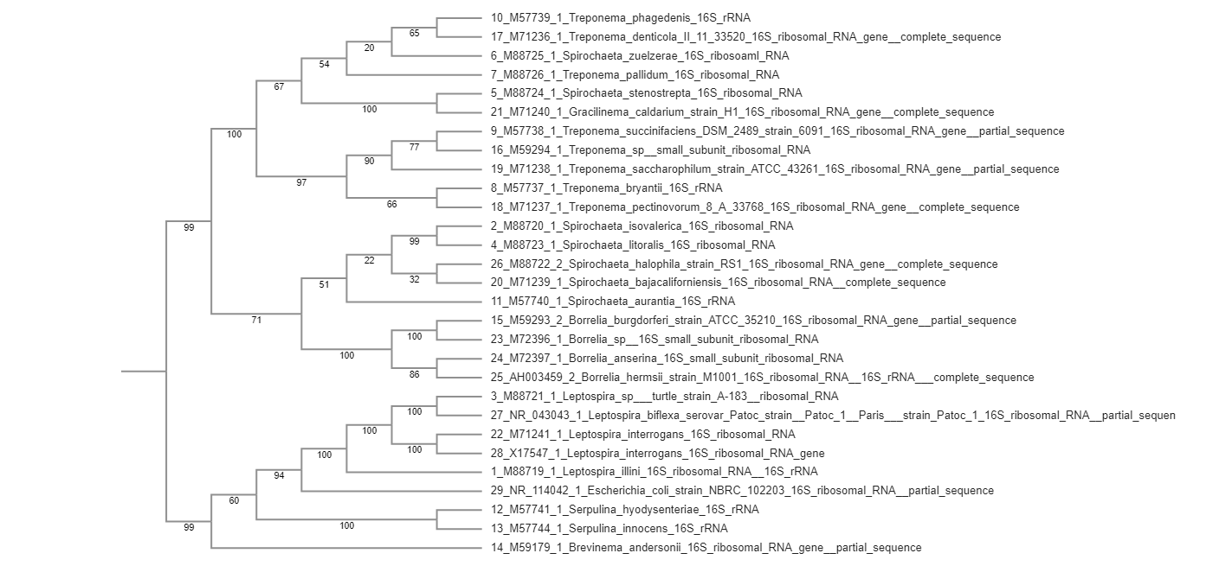

MAFT

Slide 4
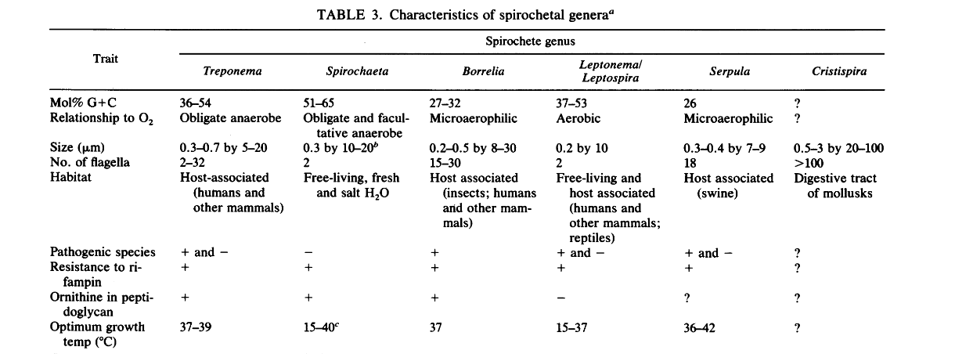

Slide 5
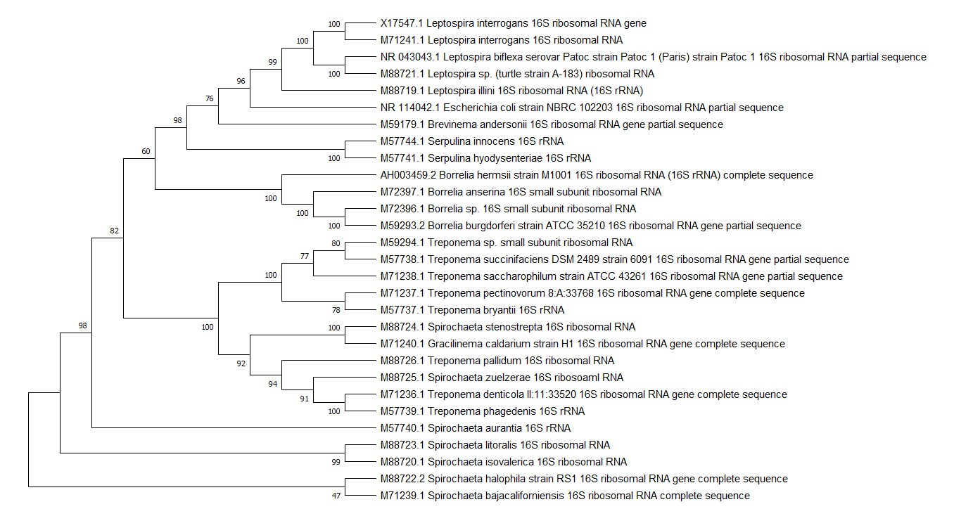
Mega

Slide 6
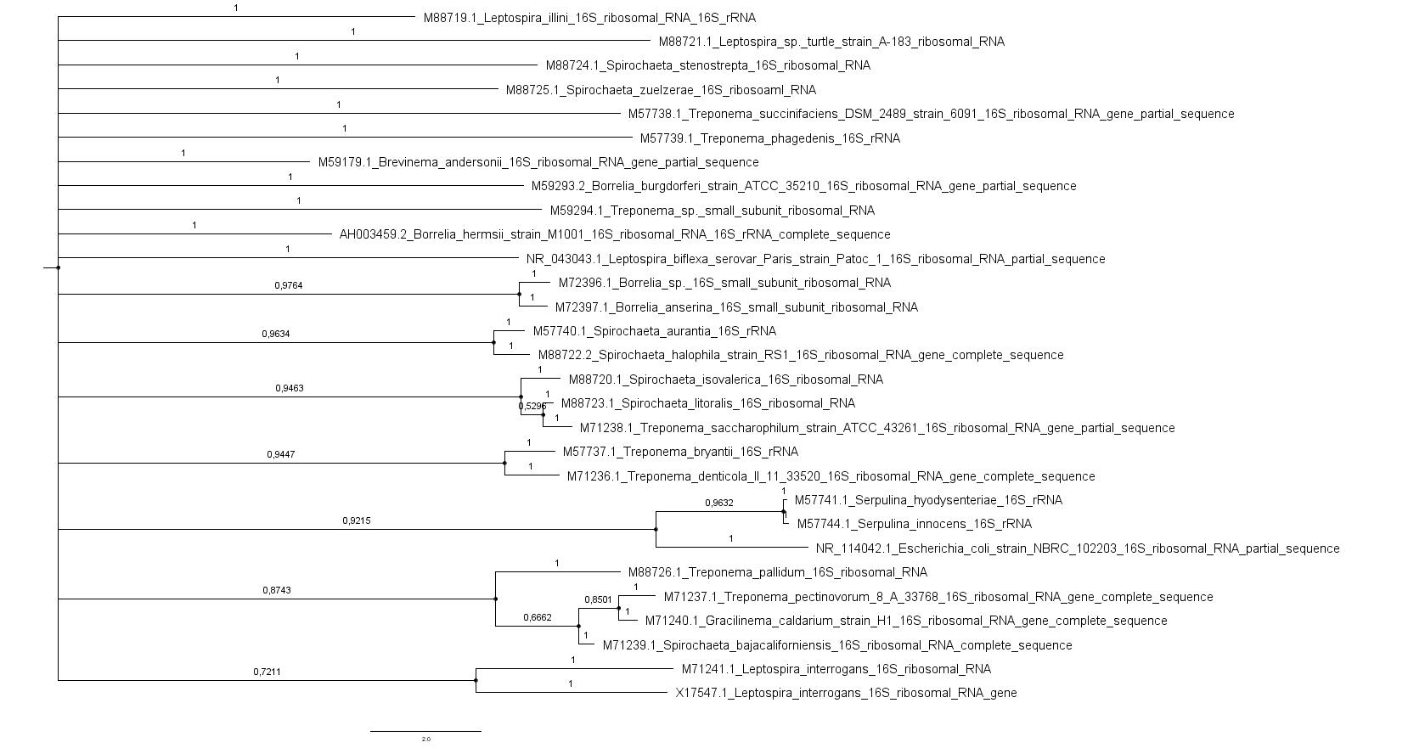
MrBayes

Slide 7
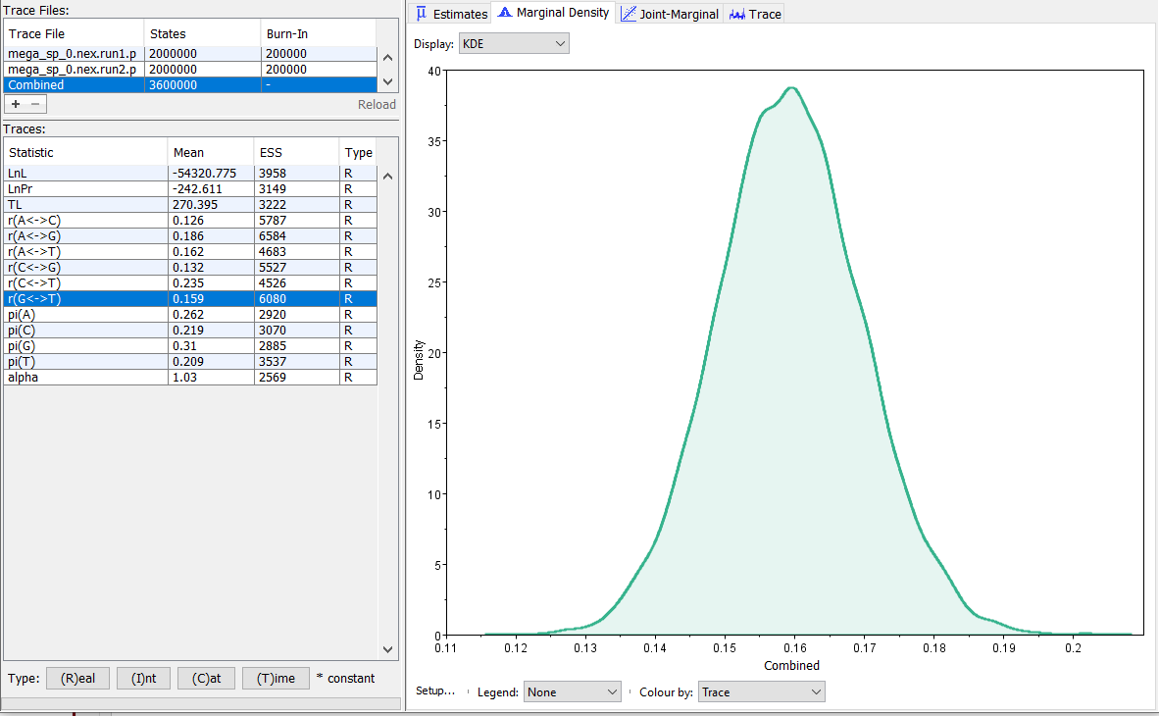
lset nst=6 rates=gamma;
mcmc ngen=2000000
samplefreq=100 printfreq=1000
burninfrac=0.25 nchains=4;

