Slide 1
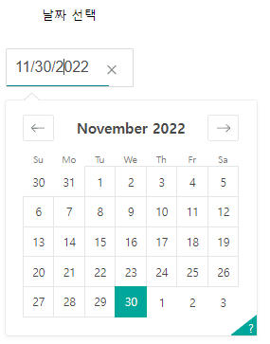
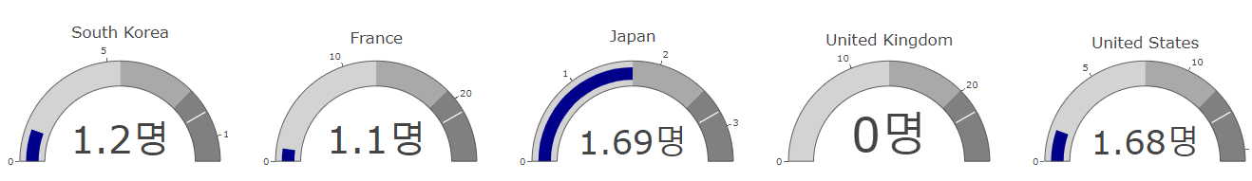
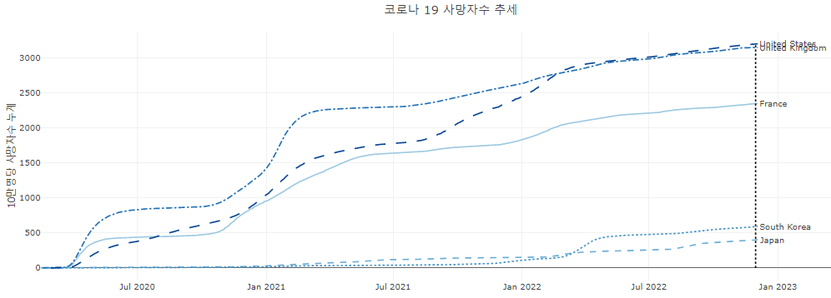
layout
callback
id = 'picker'
Input('picker‘, ‘date’)
def update_output(date_value):
….
….
Output(component_id = 'indicator_kor', component_property = 'figure'),
Output(component_id = 'indicator_fra', component_property = 'figure'),
Output(component_id = 'indicator_jpn', component_property = 'figure'),
Output(component_id = 'indicator_gbr', component_property = 'figure'),
Output(component_id = 'indicator_usa', component_property = 'figure'),
Output(component_id = 'line_5_nations', component_property = 'figure'),

