Slide 1
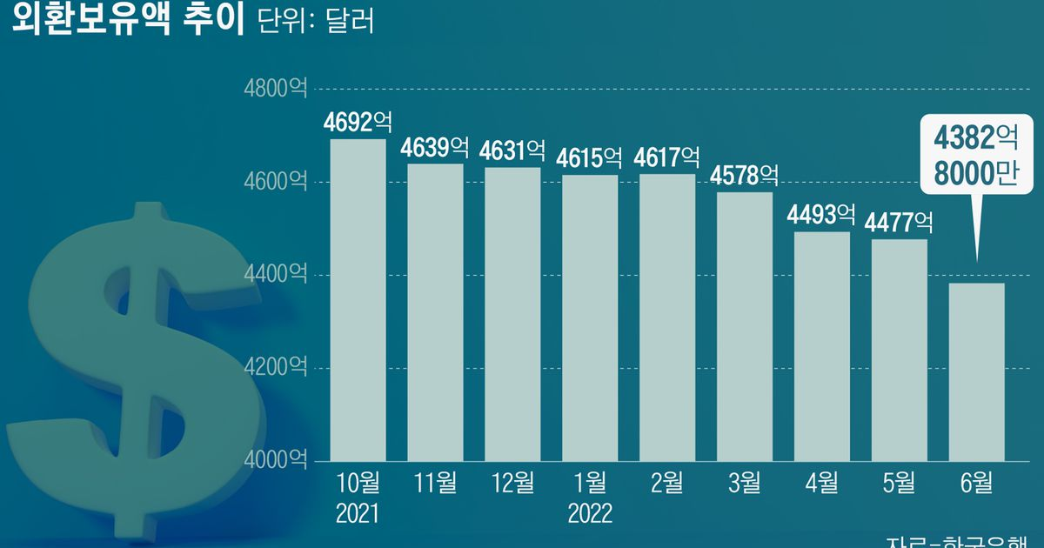
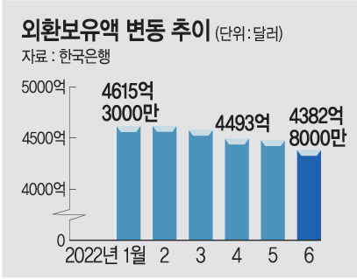
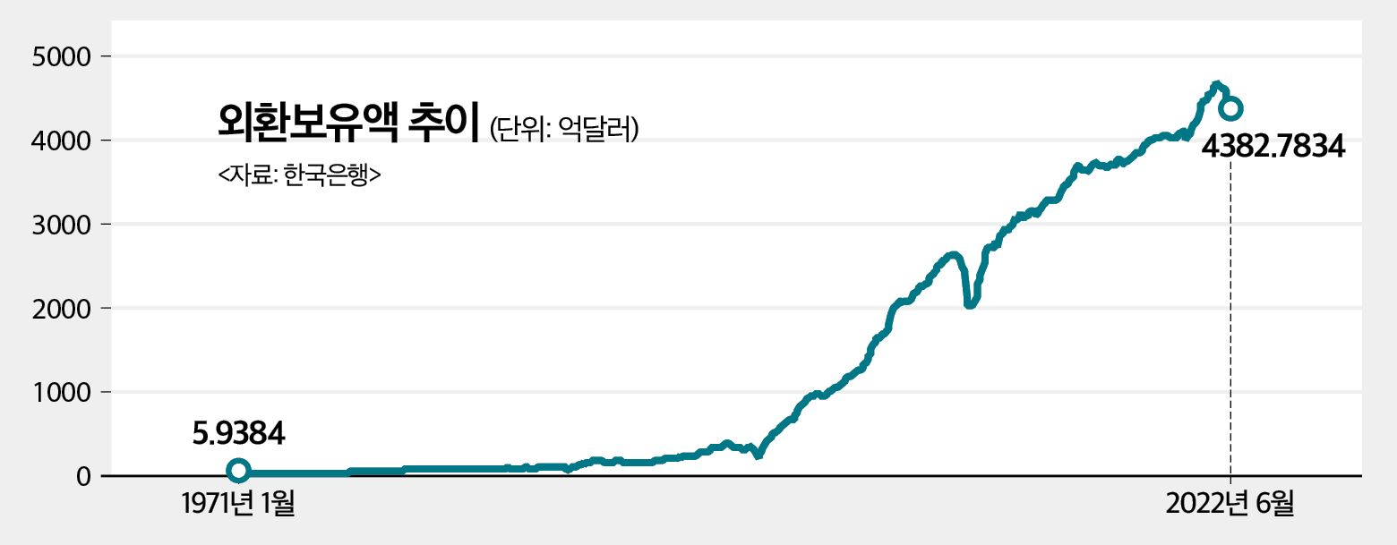
https://biz.chosun.com/policy/policy_sub/2022/07/05/FM22H2FP6NBJNDDJB5GTICAOWE/
http://www.munhwa.com/news/view.html?no=2022070501031609317001
https://www.newstomato.com/readNews.aspx?no=1133988

Slide 2
140
95

Slide 3
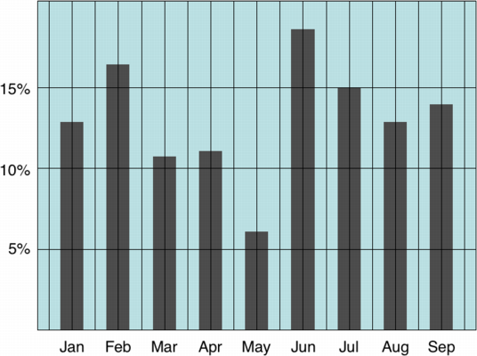
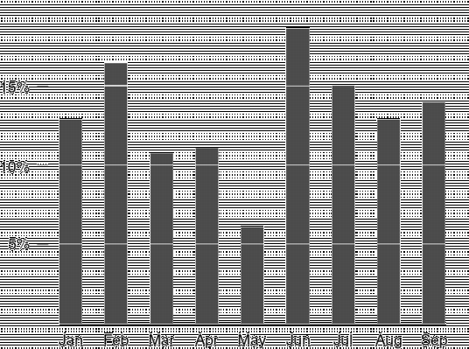
Low data ink
High data ink

Slide 4




녹색맹
적색맹
청색맹
흑백

