Slide 1
rolling(3)
expanding(3)
1960-12-31 | 1027.469
1961-12-31 | 1066.611
1962-12-31 | 1076.921
1963-12-31 | 1141.821
1964-12-31 | 1217.726
…
2016-12-31 | 29461.78
2017-12-31 | 30307.4
2018-12-31 | 31053.64
2019-12-31 | 31640.21
2020-12-31 | 31372.47

Slide 2
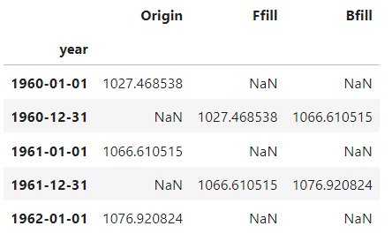

Slide 3
Upsampling
Downsampling
…
…
…
…
…

