Slide 1
R programming in a regulated environment
Bella Feng
OCRUG 4/27/2017

Slide 2
Agenda
Why?
What?
How?

Slide 3
Why?
#5 Top Programming Language ranked by IEEE
Powerful at data visualization
Talent pool for R programmers are young and growing
Many industries start moving away from SAS
FDA data reviewers use R on a daily basis
Many biostatisticians use R
Notes:
The point of exercise is to show there are many ways doing the same thing, esp. with an open source programming language like R.

Slide 4
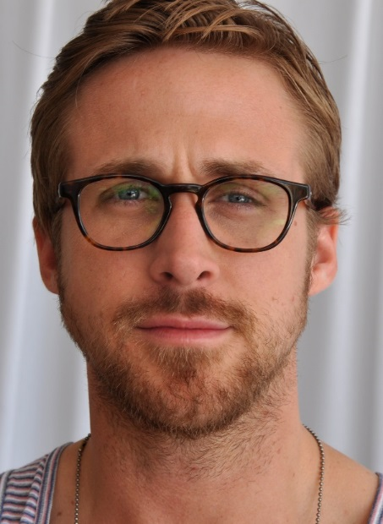

Problems Identified:
SAS
SAS
SAS
SAS
SAS
SAS
RRRRRR
Statistician
Statistical Programmer

Slide 5
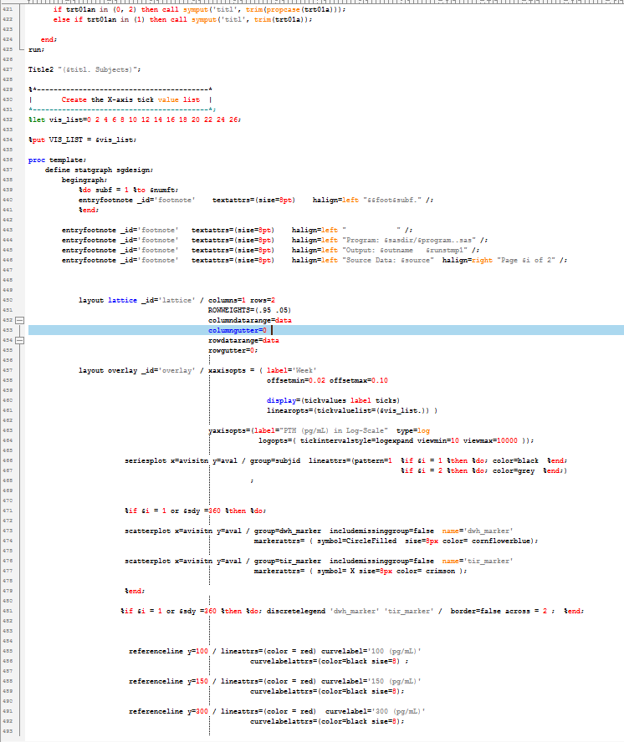
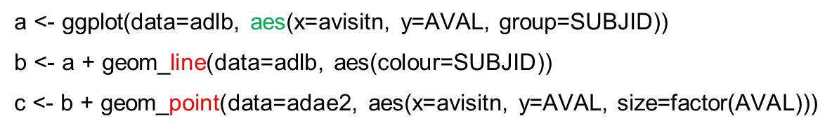
500 lines of SAS code
3 lines of R code
Notes:
The grammar of graphics is based on the insight that you can uniquely describe any plot as a combination of—you guessed it: a data set, a geom, a set of mappings, a stat, a position adjustment, a coordinate system, and a faceting scheme.

Slide 6
A brainstorming exercise:
Brainstorm as many ways as possible to select dep_time, dep_delay, arr_time, and arr_delay from flights.
mydata <- flights[c("dep_time", "arr_time", "dep_delay", "arr_delay")]
myvars <- c(“dep_time”, “dep_delay”, “arr_time”, “arr_delay”)
newdata <- flights[myvars]
select(flights, dep_time, dep_delay, arr_time, arr_delay)
select(flights, starts_with("dep_"), starts_with("arr_"))
select(flights, matches("^(dep|arr)_(time|delay)$"))

Slide 7
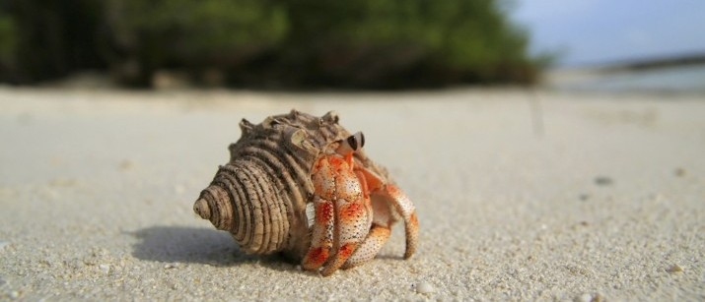
Close Source SAS

Slide 8

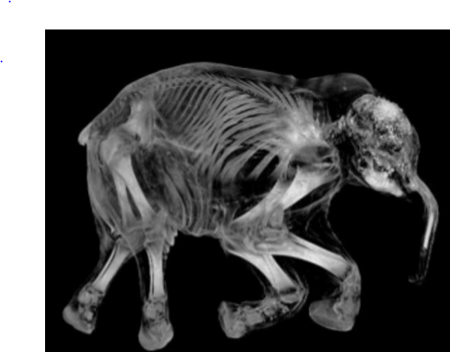
Open source: R

Slide 9
Paradox of R
Double-edge sword for R in a regulatory environment
powerful, flexible
but no consensus, too “open”!

Slide 10
In a regulatory environment, R means:
Regulated
Reproducibility
Readability

Slide 11
Regulated
FDA does not require use of any specific software for statistical analyses, and statistical software is not explicitly discussed in Title 21 of the Code of Federal Regulations.
However, the software package(s) used for statistical analyses should be fully documented in the submission, including version and build identification.
The computer software used for data management and statistical analysis should be reliable, and documentation of appropriate software testing procedures should be available.

Slide 12
Challenges
Working with IS on a validation framework for R
CRAN (external packages)
AMGEN modified package
Amgen internal package
No need for the IQ/PQ/PQ for SAS

Slide 13
Reproducibility
To show evidence of the correctness of our results
To enable others to make use of our methods and results
To enable FDA to reproduce our results(if they choose to)

Slide 14
Readability
Other people will thank you
Easy collaboration
Easy to carry forward
Credibility of your work
Your future self will thank you
Well organized project is easy to come back

Slide 15
R Script
R script for a particular graph
Similar to a single SAS program
1 program creates 1 or more outputs
Very specific requirements from publishing

Slide 16
Graph requirement
Emf embedded rtf file (examples)
Caption style for the title
devEMF
RTF(modified addPNG->addEMF)

Slide 17
R script
Header
SAS header
R snippet(demo)
Dependency packages?

Slide 18
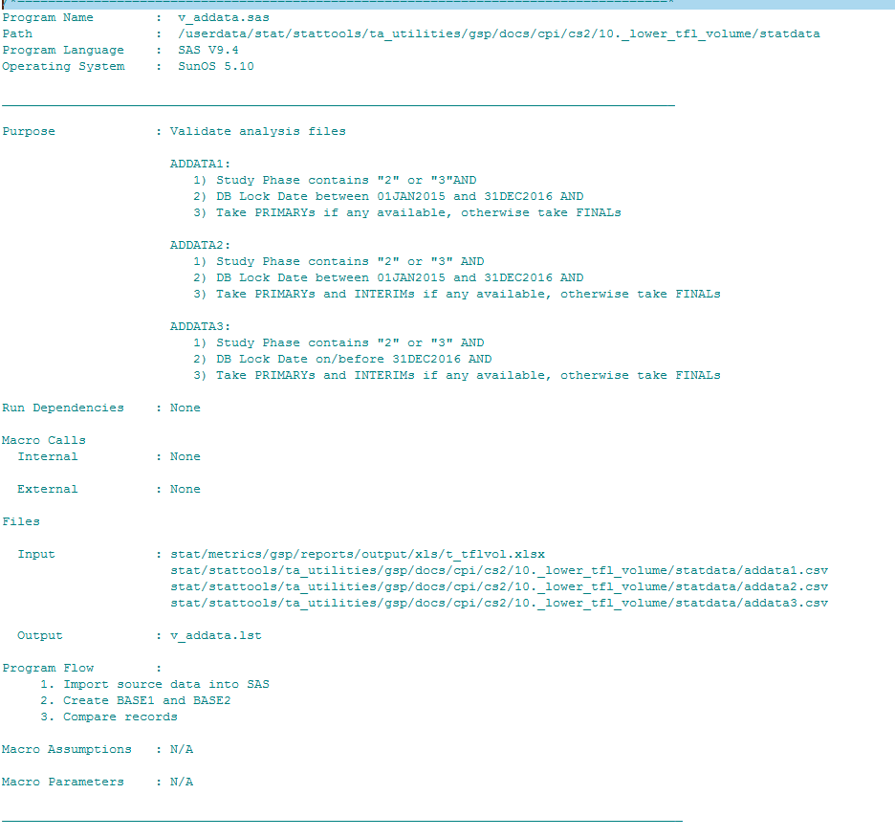

Slide 19
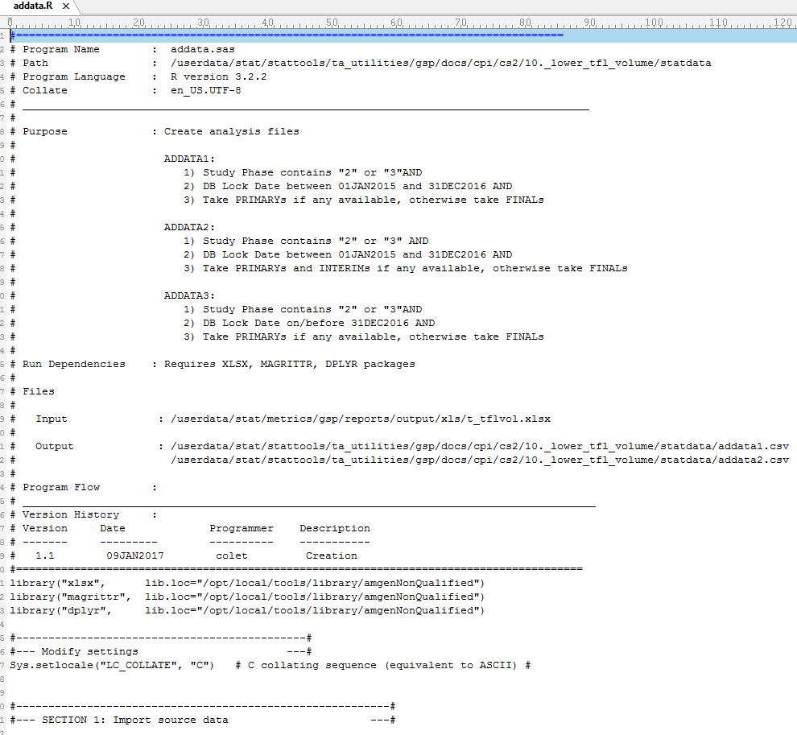
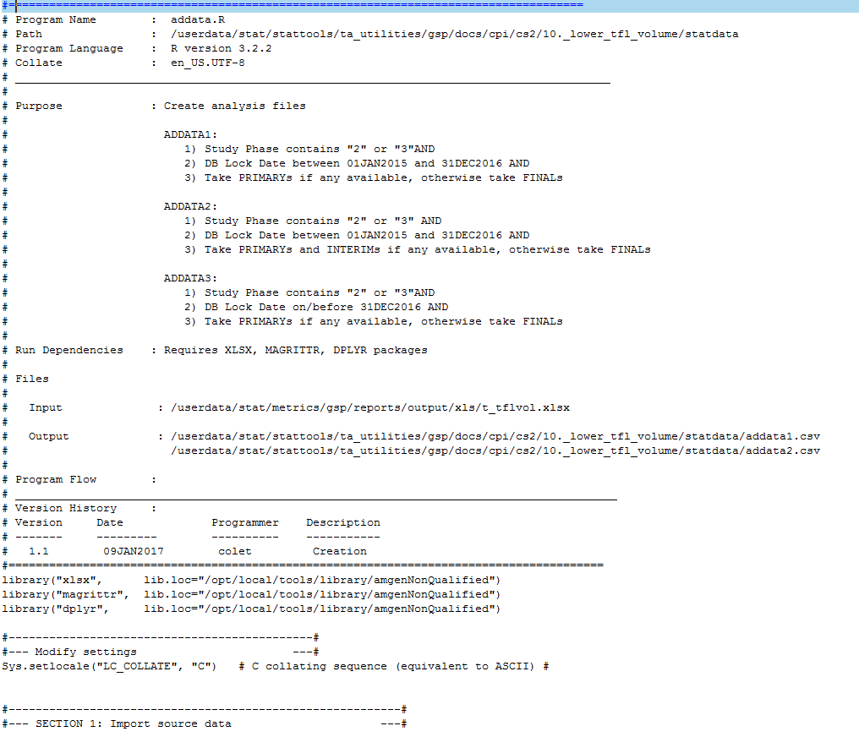

Slide 20
R script structure
source() and librarary()
Data manipulation
Function definition
Execution statement

Slide 21
The good, the bad
Script name:
foo.R
dm.R, v-dm.R
adae.R, v-adae.R
t-dm-sum-age.R, v-t-dm-sum-age.R
f-lb-by-visit.R, v-f-lb-by-visit.R

Slide 22
The good, the bad
Variable name:
avg_Clicks
GOOD: avg.clicks
OK: avgClicks
Descriptive and meaningful, exception:
x,y,z: vectors
df: a data frame
i,j: numeric indices (typically rows and columns).
n: length, or number of rows
p: number of columns

Slide 23
Assignment: x <- 5, x=5
Function name: use verb! CalculateAvg, myfunction1

Slide 24
Some rules
1. Never include install.packages(), setwd() in a script you share. Antisocial!
2. Copy and paste more than twice→ function
3. Use pipe %>% (demo)
Some short-cuts
Ctrl+Enter
Ctrl+Enter+s
Ctrl+shift+k
Ctrl+shift+c

Slide 25
Demo of where we are:
1) Demo: ggplot2 for publishing-ready figures needed for Clinical Study Reports
2) Plotly to make graphs dynamic
3) Shiny for data checks and product-level safety reporting
4) R Markdown for a source code library for figures
5) Packrat for reproducibility

Slide 26

Comments & Questions?

