Slide 1


Slide 2
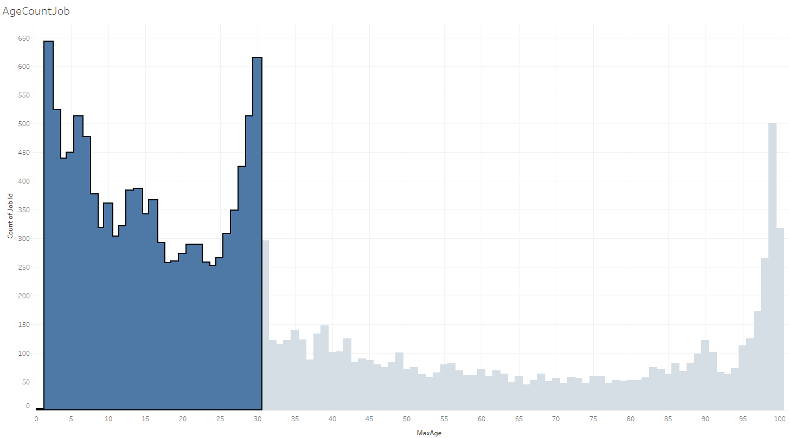

Slide 3
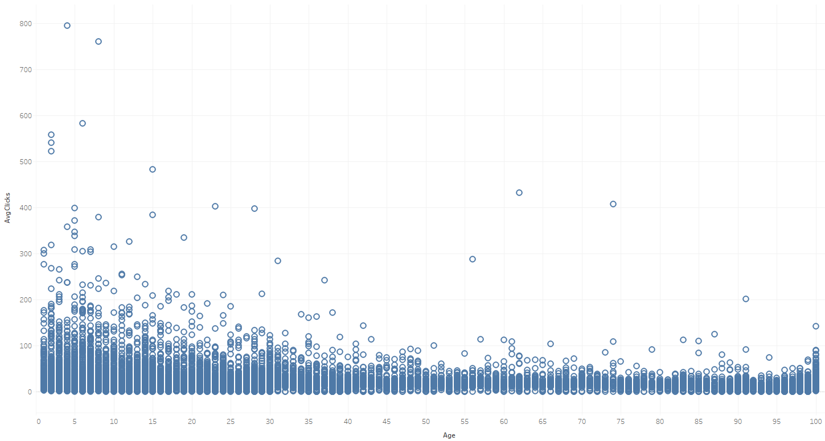

Slide 4
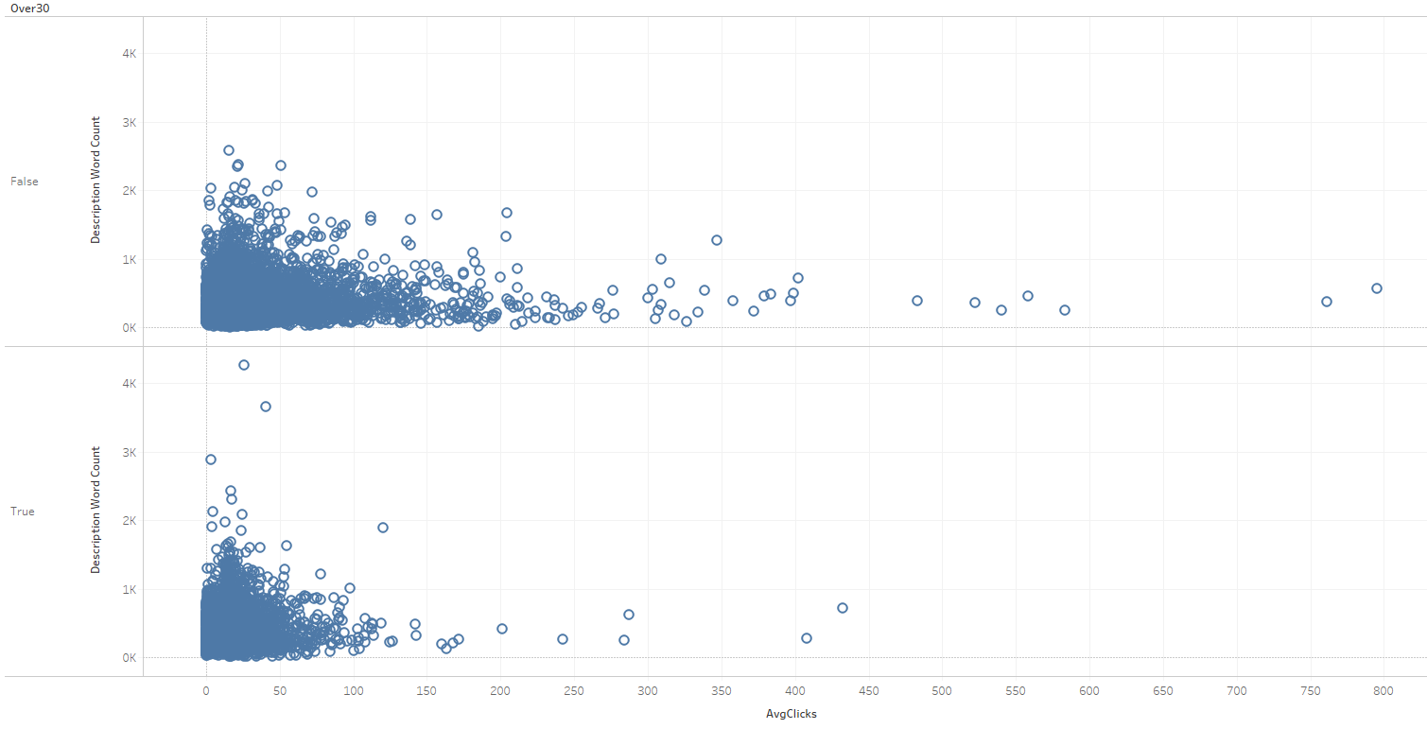

Slide 5
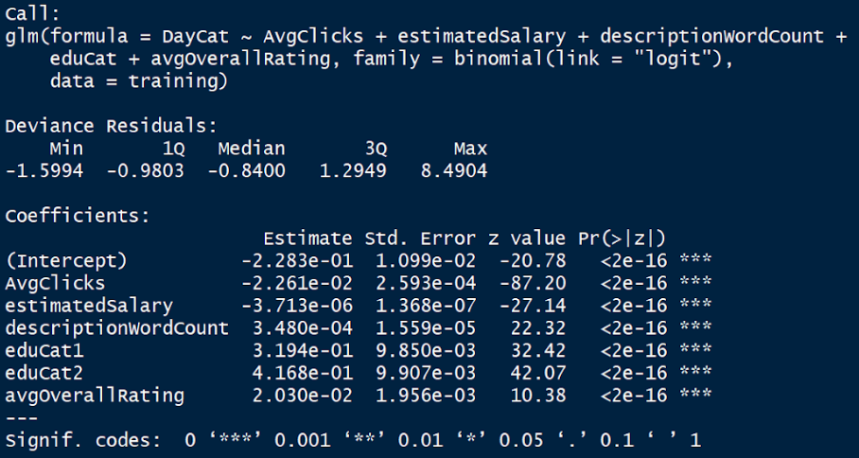
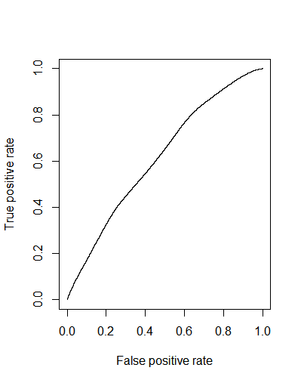
Model Summary
 | 92.50% | OR | 97.50%
High School | 1.3075607 | 1.4247717 | 1.5523733
Higher Ed | 1.2167478 | 1.3252522 | 1.4433096
Supervising | 1.0233758 | 1.1265889 | 1.2398579
Word Count | 1.000103 | 1.0002431 | 1.000383
avgClicks | 0.9773597 | 0.9795534 | 0.9816888
Model Validation: 62%

Slide 6

