Slide 1

City of Los Angeles
HR Contracts Analysis
UCI MSBA 2018 Team
Gloria Gong
Rujin Zhang
Michael Troina

Slide 2
CONTENTS
01
Business Problems
02
Data Description
03
Watson Analysis
04
Project Conclusion

Slide 3
01
Business Problems

Slide 4

Business Problems
Situations for the City of LA
1. Big requirement in HR data
61000+ employees, 1255 job classes
2. Hard questions to answer
What are the common & unique benefits for different job classes?
What will be the changes in benefit costs due to changes in specific benefit elements?
What will be the influence on crime statistics in relation to benefit changes on law enforcement employees?
3. Current difficulty in contracts retrieving
manual searching or expert knowledge?
Target: help retrieve HR info more effectively & identify real benefit costs

Slide 5
02
Data Description

Slide 6
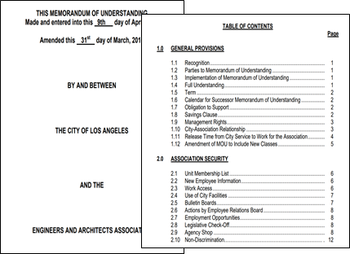
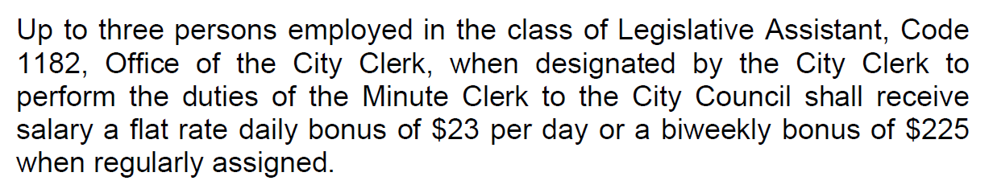
Data Description
Data: 44 MOUs (contracts):
Avg. 100+ pages each
Avg. 441 paragraphs each
Avg. 19207 words each
-- Mou1, Article 7.6 extract
Target: get key information from paragraphs

Slide 7
Data Description
Possible entities of interest:
Employee: persons employed
Job title: Legislative Assistant
Organization: Office of the City Clerk
Eligibility: designated by the City Clerk to perform the duties of …
Benefits: a flat rate daily bonus
Amount: $23
Time unit: day, biweekly

Slide 8
03
Watson Analysis

Slide 9
Watson Analysis
Watson workflow:
1
3
5
Create dictionaries
Human annotating
Model deploying
Model training
Model evaluation
2
4
Watson tools:
Watson Knowledge Studio
Watson Natural Language Understanding

Slide 10
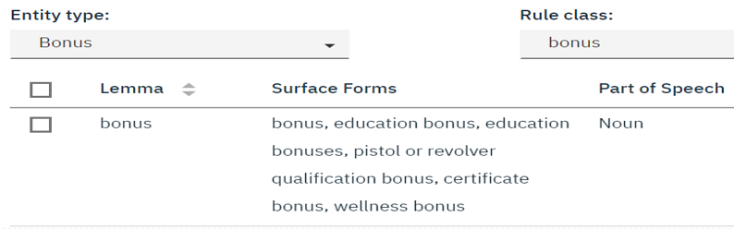

Watson Analysis
1. Create dictionaries
NLU: extracting entities & keywords
20 entities: employee, organization, job class, date, amount, bonus, eligibility…
100+ keywords
based on Watson NLU news pool and discussion with City expert
WKS: build initial dictionaries
3. Add regex rules
date, number, amount
4. Apply dictionaries (pre-annotator)

Slide 11
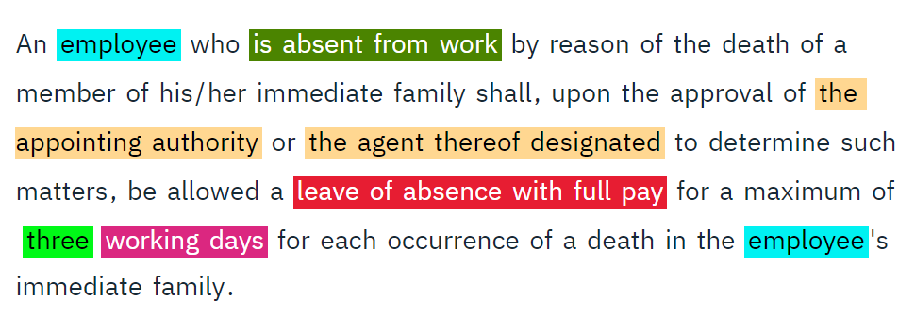
Watson Analysis
2. Human annotating
Human annotating based on dictionaries (pre-annotator)
Annotate 600+ documents in MOU1-5
employee
eligibility
organization
leave
number
time unit

Slide 12
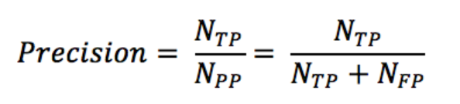
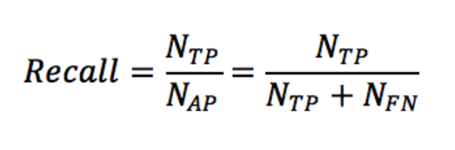

Watson Analysis
3. Model training
1. Divide documents and train
training: test: blind = 70%: 23%: 7%
2. Observe results
model F1, precision, recall
entities F1, precision, recall
[0, 1], the higher the better

Slide 13
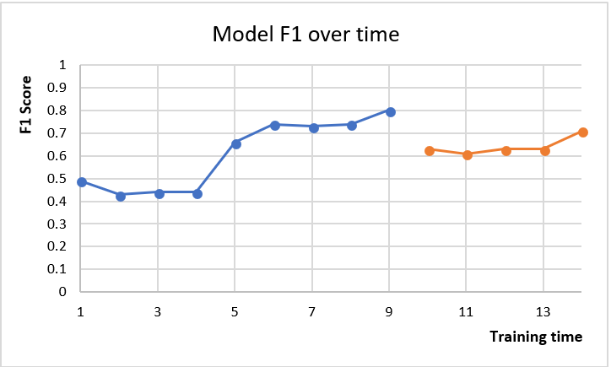
Watson Analysis
3. Model training
Model F1 result
1
2
Overall F1 improves significantly
Recall for ‘benefits’ improves significantly

Slide 14
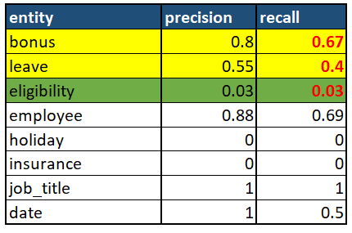
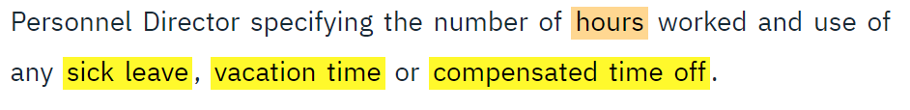
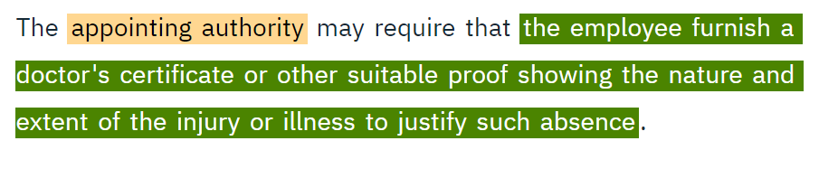
Watson Analysis
3. Model training
1

Slide 15
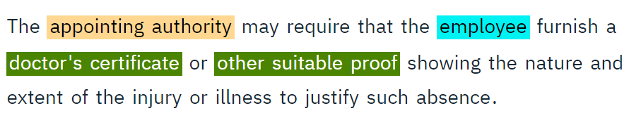
Watson Analysis
3. Model training
Model F1: 0.66 -> 0.8

Slide 16
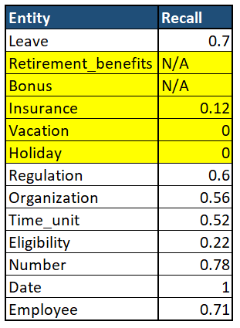
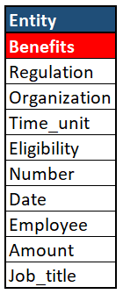
Watson Analysis
3. Model training
2

Slide 17
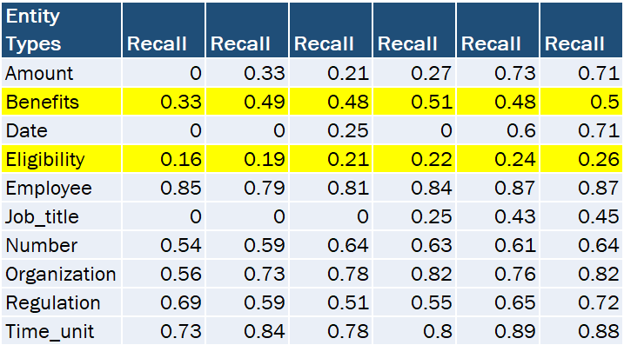
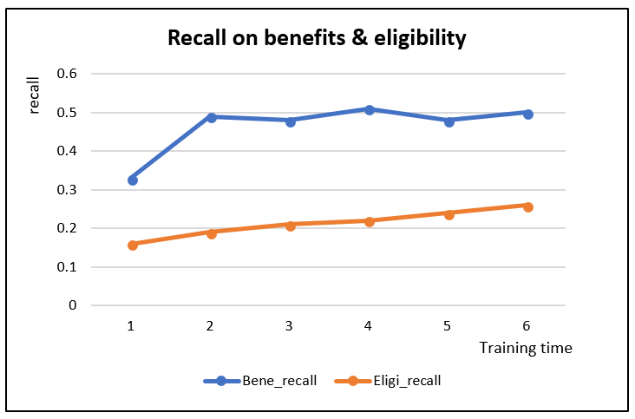
Watson Analysis
3. Model training
2

Slide 18
Watson Analysis
4. Model deploying
1. Deploy the WKS model into NLU
2. Use for extracting untrained documents
MOUs other than 1-5
Let’s try MOU6

Slide 19
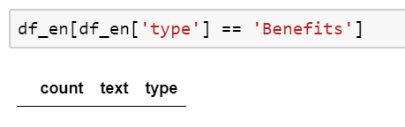
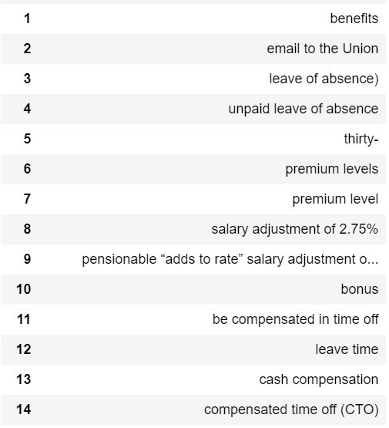
Watson Analysis
5. Model evaluation
MOU6 results: ‘benefits’
Before combining ‘benefits’:
After combining:
In total 202 unique benefits, among which
168 approved (83.17%)

Slide 20
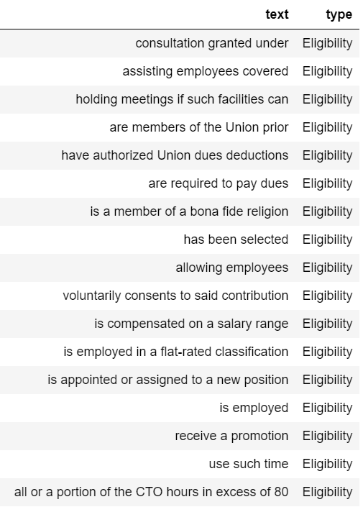
Watson Analysis
5. Model evaluation
MOU6 results: ‘eligibility’

Slide 21
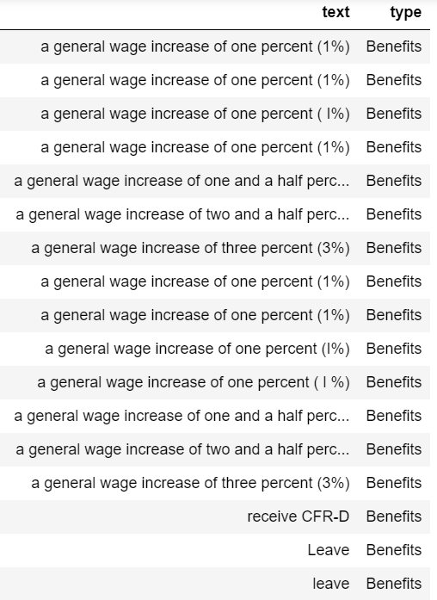
Watson Analysis
5. Model evaluation
New York Firefighters contract results: ‘benefits’
11 out of 30 have NEVER appeared in
training MOU1-5 / other City of LA MOUs

Slide 22
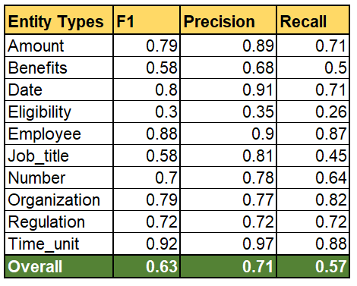
Watson Analysis
5. Model evaluation
Evaluation chart

Slide 23
04
Project Conclusion

Slide 24

Project Conclusion
Improve info retrieving efficiency
MOU6: 75 pages (531 para, 25029 words) in 4 min
Apply to any City government for contracts
Possible future directions
Add more complete entities depending on City needs
Build relations in Watsons
Machine learning experience
Try to understand machine’s way of communicating
Make assumptions -> test assumptions
Improve through comparing different results
Watson suggestion
External programming to improve working efficiency

Slide 25
Thank you!
UCI MSBA 2018 Team
Gloria Gong
Rujin Zhang
Michael Troina

