Slide 1

Money, Money, Money
Wage Growth vs Affordability
Kevin Holmes DDA 14

Slide 2
Introduction / Background
Nashville’s rapid growth has outpaced wage gains for many residents
Cost of living, especially housing, has soared in recent years
Key question: Are wage increases keeping up with what it costs to live in Nashville?
Data sources: Zillow, Metro Nashville, U.S. Census, MIT Living Wage Calculator, FRED (CPI)

Slide 3
Key Findings: Income Needed vs. Actual Wages
Income needed to afford median rent in Nashville has more than doubled since 2015
Average metro pay and household income have grown much more slowly
Since 2021, the “income gap” between what people earn and what’s needed for housing has widened sharply

Slide 4
Data & Methodology
Analyzed annual wage data for metro employees and median household income (2015–2024)
Compared with:
Income needed to afford house purchase (Zillow)
MIT Living Wage for Davidson County
Consumer Price Index (CPI) for inflation
Data merged and visualized using Python and Power BI

Slide 5
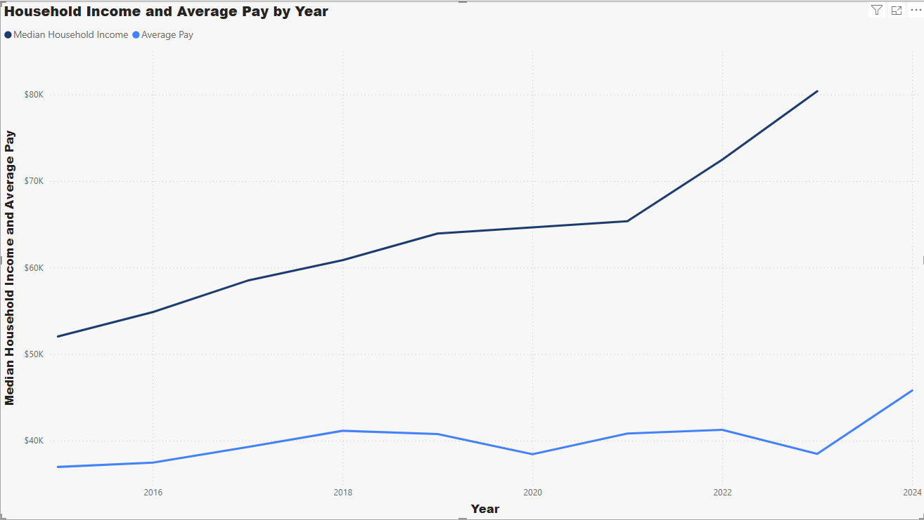
Pay and housing income 2015 - present
Steady Increase In Household income (2020 there was a gap in data due to covid, 2024 data has not been released.)

Slide 6
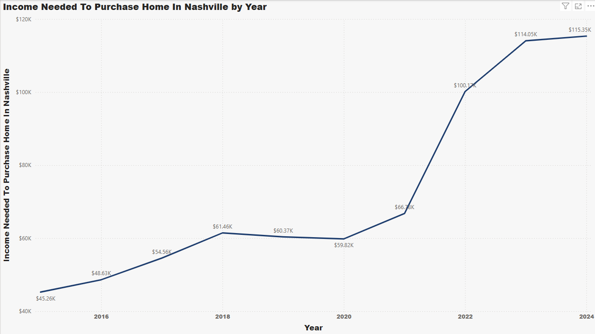
Zillow household income
Major Jump From 2021 Onward by $40,000

Slide 7
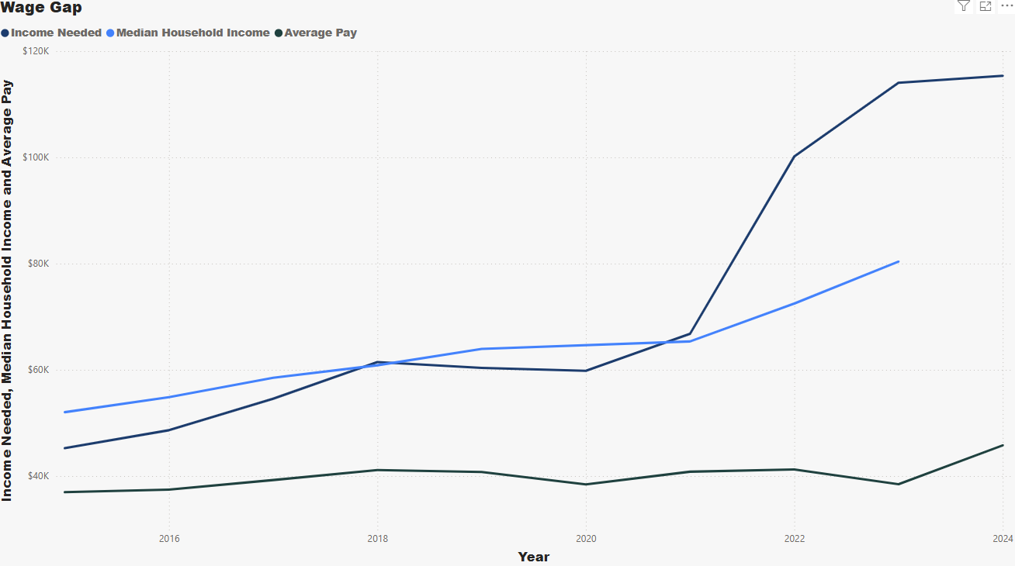
Average household income was on par with income needed until 2022. this is where the wage discrepancy takes place.

Slide 8
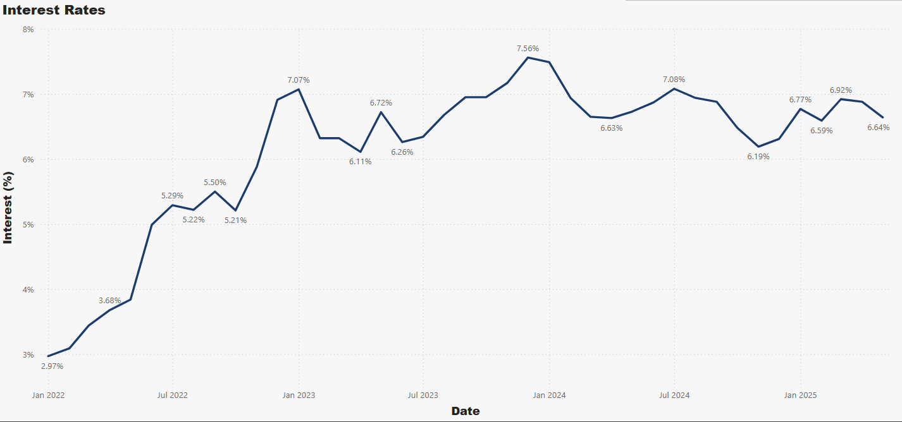
FHA Interest Rates Interest Rates took a major Jump from 2022 to now being consistent in the %6-%7 range

Slide 9
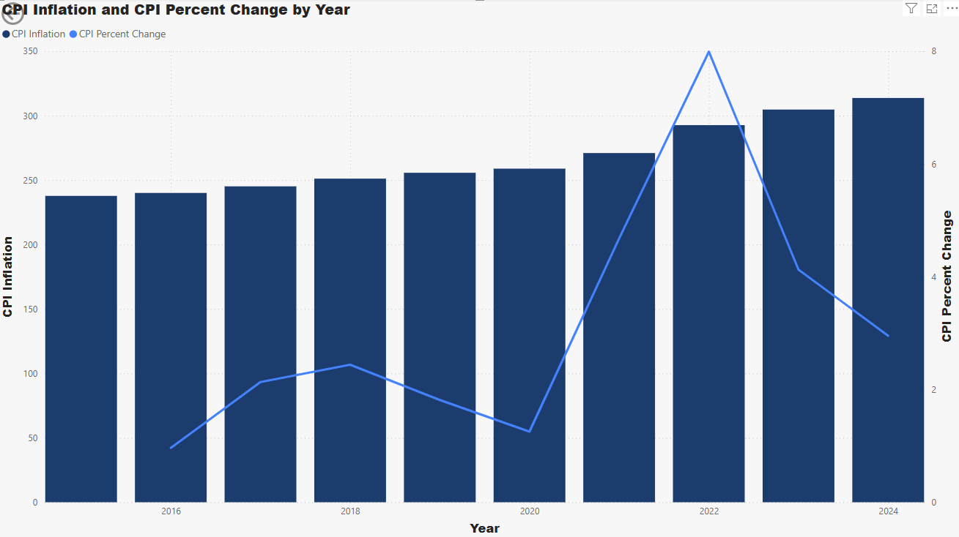
Consumer Price Index (number that indicates how much day-to-day costs are) Largest Change on the year was 2022

Slide 10
Conclusion
Wages in Nashville have not kept up with the rising cost of rent and living
The affordability gap has become a major challenge for working families
Without intervention, many residents' risk being priced out of the city

Slide 11
Questions / Discussion
Thank you!
Questions or comments?

