Slide 1
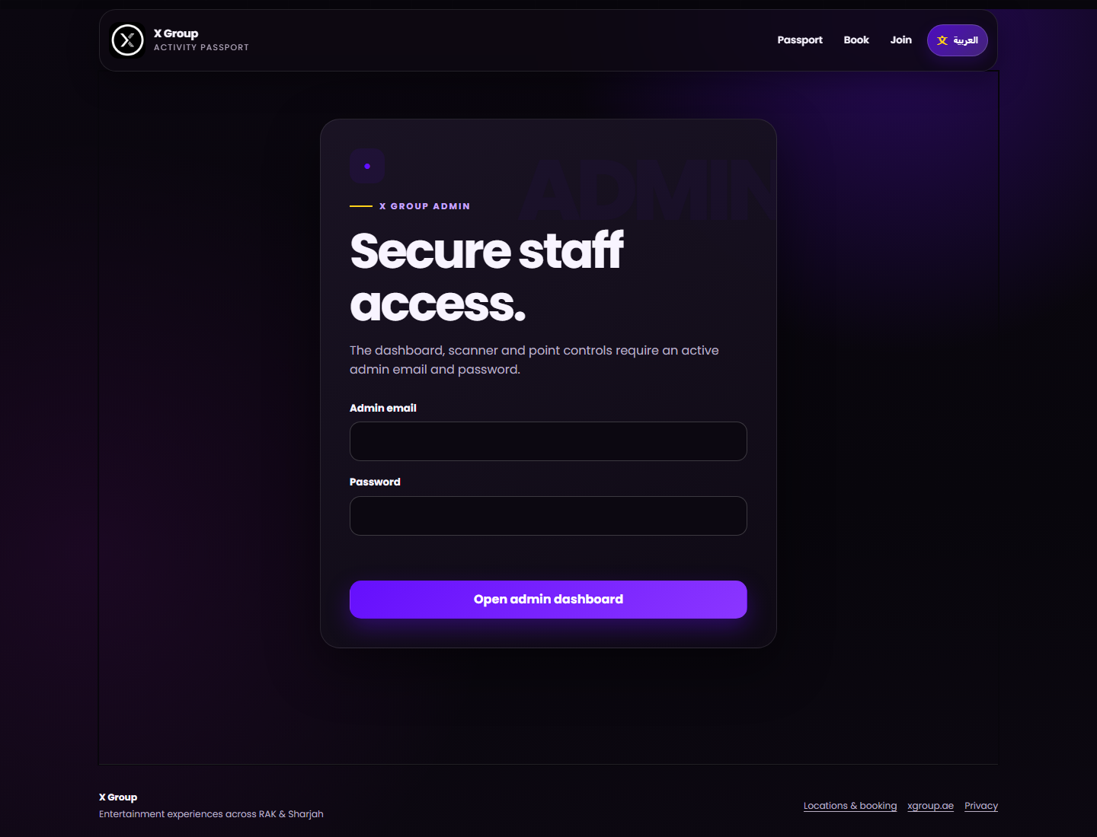
EMPLOYEE GUIDE
01 / 06
Secure admin sign-in
ADMIN LOGIN SCREEN
STAFF ONLY
1
Open the X Group admin page.
2
Enter your assigned admin email and password.
3
Tap “Open admin dashboard”.
4
Use your own account and never share the password.
X GROUP • ACTIVITY PASSPORT
xgroup.ae
Notes:
Page 1: staff-only sign-in. Never place credentials in this guide.

Slide 2
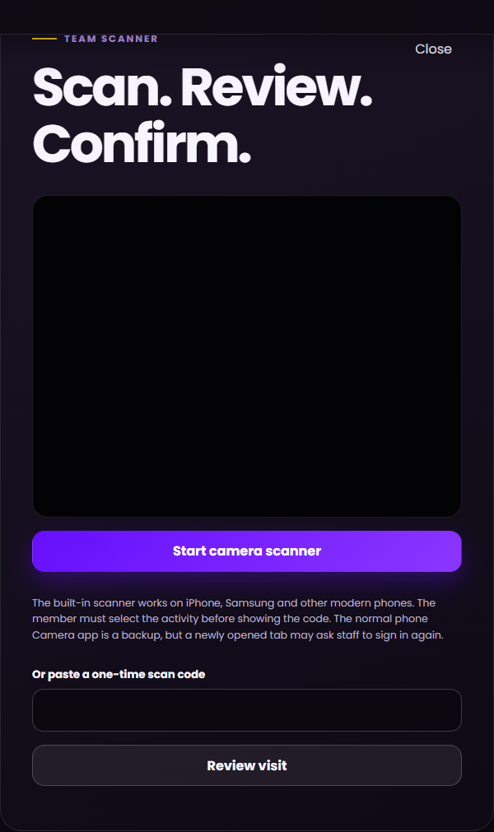
EMPLOYEE GUIDE
02 / 06
Scan the customer passport
SCAN
1
Ask the customer to select the correct activity.
2
Tap “Scan a passport”, then start the camera.
3
Hold the one-time QR code inside the frame.
4
Verify the member name and activity before continuing.
ONE-TIME QR
X GROUP • ACTIVITY PASSPORT
xgroup.ae
Notes:
Page 2: the customer must choose the activity before presenting the QR.

Slide 3
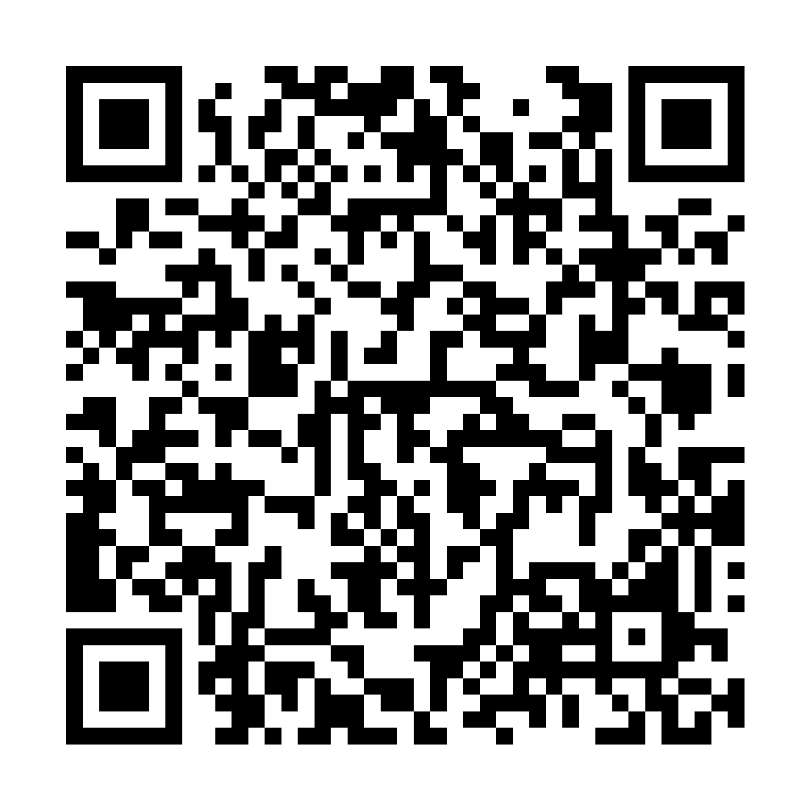
EMPLOYEE GUIDE
03 / 06
Award points or redeem
The customer can request a reward. Only authenticated staff can complete it after a new scan.
1
Customer requests
2
Staff scans QR
3
Staff confirms
REWARD READY
→
→
Add visit points
Tap Redeem
Then show the refreshed QR to staff.
Redeem reward
Cancel if no transaction happened.
Never press twice. Never award or redeem against the wrong activity.
X GROUP • ACTIVITY PASSPORT
xgroup.ae
Notes:
Page 3: customer action only prepares the QR. Redemption is atomic and staff-confirmed after scan.

Slide 4
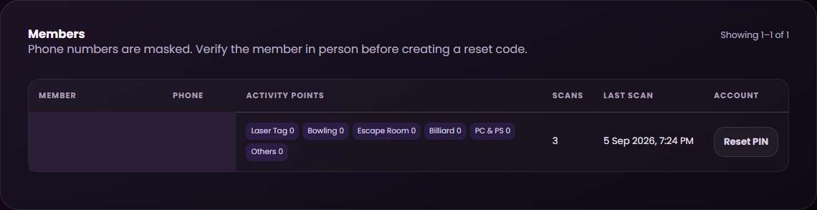
EMPLOYEE GUIDE
04 / 06
Members and complete history
MEMBER LIST
COMPLETE HISTORY
• Masked phone number
• Activity balances and visit count
• Last visit
• Reset PIN for a verified member
• Scans and confirmed points stay separate
• Reward redemptions are recorded
• Review the history before resolving a dispute
X GROUP • ACTIVITY PASSPORT
xgroup.ae
Notes:
Page 4: use masked member records and the event history to resolve questions before any correction.

Slide 5
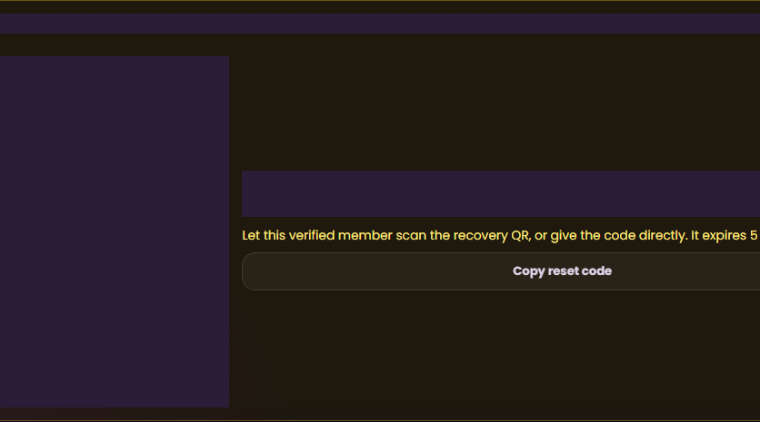
EMPLOYEE GUIDE
05 / 06
Forgotten PIN recovery
EXPIRES IN 15 MINUTES
1
Verify the customer in person.
2
Find the correct member and tap Reset PIN.
3
Let the customer scan the recovery QR or give the code.
4
The customer enters the registered phone number.
The reset code expires automatically. Staff never sees or chooses the customer’s new PIN.
5
The customer chooses a new six-digit PIN.
THE NEW PIN STAYS PRIVATE
X GROUP • ACTIVITY PASSPORT
xgroup.ae
Notes:
Page 5: verify identity in person. Recovery codes expire after 15 minutes.

Slide 6

EMPLOYEE GUIDE
06 / 06
Security and sign-out
Never ask for or record a customer PIN.
Never photograph a passport QR or recovery code.
Sign out when your shift ends.
SAFE
If a result is unclear, check history—do not repeat the transaction.
& SECURE
ADMIN
https://2thooo.github.io/x-stop-site/loyalty/#/admin
Sign out at the end of every shift.
X GROUP • ACTIVITY PASSPORT
xgroup.ae
Notes:
Page 6: security checklist and admin URL.

