Slide 1

Towards Practical Oblivious RAM
Emil Stefanov | Elaine Shi | Dawn Song
emil@cs.berkeley.edu | elaines@cs.berkeley.edu | dawnsong@cs.berkeley.edu
UC Berkeley
http://www.emilstefanov.net/Research/ObliviousRam/

Slide 2

Cloud Storage
Can we TRUST the cloud?
Dropbox
Amazon S3, EBS
Windows Azure Storage
SkyDrive
EMC Atmos
Mozy
iCloud
Google Storage

Slide 3
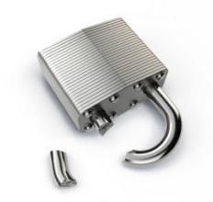
But, encryption is not always enough.
Access patterns can leak sensitive information.

Slide 4

Example Attack by Pinkas & Reinman
 | a | b | c
 |  | 1 | 2 | 3 | 4
Untrusted Cloud Storage
Buy IBM
Client
Buy EMC
?
(stock trader)
Buy IBM

Slide 5
Oblivious RAM (O-RAM)
Goal: Conceal access patterns to remote storage.
An observer cannot distinguish a sequence of read/write operations from random.
Untrusted Cloud Storage
Client

Slide 6

Naïve Solution
Impractical
$O\left(N\right)$ bandwidth overhead
Untrusted Cloud Storage
Buy IBM
Client
Buy EMC
(stock trader)
Buy IBM

Slide 7
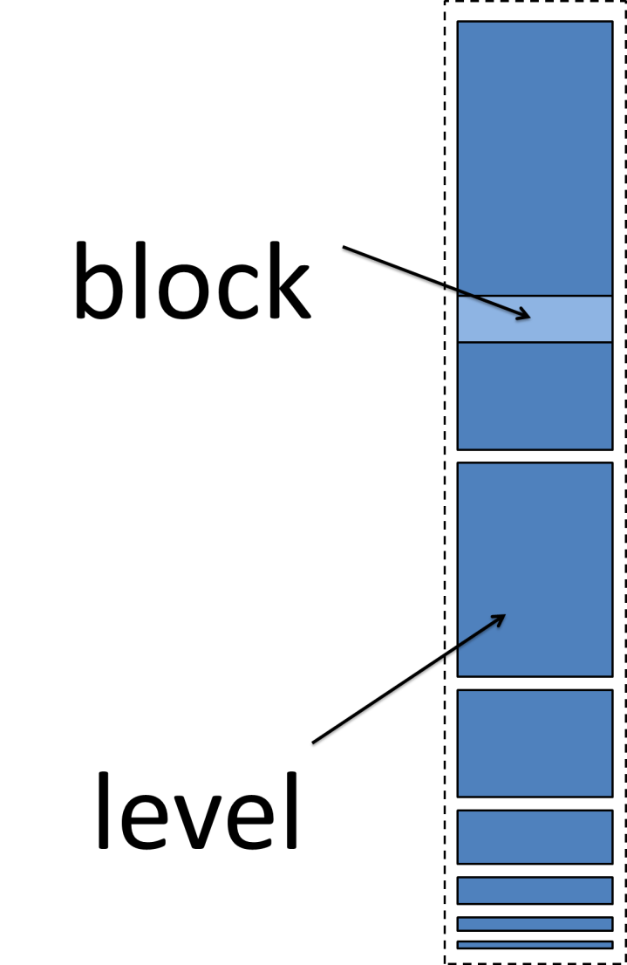
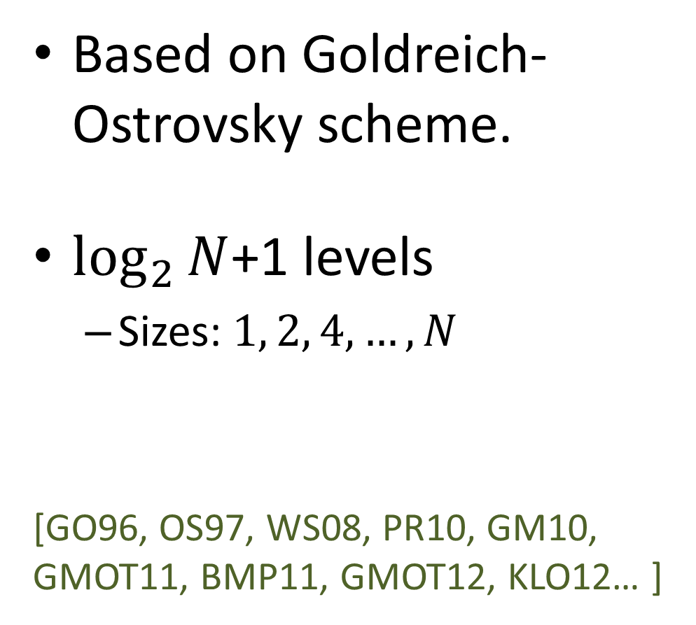
Existing Approaches
Based on Goldreich-Ostrovsky scheme.
$\log_{2}{N}$+1 levels
Sizes: $1, 2, 4,…,N$
[GO96, OS97, WS08, PR10, GM10, GMOT11, BMP11, GMOT12, KLO12… ]

Slide 8
Existing Approaches
Inside a level
Some real blocks
Useful data
Some dummy blocks
Random data
Randomly permuted
Only the client knows the permutation
Dummy Block
Real Block
Real Block
Dummy Block
Real Block
Dummy Block
Dummy Block
Real Block

Slide 9
Existing Approaches
Reading
Read a block from each level
One real block.
Remaining are dummy blocks
dummy
real
dummy
dummy
dummy
dummy
Server
Client

Slide 10






Continuous Shuffling
$$t_{0}$$
$$t_{1}$$
$$t_{2}$$
$$t_{3}$$
$$t_{4}$$
$$t_{5}$$
…
To write:

Slide 11
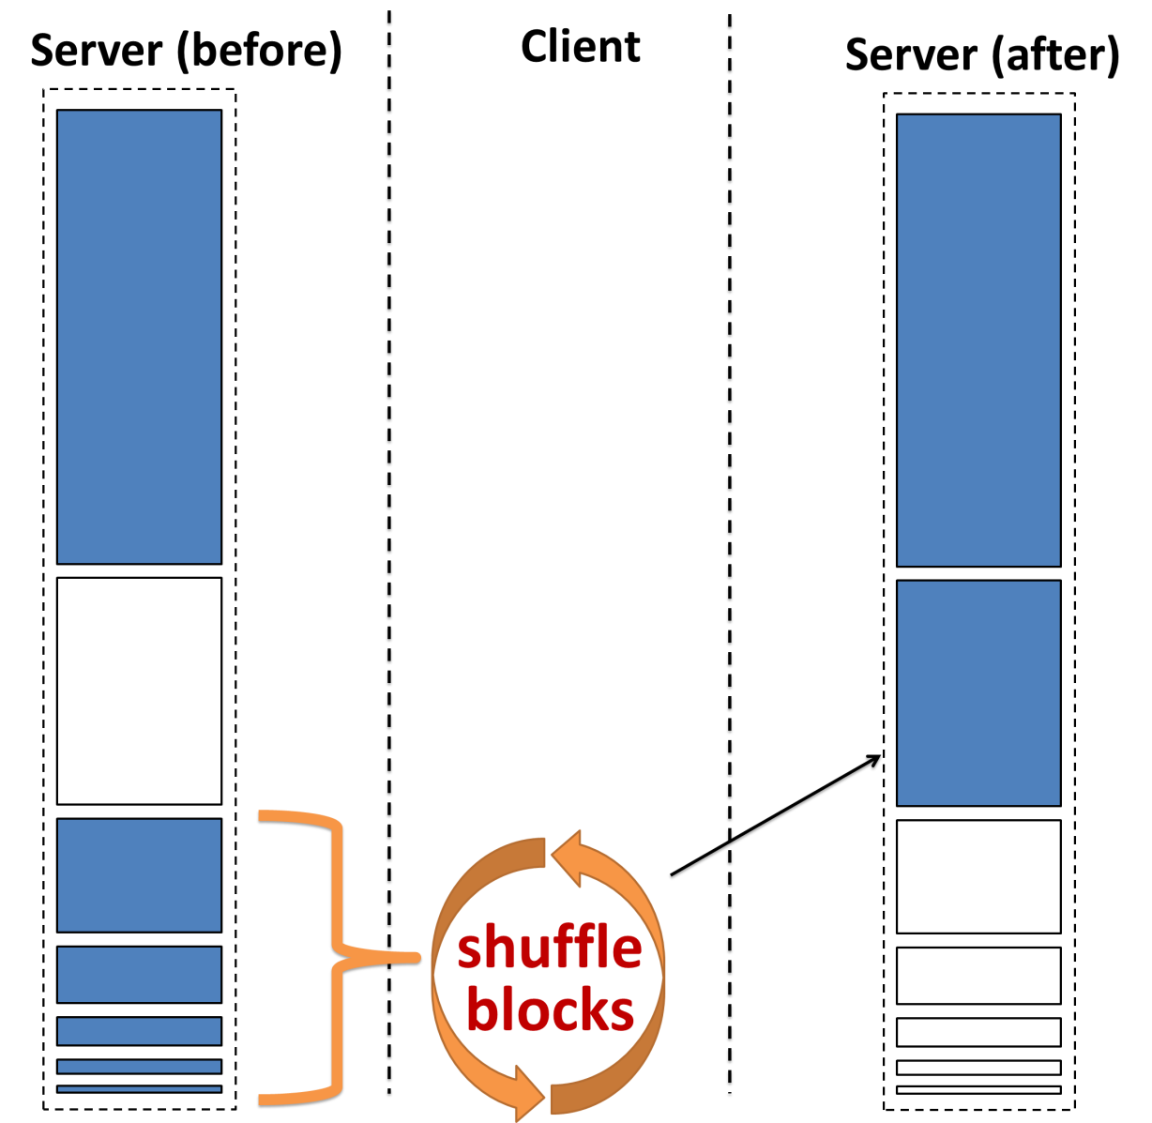
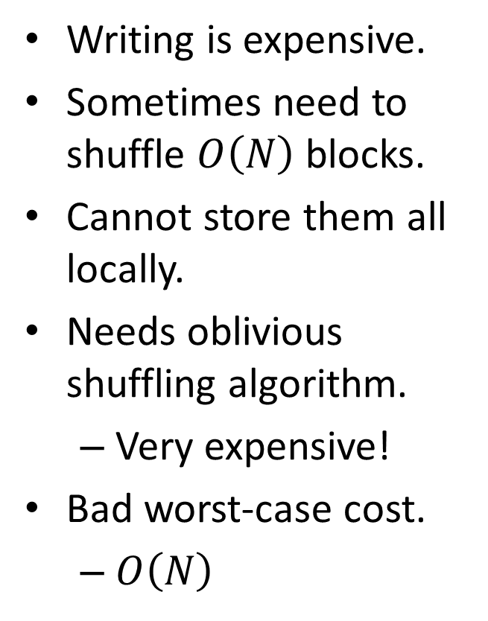
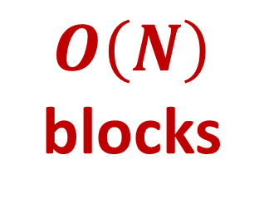
The Problem with Existing Approaches
Writing is expensive.
Sometimes need to shuffle $O\left(N\right)$ blocks.
Cannot store them all locally.
Needs oblivious shuffling algorithm.
Very expensive!
Bad worst-case cost.
$O\left(N\right)$
$$O\left(N\right)$$
blocks

Slide 12
Our Approach
Make shuffling cheaper.
Reduce the worst-case cost.
But, how?

Slide 13
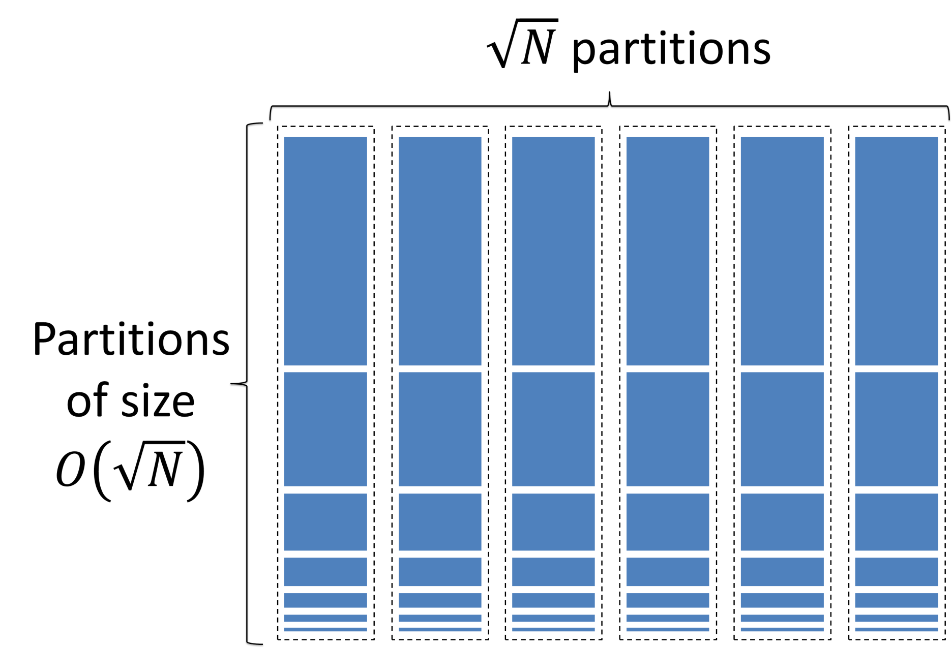
Answer: Partition the Storage

Slide 14
Challenge: Partitioning Breaks Security
O-RAM
O-RAM
O-RAM
O-RAM
O-RAM
Partitions
Server
block
Client
Read block from its randomly assigned partition
Assign and write block to a new random partition
Read block from its previously assigned random partition.
Not privacy preserving! There is linkability between reads and writes.

Slide 15
Solution: Our Partitioning Framework
O-RAM
O-RAM
O-RAM
O-RAM
O-RAM
Partitions
Server
Client
block
block
block
block
Cache Slots
block
block
block
Accessing a block:
Read from partition (previously randomly assigned).
Read/modify block data.
Write to random cache slot (don’t write to server yet).

Slide 16
Solution: Our Partitioning Framework
O-RAM
O-RAM
O-RAM
O-RAM
O-RAM
Partitions
Server
Client
block
block
block
dummy
block
Cache Slots
block
block
block
Background eviction:
Sequentially scan the cache slots.
Evict one block if possible.
Evict dummy block otherwise.

Slide 17
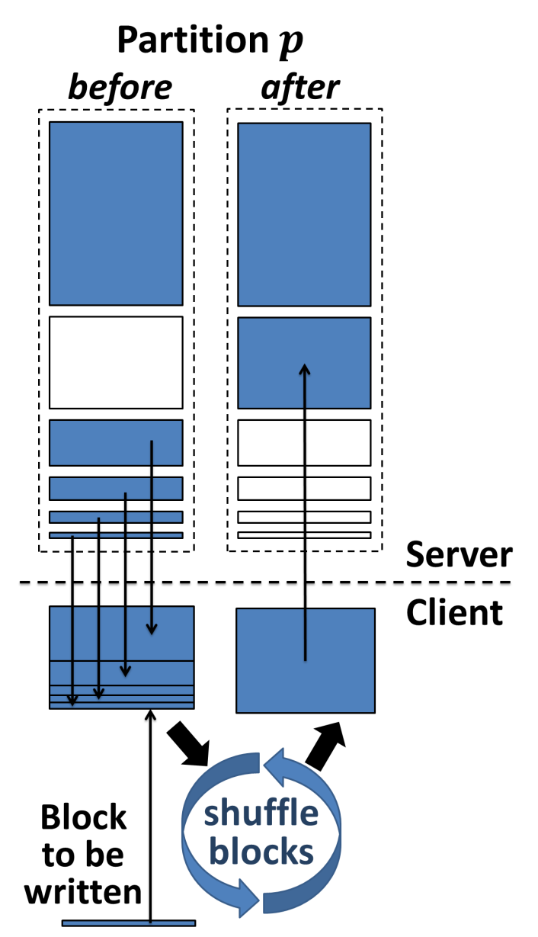
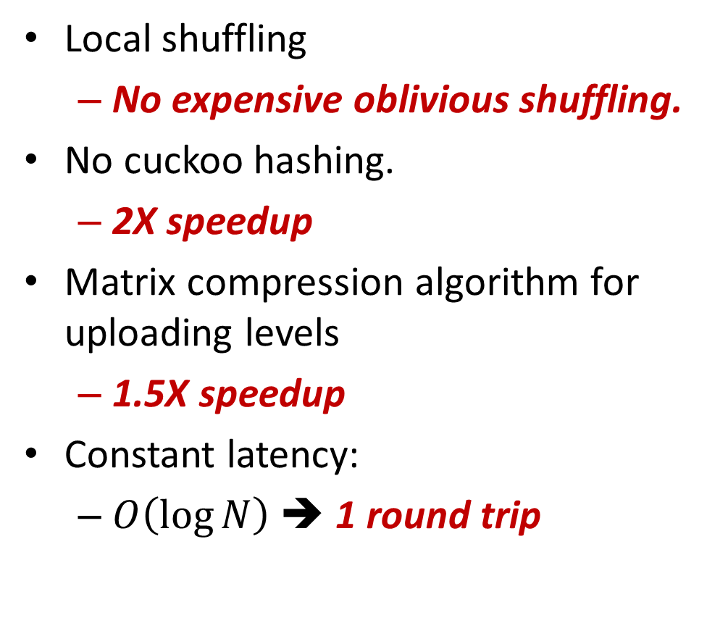
Our Partition O-RAM
Local shuffling
No expensive oblivious shuffling.
No cuckoo hashing.
2X speedup
Matrix compression algorithm for uploading levels
1.5X speedup
Constant latency:
$O\left(\log{N}\right)$ ➔ 1 round trip

Slide 18
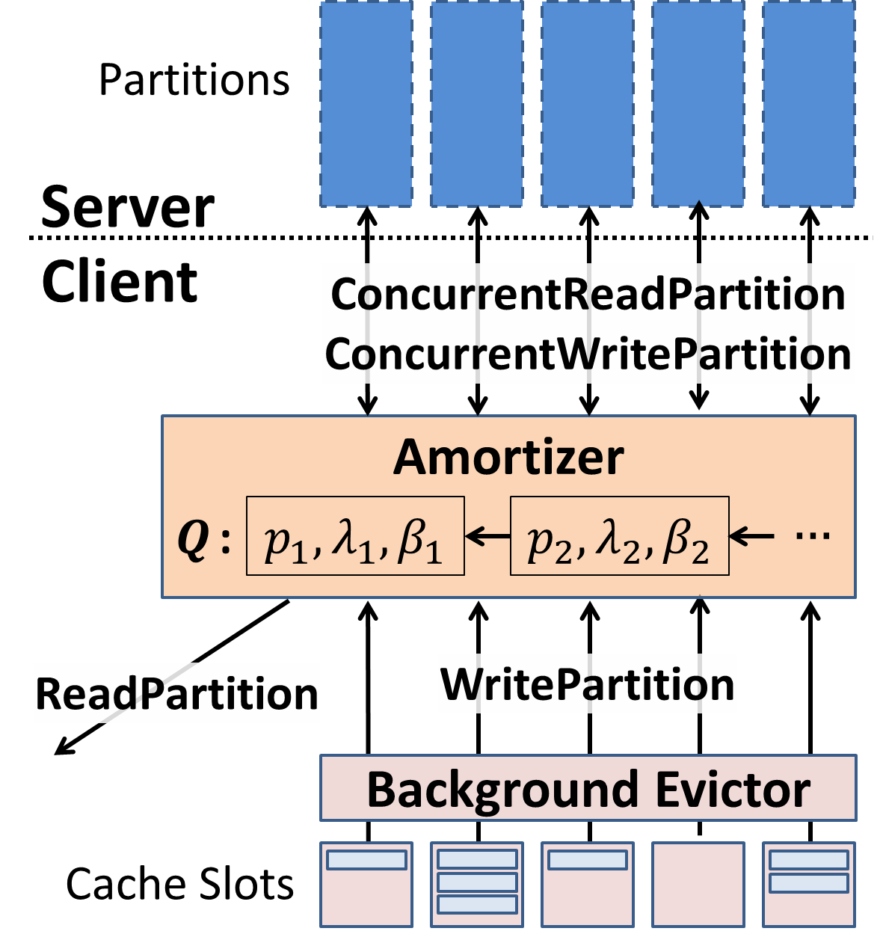
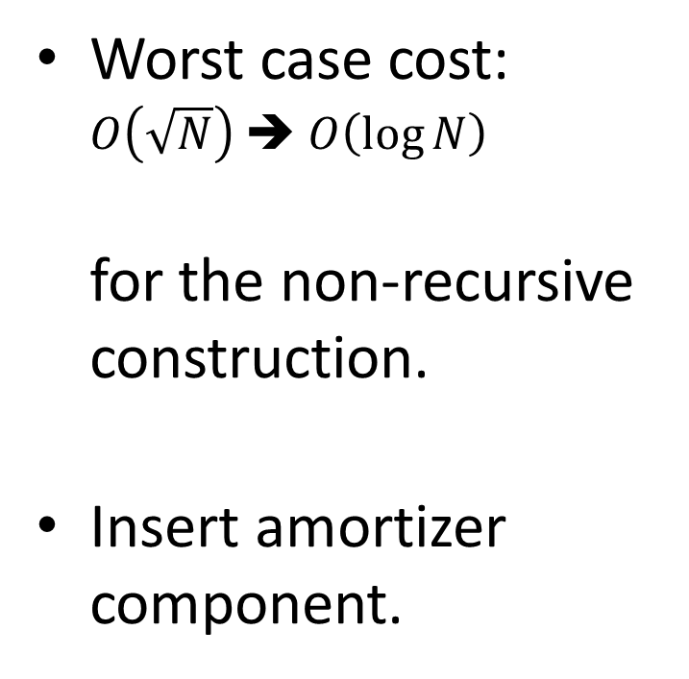
Concurrent Constructions: Reduce Worst Case Cost
Worst case cost: $O\left(\sqrt{N}\right)$ ➔ $O\left(\log{N}\right)$ for the non-recursive construction.
Insert amortizer component.

Slide 19
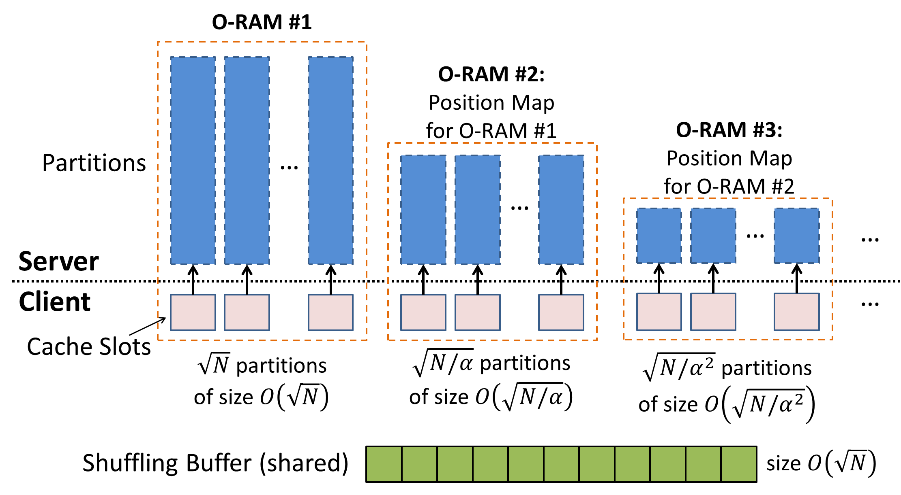
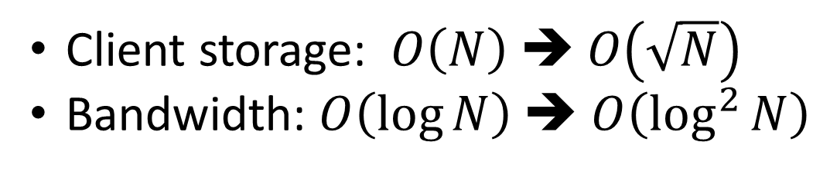
Recursive Constructions: Reduce Client Storage
Client storage: $O\left(N\right)$ ➔ $O\left(\sqrt{N}\right)$
Bandwidth: $O\left(\log{N}\right)$ ➔ $O\left(\log^{2}{N}\right)$

