Slide 1

Towards Practical Oblivious RAM
Emil Stefanov | Elaine Shi | Dawn Song
emil@cs.berkeley.edu | elaines@cs.berkeley.edu | dawnsong@cs.berkeley.edu
UC Berkeley
http://www.emilstefanov.net/Research/ObliviousRam/

Slide 2
Cloud Storage
Dropbox
Amazon S3, EBS
Windows Azure Storage
SkyDrive
EMC Atmos
Mozy
iCloud
Google Storage

Slide 3

Cloud Storage
Can we TRUST the cloud?
Dropbox
Amazon S3, EBS
Windows Azure Storage
SkyDrive
EMC Atmos
Mozy
iCloud
Google Storage

Slide 4

Data Privacy
Data privacy is a growing concern.
Large attack surface (possibly hundreds of servers)
Infrastructure bugs
Malware
Disgruntled employees
Big brother
So, many organizations encrypt their data.

Slide 5
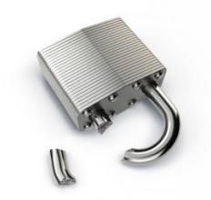
But, encryption is not always enough.
Access patterns can leak sensitive information.

Slide 6

Example Attack by Pinkas & Reinman
Untrusted Cloud Storage
Buy IBM
Client
Buy EMC
?
(stock trader)
Buy IBM

Slide 7
Oblivious RAM (O-RAM)
Goal: Conceal access patterns to remote storage.
An observer cannot distinguish a sequence of read/write operations from random.
Untrusted Cloud Storage
Client

Slide 8

Naïve Solution
Impractical
$O\left(N\right)$ bandwidth overhead
Untrusted Cloud Storage
Buy IBM
Client
Buy EMC
(stock trader)
Buy IBM

Slide 9
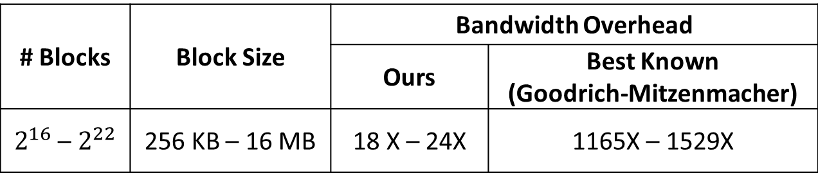
Contribution 1: Performance
63 times less bandwidth
than best existing solution for the same amount of client storage
# Blocks | Block Size | Bandwidth Overhead
 |  | Ours | Best Known (Goodrich-Mitzenmacher)
$2^{16}$ – $2^{22}$ | 256 KB – 16 MB | 18 X – 24X | 1165X – 1529X
< 0.1% of data stored on client
O-RAM Capacity | Client Storage
1 TB – 256 TB | 0.011 % – 0.078 %

Slide 10
Contribution 2: Techniques
Partitioning Framework
Breaks down server storage into smaller, more manageable partitions.
Partition O-RAM
Optimized O-RAM construction for partitions.
Recursive Constructions
Reduce client-side storage via recursion.
Concurrent Constructions
Reduce worst-case cost via concurrency.

Slide 11
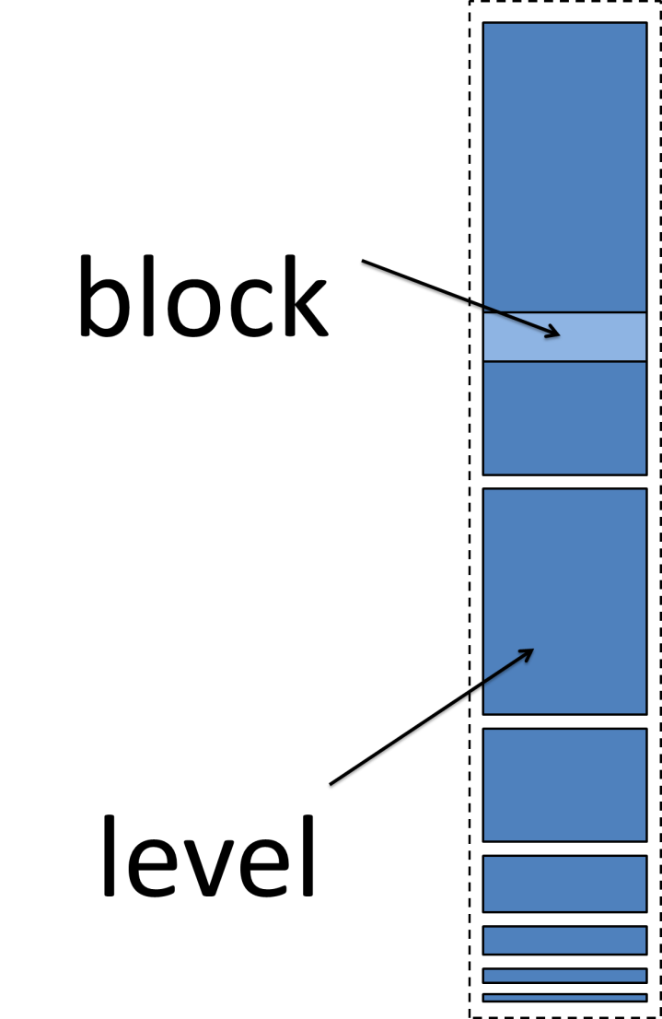
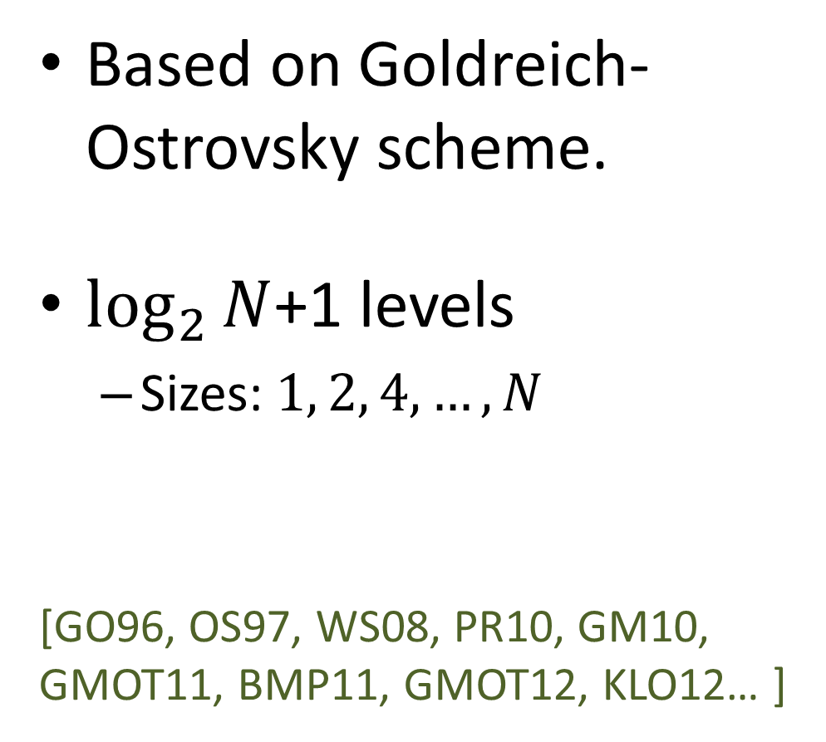
Existing Approaches
Based on Goldreich-Ostrovsky scheme.
$\log_{2}{N}$+1 levels
Sizes: $1, 2, 4,…,N$
[GO96, OS97, WS08, PR10, GM10, GMOT11, BMP11, GMOT12, KLO12… ]

Slide 12
Existing Approaches
Inside a level
Some real blocks
Useful data
Some dummy blocks
Random data
Randomly permuted
Only the client knows the permutation
Dummy Block
Real Block
Real Block
Dummy Block
Real Block
Dummy Block
Dummy Block
Real Block

Slide 13
Existing Approaches
Reading
Read a block from each level
One real block.
Remaining are dummy blocks
dummy
real
dummy
dummy
dummy
dummy
Server
Client

Slide 14
Existing Approaches
Server (before)
Client
Server (after)
Writing
Shuffle consecutively filled levels.
Write into next unfilled level.
Clear the source levels
shuffle
blocks

Slide 15






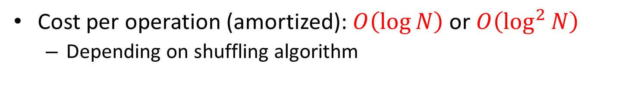
Continuous Shuffling
$$t_{0}$$
$$t_{1}$$
$$t_{2}$$
$$t_{3}$$
$$t_{4}$$
$$t_{5}$$
…
To write:
Cost per operation (amortized): $O\left(\log{N}\right)$ or $O\left(\log^{2}{N}\right)$
Depending on shuffling algorithm

Slide 16
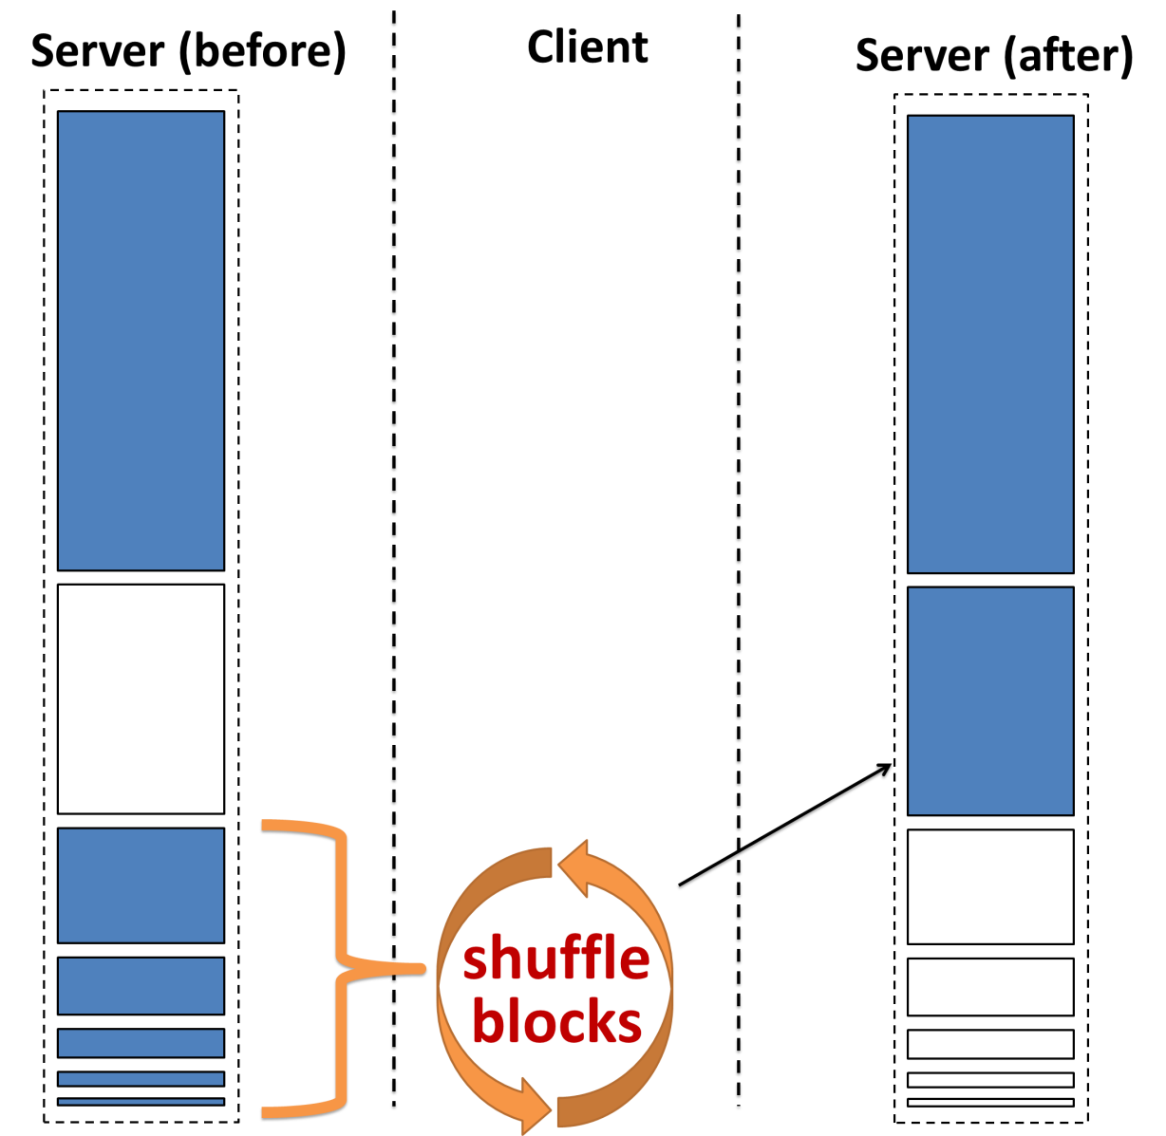
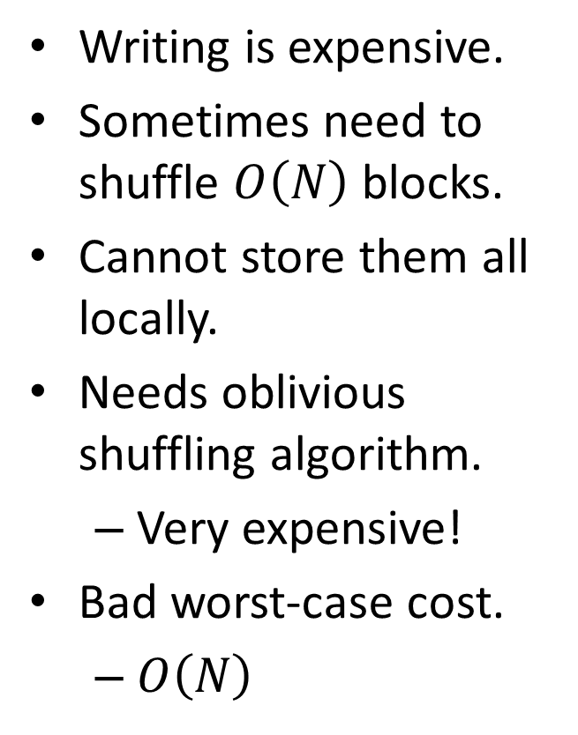
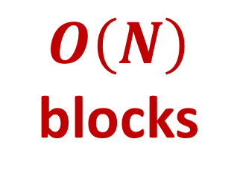
The Problem with Existing Approaches
Writing is expensive.
Sometimes need to shuffle $O\left(N\right)$ blocks.
Cannot store them all locally.
Needs oblivious shuffling algorithm.
Very expensive!
Bad worst-case cost.
$O\left(N\right)$
$$O\left(N\right)$$
blocks

Slide 17
Our Approach
Make shuffling cheaper.
Reduce the worst-case cost.
But, how?

Slide 18
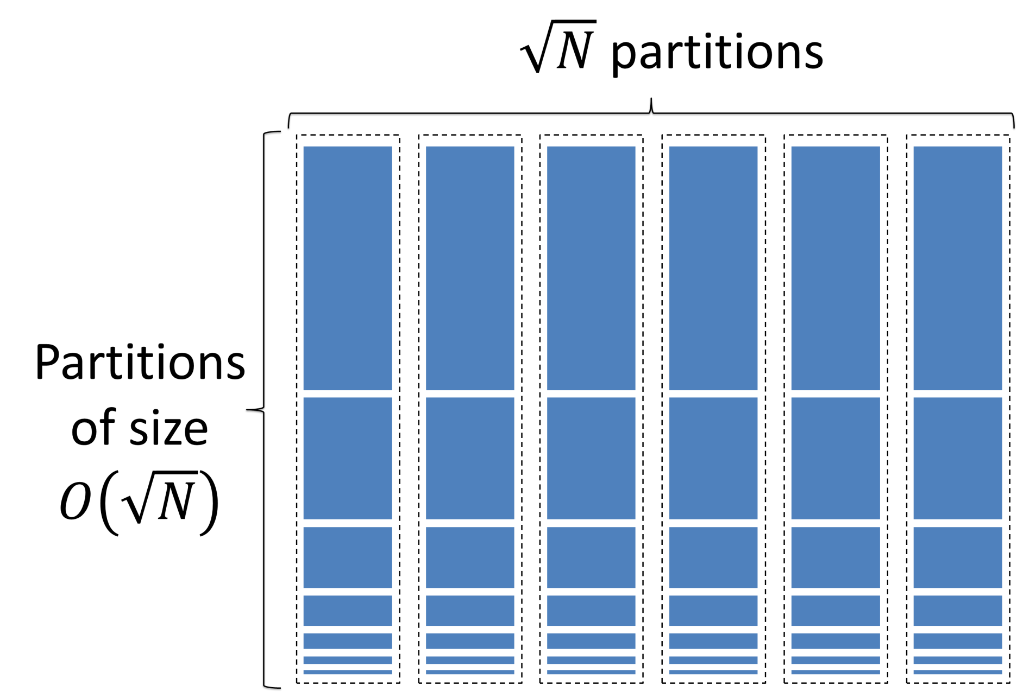
Answer: Partition the Storage

Slide 19
Challenge: Partitioning Breaks Security
O-RAM
O-RAM
O-RAM
O-RAM
O-RAM
Partitions
Server
block
Client
Read block from its randomly assigned partition
Assign and write block to a new random partition
Read block from its previously assigned random partition.
Not privacy preserving! There is linkability between reads and writes.

Slide 20
Solution: Our Partitioning Framework
O-RAM
O-RAM
O-RAM
O-RAM
O-RAM
Partitions
Server
Client
block
block
block
block
Cache Slots
block
block
block
Accessing a block:
Read from partition (previously randomly assigned).
Read/modify block data.
Write to random cache slot (don’t write to server yet).

Slide 21
Solution: Our Partitioning Framework
O-RAM
O-RAM
O-RAM
O-RAM
O-RAM
Partitions
Server
Client
block
block
block
dummy
block
Cache Slots
block
block
block
Background eviction:
Sequentially scan the cache slots.
Evict one block if possible.
Evict dummy block otherwise.

Slide 22
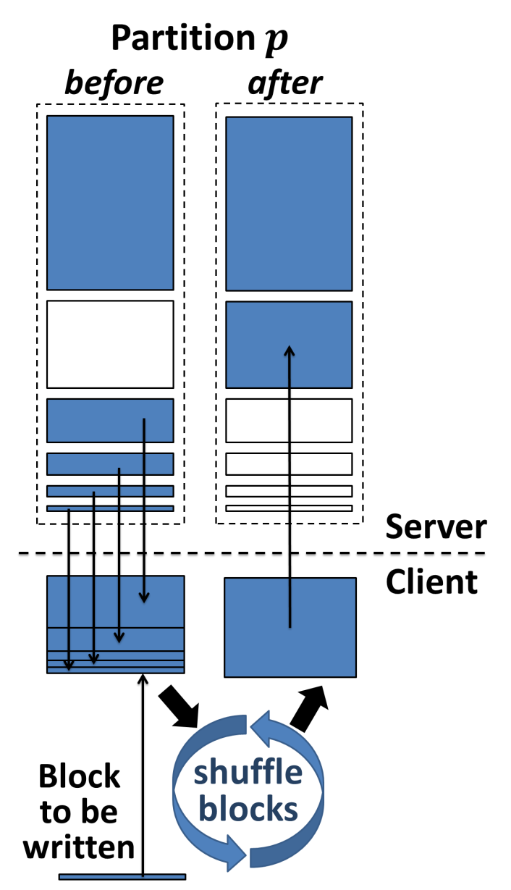
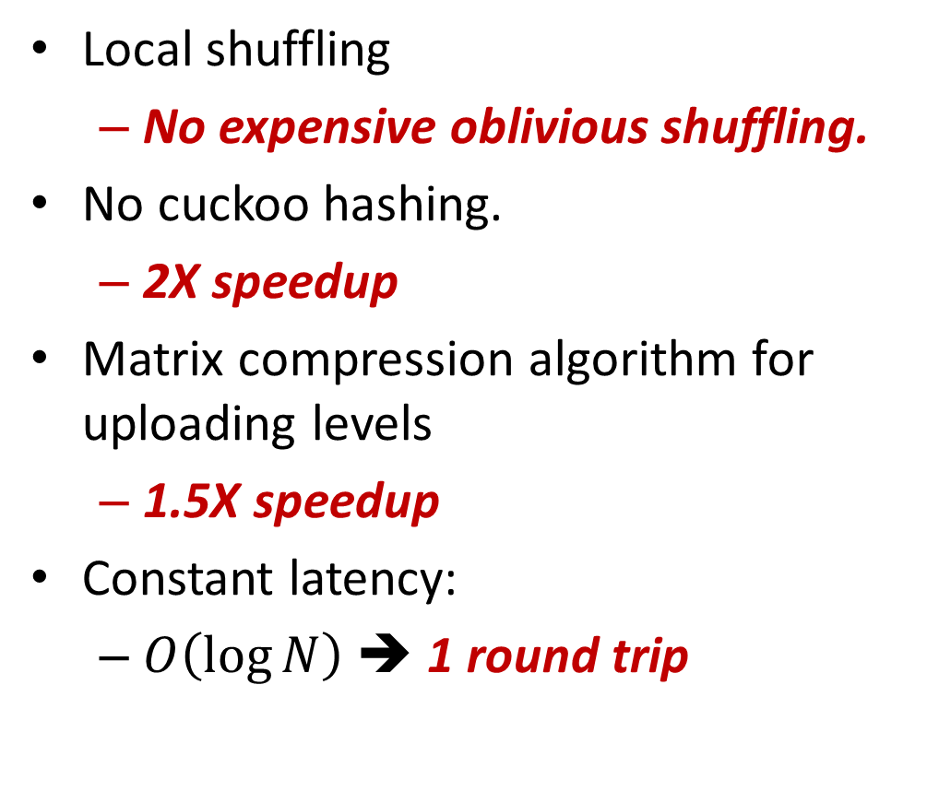
Our Partition O-RAM
Local shuffling
No expensive oblivious shuffling.
No cuckoo hashing.
2X speedup
Matrix compression algorithm for uploading levels
1.5X speedup
Constant latency:
$O\left(\log{N}\right)$ ➔ 1 round trip

Slide 23
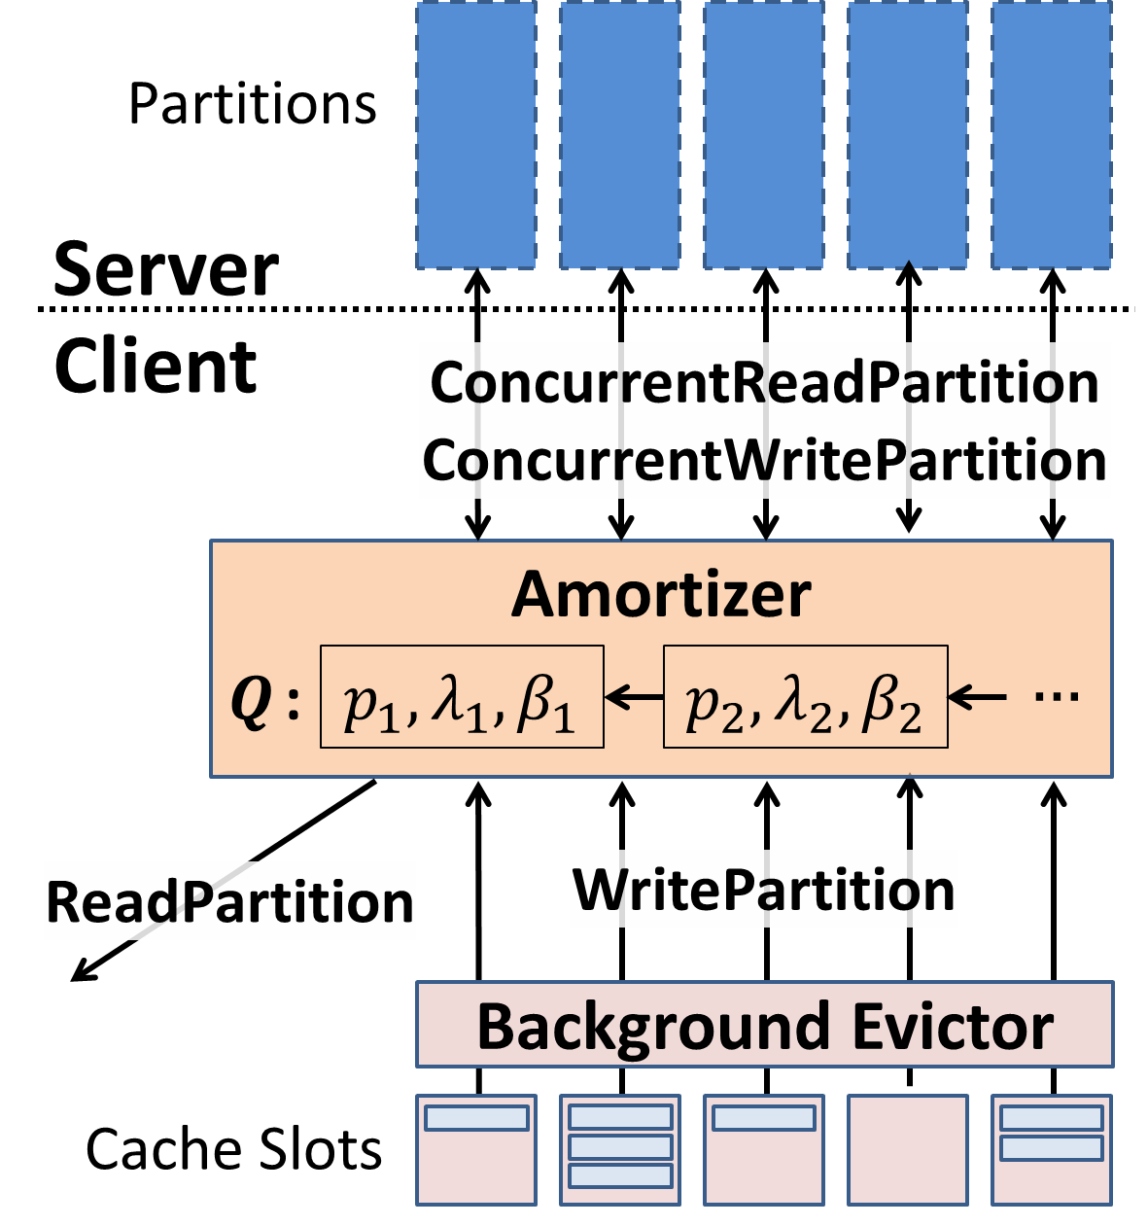
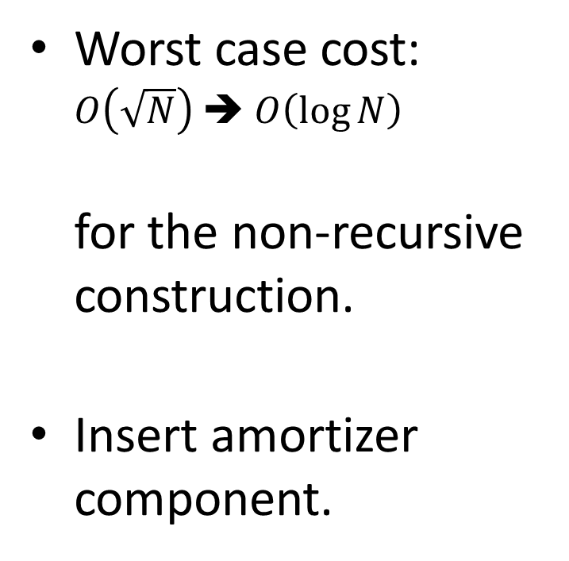
Concurrent Constructions: Reduce Worst Case Cost
Worst case cost: $O\left(\sqrt{N}\right)$ ➔ $O\left(\log{N}\right)$ for the non-recursive construction.
Insert amortizer component.

Slide 24
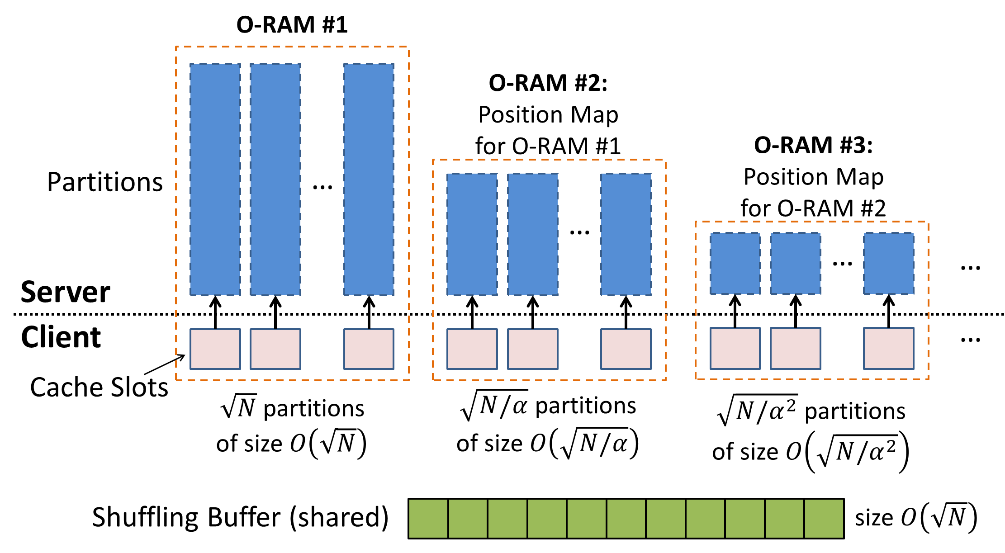
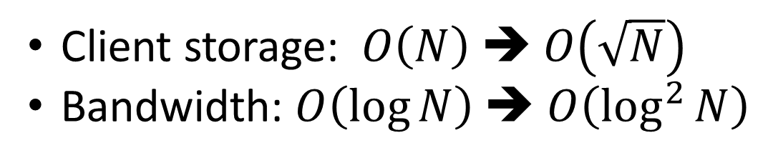
Recursive Constructions: Reduce Client Storage
Client storage: $O\left(N\right)$ ➔ $O\left(\sqrt{N}\right)$
Bandwidth: $O\left(\log{N}\right)$ ➔ $O\left(\log^{2}{N}\right)$

Slide 25
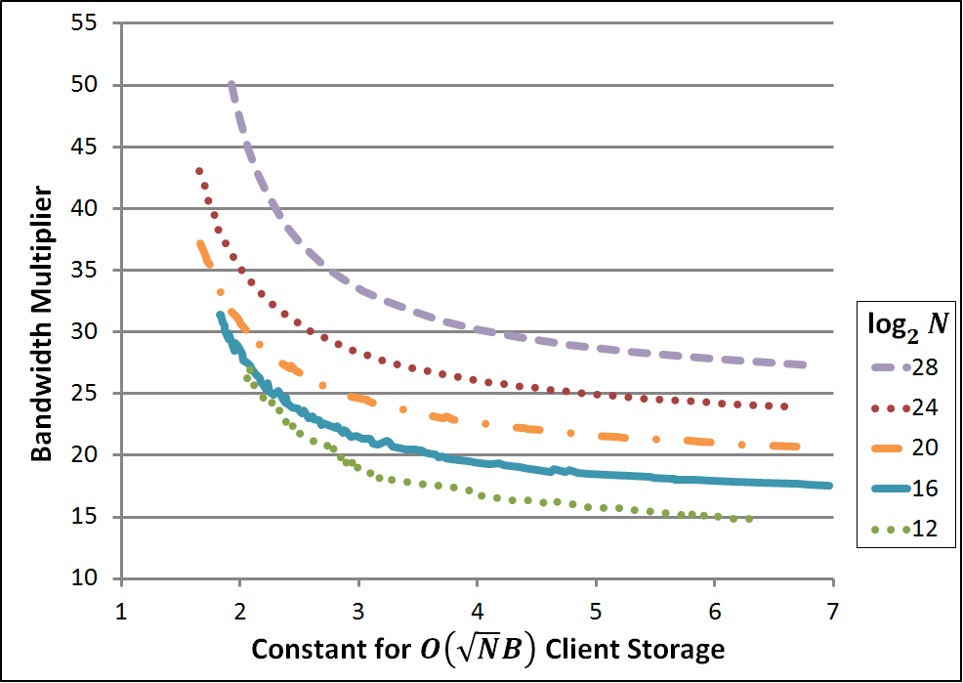
Client Storage vs. Bandwidth

Slide 26
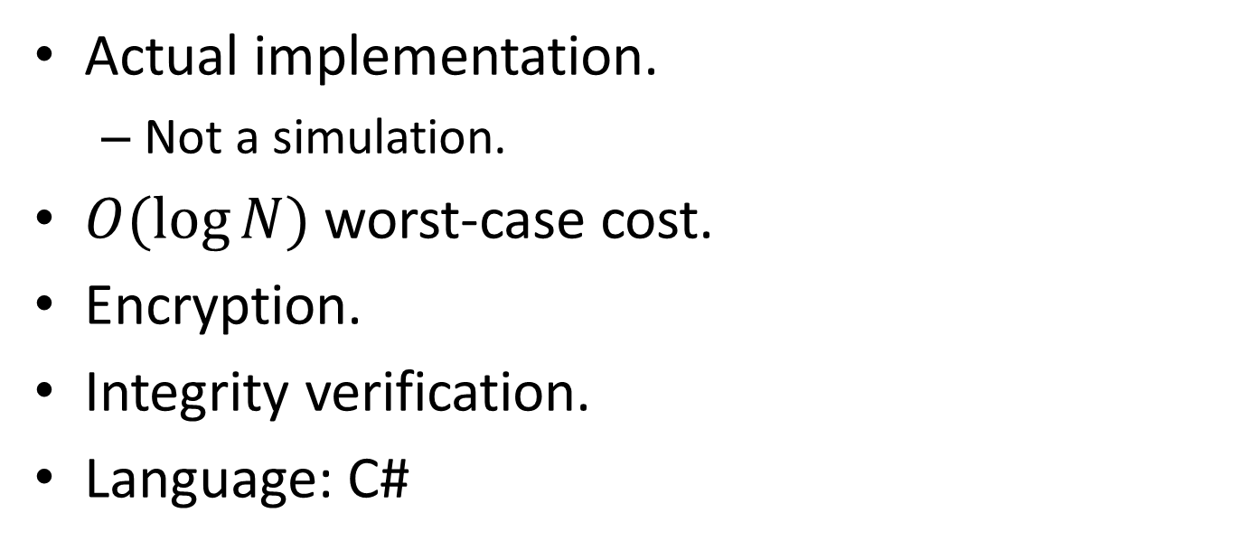
Source Code Available
http://www.emilstefanov.net/Research/ObliviousRam/
Actual implementation.
Not a simulation.
$O(\log{N})$ worst-case cost.
Encryption.
Integrity verification.
Language: C#

Slide 27
Related Work
Hierarchical based constructions and improvements.
GO96, OS97, WS08, PR10, GM10, GMOT11, CS10 , FWCKS11, CS11, BMP11, GMOT12, KLO12, …
De-amortization techniques to reduce worst-case cost.
OS97, GMOT11, BMP11 ,KLO12

Slide 28
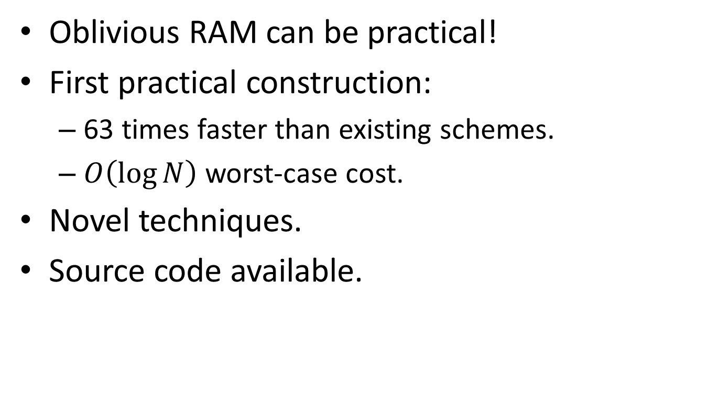
Conclusion
Oblivious RAM can be practical!
First practical construction:
63 times faster than existing schemes.
$O\left(\log{N}\right)$ worst-case cost.
Novel techniques.
Source code available.
Thank you!

