Slide 1
DATABASE SYSTEMS · FINAL PROJECT PRESENTATION
Lehigh Valley Realty
Office Database
A relational database for a real-estate office built with SQLite + Tkinter
Presented by: Dhanush Annoji, Anurag Dasari
Notes:
Title slide. This is a real-estate office database implemented in SQLite with a Tkinter desktop front-end. The presentation walks through the seven required queries A through G, each shown running in the application alongside the SQL that powers it.

Slide 2
What the application does
1
Search the market
5
One flexible property search answers every “what’s for sale?” question — by city, district, price, beds, or pool.
relations
2
Record sales
Staff record a sale against a listed home; the office’s reports update instantly.
7
3
Track agent performance
recorded queries
Per-agent totals, average sale price, and average days on market for any year.
11 / 5
4
Manage the office
Add agents and keep buyer / seller records — no SQL knowledge needed.
properties / sales seeded
Notes:
The office keeps homes listed for sale, matches buyers to them, and records the transaction when a home sells. The application captures that whole lifecycle. The user never writes SQL — they fill in forms and set filters, and the program turns that into queries behind the scenes.

Slide 3
Architecture
Split into 2 files.
app.py
app.py → calls db.py
Tkinter GUI
rows = db.search_properties(
conn, city="Bethlehem",
min_price=200000,
max_price=250000,
status="for_sale")
# the GUI never writes SQL itself
▼
db.py
Data layer
▼
schema.sql + seed.py
SQL is reviewable in one place
The GUI just calls named functions like record_sale().
Schema definition and synthetic sample data (with photos generated using IO)
▼
realestate.db
The SQLite database file
Notes:
We deliberately separated the user interface from the database logic. The GUI never builds a query string itself — it calls a named Python function such as search_properties or record_sale. That keeps the SQL in one place and makes the interface code simple.

Slide 4
The data model
Five relations: people, property, and the sale that connects them.
agents
sellers
buyers
schema.sql
agent_id · email₁
seller_id
buyer_id
CREATE TABLE sales (
sale_id INTEGER PRIMARY KEY,
property_id INTEGER NOT NULL UNIQUE
REFERENCES properties,
buyer_id INTEGER REFERENCES buyers,
selling_agent_id INTEGER REFERENCES agents,
buyer_agent_id INTEGER REFERENCES agents, -- null ok
sale_price REAL, sale_date TEXT
);
properties
property_id · →seller · →agent · photo
sales
→property (unique) · →buyer · →agents
sales.property_id is UNIQUE — a home sells at most once.
“For sale” is derived: a property with no sales row is on the market. No status flag to forget to update.
Notes:
That one design decision — property_id UNIQUE in sales — drives every ‘homes for sale’ query. Instead of a status column someone could forget to update, ‘for sale’ is a fact derived from the data: no matching sale means the home is still on the market.

Slide 5
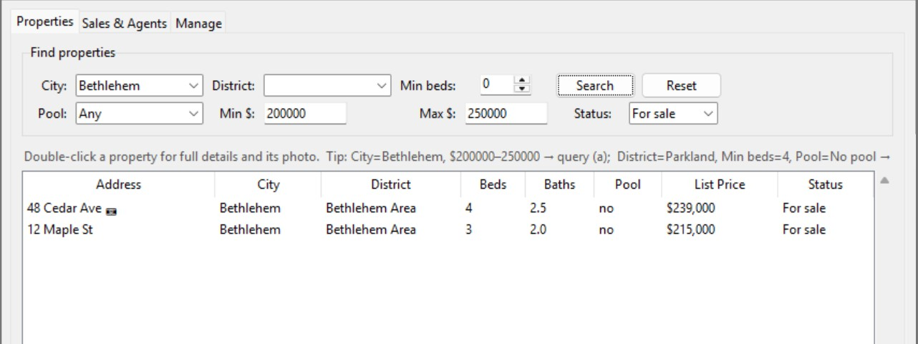
A
Homes for sale by city & price
Find addresses of homes for sale in “Bethlehem” costing between $200,000 and $250,000.
db.py
SELECT p.address, p.city, p.list_price
FROM properties p
LEFT JOIN sales s ON s.property_id = p.property_id
WHERE s.sale_id IS NULL -- still for sale
AND p.city = ? -- 'Bethlehem'
AND p.list_price BETWEEN ? AND ?; -- 200000, 250000
Two matches: 48 Cedar Ave and 12 Maple St.
A $172,000 Bethlehem home is correctly excluded
Notes:
Query A joins properties to sales, keeps only rows with no sale (still for sale), and filters by city and price band. Homes just outside the band are excluded, proving the price filter works.

Slide 6
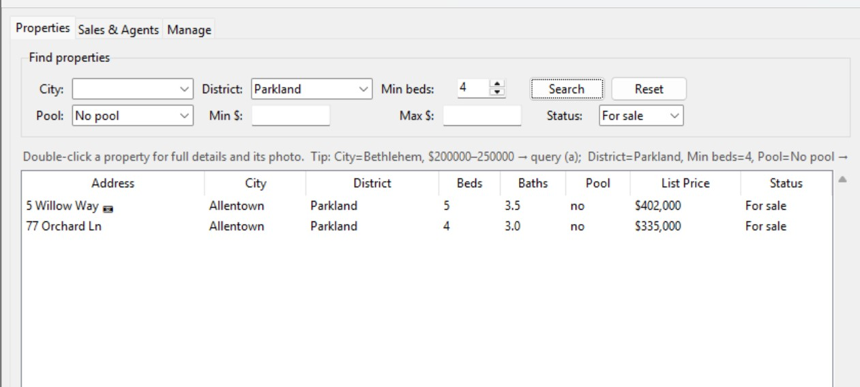
B
By school district, bedrooms & no pool
Find homes for sale in the “Parkland” school district with 4+ bedrooms and no swimming pool.
db.py
Two matches: 5 Willow Way (5 bed) and 77 Orchard Ln (4 bed).
A Parkland home with a pool and a 3-bedroom one are both excluded.
SELECT p.address, p.bedrooms, p.has_pool, p.list_price
FROM properties p
LEFT JOIN sales s ON s.property_id = p.property_id
WHERE s.sale_id IS NULL
AND p.school_district = ? -- 'Parkland'
AND p.bedrooms >= ? -- 4
AND p.has_pool = 0; -- no pool
Notes:
Same for-sale join as A, now filtered by district, a minimum bedroom count, and has_pool = 0. Two Parkland homes are deliberately excluded — one has a pool, one has only three bedrooms — demonstrating both extra conditions.

Slide 7
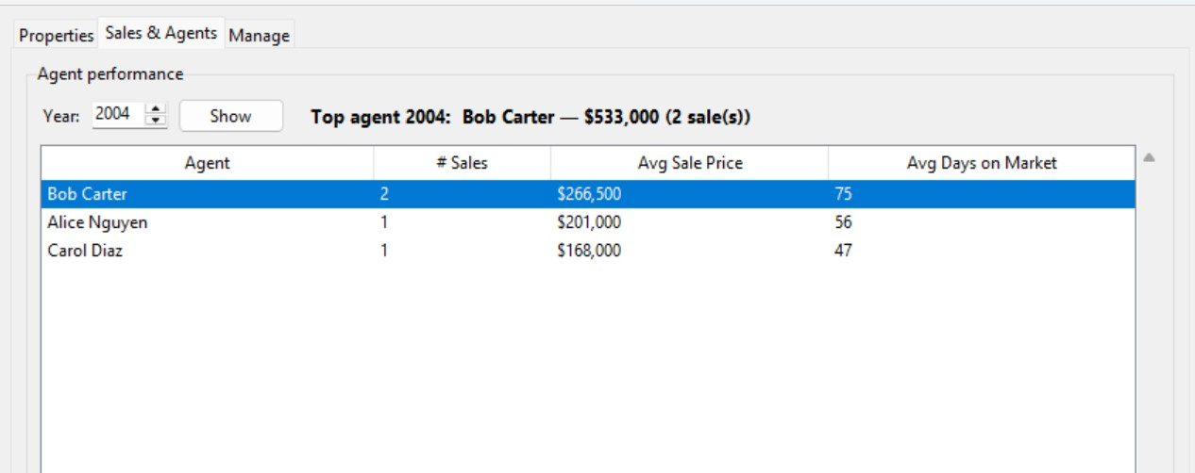
C
Top-selling agent of the year
Find the agent who sold the most property in 2004 by total dollar value.
db.py
Winner: Bob Carter — $533,000 across 2 sales.
strftime('%Y', …) pulls the year so the sum covers 2004 only.
SELECT a.name, SUM(s.sale_price) AS total_value,
COUNT(*) AS num_sales
FROM sales s
JOIN agents a ON a.agent_id = s.selling_agent_id
WHERE strftime('%Y', s.sale_date) = '2004'
GROUP BY a.agent_id
ORDER BY total_value DESC LIMIT 1;
Notes:
Query C groups 2004 sales by the selling agent, sums the sale prices, and takes the largest. strftime extracts the year from the stored date so we restrict the sum to 2004.

Slide 8
D
Per-agent averages
For each agent, the average selling price in 2004 and the average time on the market.
db.py
Time on market = sale_date − listing_date, via julianday().
This is why the design stores both a listing_date and a sale_date.
SELECT a.name,
ROUND(AVG(s.sale_price),2) AS avg_price,
ROUND(AVG(julianday(s.sale_date)
- julianday(p.listing_date)),1) AS avg_days
FROM sales s
JOIN properties p ON p.property_id = s.property_id
JOIN agents a ON a.agent_id = s.selling_agent_id
WHERE strftime('%Y', s.sale_date) = '2004'
GROUP BY a.agent_id;
Notes:
Days on market is the sale date minus the listing date. SQLite’s julianday() turns each date into a day-number, so subtracting them gives days on market, which we then average per agent.

Slide 9
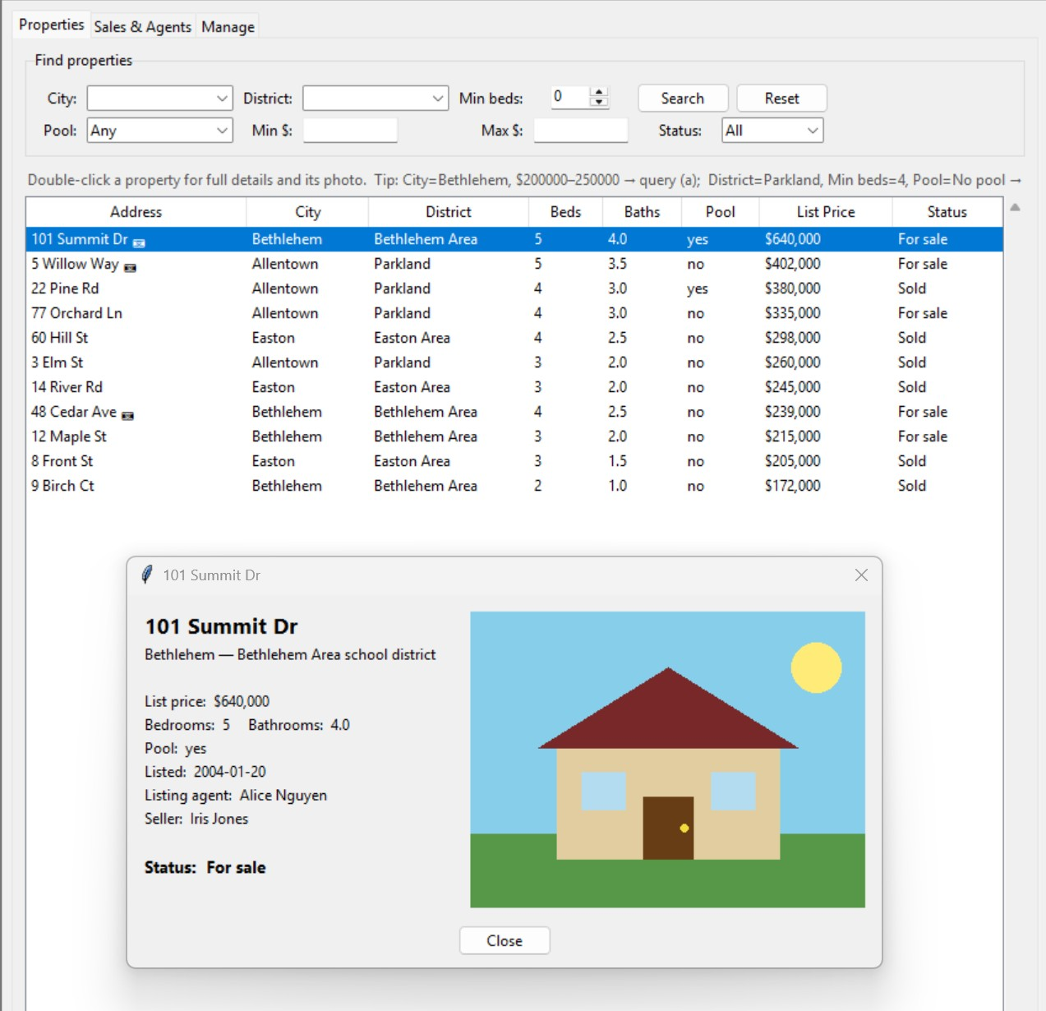
E
Photo of the most expensive house
Show a picture of the most expensive house(s) in the database.
db.py
SELECT address, city, list_price, photo
FROM properties
WHERE list_price = (
SELECT MAX(list_price)
FROM properties
);
Winner: 101 Summit Dr, Bethlehem — $640,000.
House photos are stored in the database as image BLOBs.
Double-click any row to open its detail window and render the photo.
Notes:
We store the image bytes directly in the photo column. When the detail window opens, the program reads those bytes back and renders them. Only a few houses carry a photo — the most expensive one always does.

Slide 10
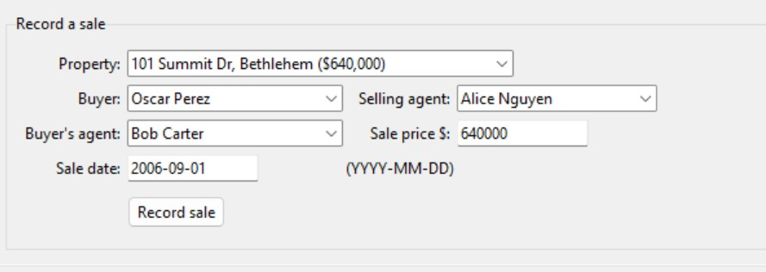
F
Record a sale
Record the sale of a listed home — price, buyer, selling agent, buyer’s agent (optional), and date.
db.py · record_sale()
The buyer’s-agent field may be left empty (“(none)”).
A guard rejects selling a home that is already sold.
# first check the property isn't already sold
INSERT INTO sales
(property_id, buyer_id, selling_agent_id,
buyer_agent_id, sale_price, sale_date)
VALUES (?, ?, ?, ?, ?, ?);
Notes:
Query F inserts a new row into sales. The buyer’s agent may be null. The program first checks the property isn’t already sold, so a home can’t be double-sold.

Slide 11
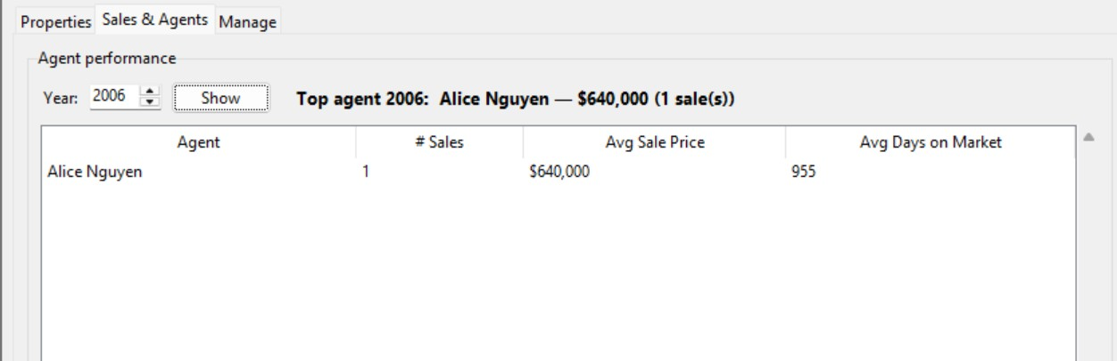
F
Flow through the rest of the system
Once recorded, the sale instantly changes every derived view.
The sold home immediately leaves the “for sale” search results.
It appears in the agent-performance report for its year (Alice Nguyen 1 sale$640,000, listed 2004 → sold 2006 ≈ 955 days on market).
Nothing is hand-updated: “for sale” status and every report are computed live from the sales table.
Notes:
Because ‘for sale’ and the reports are computed live from the sales table, recording a sale updates everything at once — the home disappears from the for-sale list and shows up in that year’s performance numbers.

Slide 12
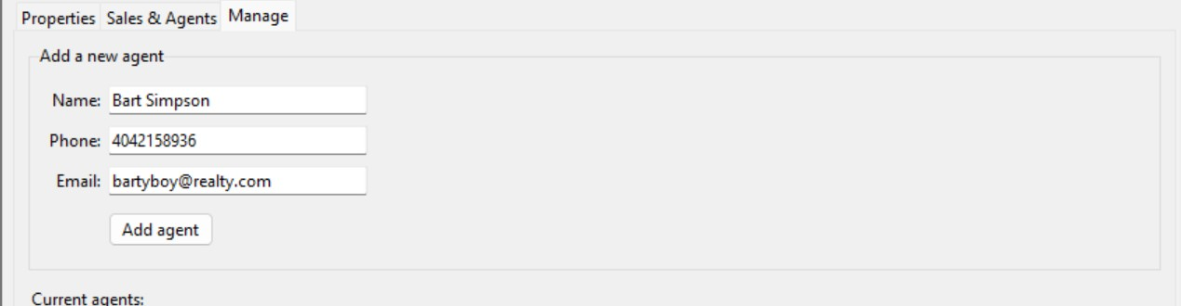
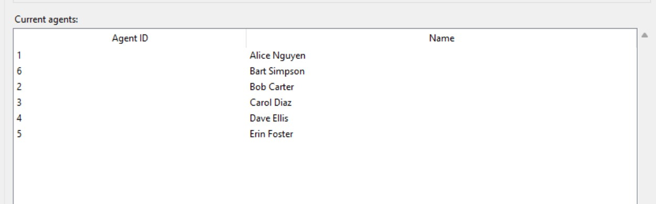
G
Add a new agent
Add a new agent to the database.
db.py · add_agent()
INSERT INTO agents
(name, phone, email)
VALUES (?, ?, ?);
-- email is UNIQUE
New agent “Bart Simpson” is added as agent #6.
The email column is UNIQUE so a duplicate email is rejected.
The new agent immediately becomes selectable when recording a sale.
Manage tab — the add-agent form
…and the updated agent list, now including agent #6
Notes:
Query G is a straightforward insert into agents. It also demonstrates the email UNIQUE constraint — adding a duplicate email is rejected. The new agent appears in the list and becomes selectable when recording sales.

Slide 13
Summary
A complete real-estate office database
Clean separation of concerns
Every required query A–G
A schema that can’t drift
Notes:
To summarize: a complete office database in SQLite and Tkinter, with all SQL isolated in the data layer, every required query reachable through a natural interface, and a schema where ‘for sale’ is derived rather than maintained by hand.

