Slide 1
OOP-Mini Project
Sorting Algorithm Demonstration
Team 17

Slide 2
Teams Members and Contribution
Đường Minh Quân
Phạm Ngọc Quân
Nguyễn Văn Quốc
Bùi Minh Quang
-Controller (Home, Sort, BubbleSort, InsertionSort, QuickSort) -50%
-View(Home, Sort, BubbleSort, InsertionSort, QuickSort) -70%
-Main Application.
- Column Bar and TextValue
.
-Utilities (Animation, SetVisible).
Application Assets.
-Report.
-Controller (Home, Sort, BubbleSort, InsertionSort, QuickSort) - 50%
-View(Home, Sort, BubbleSort, InsertionSort, QuickSort).
-Utilities (Array).
Sorting, InsertionSort Algorithm.
-Input Parser (65%).
-QuickSort Algorithm (25%)
-Exceptions Handling (
Datatype, MinMaxValue, Null, Number of Value)
-Specific packages Class Diagram.
-Input Parser (35%).
-Presentation Design (50%).
-QuickSort Algorithm (25%)
-View(Home, Sort, BubbleSort, InsertionSort, QuickSort) -30%
-QuickSort Algorithm (50%).
-General Class Diagram.
-Use Case Diagram.
-Presentation design (50%).
Claimer:
HomePage design is inspired by a K65 Project.
The pseudocode, color and animation is inspired by VisualAlgo by NUS University
More details and reference links are available in our report.

Slide 3
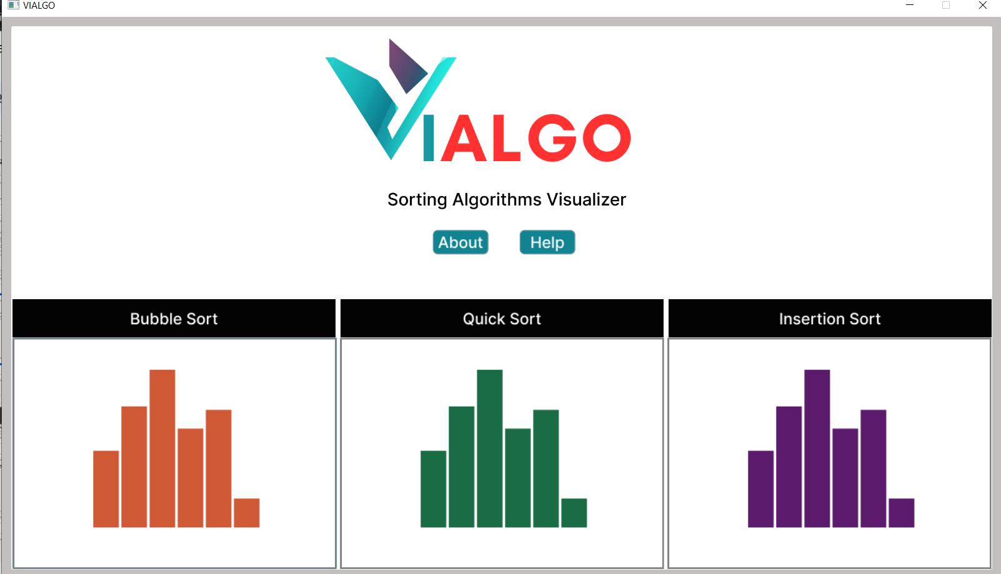
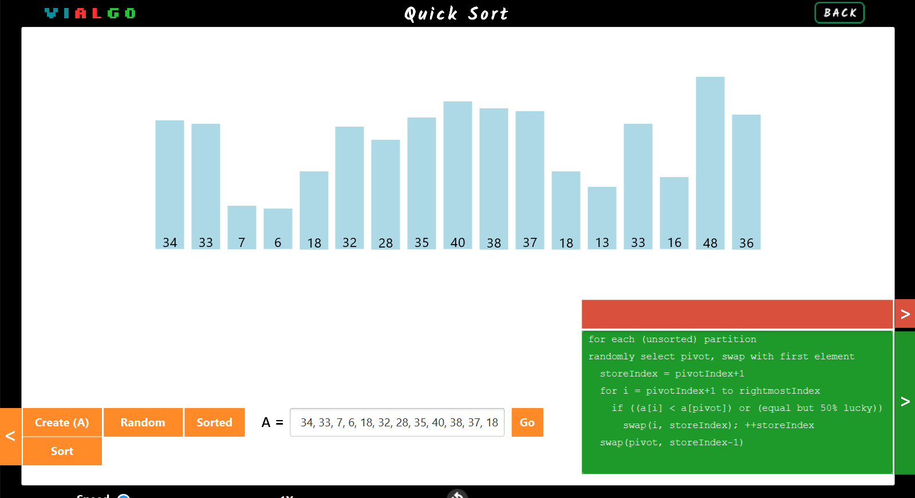
Project Statement
Our main goal in this project is to create a program that can visually demonstrate 3 types of Sorting Algorithm, namely Insertion Sort, Bubble Sort, and QuickSort (3 versions).
There are different options for array creating.
User can also alter the speed of the program
User can choose one of 3 Sorting Algorithms to demonstrate.

Slide 4
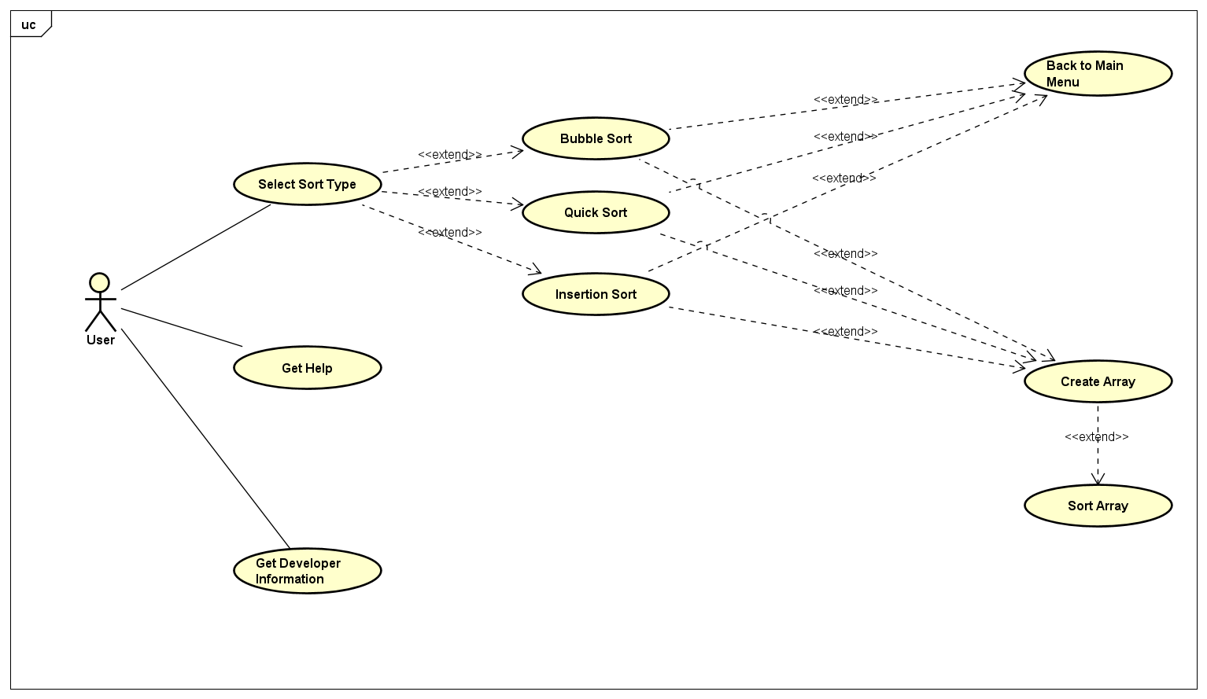
Use Case Diagram
User can choose 1 of 3 sorting algorithms in the Home Page.
When user is in a specific Sorting Screen, they can either create and sort array to view the demonstration or they can get back to the Main Menu,
Also, user may choose to get help or more information about the development team.

Slide 5
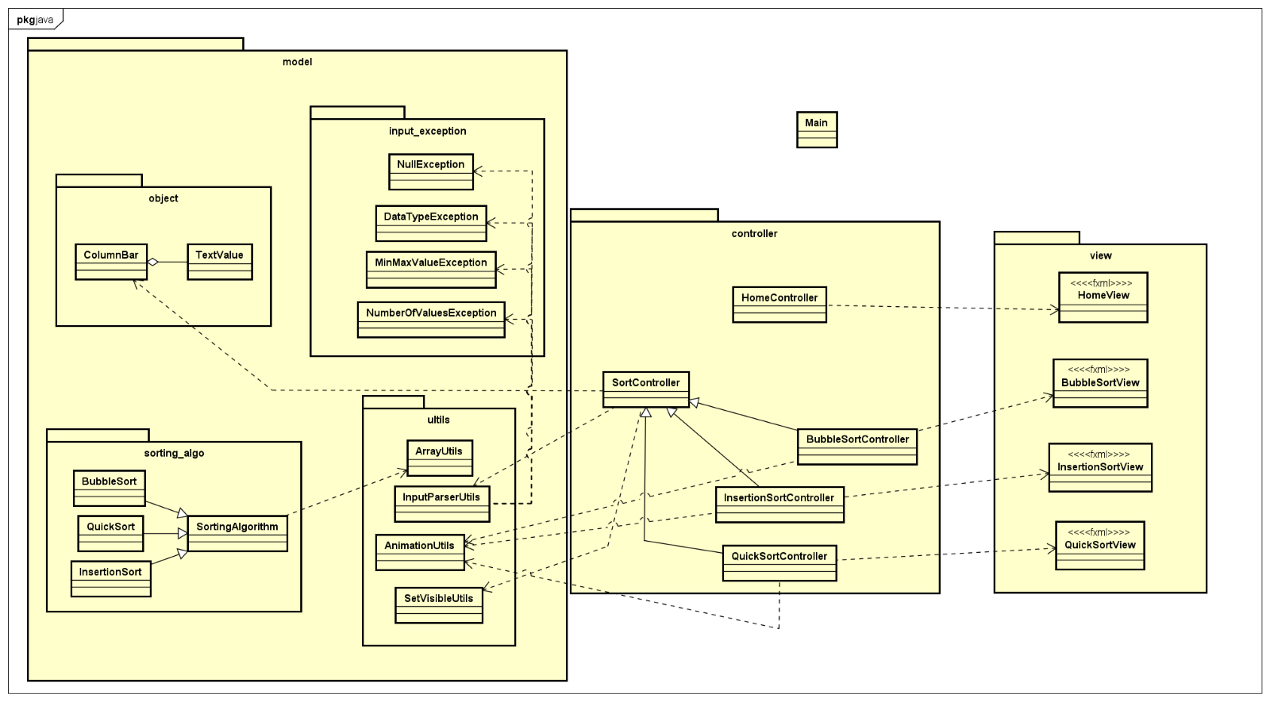
General Class Diagram
Our model is designed based on MVC design.
Model contains 4 packages (object, sorting_algo, utils, input_exception)
Controller and view packages are designed for each sorting algorithm

Slide 6
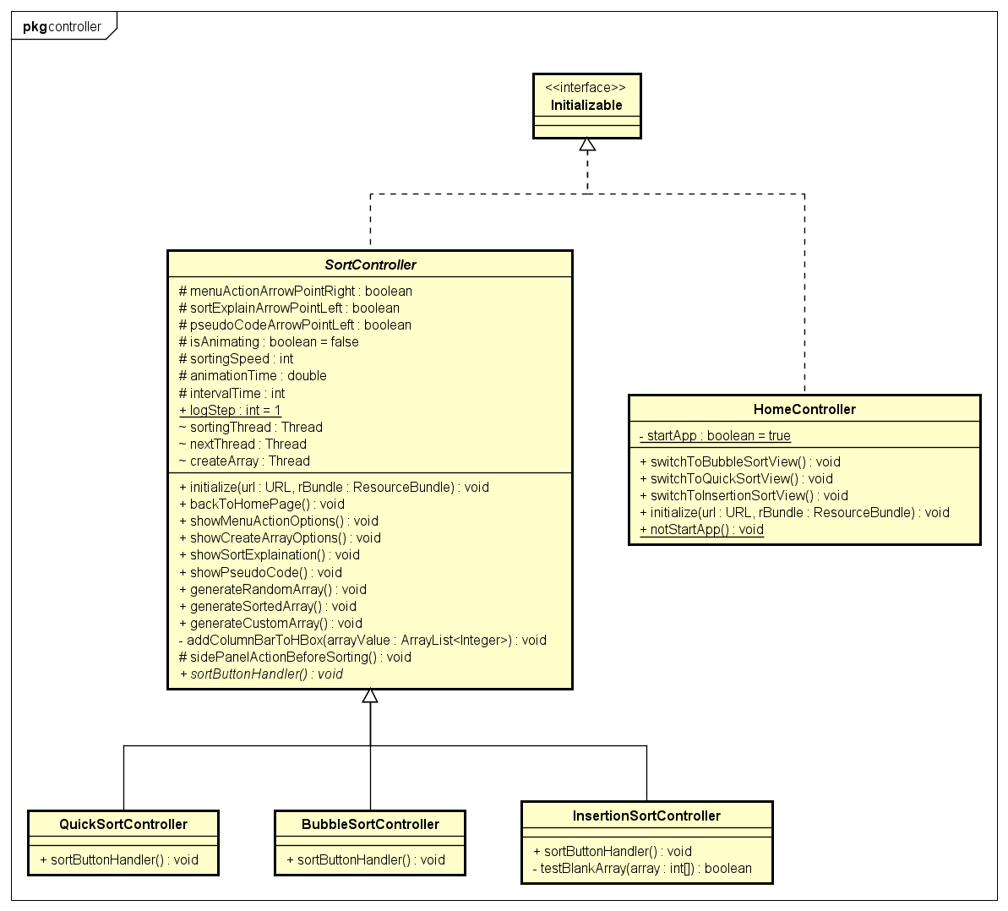
Detailed Class Diagram- controller
SortController is an abstract class containing attributes and (abstract) methods.
BubbleSortController, InsertionSortController, and QuickSortController) inherited from SortController.
Controllers implements Initializable interface.

Slide 7
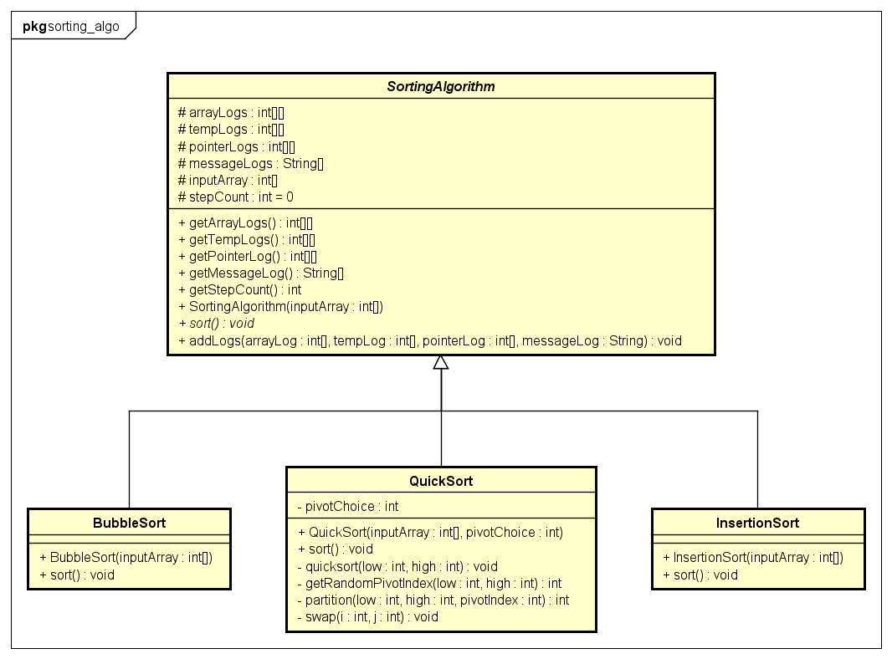
Detailed Class Diagram- sorting
SortingAlgorithm is the abstract class
BubbleSort, QuickSort, and InsertionSort all inherit from Sorting Algorithm.

Slide 8
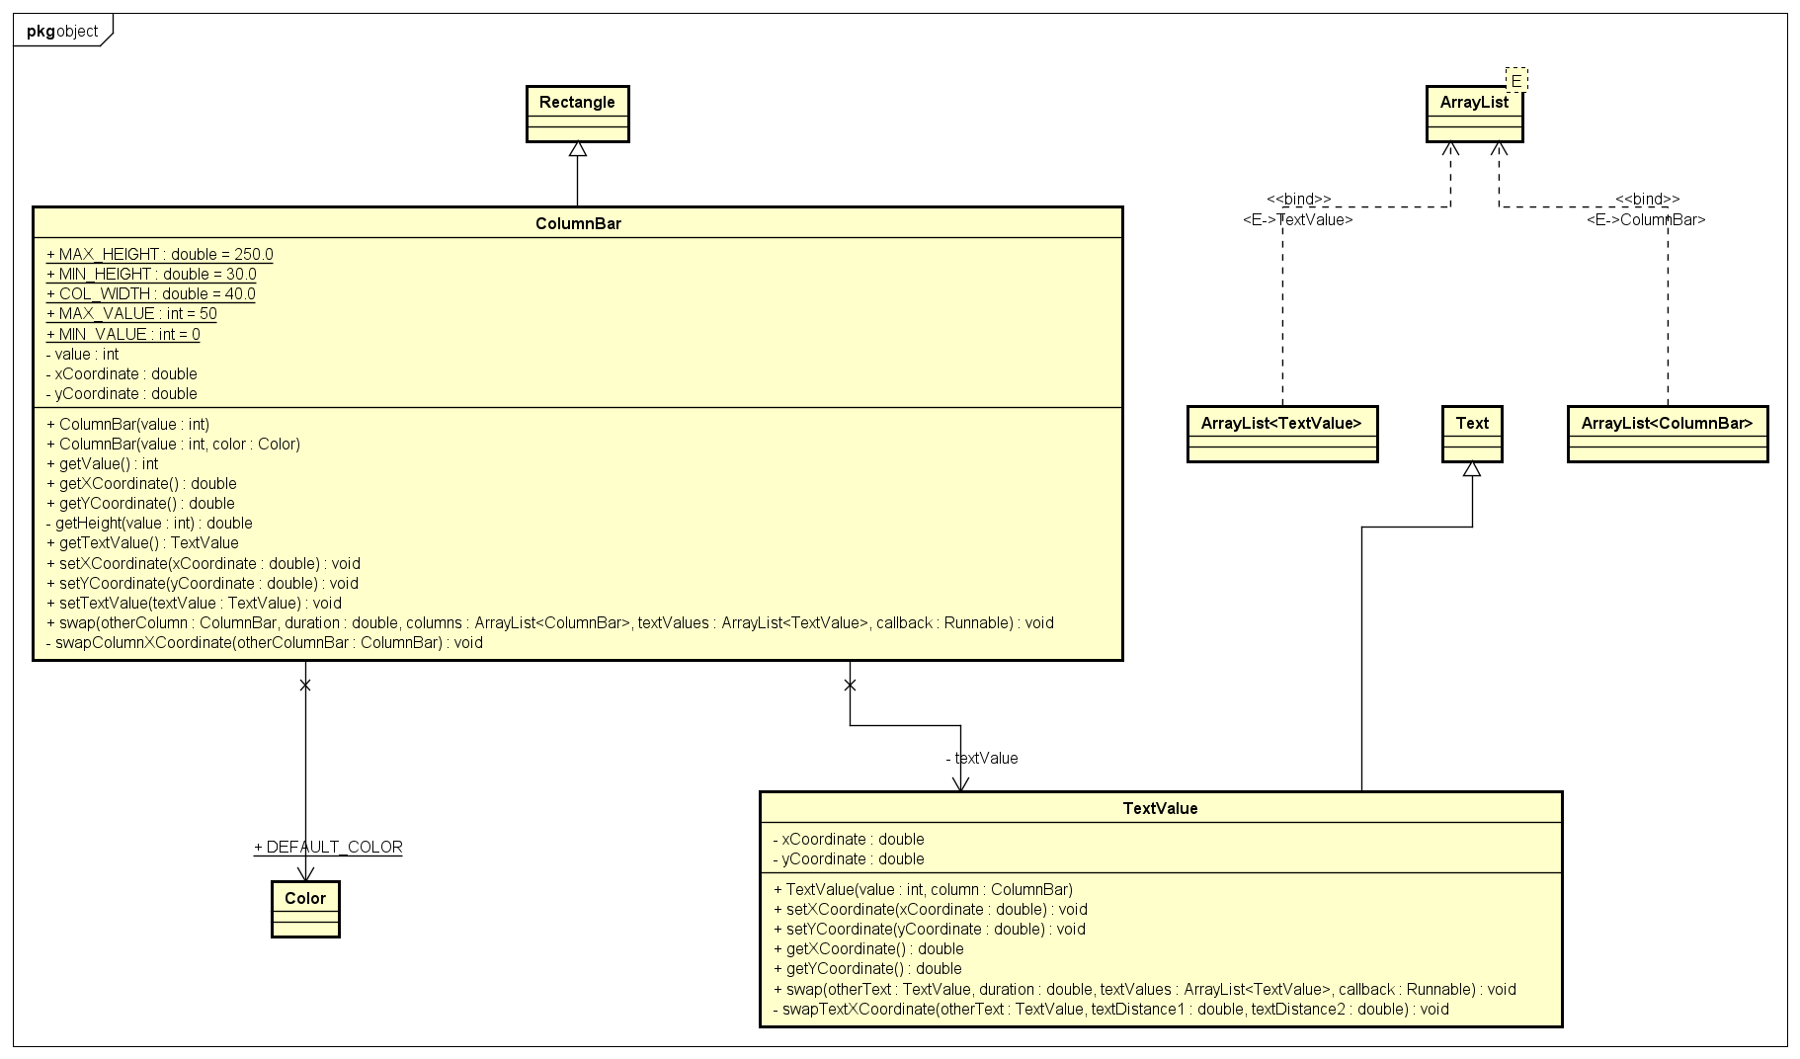
Detailed Class Diagram- object

Slide 9
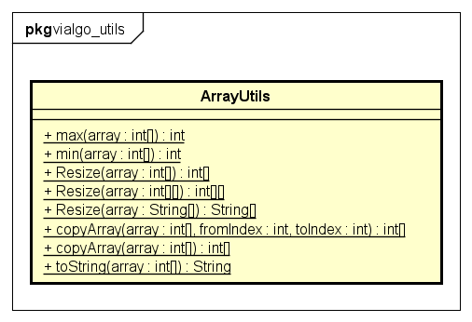
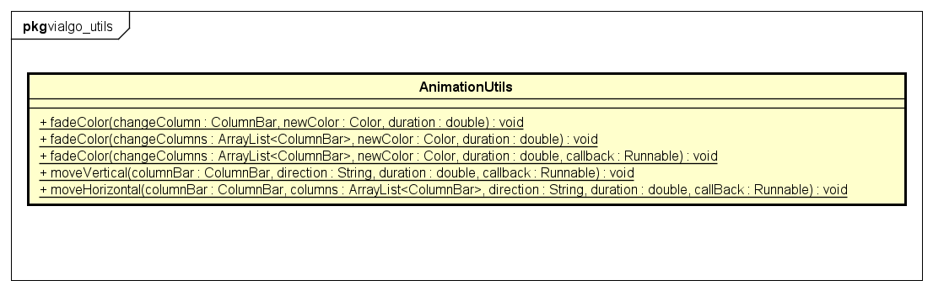
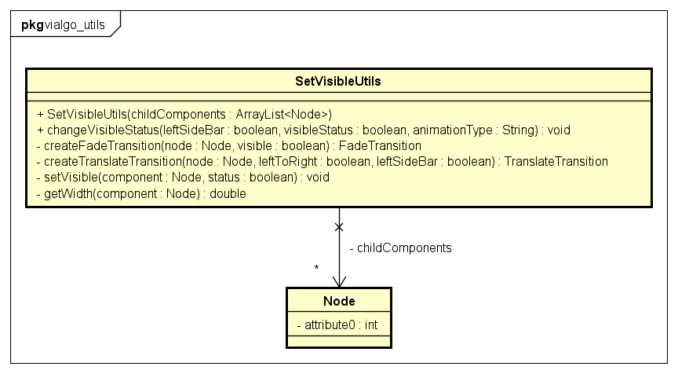
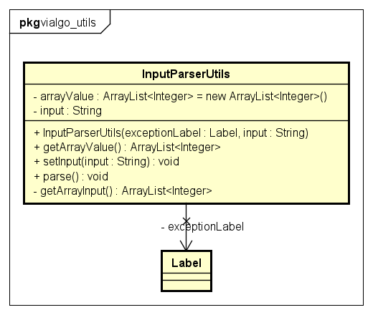
Detailed Class Diagram - utils

Slide 10
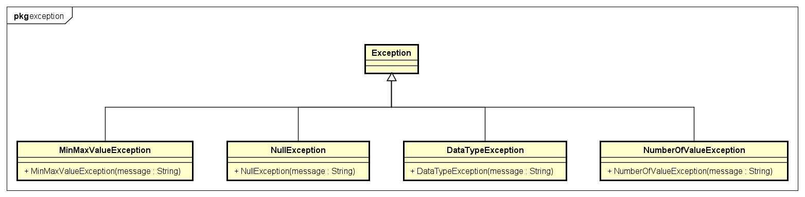
Detailed Class Diagram- exception
Exception is the parent class.
There are 4 specific exception for specific case: min and max value, object indication, data type, and the number of value.

Slide 11
Inheritance
In the data collection section, the program uses abstract classes and interfaces.
The apps are created as separate classes and inherit from the abstract classes and
Interfaces.
In the program, single-level inheritance is used in many classes,. The use of inheritance helps make the code more concise and readable. For example when setting sorting classes in package controller they call diffferent component such as column’s value and input array
Benefits: Inheritance facilitates rapid and concise programming.

Slide 12
Polymorphism
Polymorphism is demonstrated in the program through the following points:
Method overloading is implemented in the classes of vlalgo_utils package, allowing the creation of methods with different types of input parameters.
Benefits: Polymorphism allows writing a single method with multiple parameter types. Additionally, it enables customization of inherited methods to suit specific objects, such as pressent animation of different algorithms in different ways.

Slide 13
Encapsulation
Properties are hidden using the private access modifier, and public methods are
used to access and modify the data.
Benefits: Ensures data security

Slide 14
Abstraction
Abstraction is implemented through abstract classes and interfaces, with
subsequent classes inheriting from them
Benefits: Abstracting common attributes of entities helps simplify and
expedite programming.

Slide 15
Demo Scenario
Click here

