Slide 1




Presented by :
Neuro Pulse
KERALA FINANCE KNOWLEDGE INTELLIGENCE PLATFORM

Slide 2

INTRODUCTION
Kerala Finance KIP is an AI-powered platform designed to make government document management easier and more efficient. It helps officials quickly find, understand, and verify important financial documents through smart search, document tracking, automated extraction, and AI assistance. The entire system runs locally, ensuring that sensitive financial information remains secure and protected.

Slide 3

THE PROBLEM
Volume & Complexity:
Thousands of Government Orders, circulars, budget docs, and GST policies across years and formats.
Lineage & Supersession:
High risk of using superseded orders, affecting financial decisions and file processing.
Time-Intensive Workflow:
Officials spend hours manually searching, extracting clauses, and drafting policy notes.
Security Constraints:
Highly sensitive financial data cannot be sent to public cloud AI APIs.

Slide 4

OUR SOLUTION
01
Intelligent Search:
Hybrid semantic & keyword search with verifiable source citations.
Document Lineage Tracker:
Automatically resolves active vs. superseded orders.
02
03
Automated Extraction:
Instantly pulls structured clauses and financial figures from PDFs.
Agentic Assistance:
AI agents that help research GST policies and draft official policy notes.
04
Enterprise Security:
Fully local deployment (Ollama LLM) with Role-Based Access Control and tamper-evident audit logs.
05

Slide 5
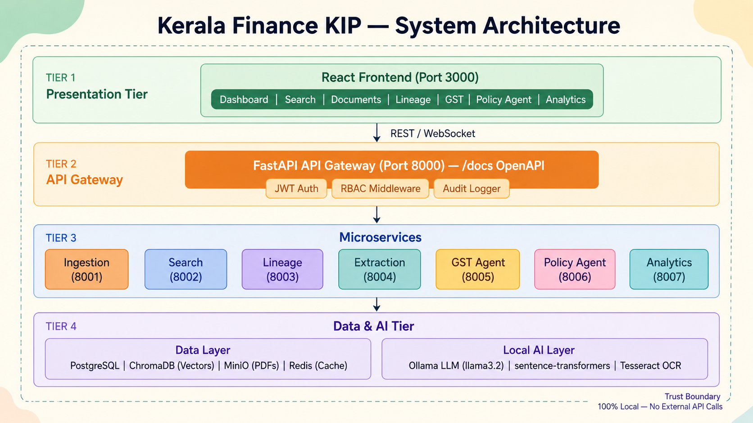

Slide 6
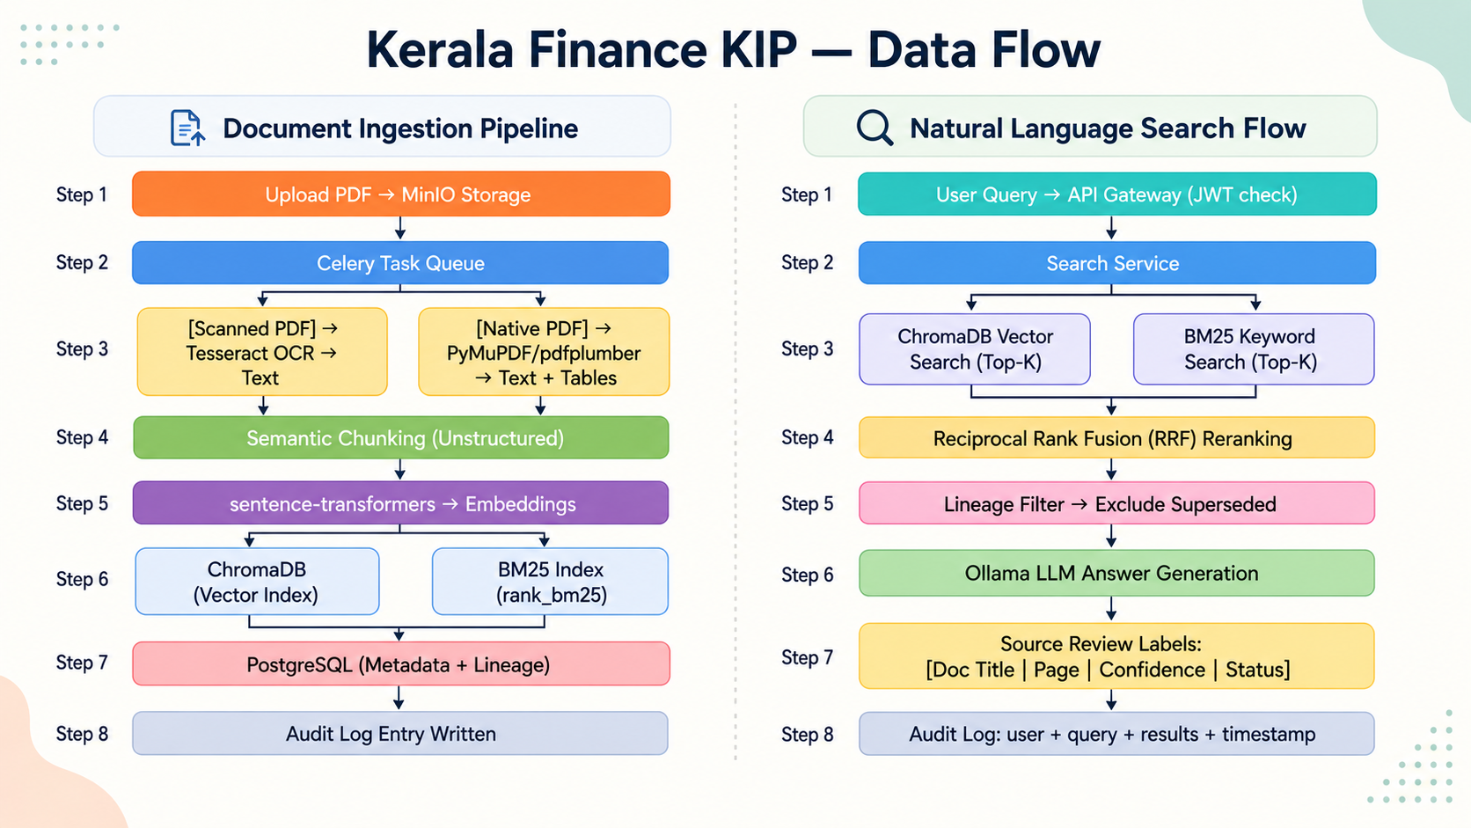

Slide 7

KEY FEATURE: SOURCE REVIEW LABELS
The AI Hallucination Problem
Our Approach
Generative AI cannot be trusted blindly in government finance.
Every AI output includes a Source Review Label.
What it Shows
01
Exact source document and page number.
02
Active/Superseded status indicator.
03
Confidence score of the extraction.

Slide 8
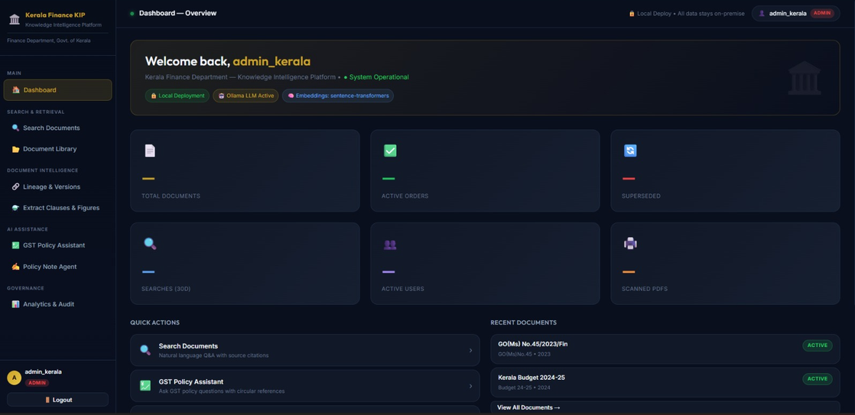
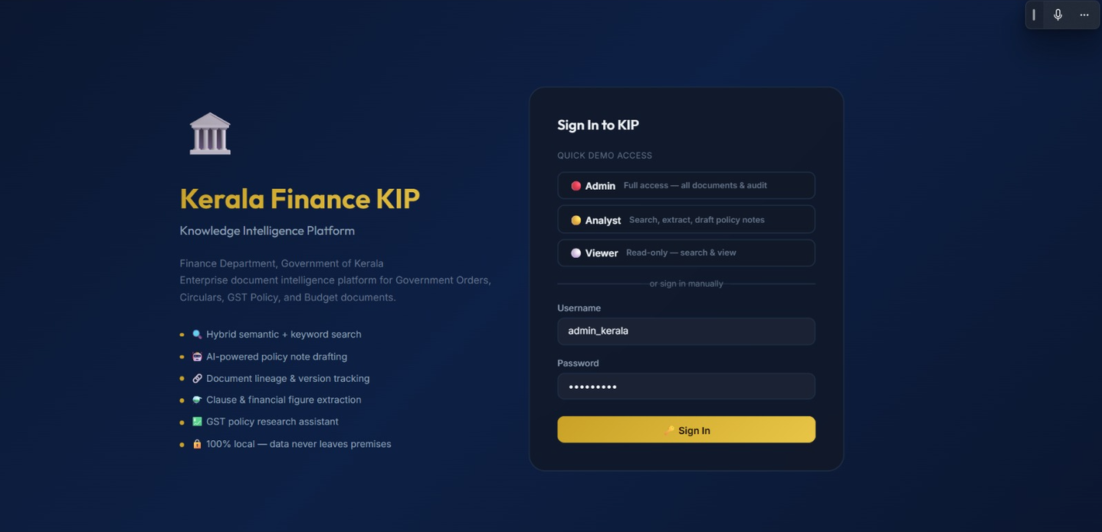
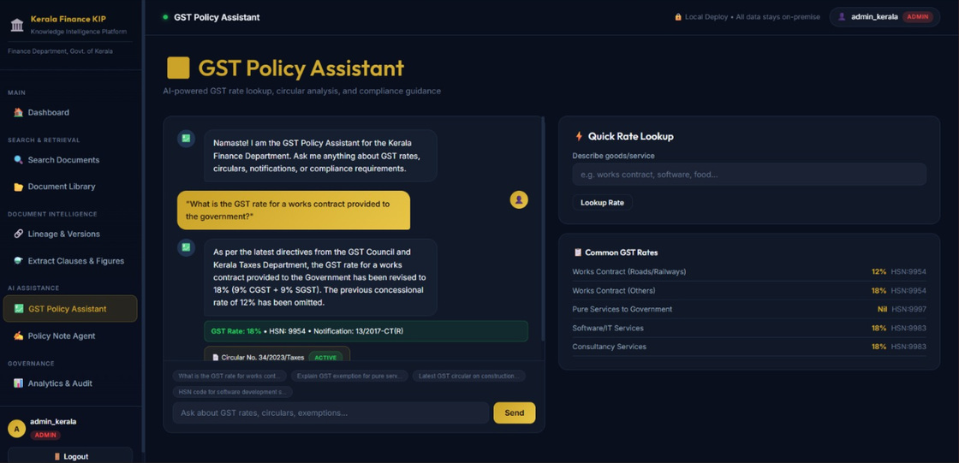
02
Dashboard
FEATURE DEMO
01
Login Page
03
GST Policy Assistant

Slide 9
EVALUATION & QUALITY
Automated Testing:
Pytest suite continuously measures search accuracy, lineage resolution, and access control.
01
Dockerized Deployment:
The entire 12-container system spins up with a single docker compose up command.
02
Auditability:
Every search, extraction, and login is recorded in an append-only SQLite audit log.
03

Slide 10
FUTURE ENHANCEMENT
e-Office Integration:
Connect KIP with existing government workflows for seamless document processing.
01
Advanced AI Assistance:
Improve AI-based policy research and automated policy note drafting.
02
Malayalam Language Support:
Add Malayalam OCR and multilingual search capabilities.
03
Scalable Deployment:
Expand the platform to support more departments and larger document collections.
04

Slide 11
CONCLUSION
Kerala Finance KIP makes government document management faster, smarter, and more secure by combining AI, intelligent search, document tracking, and automated information extraction. It helps officials quickly access and verify reliable financial information while keeping sensitive data secure through 100% local processing. Overall, the platform provides a strong foundation for efficient, transparent, and technology-driven financial administration.

Slide 12




Thank
You

