Slide 1
IFNAR1 – coding variant
rs2257167

Slide 2
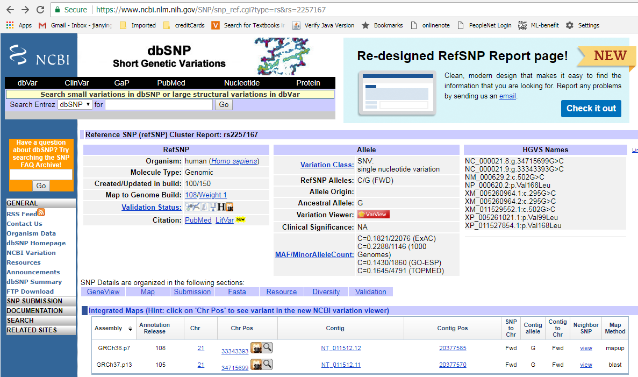

Slide 3
dbSNP: rs2257167
Reference allele: G
Variant allele: C
Minor allele frequency (MAF) in populations
C=0.1821/22076 (ExAC)
C=0.2288/1146 (1000 Genomes)
C=0.1430/1860 (GO-ESP)
C=0.1645/4791 (TOPMED)
In our study
 | Reference allele (G) frequency | Variant allele (C) frequency
ALL individual | 0.7313433 | 0.2686567
Individual with RSV positive | 0.7319202 | 0.2680798

Slide 4
Association test on this SNP
Here, we assume A allele is the reference allele (G)
We tested three hypotheses (logistic regression)
Additive effect (Case I: AA AB BB)
Dominate effect from the variant allele (Case II: AA vs AB/BB)
Recessive effect from the variant allele (Case III: AA/AB vs BB)
Chi-square test
Cochran-Armitage trend test
Generate odds ratio and confident interval

Slide 5
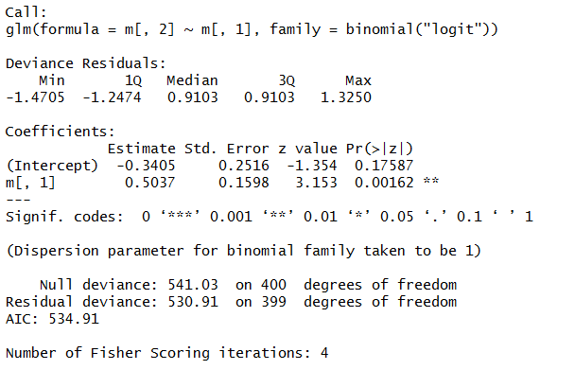
Testing the additive effect (Case I: AA AB BB)

Slide 6
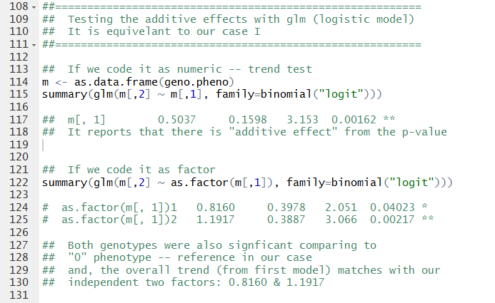
Testing the additive effect (Case I: AA AB BB)

Slide 7
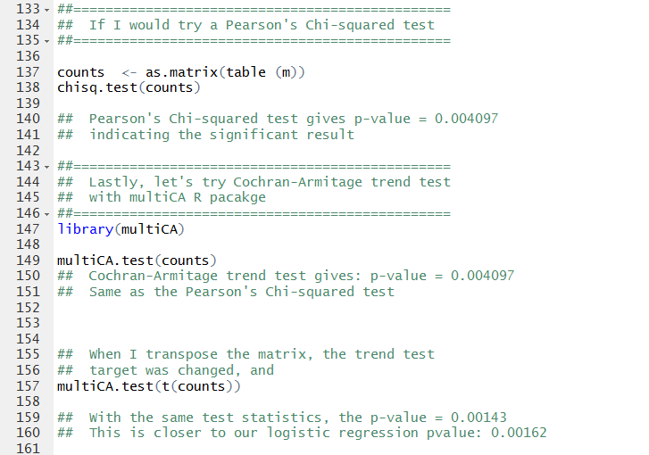
Testing the additive effect (Case I: AA AB BB) --chi-square vs trend test

