Slide 1
R parallel

Slide 2
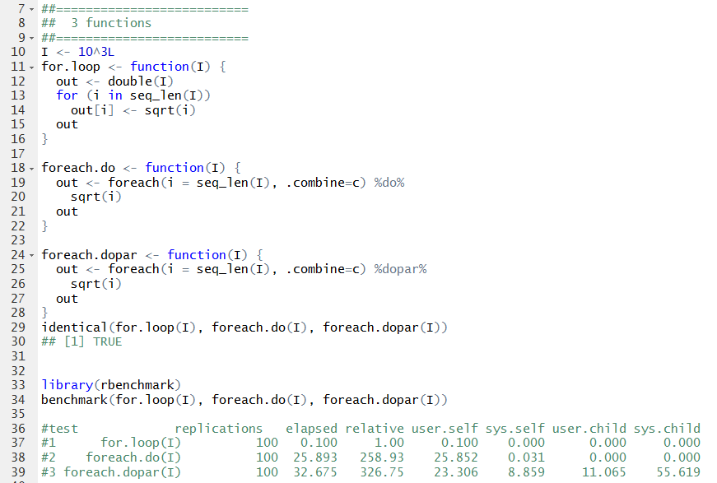
“dopar” – does need some overhead

Slide 3
R-parallel – temporary conclusion
R “for loop” does not have “optimized computer engineering”
doParallel and doMC are comparable
Windows: only doParallel is supported
Linux/Mac: both packages are supported
R-parallel is “better” implemented under Linux
Choose Linux if ever possible
Choose “doMC” over “doParallel”
R-parallel procedure also has it own overhead

Slide 4
Effort in recent projects
NTP sample collection standard development
Oxidative stress mechanistic study
R parallel with doMC
microRNA from rat body map (on going)

Slide 5
Vera, G. et al. 2008, BMC Bioinformatics 9:390
Notes:
In 2008, a group of researchers from Spain introduced an R/parallel package (Vera, Jansen et al. 2008), which can be integrated with any existing R packages, provides a users’ friendly framework without any modification of the existing code and ensures the analysis run in a parallel mode. According to their assessment, with this R/parallel package, the processing time could be reduced by N-fold where N being the number of available processor core.

Slide 6
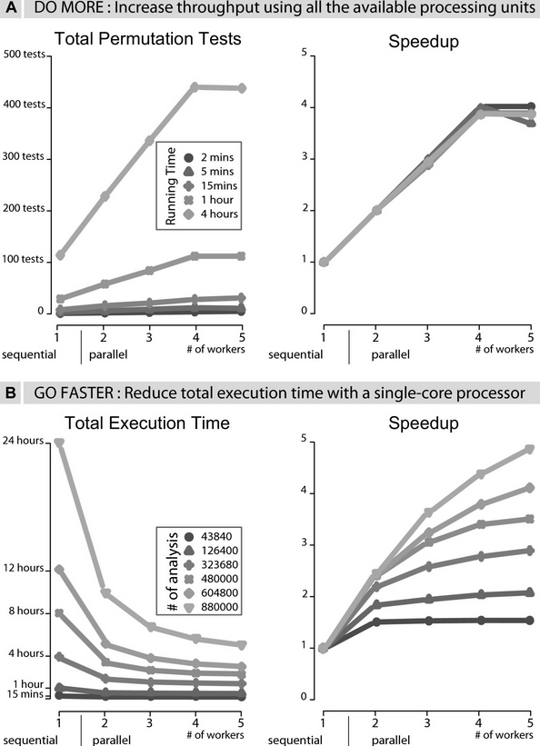

Slide 7
A working solution
doMC package – Steve Weston
An interface between foreach and multicore
Therefore, two main components
registerDoMC()
foreach paired with %dopar%
A good example in genomic science would be
foreach (chr in chrs) %dopar% whateverFunction

Slide 8
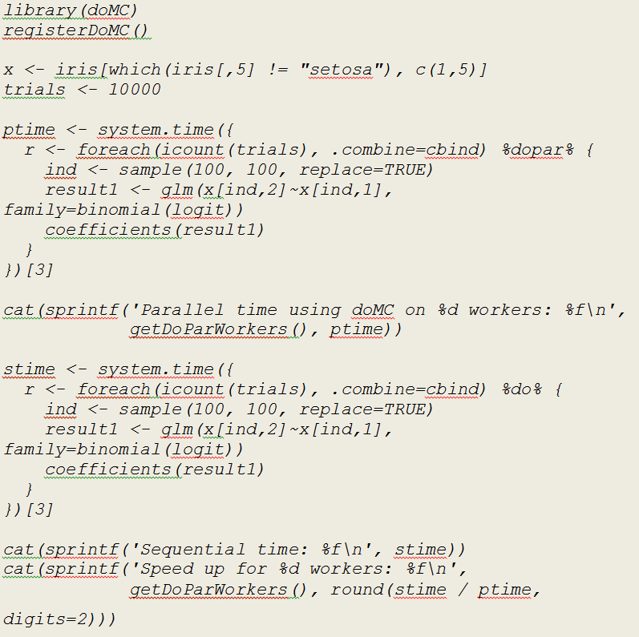

Slide 9


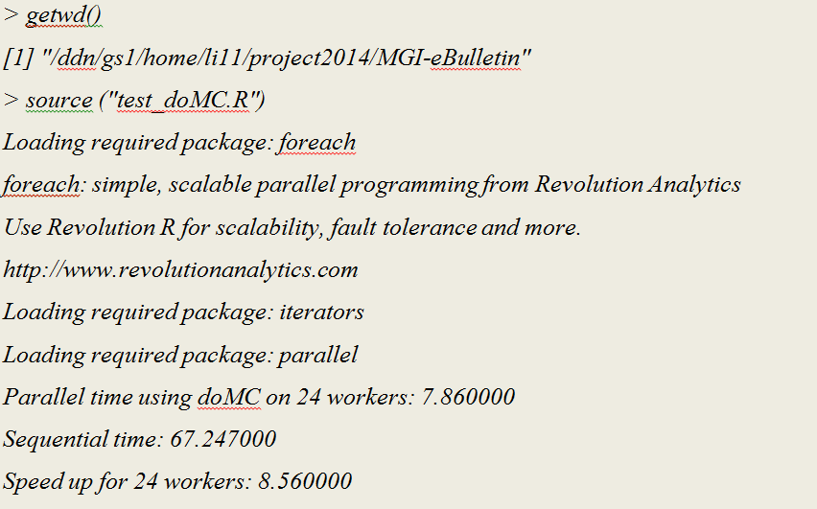

Slide 10
A few things to keep in mind
doMC relies on “fork” – windows is NOT supported
Even in linux, some operations will fail
doMC relies on mutlicore – fork without exec
NOT safe in GUI environment
A good example is R.app on MacOS X
Lastly, anyone help with “CPU”, “processor” or “core” concept?

Slide 11
