Slide 1
Leveraging special R features
Report with Rmarkdown, speed up with R-parallel, etc.

Slide 2
R-markdown language
Markdown
Create formatted documents
Source file type .md, contain text and formatting commands
Simpler than most other formatting languages, such as LaTeX or HTML,
R Markdown is an extension of Markdown
RMarkdown includes R code imbedded
Results in the formatted document (html, or pdf)
Integrates documents and results from your analysis
Synchronizes changes in data set, analysis, etc.
Benefit using the Rmarkdown
Develop and test simultaneously
Ensure the reproducibility
Generate the convenient html report for record keeping, viewing, and sharing

Slide 3
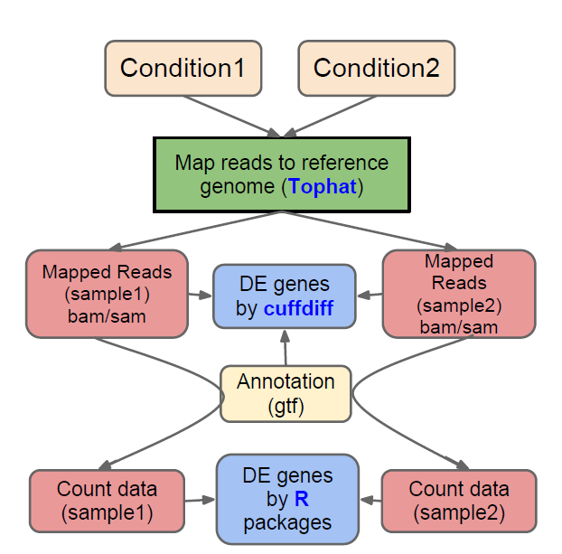
General RNASeq analysis pipeline

Slide 4
RNASeq analysis ensemble pipeline

Slide 5
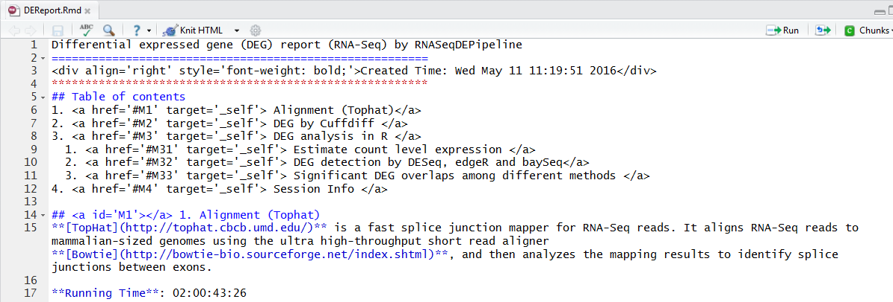
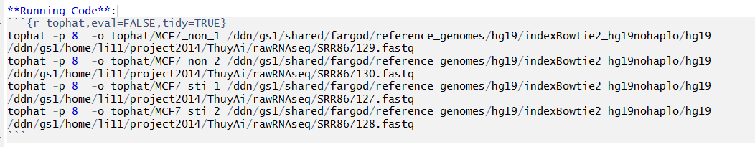
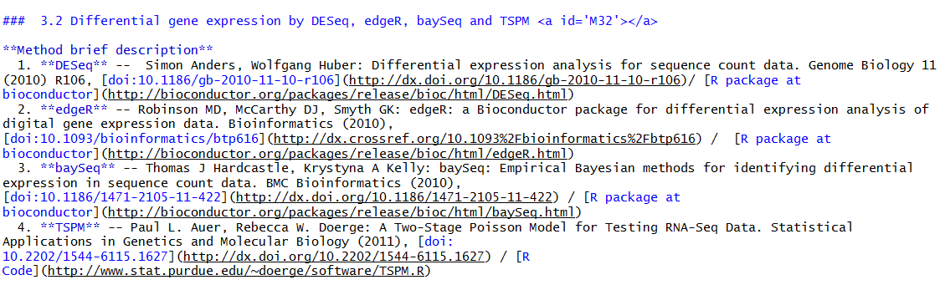
Notes:
Maybe demo starts here while waiting for run

Slide 6
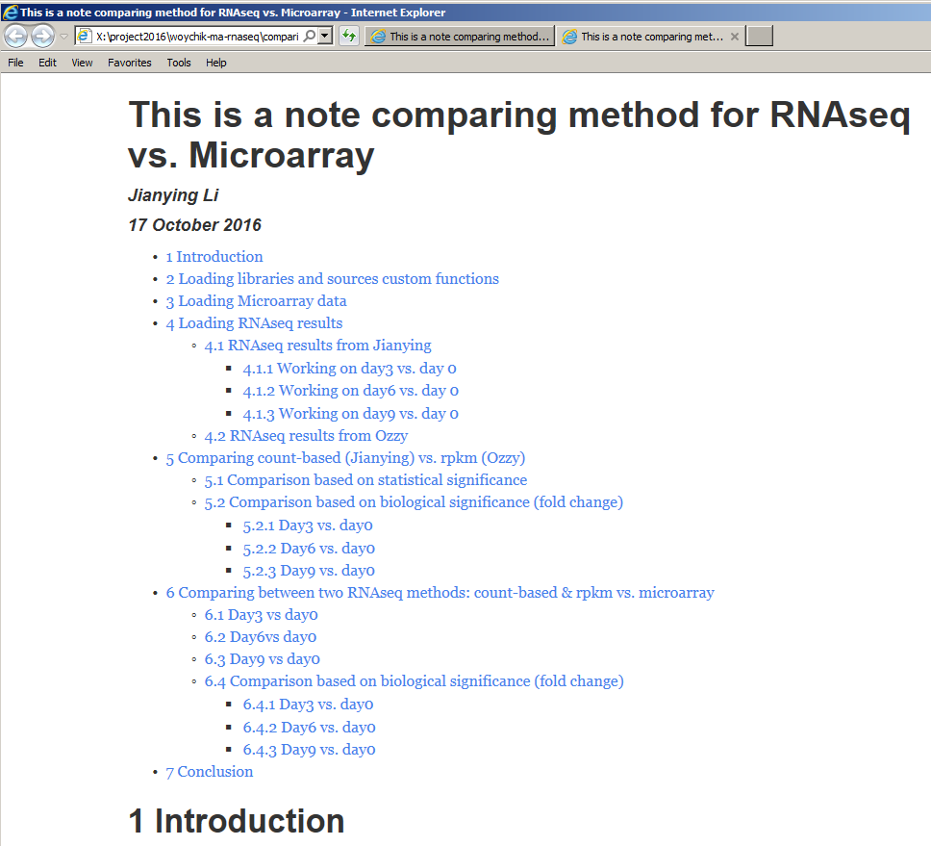

Slide 7
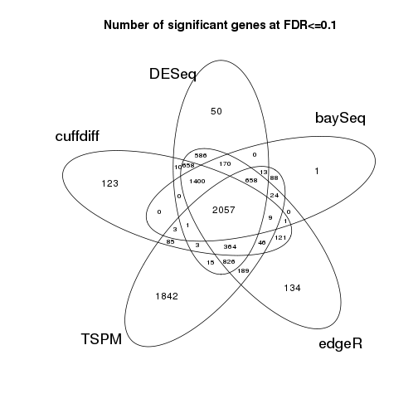


Notes:
Get an html prepared report,
Show a couple live examples

Slide 8
Produce a pdf report -- suggested prerequisite
http://rmarkdown.rstudio.com/pdf_document_format.html#overview
Within Rstudio (assuming Rstudio is installed)
There is an R package called “rticles”
https://github.com/rstudio/rticles
Just following the tutorial session
Produce a Journal of Statistical Software
Notes:
Based on the golden gate association pdf results

Slide 9
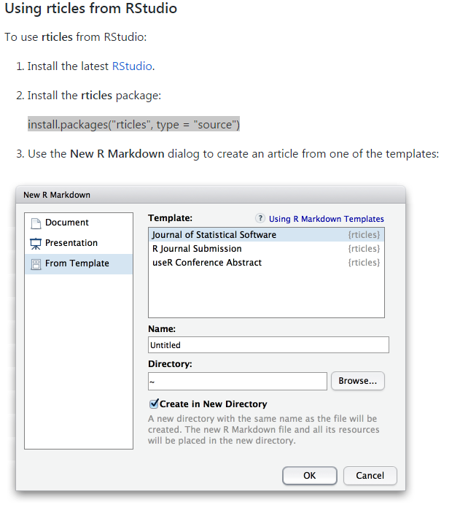
“rticles” installation – create first “rticles - jss”

Slide 10
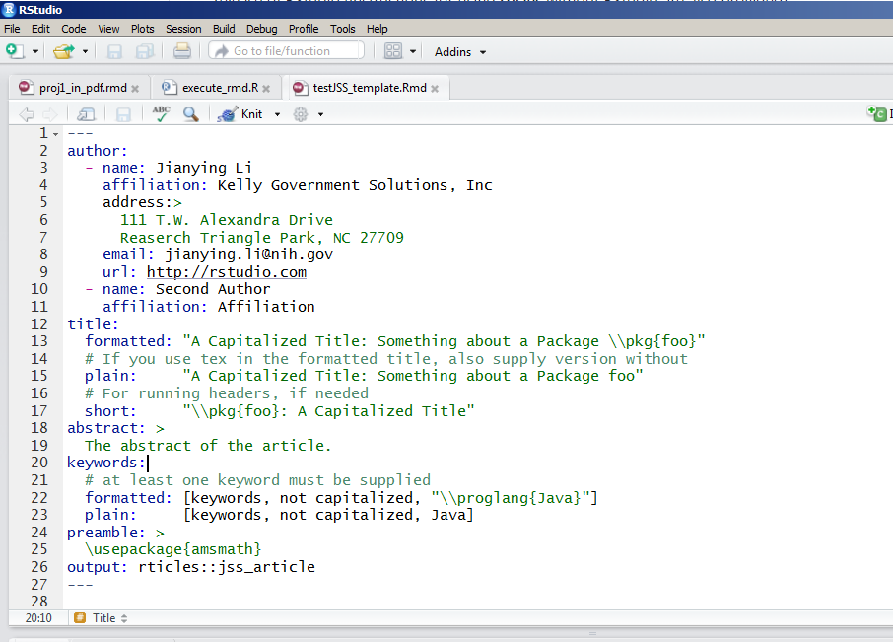
Generate the article using “knitr”

Slide 11
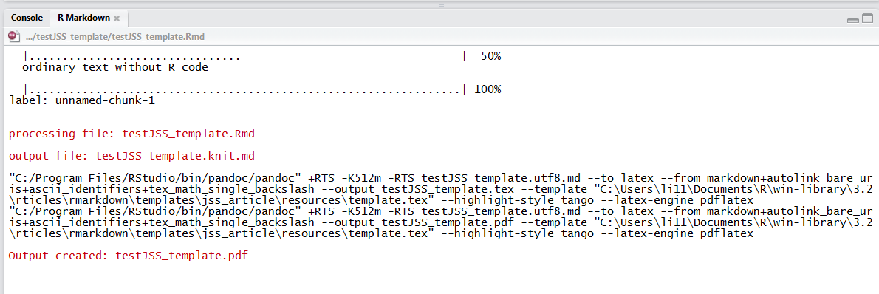
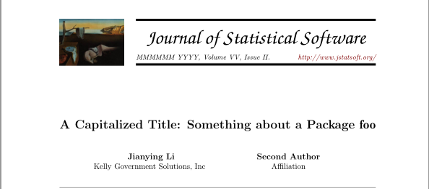
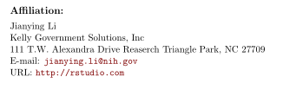

Slide 12
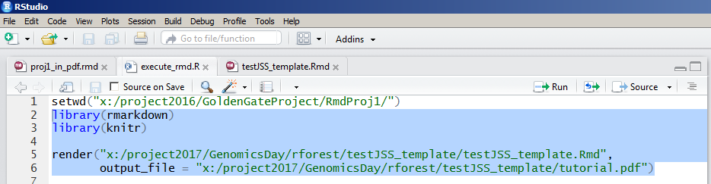
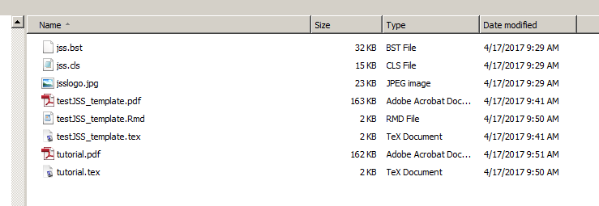
What behind the scene
Run the block of the code
It produces a LaTex file the converts to a .pdf file

Slide 13
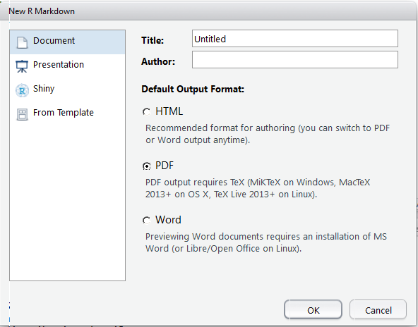
It is required – pdf requires Tex

Slide 14
R – parallel processing
”for” loop in R is quite inefficient
May not be the case anymore
Use “apply” and its derivatives if possible
The “foreach” pairing with “dopar” speeds up the process
Two R packages support “dopar”
doParallel
doMC
”mcapply” over-trumps “apply”
”dopar” does have overhead

Slide 15
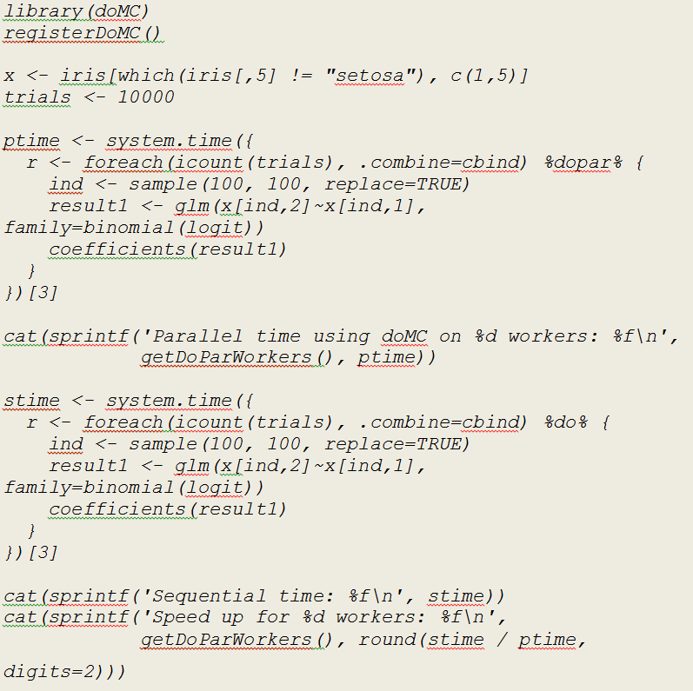
Notes:
Switch to demo

Slide 16
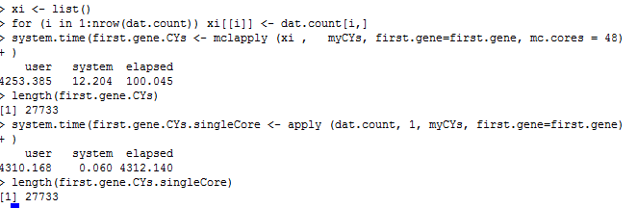
Head to head: mcapply vs. apply

Slide 17
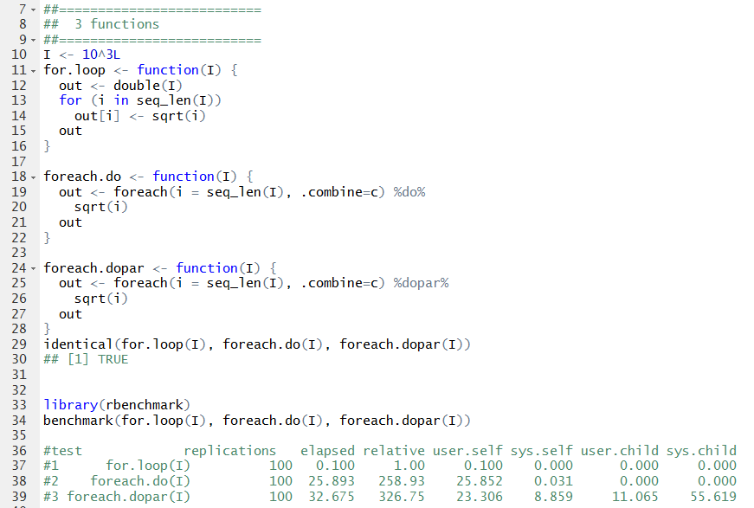
“dopar” – apparently with overhead

