Slide 1
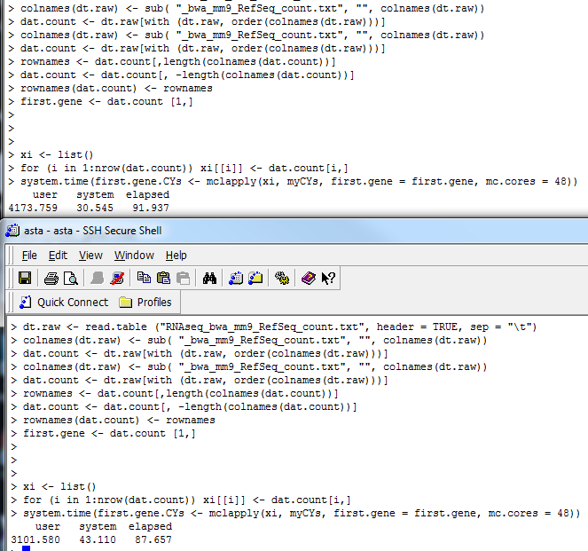
Comparing again an old server
latimer
asta

Slide 2
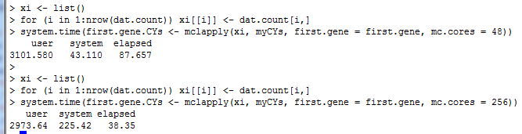
Work with different number of cores
Asta with
48 cores
Asta with
256 cores

Slide 3
Temporary conclusion
When using the same number of cores (48), “asta” performs better than an old server (“latimer”)
When using all available cores (256) on “asta”, the time allocation was reflected between “user” and “system”
There was ~60% used when application (claiming 256 cores) was launched
It was hard to know “how many cores were actually used”
Decipher the R proc.time
The ‘user time’ is the CPU time charged for the execution of user instructions of the calling process
The ‘system time’ is the CPU time charged for execution by the system on behalf of the calling process

