Slide 1
R parallel

Slide 2
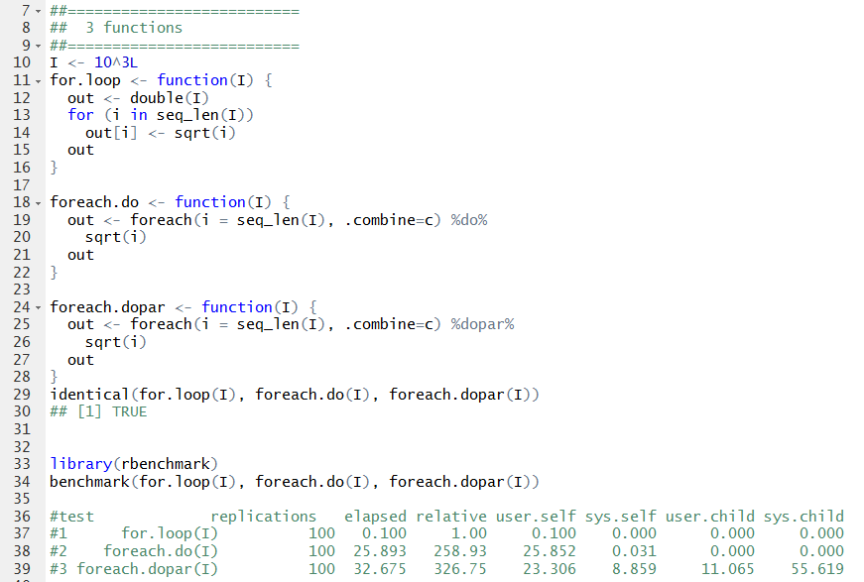
“dopar” – does need some overhead

Slide 3
R-parallel – temporary conclusion
R “for loop” does not have “optimized computer engineering”
doParallel and doMC are comparable
Windows: only doParallel is supported
Linux/Mac: both packages are supported
R-parallel is “better” implemented under Linux
Choose Linux if ever possible
Choose “doMC” over “doParallel”
R-parallel procedure also has it own overhead

Slide 4
Follow the instruction
https://www.youtube.com/watch?v=QUIUJJyOPJw

Slide 5
What is an instruction manual?
List out all the safety alert
List out all the equipment one need
List out the RIGHT procedure to conduct a job
Provides salvage strategies

Slide 6
Timothy, 3:16 - 17
All Scripture is God-breathed and is useful for teaching, rebuking, correcting and training in righteousness,
So that the servant of God may be thoroughly equipped for every good work.

