Slide 1
Leveraging special R features
Reporting with Rmarkdown, R-parallel, etc.

Slide 2
R-markdown language
Markdown
Create formatted documents
Source file type .md, contain text and formatting commands
Simpler than most other formatting languages, such as LaTeX or HTML,
R Markdown is an extension of Markdown
RMarkdown includes R code imbedded
Results in the formatted document (html, or pdf)
Integrates documents and results from your analysis
Synchronizes changes in data set, analysis, etc.
Benefit using the Rmarkdown
Develop and test simultaneously
Ensure the reproducibility
Generate the convenient html report for record keeping, viewing, and sharing

Slide 3
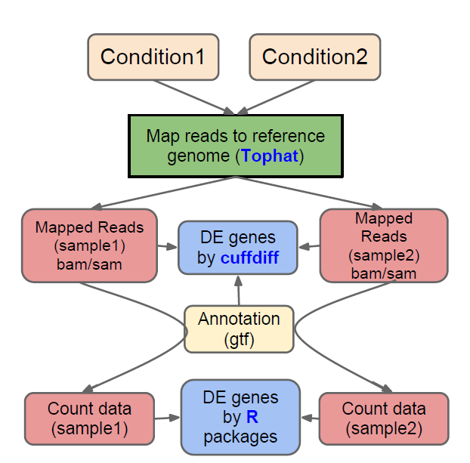
General RNASeq analysis pipeline

Slide 4
RNASeq analysis ensemble pipeline

Slide 5
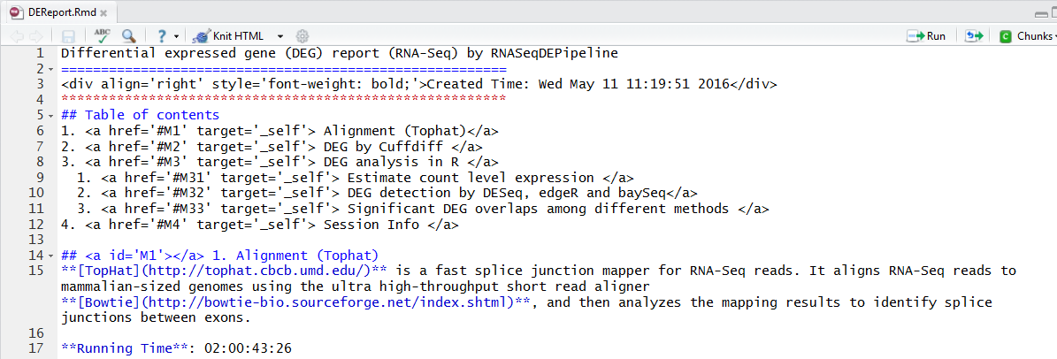
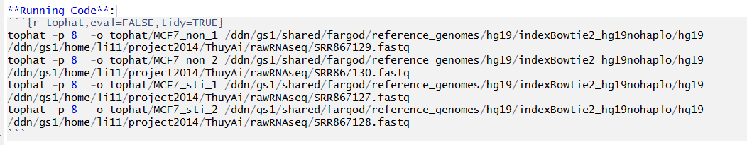
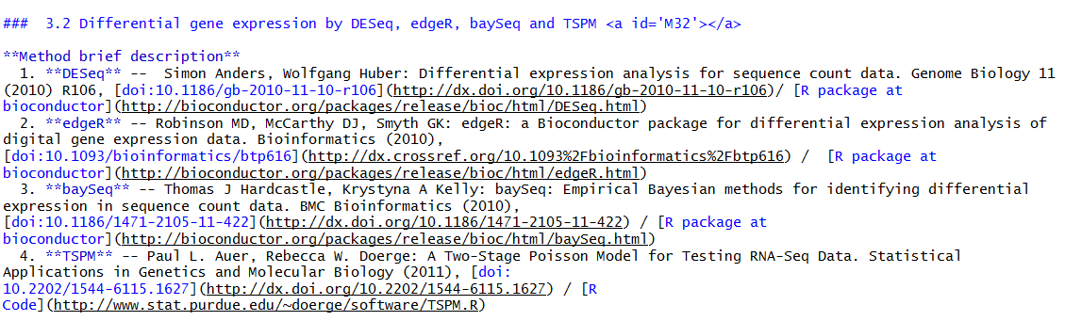

Slide 6
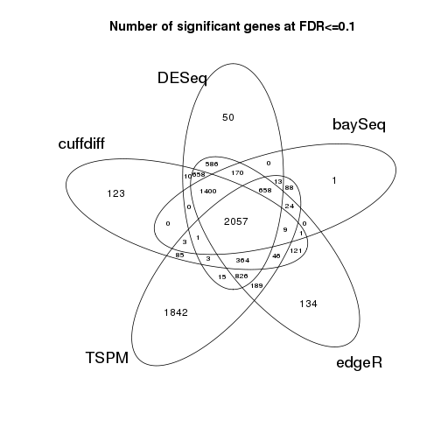



Slide 7
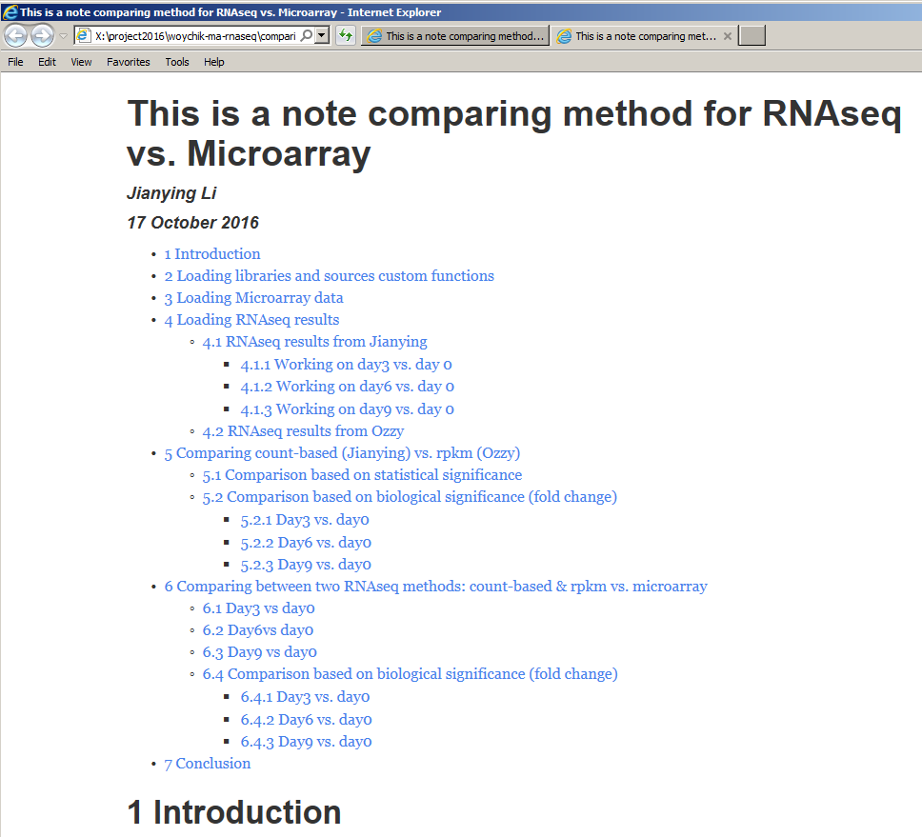
Notes:
Get an html prepared report,
Show a couple live examples

Slide 8
Demo on “titanic” randomforest prediction if time allows
Need .rmd code demo
Need to render .rmd
Need to launch html report
Demo-goldengate project

Slide 9
Produce a pdf report -- suggested prerequisite
http://rmarkdown.rstudio.com/pdf_document_format.html#overview
Within Rstudio (assuming Rstudio is installed)
There is an R package called “rticles”
https://github.com/rstudio/rticles
Just following the tutorial session
Produce a Journal of Statistical Software

Slide 10
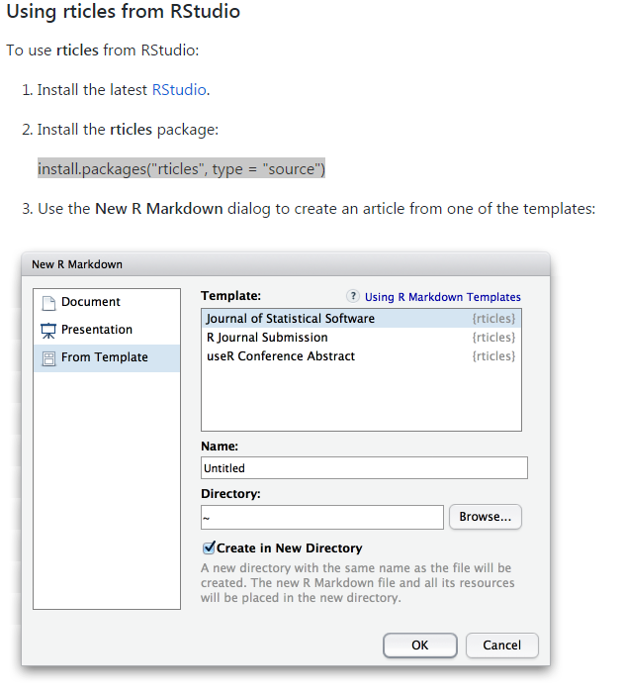
“rticles” installation – create first “rticles - jss”

Slide 11
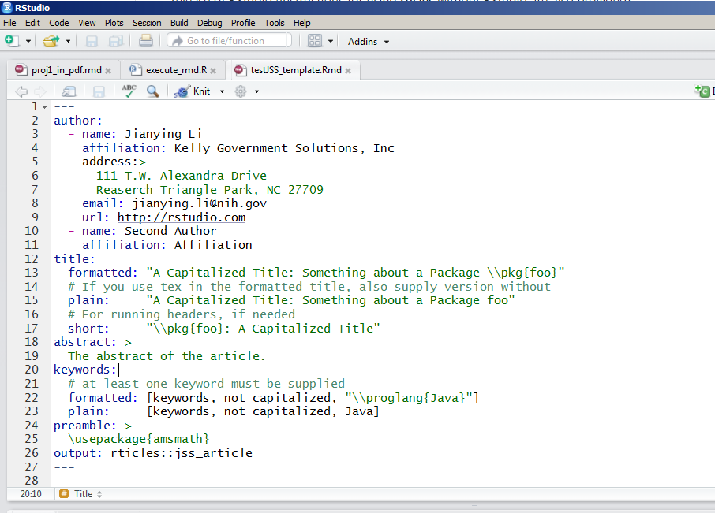
Generate the article using “knitr”

Slide 12
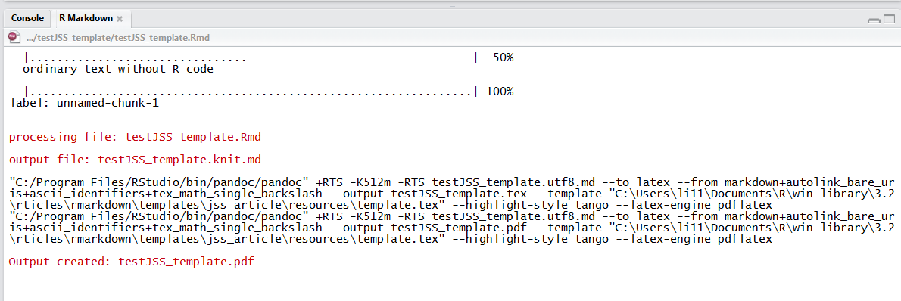
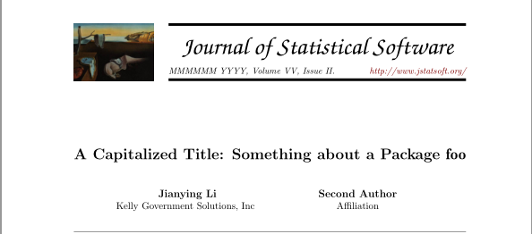
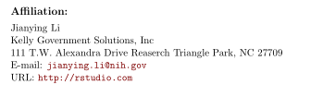

Slide 13
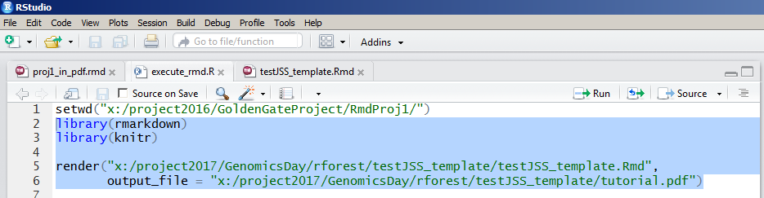
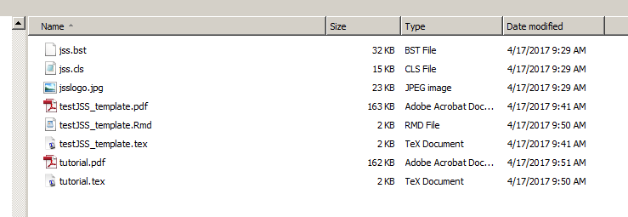
What behind the scene
Run the block of the code
It produces a LaTex file the converts to a .pdf file

Slide 14
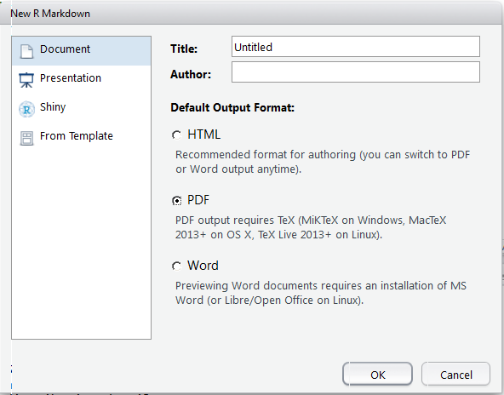
Almost forgot – pdf requires Tex

