Slide 1
Decision tree

Slide 2
Binary tree -- criteria
Entropy
Information gain
Gini Index
Gain ratio
Reduction in variance
Chi-Square
CHAID (Chi-squared Automatic Interaction Detector)

Slide 3
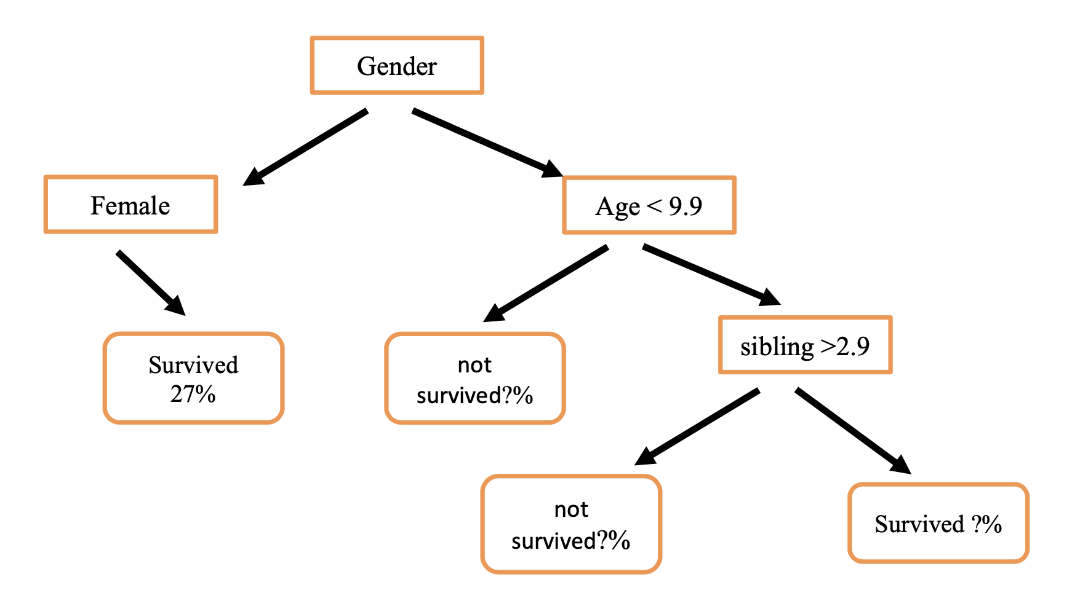

Slide 4
Examine the data
Prediction features
Gender
Age
Num of sibling
Prediction outcome
Survival (%)
Method
Count how many samples of each class reach a given leaf

Slide 5
For example, for the leaf corresponding to the decision [ Female, Age <9, sibling <2.9]
it was observed that in 73% of cases, the sample reaching this leaf was a person 'Not survived’ and in 27% of the cases, it was a person survived.

Slide 6
The decision tree consists of nodes that
use one of the entries of the decision vector
and applies a threshold

