Slide 1
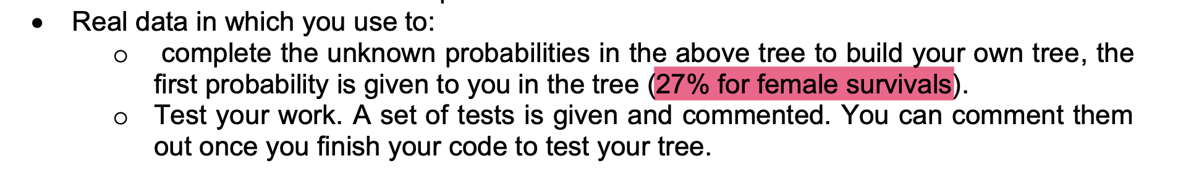
Q1: 27% of female survivals – where does it come from?
There are 663 entries
Of which, there are 239 females
Then, out of 239 females, 180 survived, 180/239 = 75.31%
Therefore, it reports as 180/663 = 27.15%

Slide 2
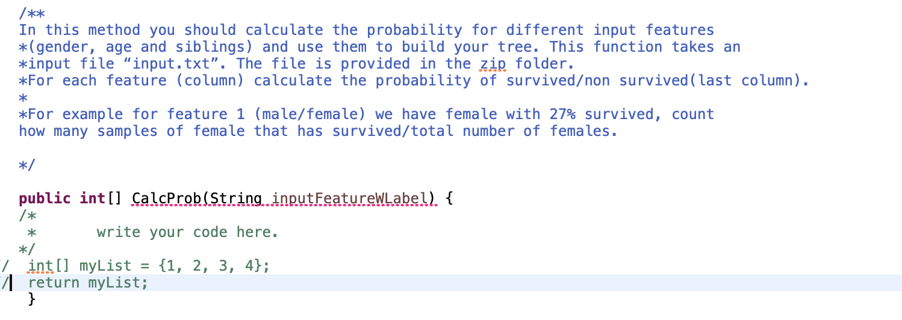
In the code, I found this BUT I think it is WRONG!

Slide 3

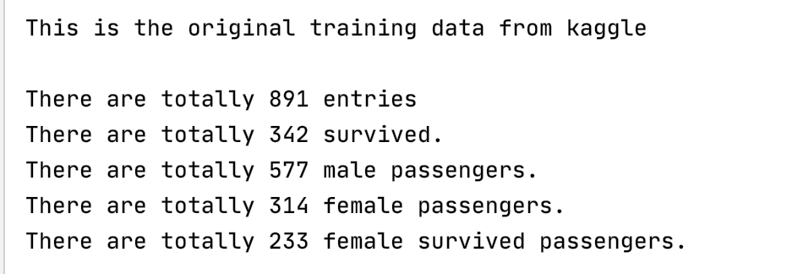
The professor’s response -- I can barely accept
Female survival rate is: 233/314 = 74.20%
https://www.kaggle.com/c/titanic/data

Slide 4
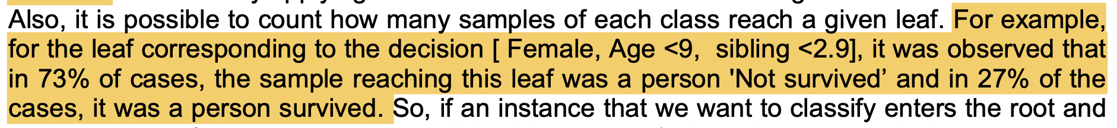
Q2:we will NEVER have this case?
Given the tree in the homework instruction, how can we get answer 1??

Slide 5
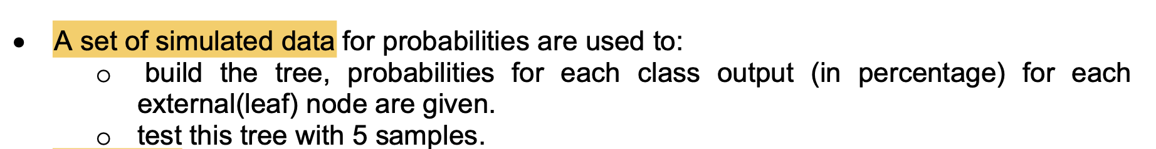
Q3, which/where is the simulated data?
Is it input.txt??

Slide 6
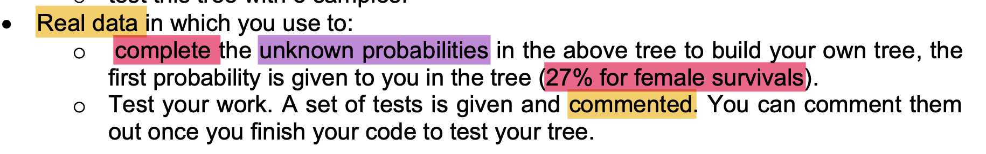
Q3, which/where is the real data?
It seems to be input.txt, but need to be sure

Slide 7
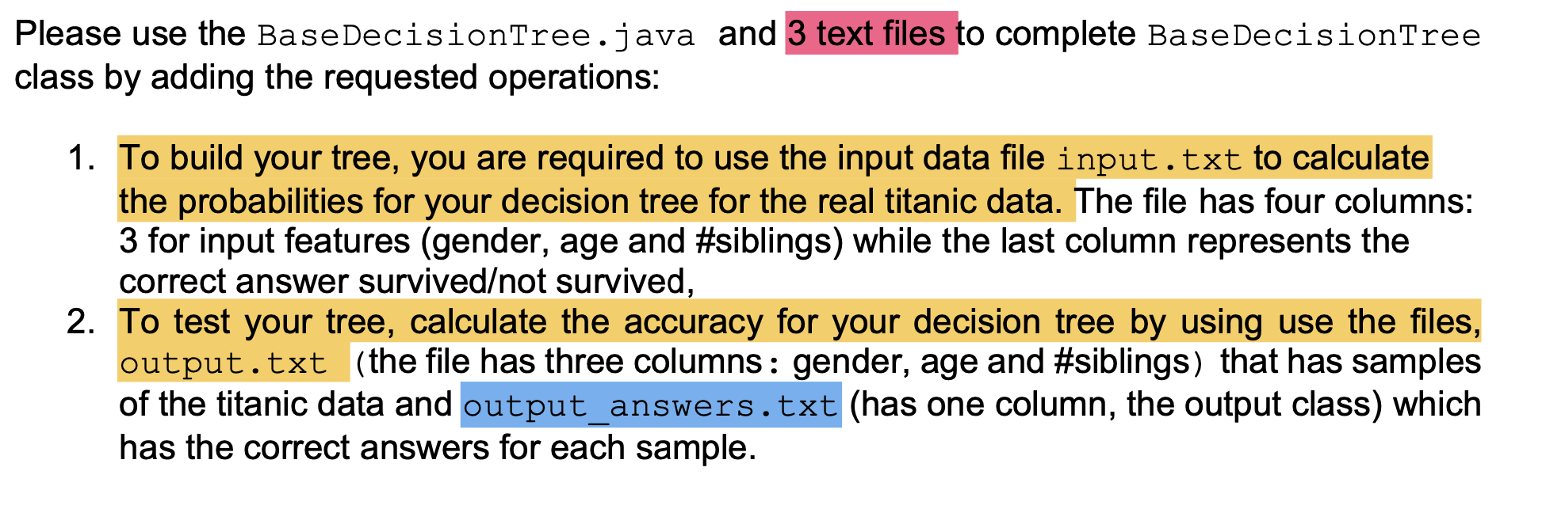
Q4, we ONLY have two .txt files
where it the third one?? Or, could it be a typo??

Slide 8
Q5, the instruction is NOT clear

