Slide 1
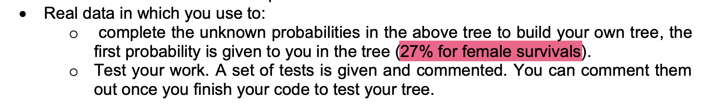
The only possible explanation
There are 663 entries
Of which, there are 239 females
Then, out of 239 females, 180 survived
Therefore, it reports as 180/663 = 27.15%
I think it is WRONG!

Slide 2
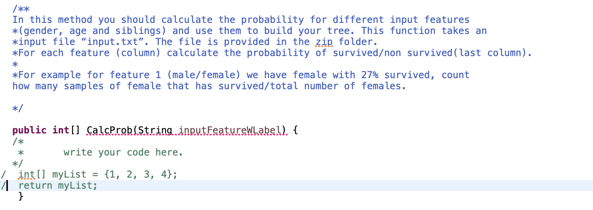
In the code, I found this and I think it is WRONG!

