Slide 1
Decision tree overview
11052020

Slide 3
An example of a tree

Slide 4
Basic terminologies
Root Node (Top Decision Node): It represents the entire population or sample and this further gets divided into two or more homogeneous sets.
Splitting: It is a process of dividing a node into two or more sub-nodes.
Decision Node: When a sub-node splits into further sub-nodes, then it is called a decision node.
Leaf/ Terminal Node: Nodes with no children (no further split) is called Leaf or Terminal node.
Pruning: When we reduce the size of decision trees by removing nodes (opposite of Splitting), the process is called pruning.
Branch / Sub-Tree: A sub section of the decision tree is called branch or sub-tree.
Parent and Child Node: A node, which is divided into sub-nodes is called a parent node of sub-nodes whereas sub-nodes are the child of a parent node.

Slide 5
Decision tree basic
Select the best attribute using Attribute Selection Measures(ASM) to split the records.
Make that attribute a decision node and breaks the dataset into smaller subsets.
Starts tree building by repeating this process recursively for each child until one of the condition will match:
All the tuples belong to the same attribute value.
There are no more remaining attributes.
There are no more instances.

Slide 6
Binary tree -- criteria
Entropy
Information gain
Gini Index
Gain ratio
Reduction in variance
Chi-Square
CHAID (Chi-squared Automatic Interaction Detector)

Slide 7
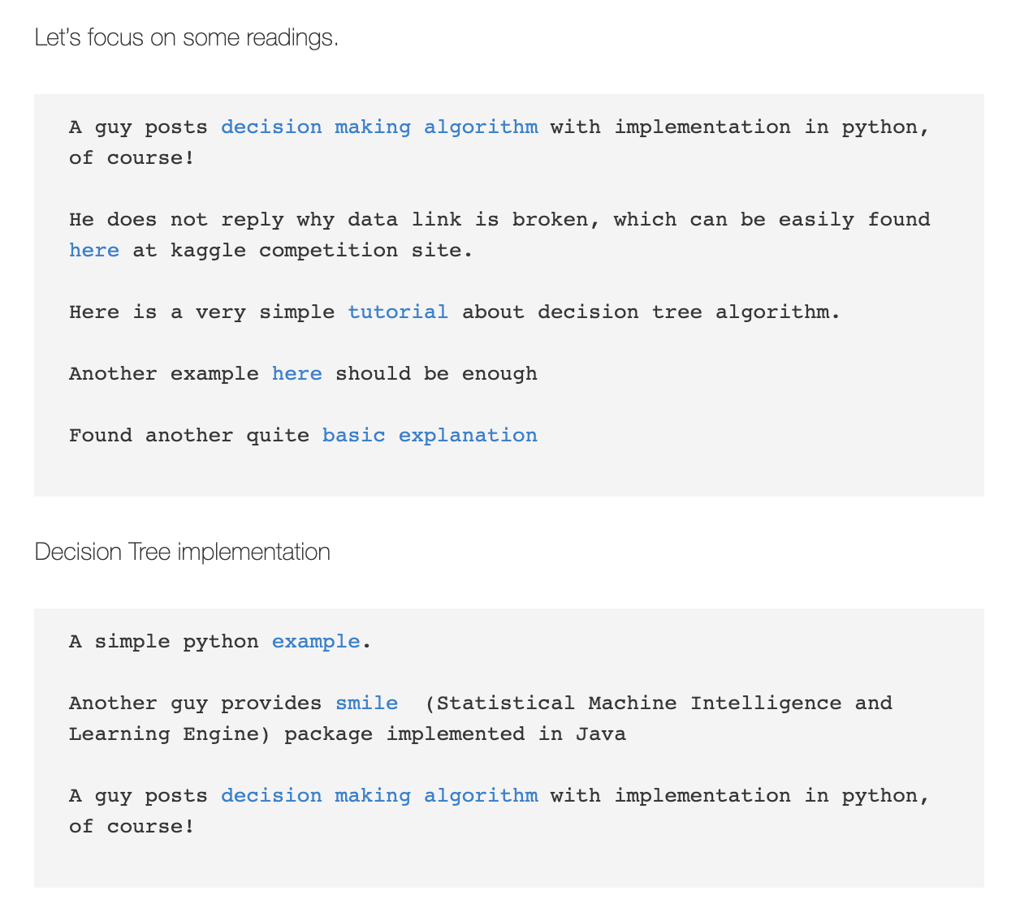
My note on machine learning

Slide 8
A few very good learning portals
https://www.kdnuggets.com/2020/01/decision-tree-algorithm-explained.html
https://dataaspirant.com/how-decision-tree-algorithm-works/
https://www.geeksforgeeks.org/decision-tree-introduction-example/
https://towardsdatascience.com/machine-learning-basics-descision-tree-from-scratch-part-i-4251bfa1b45c
https://www.geeksforgeeks.org/decision-tree-implementation-python/

Slide 9
Our homework problem
11062020

Slide 10
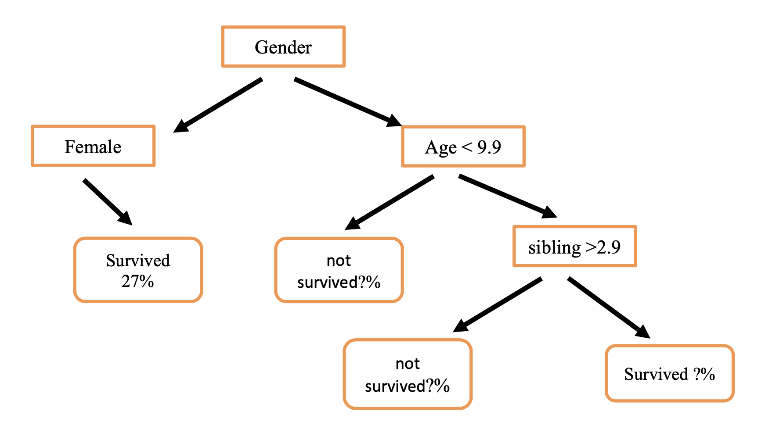
Proposed tree structure

Slide 11
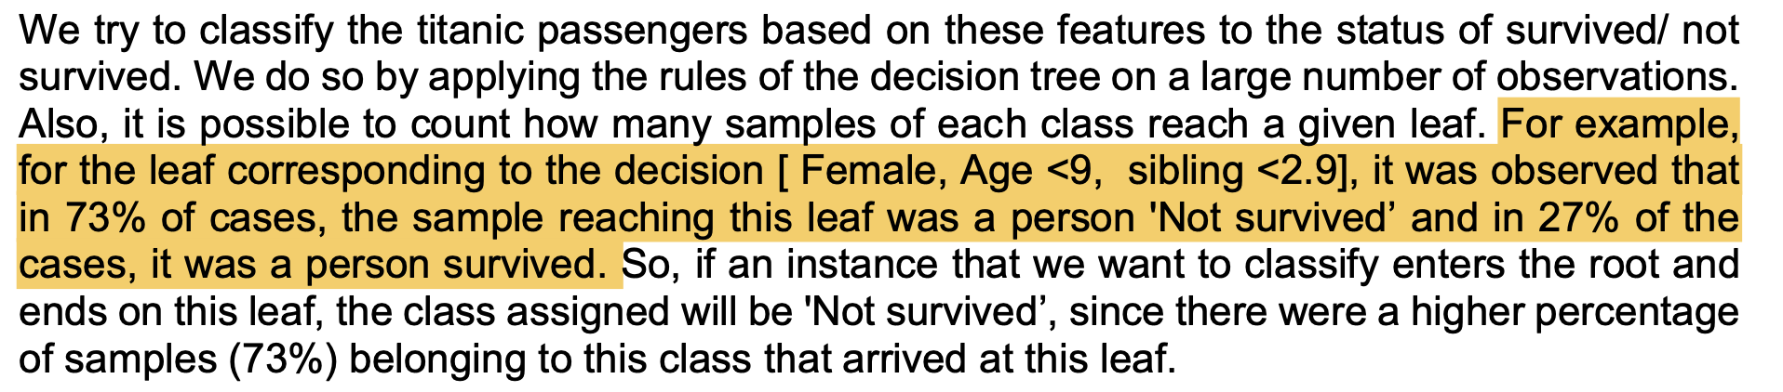
An example in the home work
For example, for the leaf corresponding to the decision [ Female, Age <9, sibling <2.9]
Could be “arbitrary” but not in this example?
It was observed that in “73% of cases”, the sample reaching this leaf was a person 'Not survived’ and in 27% of the cases, it was a person survived.

Slide 12
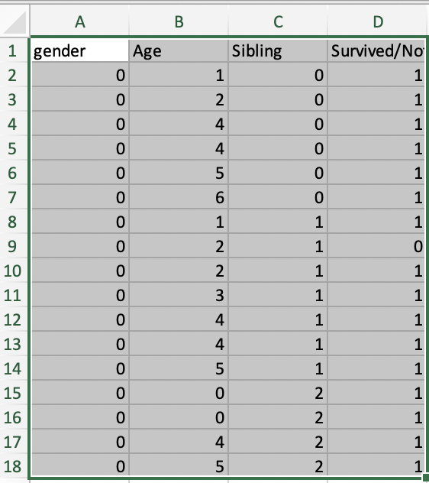
[ Female, Age <9, sibling <2.9]
Survival rate = 16/17 = 94.11%

Slide 13
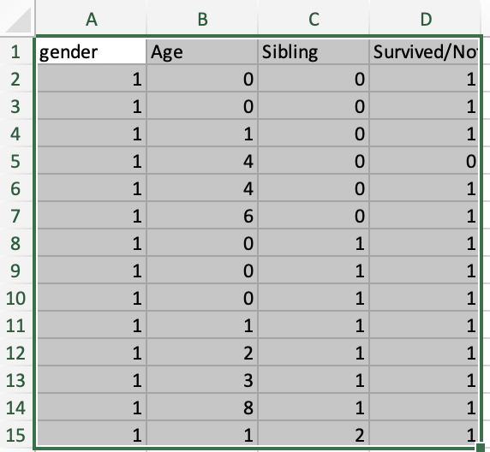
[ Male, Age <9, sibling <2.9]
Survival rate = 13/14 = 92.86%

Slide 14
Requirement
Prediction features
Gender
Age
Number of siblings
Prediction outcome
Survival (%)
Procedure
The entries of the decision vector and applies a threshold.
Depending on the result of the comparison, we branch left or right.
A feature vector enters the tree by the root.
It follows a series of comparisons leading to a leaf of the tree.

Slide 15
How do human language match the computer language
The entries of the decision vector and applies a threshold
Which method does this job?
Depending on the result of the comparison, we branch left or right
Which method does this job?
A feature vector enters the tree by the root
Which method does this job?
It follows a series of comparisons leading to a leaf of the tree
What is the end result?

Slide 16
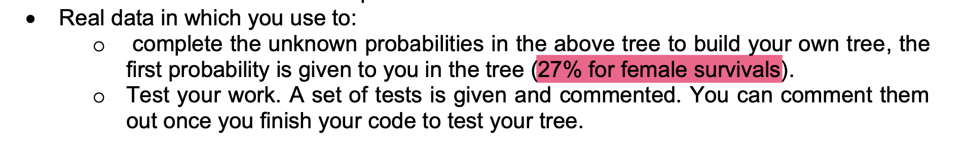
The only possible explanation
There are 663 entries
Of which, there are 239 females
Then, out of 239 females, 180 survived
Therefore, it reports as 180/663 = 27.15%
I think it is WRONG!

Slide 17
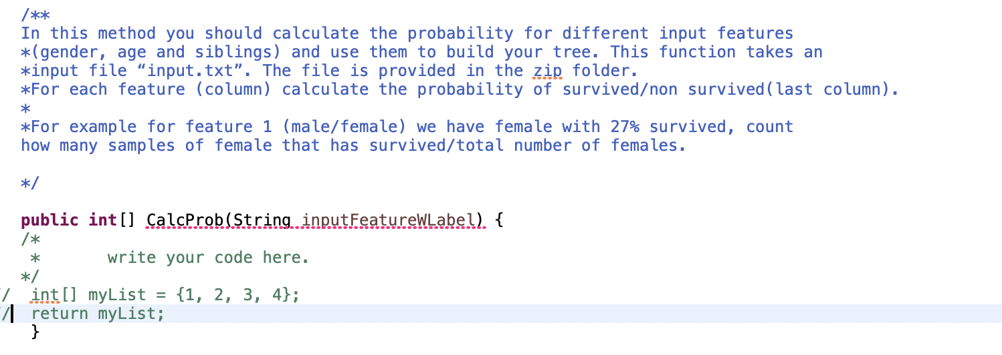
I think it is WRONG!

Slide 18

The professor’s response

Slide 19
In the end of the day
Main task: to fill in all the missing “probabilities”
A few java methods need to be implemented/completed
Can you possibilities test this in your java program

Slide 20
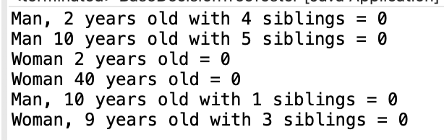
Question 1: why all the results are NOT survived?

Slide 21
Traversal order

