Slide 1
Learning Python programming
With PyCharm-edu

Slide 2
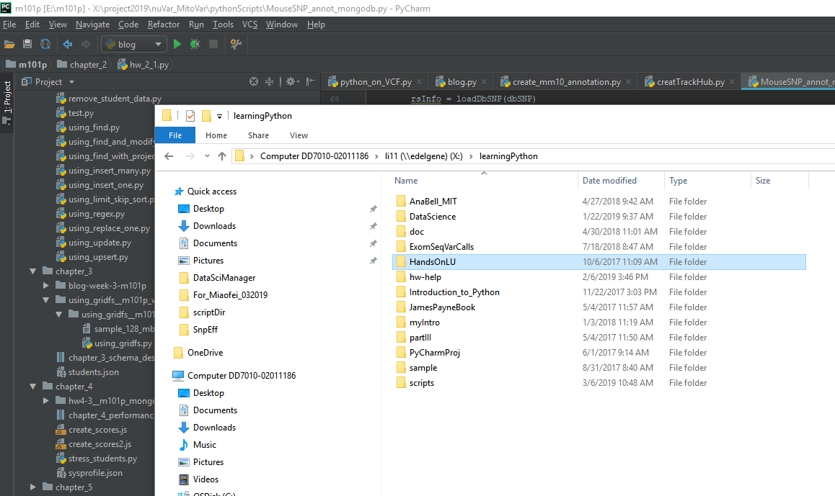
Import an existing project into pycharm
Trying to import HandsOnLU into PyCharm

Slide 3
Import a project from a project folder
File → open

Slide 4
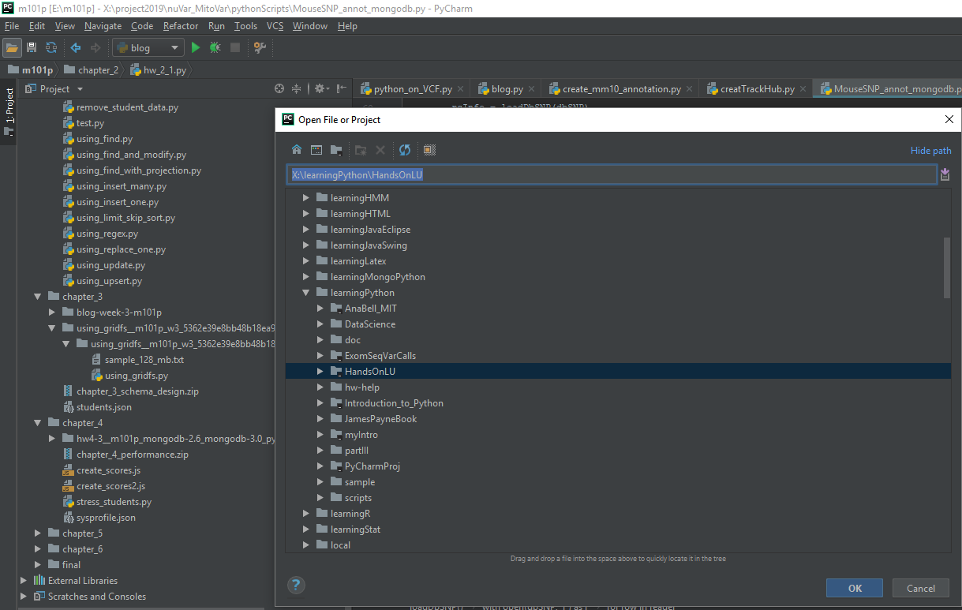
Click OK here

Slide 5
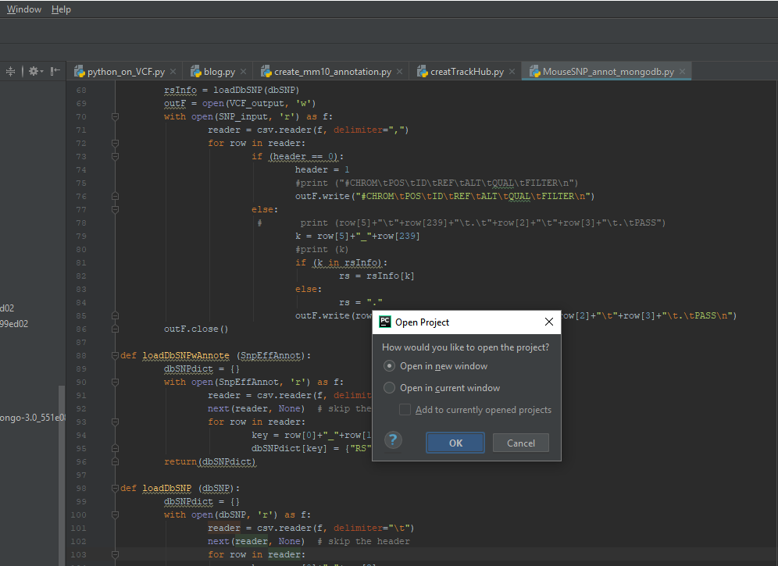
Click OK here

Slide 6
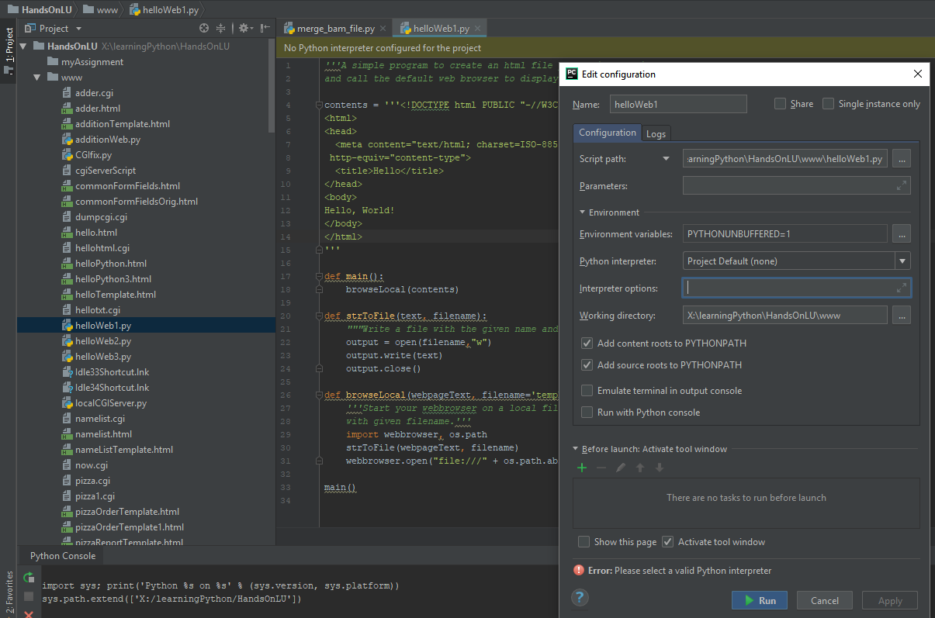
Project loaded
Need to define interpreter here

