Slide 1
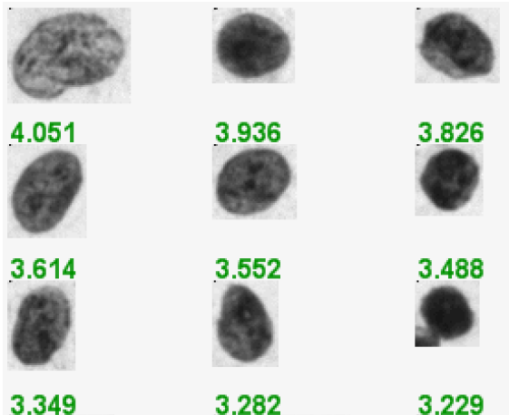
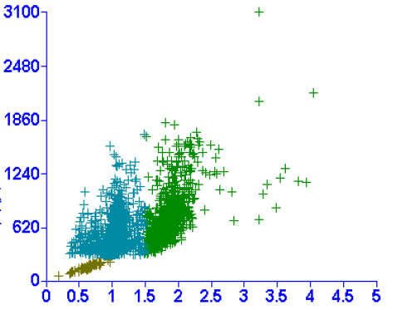
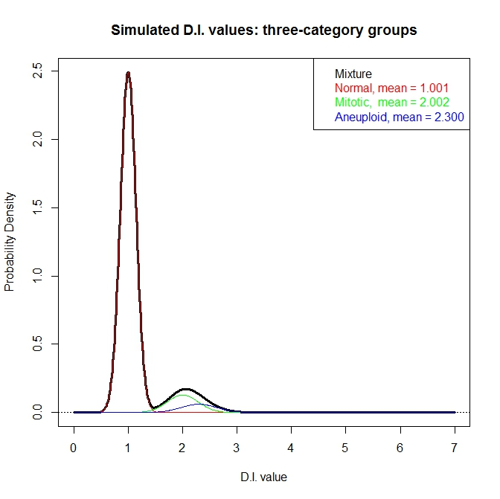
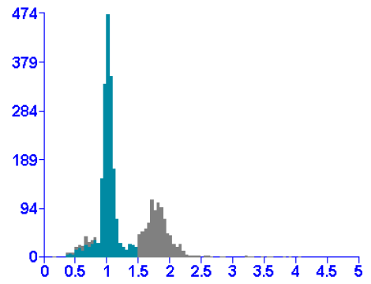
Notes:
Figure 1 DNA imaging data

Slide 2
D.I. values
Identify peak candidates from the density plot
Expert-guide parameters
Stripping out the normal cell population
Stripping out the mitotic cell population
Retain summary statistics for normal and mitotic populations
Expert-guide parameters
Populate measurement for new variable from densities

Slide 3
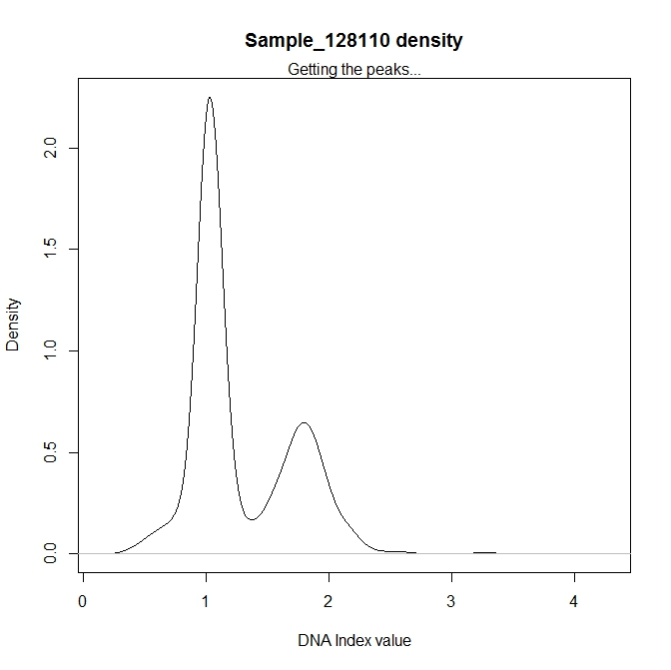
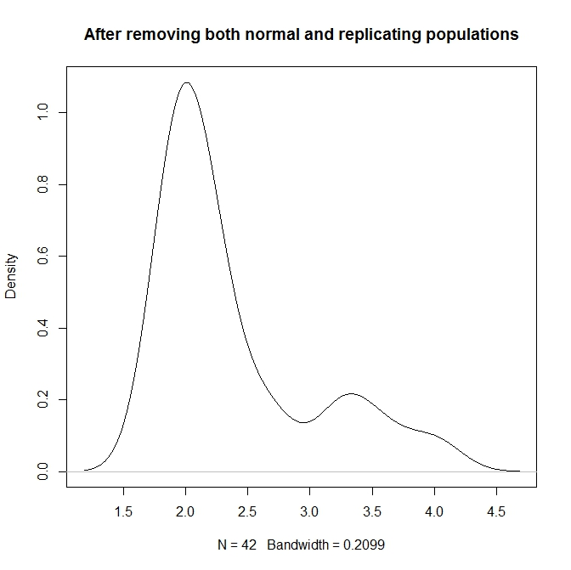
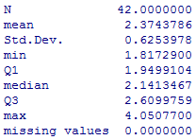
1.02
2.00
1.79
1788
3.33
3.25, 3.57, 3.99
Notes:
Figure 4 Data cleaning results from ExGCRn procedure

Slide 4
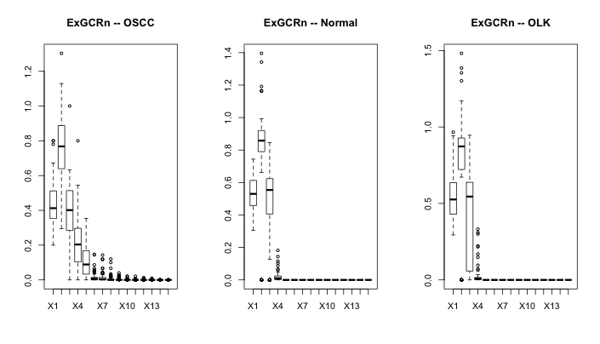

Slide 5
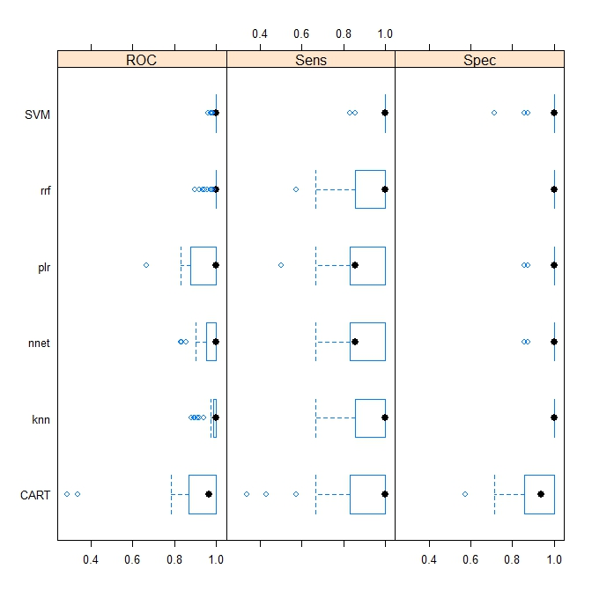

Slide 6
