Slide 1
Mixture of Gaussian distribution
Simulating D.I. values

Slide 2
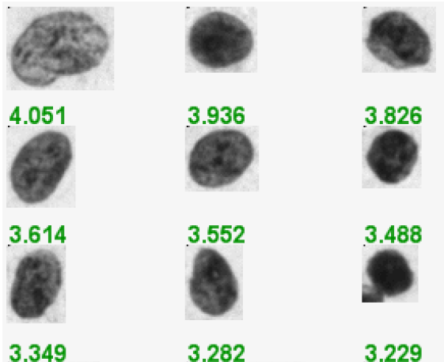
Abnormal nucleus image (D.I. value)
Papanicolaou (Pap) smears and nucleus was stained with Feulgan stain

Slide 3
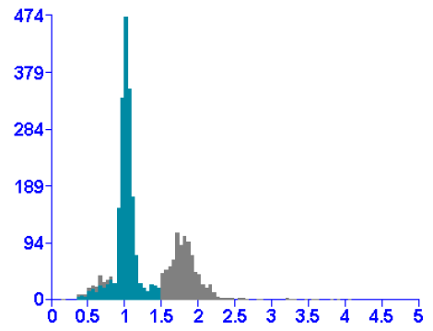
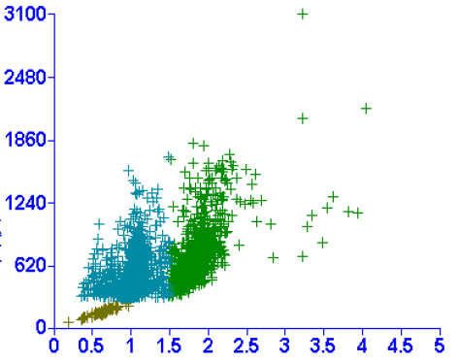
Cell population distribution

Slide 4
Summary statistics
Group | Mean1 | SD1 | Mean2 | SD2 | Mean3 | SD3
normal1 | 0.96 | 0.155 | 1.961 | 0.22 | 2.321 | NA
normal2 | 0.878 | 0.178 | 1.675 | 0.361 | 2.355 | NA
normal3 | 0.925 | 0.153 | 1.642 | 0.349 | NA | NA
normal4 | 1.001 | 0.088 | 1.878 | 0.237 | NA | NA
normal5 | 0.96 | 0.133 | 1.778 | 0.267 | 2.307 | 0.009
normal6 | 0.974 | 0.1 | 1.588 | 0.32 | NA | NA
normal7 | 0.888 | 0.182 | 1.407 | 0.278 | 2.391 | 0.046
normal8 | 0.963 | 0.155 | 1.71 | 0.256 | NA | NA
normal9 | 0.995 | 0.085 | 1.434 | 0.294 | NA | NA
OLK1 | 0.751 | 0.137 | 1.578 | 0.172 | 3.675 | NA
OLK2 | 0.959 | 0.117 | 1.718 | 0.368 | NA | NA
OLK3 | 0.94 | 0.14 | 1.938 | 0.19 | NA | NA
OLK4 | 0.992 | 0.074 | 1.66 | 0.172 | 3.2 | 0.261
OLK5 | 0.912 | 0.155 | 1.818 | 0.272 | 3.366 | 0.808
OLK6 | 0.949 | 0.138 | 1.798 | 0.315 | 2.332 | NA
OLK7 | 0.95 | 0.129 | 1.771 | 0.27 | NA | NA
OLK8 | 0.925 | 0.15 | 1.696 | 0.358 | 2.42 | 0.057
OLK9 | 0.898 | 0.172 | 1.54 | 0.391 | 2.483 | NA
OSCC1 | 0.979 | 0.096 | 1.959 | 0.278 | 2.41 | 0.289
OSCC2 | 0.911 | 0.128 | 1.604 | 0.193 | 3.185 | 0.734
OSCC3 | 0.88 | 0.14 | 1.564 | 0.327 | 2.393 | 0.127
OSCC4 | 0.989 | 0.147 | 1.848 | 0.179 | 2.613 | 0.442
OSCC5 | 0.991 | 0.091 | 1.596 | 0.123 | 2.772 | 0.396
OSCC6 | 0.955 | 0.955 | 1.855 | 0.299 | 2.441 | 0.233
OSCC7 | 0.983 | 0.099 | 1.579 | 0.148 | 3.2 | 0.265
OSCC8 | 0.871 | 0.211 | 1.402 | 0.121 | 2.743 | 0.263
OSCC9 | 0.884 | 0.104 | 1.694 | 0.225 | 2.605 | 0.238

Slide 5
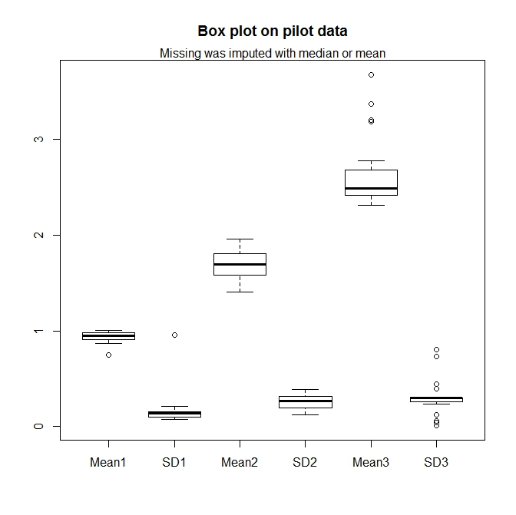

Slide 6
Our goal -- step
Three basic clusters of cell populations
D.I. value: 0.9 – 1.249
D.I. value: 1.250 – 2.299
D.I. value: > 2.300
Assuming equal C.V. across three populations, and estimated from “normal sample”:
Three means: 1.001, 2.002, 3.003

Slide 7
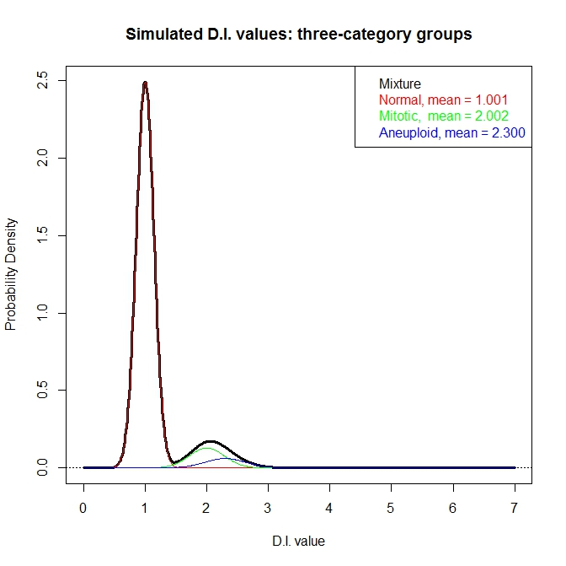

Slide 8
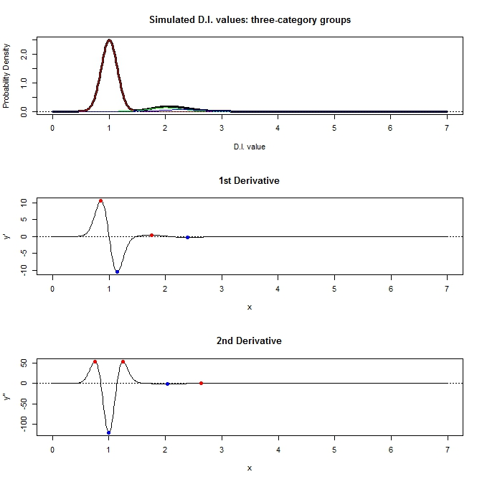

Slide 9
Our hurdle
Too much information from “normal” cluster
Possible to detect the “mitotic” stage
Impossible to detect “aneuploidy” stage
Need to strip out the “normal” information first, but how?
Don’t know
Don’t know
Don’t know

Slide 10
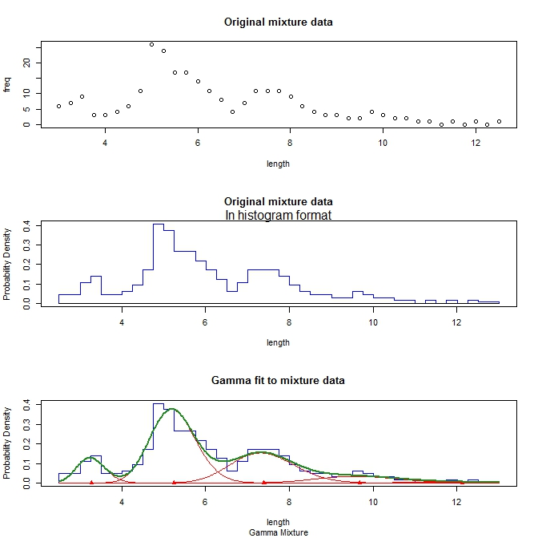

Slide 11
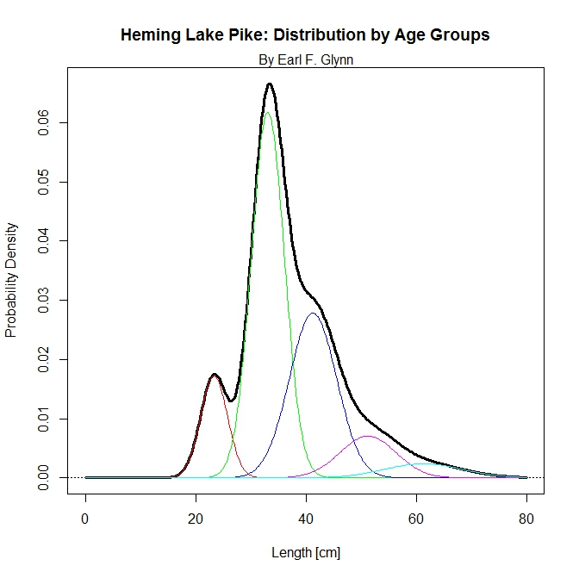
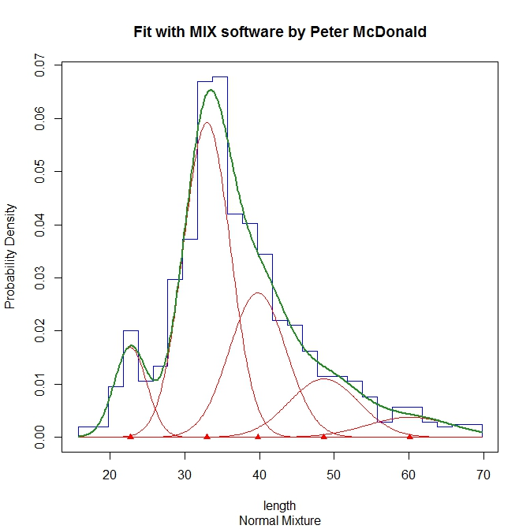
Mixture of five group data

