Slide 1
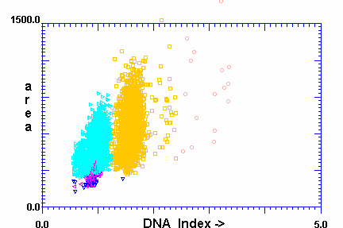
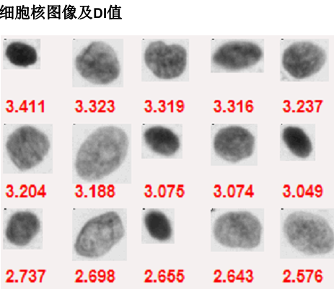
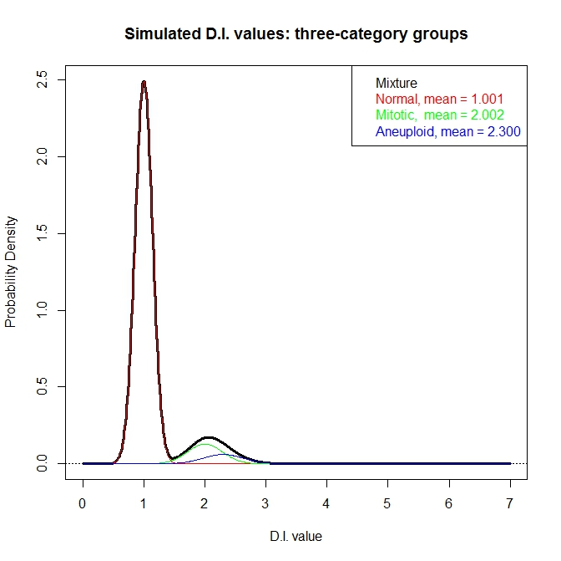
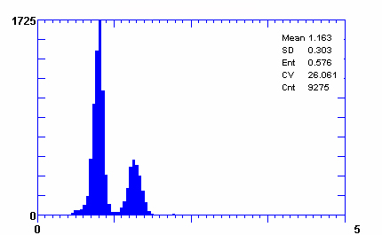
Figure 1
Liu, et al.
A
B
C
D
Notes:
Figure 1 DNA imaging data

Slide 2
Figure 2
Liu, et al.
D.I. values
Identification of candidate peaks from the density plot
Extraction of the diploid cell population
Expert-guided
data cleaning and reconstruction (EDCAR)
Extraction of the tetraploid cell population
Jianying, ExGCRn is an acronym which is hard to be remembered. I am not happy with EDCAR either. What about “Expert-guided data transformation and reconstruction” (EdTAR)谐音“爱他”
Isolation of the aneuploid cell population
Reconstruction of data of all cell populations
Calculation of Oral Cancer Risk Index (OCRI)

Slide 3
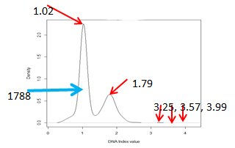
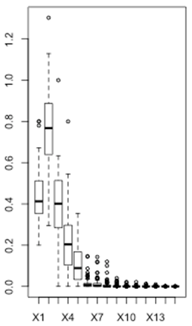
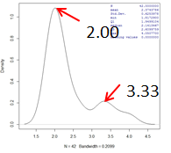
Figure 3
Liu, et al.
C
A
B
Normal
C
D
E
OLK
F
G
H
OSCC
After extraction of diploid and tetraploid
Before EDCAR
After EDCAR

Slide 4
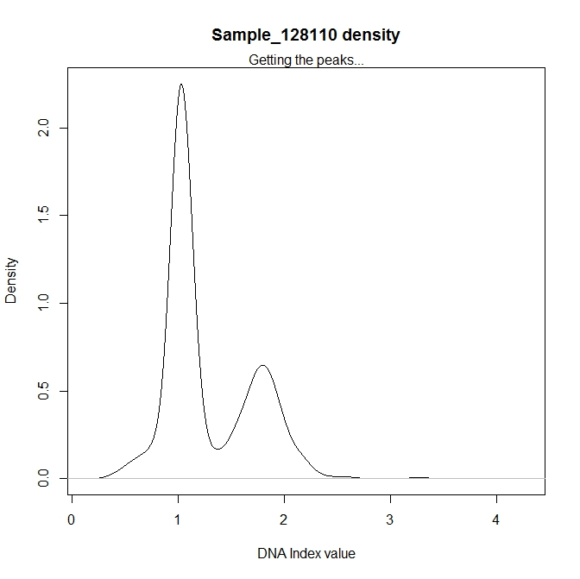
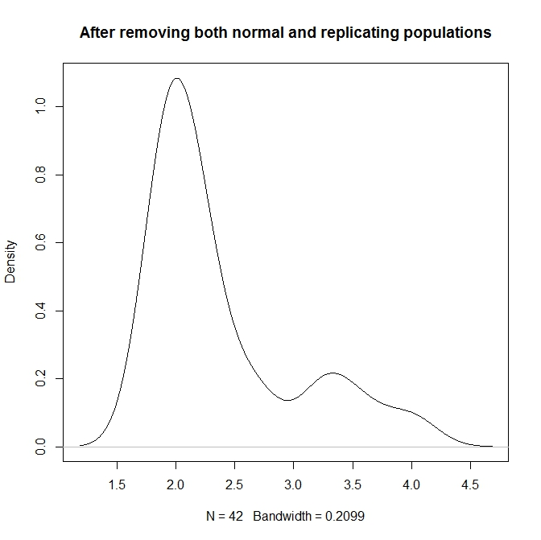
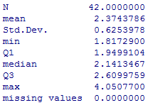
1.02
2.00
1.79
1788
3.33
3.25, 3.57, 3.99
Notes:
Figure 4 Data cleaning results from ExGCRn procedure

Slide 5
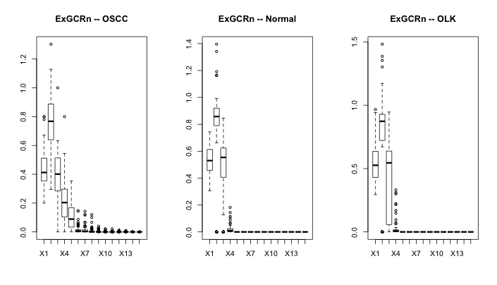
要用同样的Scale (0.0, 0.2, 0.4, 0.6, 0.8, 1.0, 1.2, 1.4, 1.6)

Slide 6
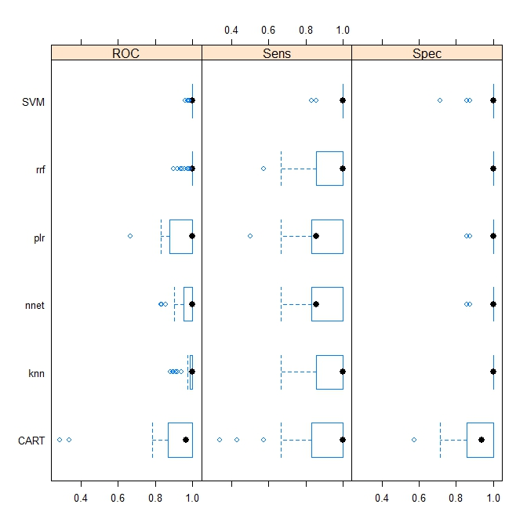
Figure 4
Liu, et al.
挪到图的下面
Sensitivity
Specificity
全
用
大
写
0.4 0.6 0.8 1.0

Slide 7
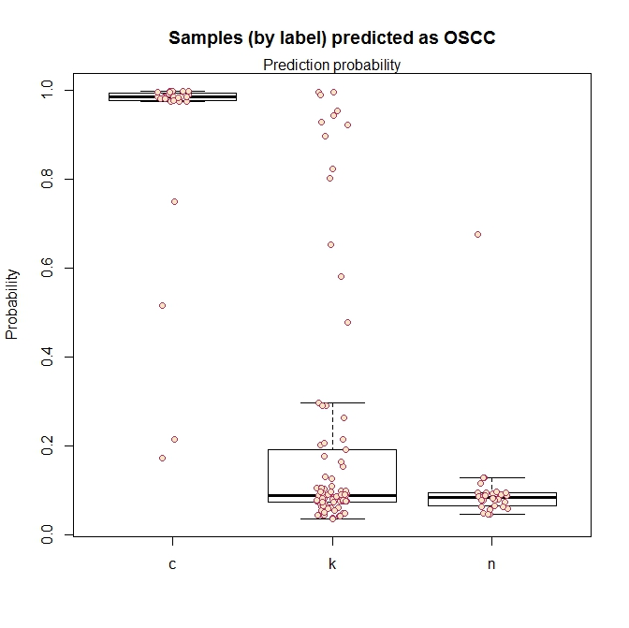
Figure 5
Liu, et al.
去掉这些
Oral Cancer Risk Index (OCRI)
OSCC
OLK
Normal

