Slide 1
Early Detection of Malignant and Pre-malignant
DNA Image Cytometry
Jianying Li

Slide 2
Outline
Nucleus DNA staining for early detection
Understand the data distribution nature
Expert Guided Data Cleaning and Reconstruction (ExGCRn)
Stretching the prediction modeling
Integrating extra domain information
Empower the patient
Moving toward the standardization

Slide 3
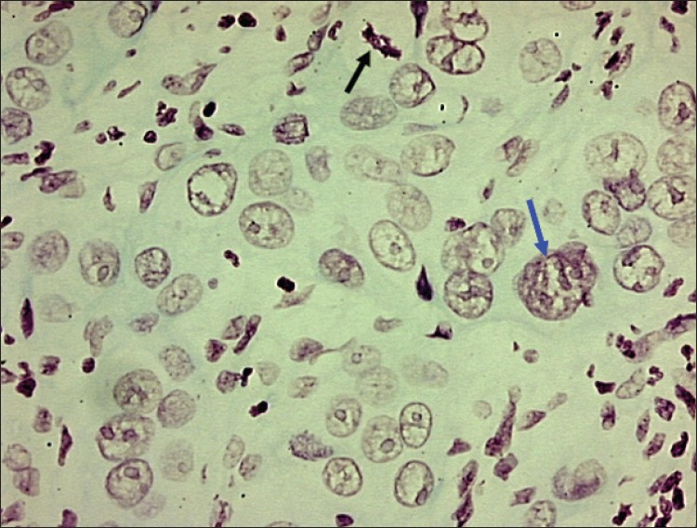
Photomicrograph of moderately well differentiated OSCC showing large tumor nucleus
with multiple prominent nucleoli (blue arrow) and abnormal mitotic figure (black arrow)
DB Nandini and RV Subramanyam, 2011, Nuclear features in oral squamous
cell carcinoma: A computer-assisted microscopic study, V.15:2, 177-181,JOMFP

Slide 4
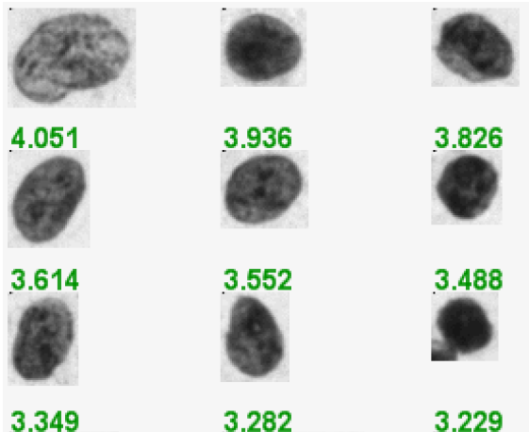
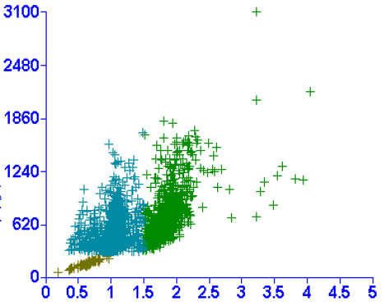
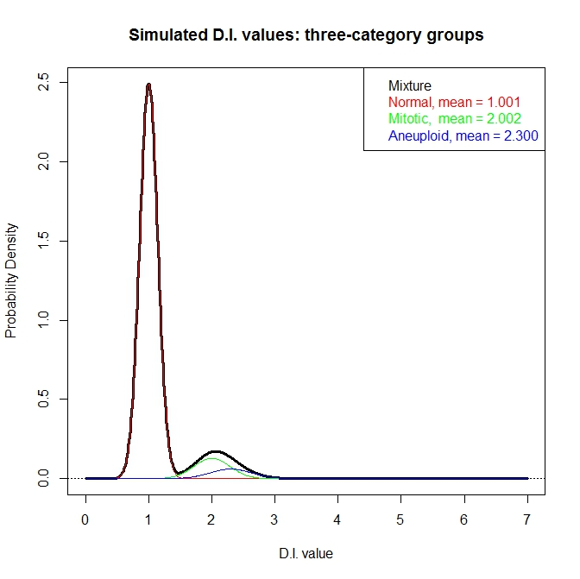
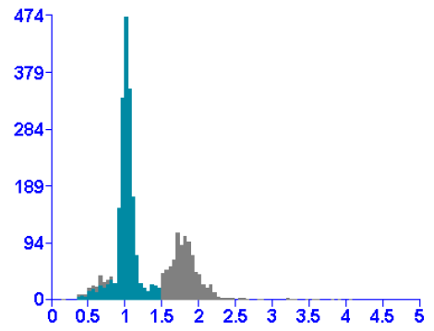
Need fix here
Notes:
Figure 1 DNA imaging data

Slide 5
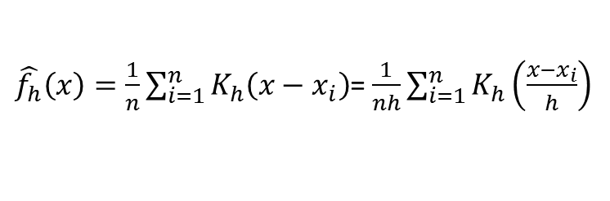
Kernel density estimation
Getting the estimated probability density function for unknown random variable
Where K(.) is the kernel normally
Uniform
Triangular
Normal
Etc.
Standard normal was used as the kernel
Smoothing approach
$\hat{f_{h}}\left(x\right)=\frac{1}{n}\sum_{i=1}^{n}{K_{h}\left({x−x}_{i}\right)}$= $\frac{1}{nh}\sum_{i=1}^{n}{K_{h}\left(\frac{{x−x}_{i}}{h}\right)}$

Slide 6
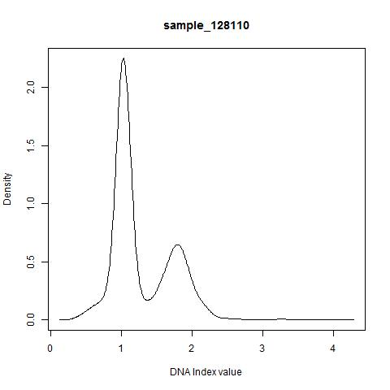
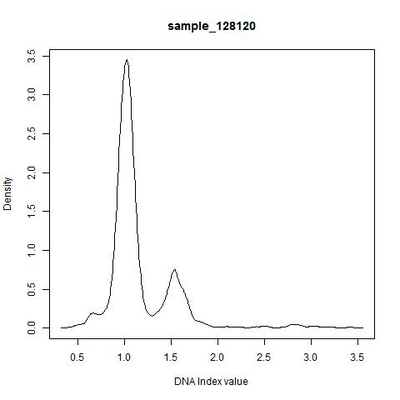
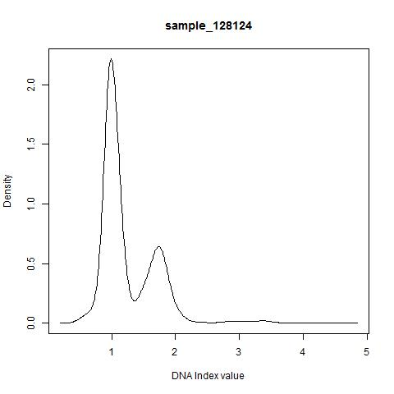
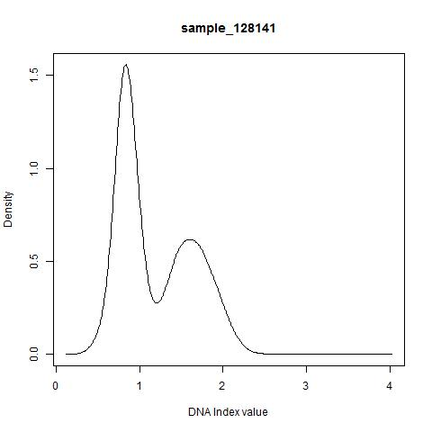

Slide 7
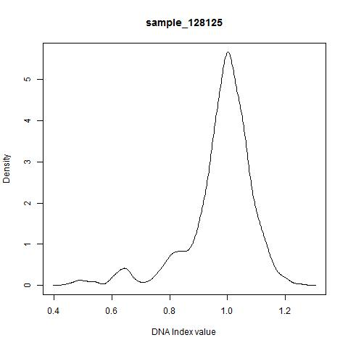
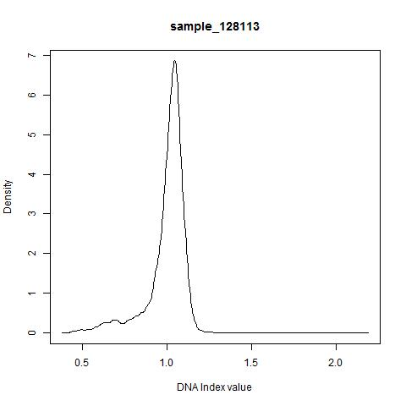
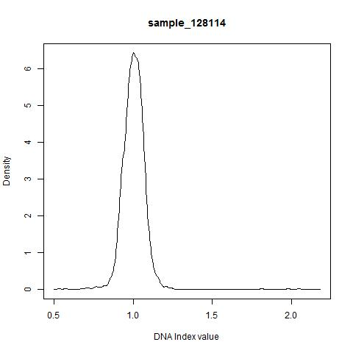
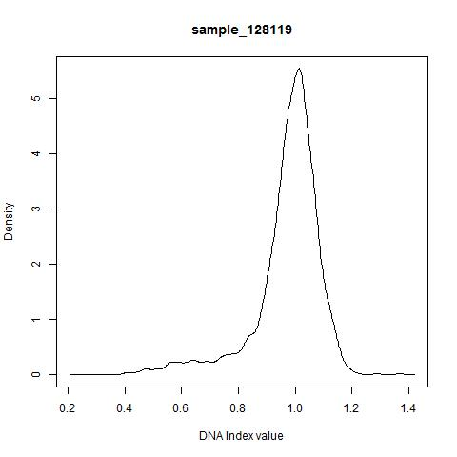

Slide 8
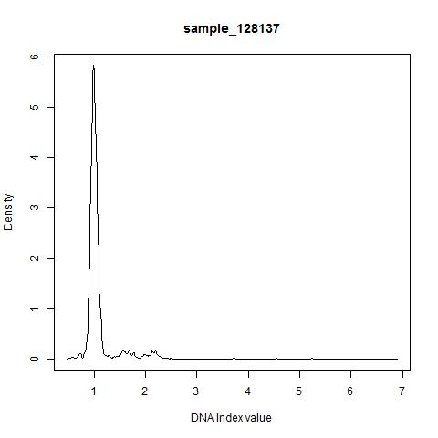
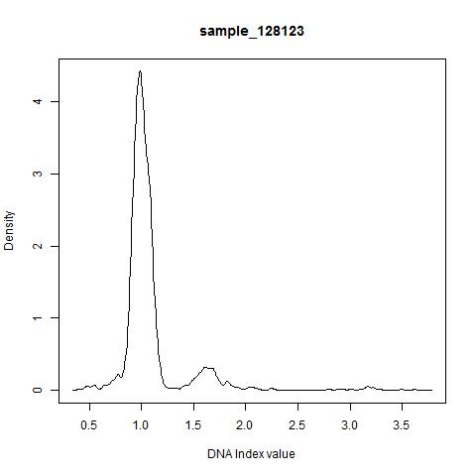
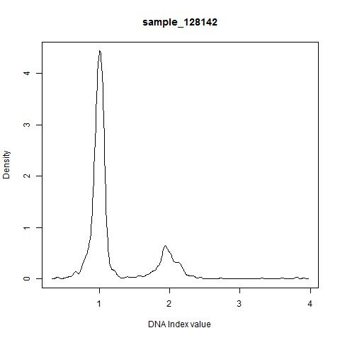
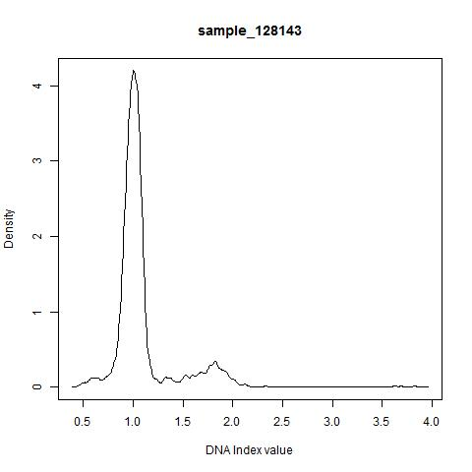

Slide 9
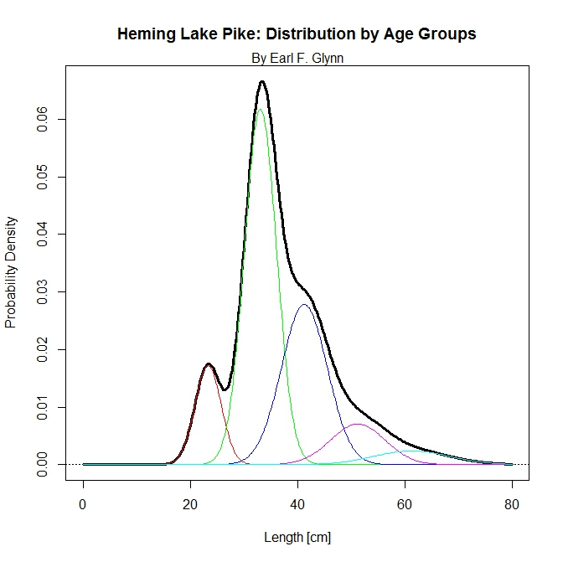
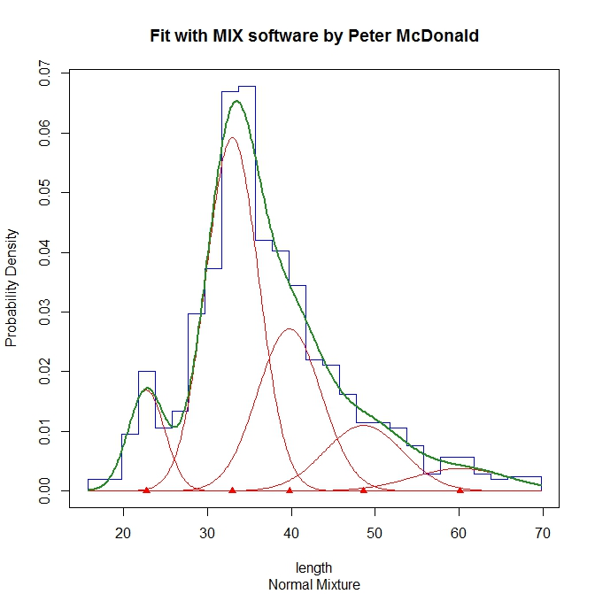
A well fit mixture of distributions

Slide 10
Challenge in the data analysis
Mixture of three cell populations
Normal cell population (diploid)
Mitotic cell population (4n)
Carcinoma (aneuploidy cell)
Two non-informative cell populations take the main density
Signal is largely washed out/saturated
Extreme challenge with “OLK” samples

Slide 11
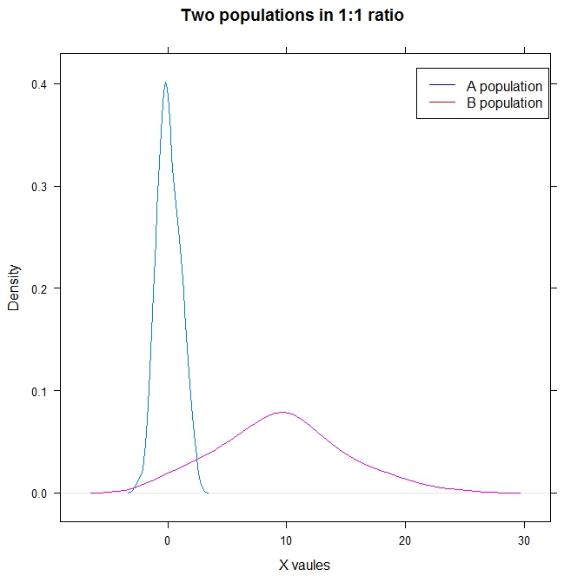

Slide 12
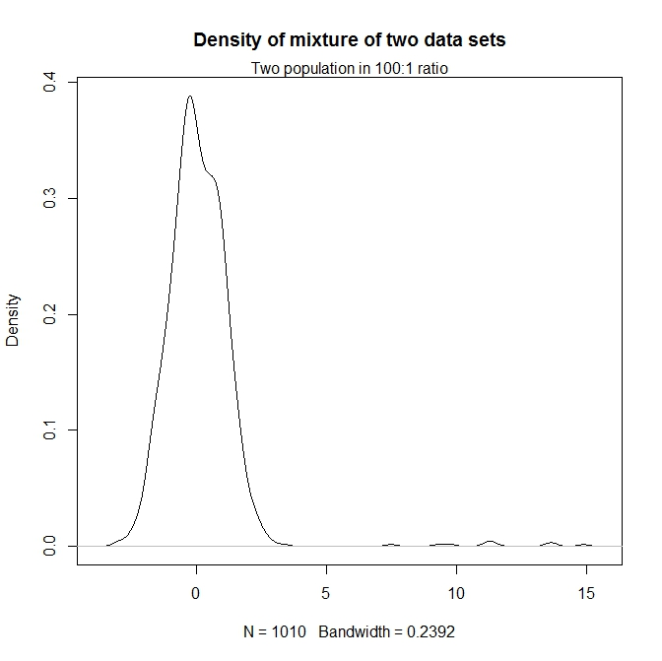

Slide 13
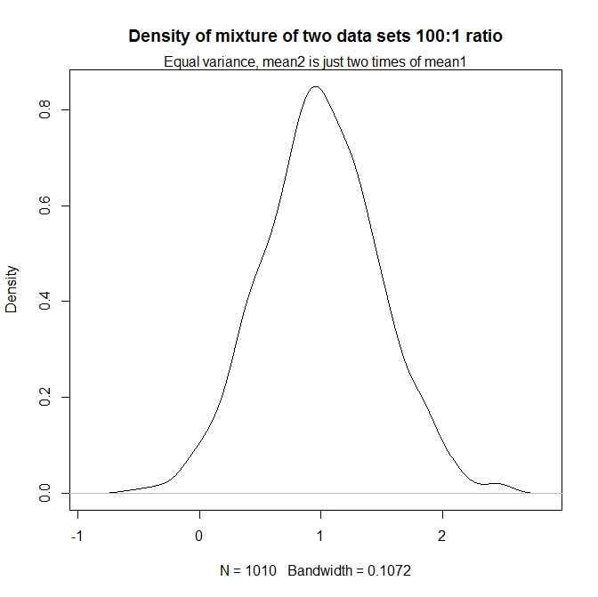

Slide 14
Expert Guided Data Cleaning and Reconstruction (ExGCRn)
Expert input
Param1: Threshold for aneuploidy D.I.
Param2: Mean D.I. value for mitotic cell population
Param3: Standard deviation for mitotic and aneuploidy cell populations
Param4: Ratio of normal cell (both normal and mitotic) vs. aneuploidy when three populations observed
Param5: Ratio of normal cell (both normal and mitotic) vs. aneuploidy when no aneuploidy population observed
Param6: Ratio of normal cell vs. mitotic population when no aneuploidy population observed

Slide 15
Expert Guided Data Cleaning and Reconstruction (ExGCRn) –cont.
Data reconstruction
The reconstruction was handled according to the number of populations determined in the cleaning steps
Step 1 If three populations were determined, a cap of “8” was applied for the D.I. values
Step 2 Parameters either from the expert input or derived from the data itself were used
Step 3 A heuristic cumulated density function was derived and used to guide the “random sampling” of the data points
Step 4 The dataset was stretched/binned between [0, 8] on the D.I. axis.
The density within each bin will be recorded as the measurement of that “variable”
Any missing values were replaced with 0.00001

Slide 16
Expert Guided Data Cleaning and Reconstruction (ExGCRn) –cont.
Stripping the normal population
Step 1 Derive the probability density function with kernel density estimation smoothing
Step 2 Determine the mode of the normal cell population
Step 3
(a) Use the data to the left side of the mode
(b) Estimate the mean and standard deviation of the normal population
Step 4 Remove the data point to the left the mode
Step 5
(a) Find the symmetric subset of the data on the right of the mode
(b) Break the data on the right into equal n parts according to the KDE density
Foreach interval
Derive the theoretical number of data points
Randomly select candidate data points to be filtered
Recover missing data points due to rounding errors
End of foreach loop
Step 6 --> go back to step 1 and evaluate the stripping efficiency
If the first left most mode is less than the threshold
Redo step 2 – step 6
Else
Finish stripping the normal population
Compute the mean and standard deviation from the stripped first population only
Store number of data points filtered

Slide 17
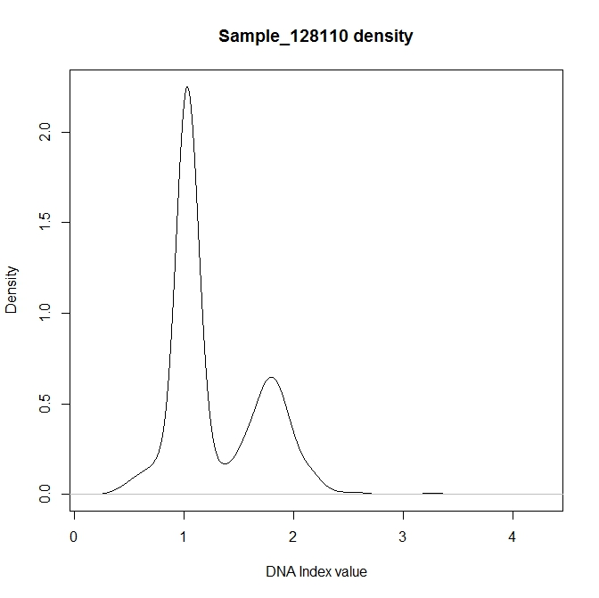
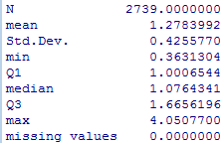
Alleviate the impact from the “normal” cell population

Slide 18
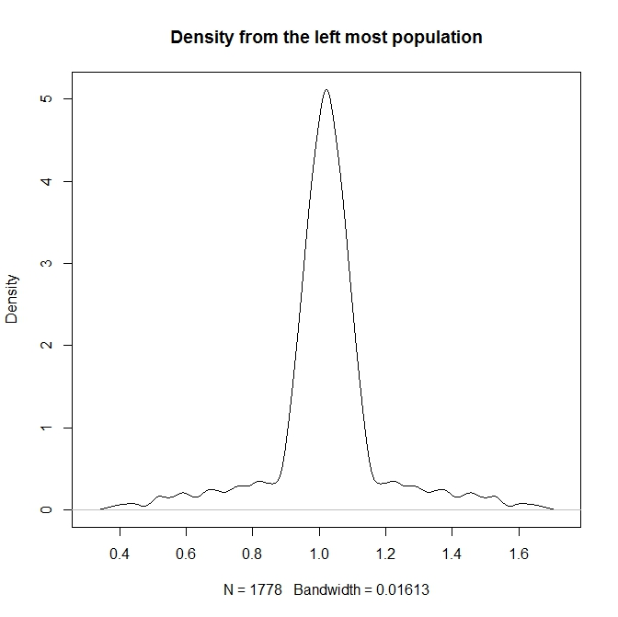
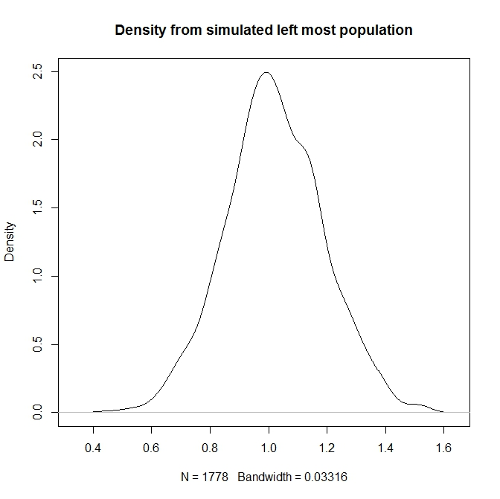
The left-most population

Slide 19
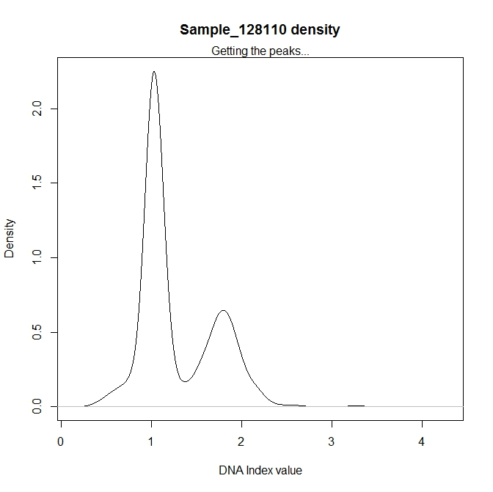
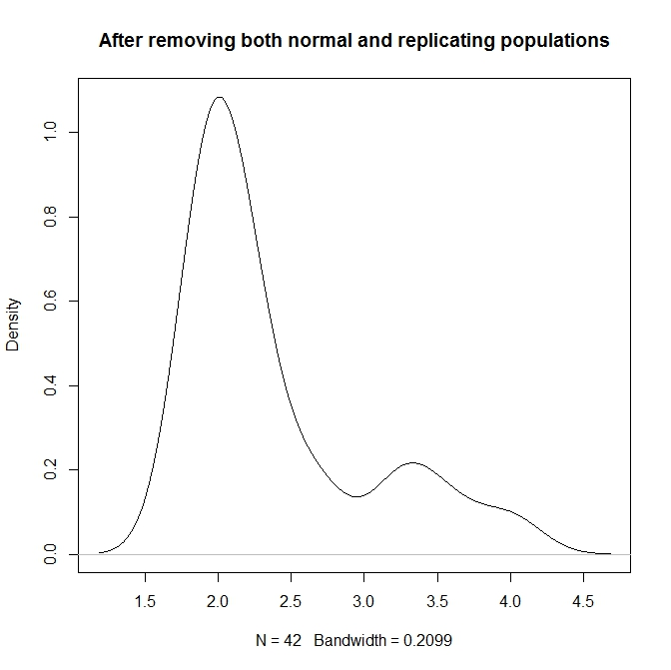
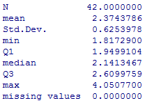
1.02
2.00
1.79
1788
3.33
3.25, 3.57, 3.99
Notes:
Figure 4 Data cleaning results from ExGCRn procedure

Slide 20
Predicting the clinical outcome
Newly formulated dataset (ExGCRn)
Stretched statistical models
Tested out models with various prediction power
Optimized the parameter setting
Evaluated model performance
Prediction results
Clinical outcome and further implementation
R -- Caret package used

Slide 21
Get a few model explaining

Slide 22
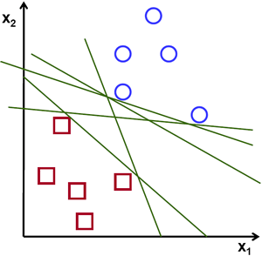
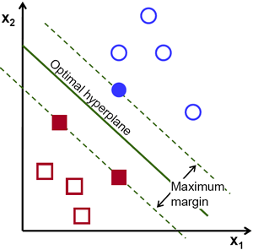
SVM – maximize the margin

Slide 23
Roc curves..

Slide 24
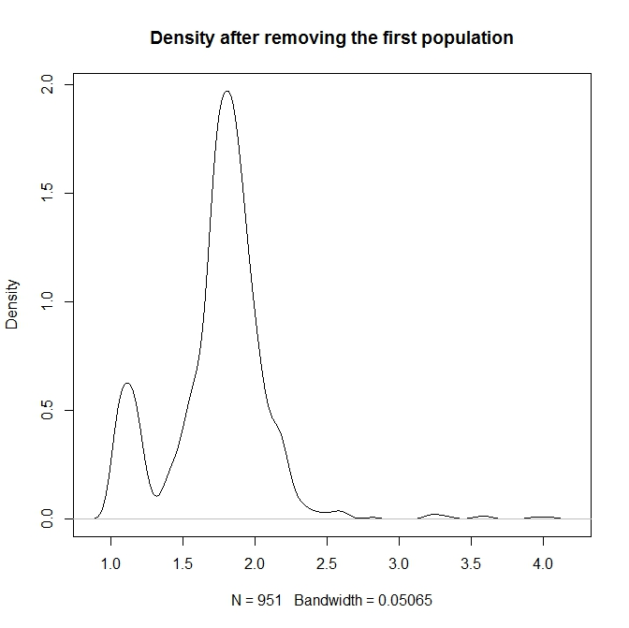
The artifact
3.25, 3.57, 3.99

Slide 25
2.00
3.33

Slide 26
1.02
1.79
1788
3.25, 3.57, 3.99

Slide 27
Extra slides here and on

Slide 28
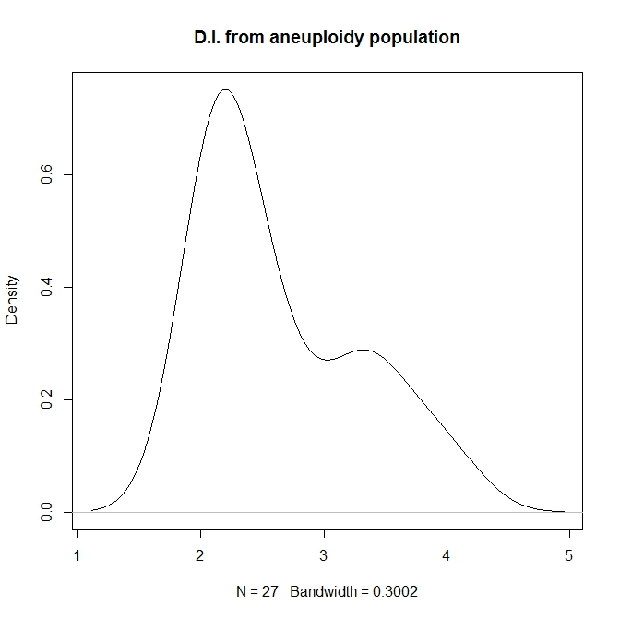
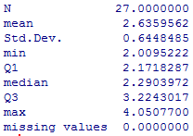

Slide 29
Stripping a population from a mixture --from left to right
Dynamically identify the left-most peak
Estimate the summary statistics using half of the distribution
Stripping the data from the population
Sequentially stripping

Slide 30
Moving toward the standardization
Accumulating the data in the database
Data-driven approach data analysis
Walking hand-in-hand with clinical doctor
Establishing the standard protocols

Slide 31
Our goal
for Liu Yao's exfoliated cell project, you may show what you have done for Liu Yao's current paper, what you plan to do if we put many other parameters of exfoliated cells (DI value, cell size, ...) and potentially new parameters (DNA methylation, gene mutation...) into data analysis in the future. Also you may paint a picture of a complete service of oral exfoliated cells starting from samples collection, sample analysis, data acquisition, data analysis, recommendation of further lab analysis, recommendation of clinical follow-up and therapy, ... Our goal is the feed them a vision that we and they can work continuously for >10 years.

Slide 32
Objectives
Understanding and unveiling the biological mechanism of oral squamous cell carcinoma
Leveraging nuclei stain imaging technology (Feulgen staining)
Extracting the determining digitized information
Developing data processing protocol
Building predicting model for detecting abnormal cell dividing – cancer diagnosis
Establishing the standard for oral cancer early diagnosis

Slide 33

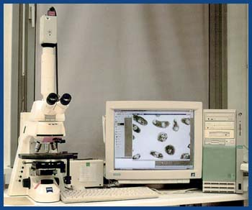
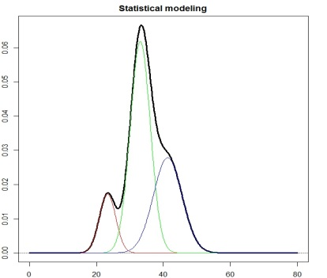
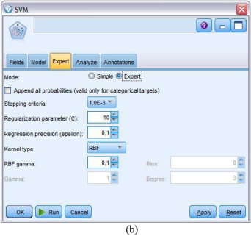

Raw dataDB

Slide 34
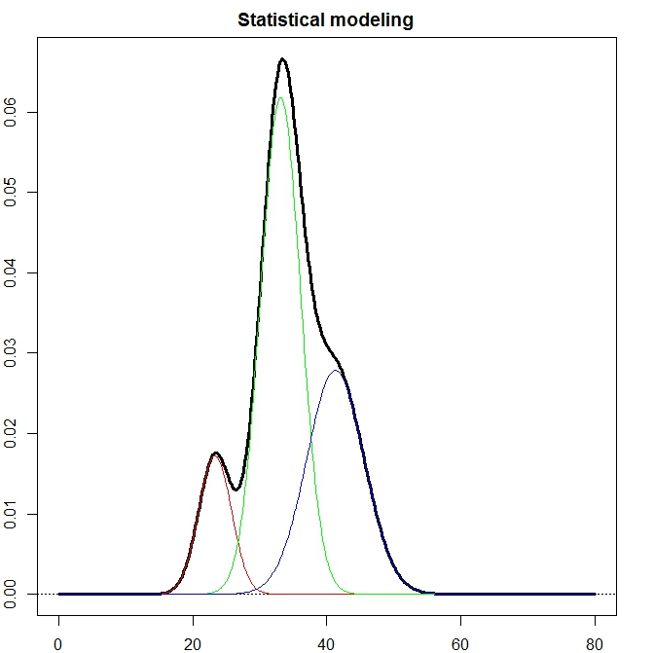


Slide 35
Abnormal nucleus image (D.I. value)
Papanicolaou (Pap) smears and nucleus was stained with Feulgan stain

Slide 36
Cell population distribution

Slide 37
Summary statistics
Group | Mean1 | SD1 | Mean2 | SD2 | Mean3 | SD3
normal1 | 0.96 | 0.155 | 1.961 | 0.22 | 2.321 | NA
normal2 | 0.878 | 0.178 | 1.675 | 0.361 | 2.355 | NA
normal3 | 0.925 | 0.153 | 1.642 | 0.349 | NA | NA
normal4 | 1.001 | 0.088 | 1.878 | 0.237 | NA | NA
normal5 | 0.96 | 0.133 | 1.778 | 0.267 | 2.307 | 0.009
normal6 | 0.974 | 0.1 | 1.588 | 0.32 | NA | NA
normal7 | 0.888 | 0.182 | 1.407 | 0.278 | 2.391 | 0.046
normal8 | 0.963 | 0.155 | 1.71 | 0.256 | NA | NA
normal9 | 0.995 | 0.085 | 1.434 | 0.294 | NA | NA
OLK1 | 0.751 | 0.137 | 1.578 | 0.172 | 3.675 | NA
OLK2 | 0.959 | 0.117 | 1.718 | 0.368 | NA | NA
OLK3 | 0.94 | 0.14 | 1.938 | 0.19 | NA | NA
OLK4 | 0.992 | 0.074 | 1.66 | 0.172 | 3.2 | 0.261
OLK5 | 0.912 | 0.155 | 1.818 | 0.272 | 3.366 | 0.808
OLK6 | 0.949 | 0.138 | 1.798 | 0.315 | 2.332 | NA
OLK7 | 0.95 | 0.129 | 1.771 | 0.27 | NA | NA
OLK8 | 0.925 | 0.15 | 1.696 | 0.358 | 2.42 | 0.057
OLK9 | 0.898 | 0.172 | 1.54 | 0.391 | 2.483 | NA
OSCC1 | 0.979 | 0.096 | 1.959 | 0.278 | 2.41 | 0.289
OSCC2 | 0.911 | 0.128 | 1.604 | 0.193 | 3.185 | 0.734
OSCC3 | 0.88 | 0.14 | 1.564 | 0.327 | 2.393 | 0.127
OSCC4 | 0.989 | 0.147 | 1.848 | 0.179 | 2.613 | 0.442
OSCC5 | 0.991 | 0.091 | 1.596 | 0.123 | 2.772 | 0.396
OSCC6 | 0.955 | 0.955 | 1.855 | 0.299 | 2.441 | 0.233
OSCC7 | 0.983 | 0.099 | 1.579 | 0.148 | 3.2 | 0.265
OSCC8 | 0.871 | 0.211 | 1.402 | 0.121 | 2.743 | 0.263
OSCC9 | 0.884 | 0.104 | 1.694 | 0.225 | 2.605 | 0.238

Slide 38
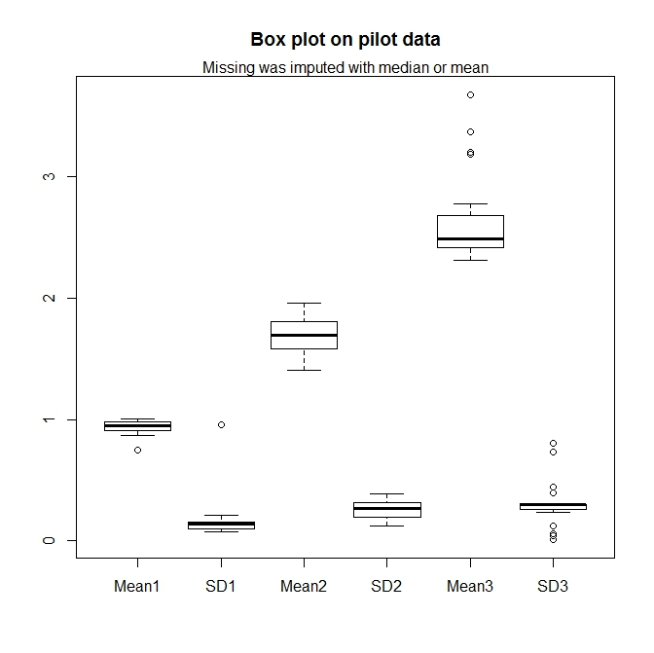

Slide 39
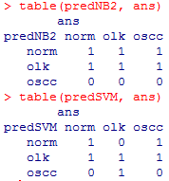
Two prediction model fitting
Data was randomly separated to training and testing (7:2)
Two models were tested
NaïveBayes
SVM
Prediction was applied on the testing data
And, the results

Slide 40
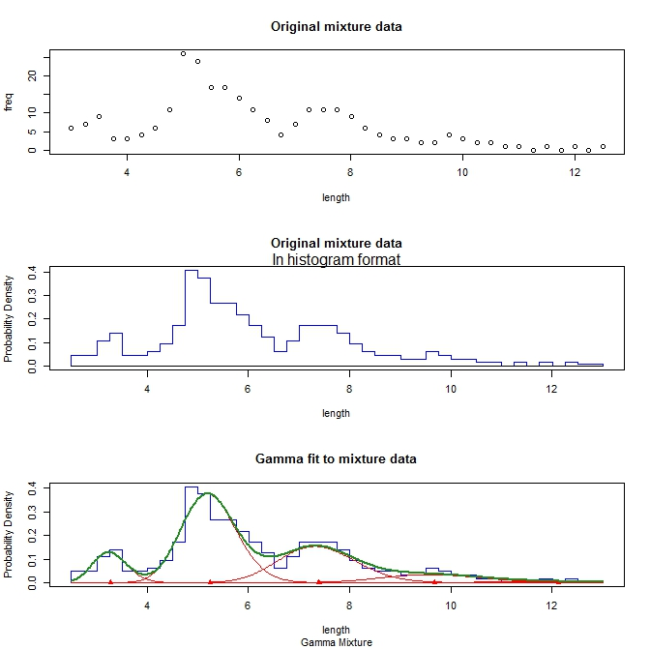

Slide 41
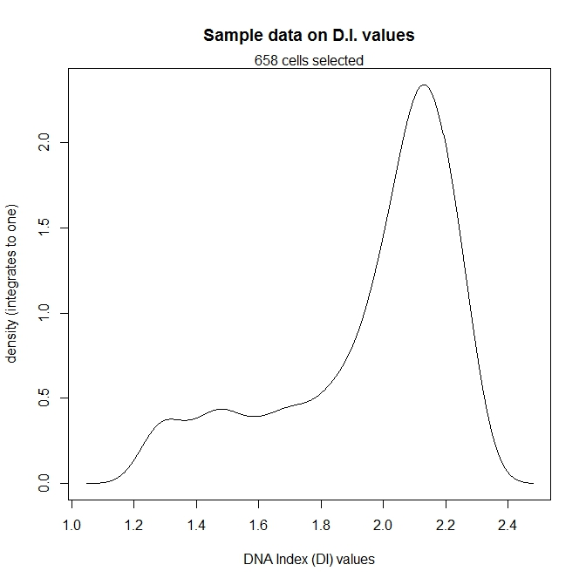
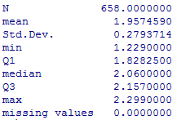
One sample data

Slide 42
Our first trial – step one
Three basic clusters of cell populations
D.I. value: 0.9 – 1.249
D.I. value: 1.250 – 2.299
D.I. value: > 2.300
Assuming equal C.V. across three populations, and estimated from “normal sample”:
Three means: 1.001, 2.002, 3.003

Slide 44
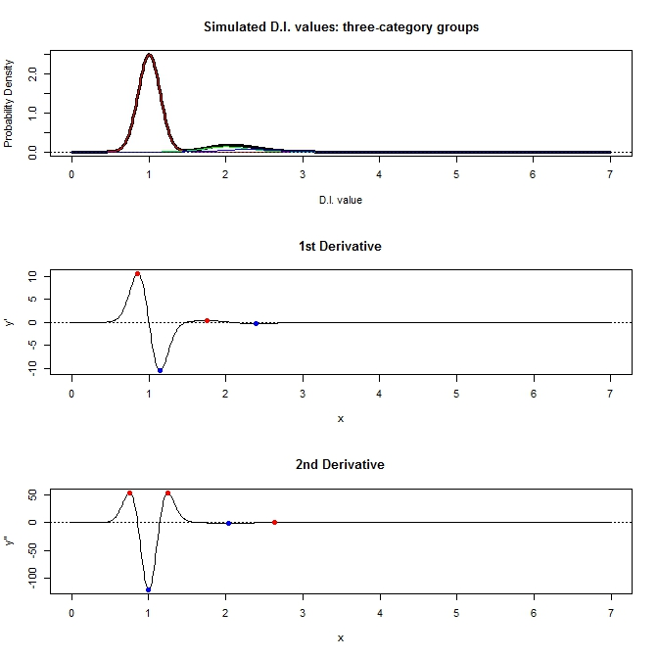

Slide 45
Our hurdle
Too much information from “normal” cluster
Possible to detect the “mitotic” stage
Impossible to detect “aneuploidy” stage
Need to strip out the “normal” information first, but how?
Don’t know
Don’t know
Don’t know

Slide 46
On-going effort and future goal
Get sufficient summary statistics from ten of thousands cells (i.e. D.I. values)
Evaluating the summary statistics
Reflect the mixture of distribution
Robust enough (enough information) to differentiation cell population
Capture cell population characteristics
Building the prediction model
Assess model performance
Provide accurate diagnosis guidance
Constantly improve the model

Slide 47
Raw dataDB

Slide 51
Two prediction model fitting
Data was randomly separated to training and testing (7:2)
Two models were tested
NaïveBayes
SVM
Prediction was applied on the testing data
And, the results

Slide 52
The challenges/objectives
To alleviate the impact from the “normal” cell population
Even, the replication cell population
To get the sufficient summarization of the data
To pruning the predication model(s)

Slide 53
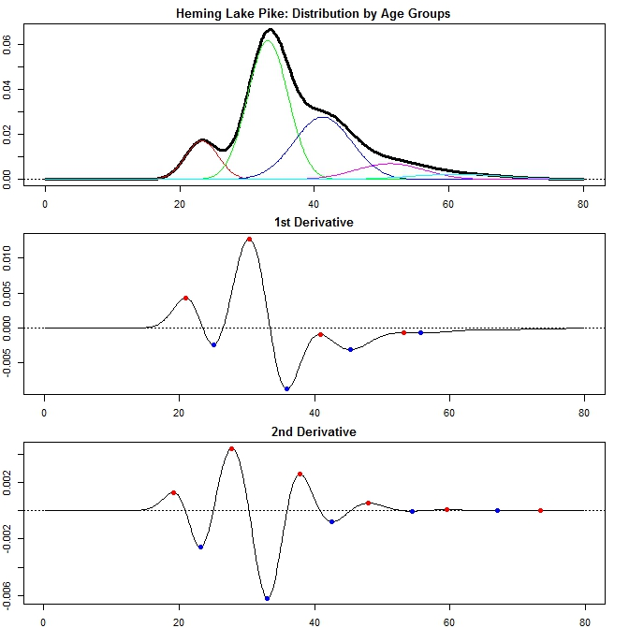

Slide 54
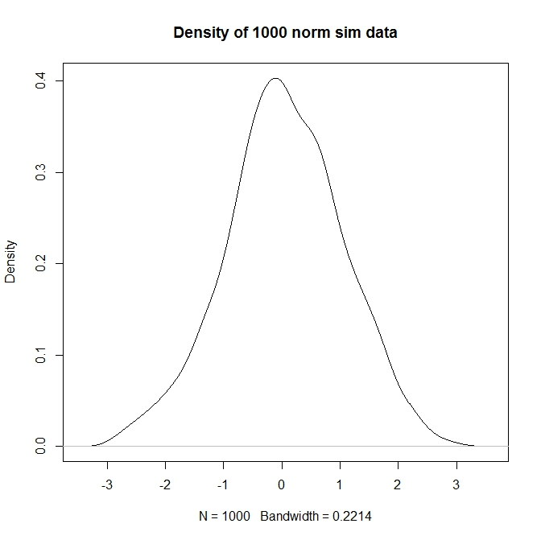

Slide 55
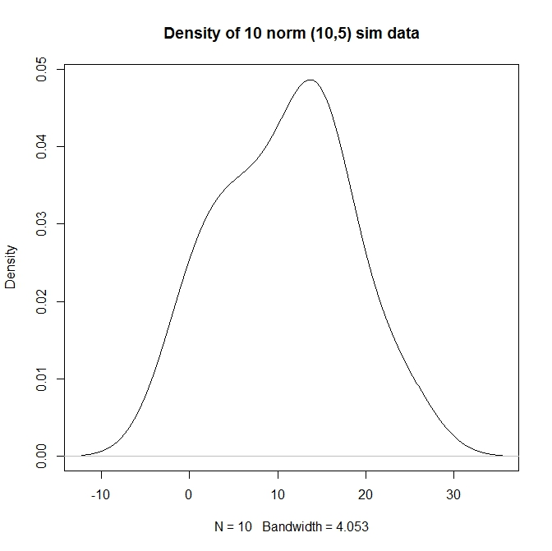

Slide 56
Alleviate the impact from the “normal” cell population

Slide 57
1.02
1.79
1788
3.25, 3.57, 3.99

Slide 59
Stripping a population from a mixture --from left to right
Dynamically identify the left-most peak
Estimate the summary statistics using half of the distribution
Stripping the data from the population
Sequentially stripping

Slide 60
The left-most population

Slide 61
The artifact
3.25, 3.57, 3.99

Slide 62
2.00
3.33

Slide 63
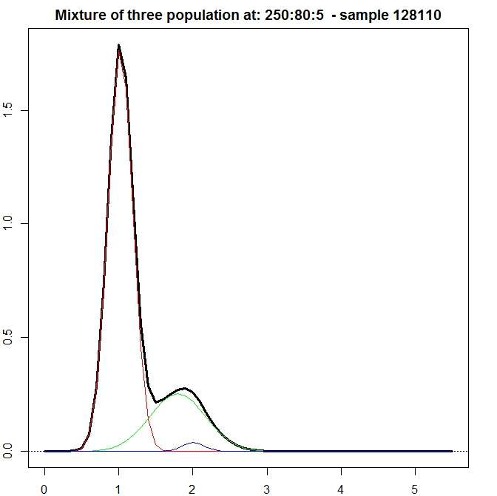

Slide 64
Notes:
Figure 3 Kernel density smoothed density plots on D.I. values

Slide 65
1.02
2.00
1.79
1788
3.33
3.25, 3.57, 3.99
Notes:
Figure 4 Data cleaning results from ExGCRn procedure

Slide 66
Need roc curve comparison
May prediction precision
Etc.

