Slide 1
Notes:
Figure 1. Overall workflow

Slide 2
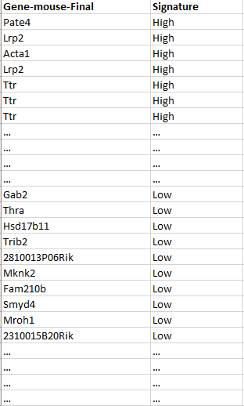
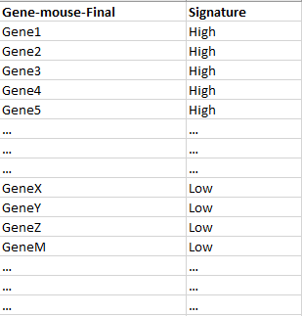
Eliminate target
genes
Re-calculate GATA2 activity
X₁
GATA2
PGR
Y₁
ξ₁
γ₂₁
γ₁₁
[SOX17]
Y₂
ξ₂
Notes:
Figure 2. Testing the biological hypothesis.

Slide 3
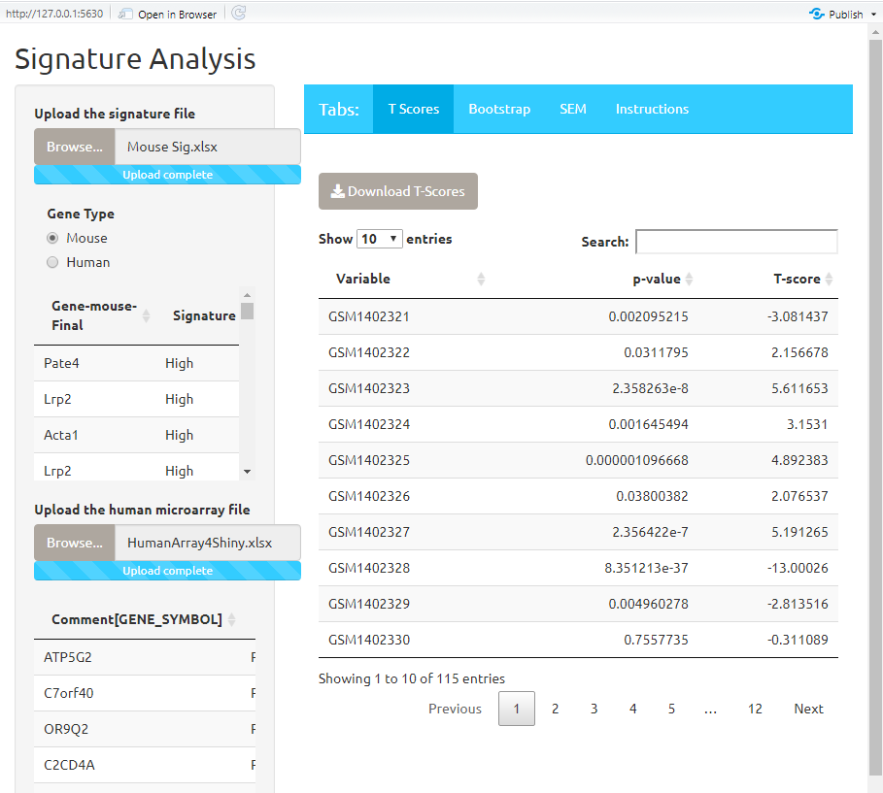
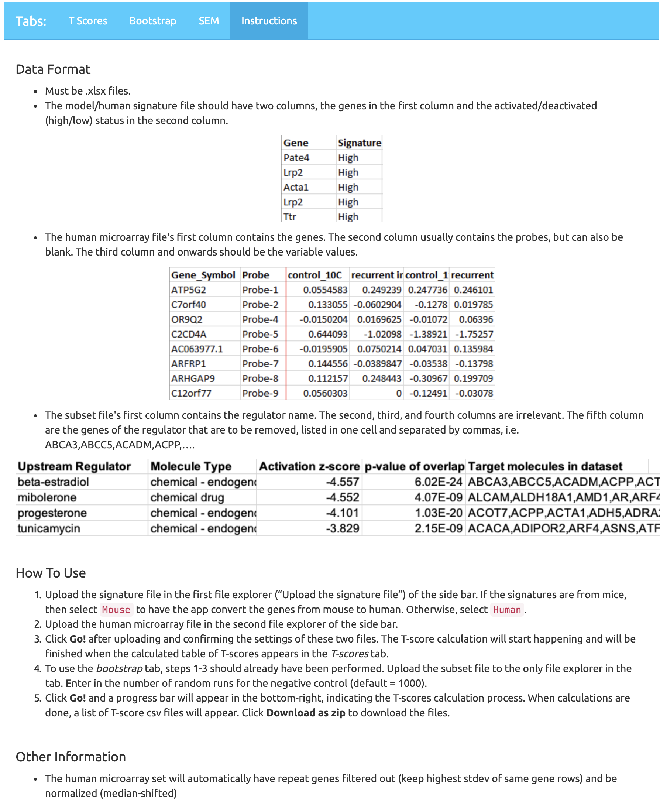


https://edelgene.niehs.nih.gov/ibsip2019/SignatureAnalysis/
Notes:
Figure 3. A screenshot of the Signature Analysis R Shiny application. It has four tab and the last tab shows the instruction of how to use this application. Two QR codes are for code repository on GitHub and a docker image.

Slide 4
GATA2 significant gene List
GATA2 significant gene List
All genes except GATA2&PGR (list)
+ SOX17
Random exclude N genes
A downstream target gene list (N)
Exclude downstream target genes
Shrunk significant gene List
Shrunk significant gene List
Add back to
the shrunk list
Random draw (N)
genes
Calculate the
activity with
the Signature
Analysis App
Restore back to the original number of genes
GATA2
PGR
GATA2
PGR
γ₁₁
γ₂₁
γ₁₁
ξ₁
γ₂₁
ξ₁
[SOX17]
[SOX17]
Calculate the activity with the Signature Analysis App
ξ₂
ξ₂
Notes:
Figure 4A A two-fold bootstrap strategies. On the left hand, we coin the name “elimination without replacement”; whereas the one on the right, “elimination with replacement”.

Slide 5
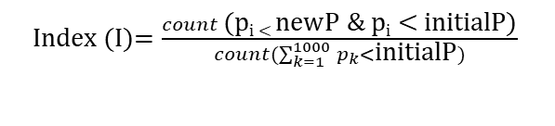
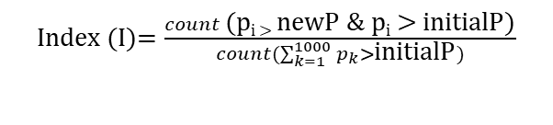
Shrunk significant gene List
Favorable impact
New p-val
of GATA2
Initial p-val
of GATA2
Adverse impact
If the new p-value is bigger
If the new p-value is smaller
For each holdoff p-value (p_{i})
Comparing the new pvalue
to the initial pvalue
For each holdoff p-value (p_{i})
Index (I)$=\frac{count \text{(}\text{pi}\text{ < }\text{newP}\text{ \& }\text{p}\text{i}\text{ < }\text{initialP}\text{)}}{count(\sum_{k=1}^{1000}{p_{k}<}\text{initialP})}$
Index (I)$=\frac{count \text{(}\text{pi}\text{ > }\text{newP}\text{ \& }\text{p}\text{i} \text{>} \text{initialP}\text{)}}{count(\sum_{k=1}^{1000}{p_{k}>}\text{initialP})}$
For the apparent constraint, the
index (I) would be a numerical value [0,1]
Notes:
Figure 4B. Based on the two-fold bootstrap strategies, an index value is calculated to infer the impact significance

Slide 6
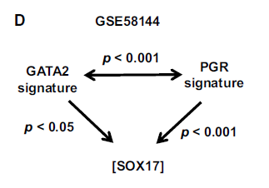
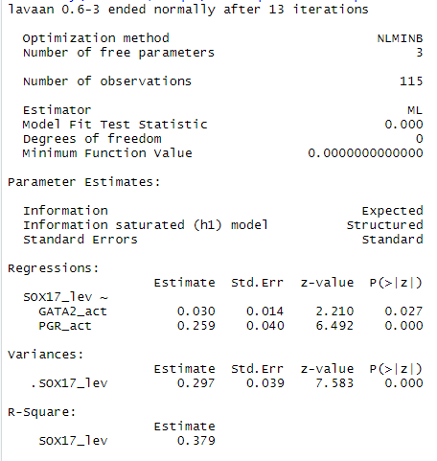
Notes:
Supplemental Figure 1. Validating the results from M-Plus with newly developed R-program

Slide 7
Regulator | Molecule Type | SEM p-value (GATA2) | SEM p-value (PGR) | p-value (IPA) | NumOfDownstreamGenes | Predicted Activation State (IPA)
ATF4 | transcription regulator | 0.0709 | 1.24E-11 | 0.000000252 | 34 | Inhibited
beta-estradiol | chemical - endogenous mammalian | 0.2264 | 2.02E-12 | 6.02E-24 | 289 | Inhibited
EGFR | kinase | 0.1184 | 6.02E-12 | 1.1E-10 | 73 | Inhibited
ERN1 | kinase | 0.0456 | 1.93E-11 | 1.58E-08 | 31 | Inhibited
FOXO3 | transcription regulator | 0.0513 | 1.40E-11 | 3.87E-10 | 62 | Activated
HOXA10 | transcription regulator | 0.0353 | 4.27E-11 | 2.74E-08 | 39 | Inhibited
MITF | transcription regulator | 0.0483 | 2.29E-11 | 5.91E-02 | 27 | Activated
progesterone | chemical - endogenous mammalian | 0.0927 | 4.72E-12 | 1.03E-20 | 124 | Inhibited
PTEN | phosphatase | 0.0741 | 1.78E-11 | 4.30E-08 | 83 | Activated
RUNX3 | transcription regulator | 0.0399 | 2.96E-11 | 3.10E-03 | 20 | Inhibited
TGFBR1 | kinase | 0.0327 | 5.00E-11 | 8.22E-03 | 14 | Activated
Vegf | group | 0.0699 | 6.57E-12 | 5.22E-06 | 72 | Inhibited
XBP1 | transcription regulator | 0.0276 | 5.68E-11 | 2.88E-09 | 45 | Inhibited

Slide 8
Upstream regulator | Molecular type | Index(I) | Impact | NumOfDownstreamGenes | IPA (p- value)
BCL6 | transcription regulator | <0.001 | Adverse | 28 | 9.96E-03
BRCA1 | transcription regulator | <0.001 | Adverse | 32 | 2.07E-05
CTNNB1 | transcription regulator | <0.001 | Adverse | 92 | 2.50E-04
EHMT2 | transcription regulator | <0.001 | Adverse | 9 | 7.90E-03
EP300 | transcription regulator | <0.001 | Adverse | 65 | 3.44E-06
MAX | transcription regulator | <0.001 | Adverse | 20 | 2.82E-05
NFYA | transcription regulator | <0.001 | Adverse | 15 | 3.68E-03
PML | transcription regulator | <0.001 | Adverse | 22 | 1.42E-03
SIN3A | transcription regulator | <0.001 | Adverse | 13 | 1.53E-03
SIN3B | transcription regulator | <0.001 | Adverse | 7 | 1.11E-03
SP1 | transcription regulator | <0.001 | Adverse | 80 | 1.66E-06
SP3 | transcription regulator | <0.001 | Adverse | 39 | 3.25E-06
TP73 | transcription regulator | <0.001 | Adverse | 47 | 8.98E-03
TWIST1 | transcription regulator | <0.001 | Adverse | 23 | 5.50E-03
YAP1 | transcription regulator | <0.001 | Adverse | 17 | 5.31E-03
ZNF282 | transcription regulator | <0.001 | Adverse | 3 | 2.16E-03
EZH2 | transcription regulator | 0.0023 | Adverse | 45 | 3.04E-03
TCF3 | transcription regulator | 0.0024 | Adverse | 41 | 7.42E-03
EGFR | kinase | <0.001 | Adverse | 73 | 1.10E-10
beta-estradiol | chemical - endogenous mammalian | 0.0019 | Adverse | 289 | 6.02E-24
PTEN | phosphatase | 0.0020 | Adverse | 83 | 4.30E-08
Vegf | group | 0.0022 | Adverse | 72 | 5.22E-06
MITF | transcription regulator | 0.0023 | Adverse | 27 | 5.91E-02
ATF4 | transcription regulator | 0.0024 | Adverse | 34 | 2.52E-07
progesterone | chemical - endogenous mammalian | 0.0038 | Adverse | 124 | 1.03E-20
ERN1 | kinase | 0.0263 | Adverse | 31 | 1.58E-08
RUNX3 | transcription regulator | 0.0470 | Adverse | 20 | 3.10E-03
FOXO3 | transcription regulator | 0.0531 | Adverse | 62 | 3.87E-10
HOXA10 | transcription regulator | 0.2416 | Adverse | 39 | 2.74E-08
TGFBR1 | kinase | 0.2808 | Adverse | 14 | 8.22E-03
XBP1 | transcription regulator | 0.9701 | Adverse | 45 | 2.88E-09

