Slide 1
Linear discriminant analysis

Slide 2
Assumptions
Responsive variable (to be predicted to)
Dependent variable
Categorical or classes
2 or more dependent variables
Independent variable (to be trained on)
Each and all variables are normally distributed
Each variable has the same variance
Scale and normalization could be helpful
Remove the outliers if necessary

Slide 3
LDA – under the hood
Important summary statistics
μ_{k}: The mean of all training observations from the k^{th} class.
σ²: The weighted average of the sample variances for each of the k classes.
π_{k}: The proportion of the training observations that belong to the k^{th} class.
Formula, for each class/category “k”, D_{k}(x) is calculated
D_{k}(x) = x * (μ_{k}/σ²) – (μ_{k}²/2σ²) + log(π_{k})
x is assigned to class k (of m classes) when D_{k}(x) is the maximum among all m D_{i} (x) values (i = 1:m)

Slide 4
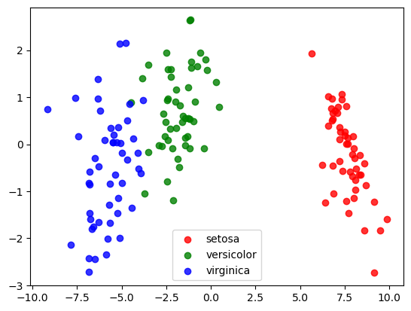
Iris class prediction with LDA

Slide 5
A few things to be watch out for
p x n ratio is very important
Training set and prediction set
Model pruning with cross-validation
Are there other methods that may perform better

