Slide 1
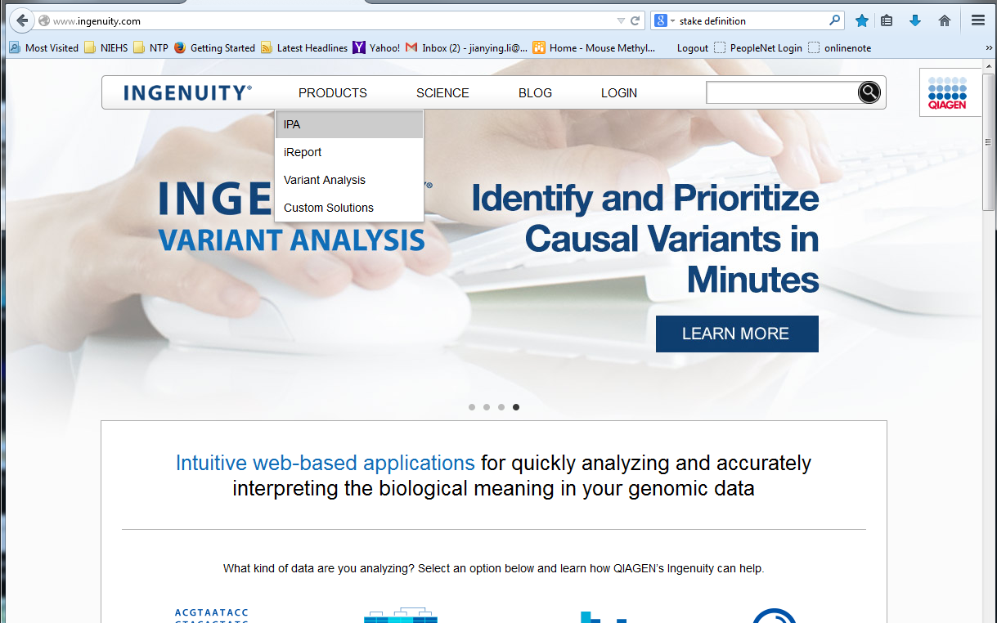
Here is the URL
Mouse over this selection

Slide 2
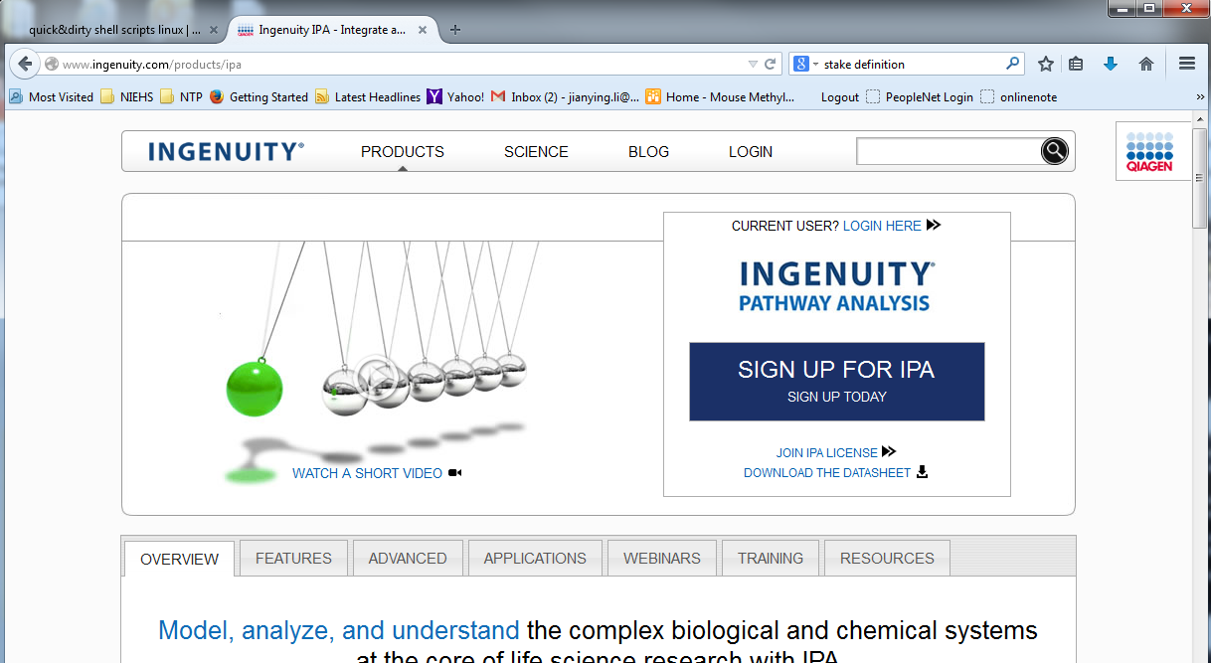
URL changes once one selects IPA from the product list
Click sig up

Slide 3
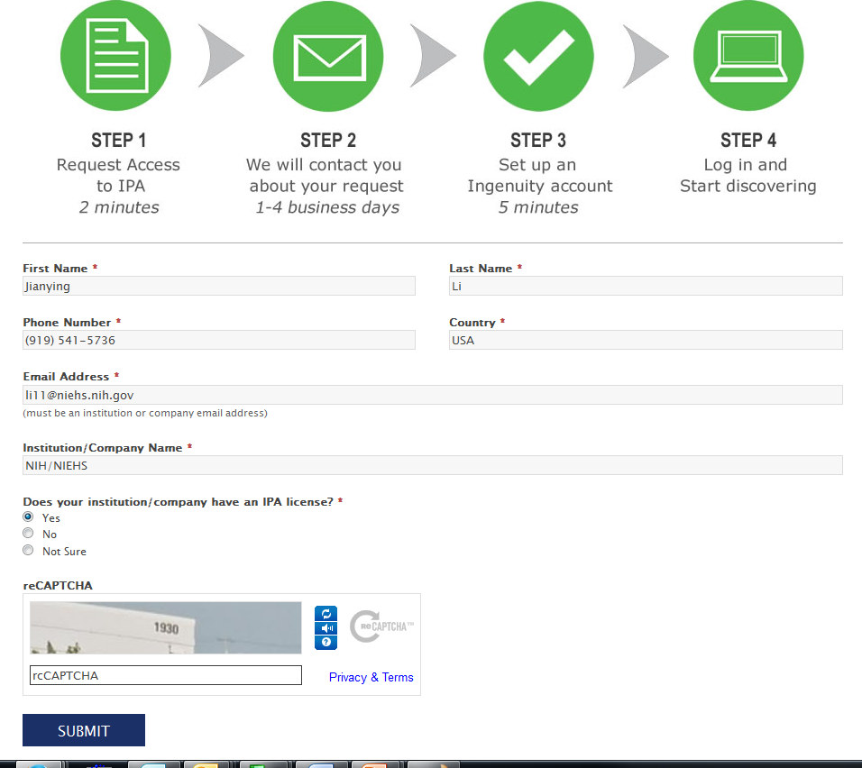
Fill in the information and
Make sure to
Use @niehs.nih.gov
check “yes”
The, click submit

Slide 4
