Slide 1
Pathway Analysis
Biostatistics and Bioinformatics Short Course
02/12/16
Brian Bennett, Ph.D.
(brian.bennett@nih.gov)

Slide 2
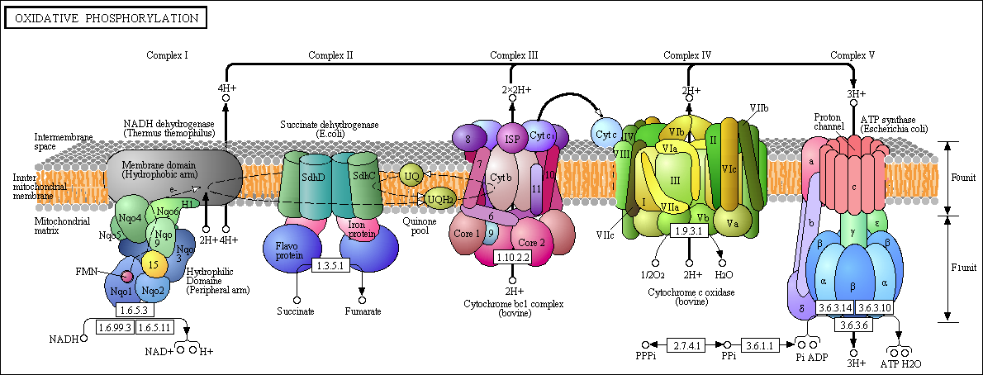
What is a Biological Pathway?
A set of molecules in a cell that work together through a series of actions to achieve a particular outcome

Slide 3
What is Pathway Analysis?
Identifying pathways whose genes are associated with a particular biological condition
Examines the combined signal from multiple genes, as opposed to looking at individual genes separately
Recently, this definition has been extended to include any set of genes that have some sort biological connection (gene sets)
Mechanistic and signaling cascades (KEGG, Biocarta)
Functional and biological processes (GO)
Associated with a disease or condition
Chromosomal proximity
Computationally derived

Slide 4

Advantages over Single-Gene Analysis
Different samples from a common condition may have different key genes that are all driving changes in the same pathway

Slide 5
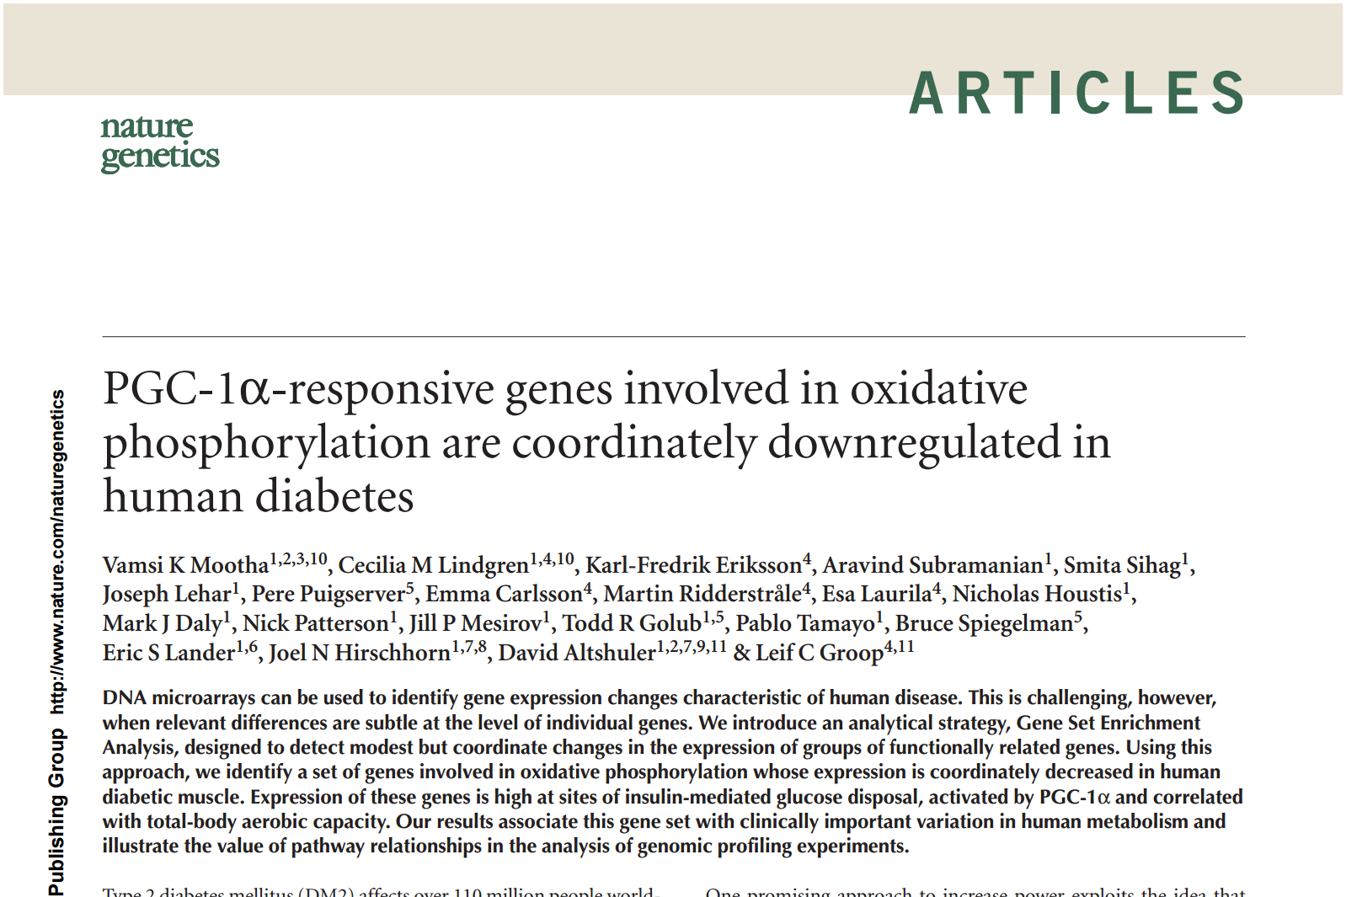
Advantages over Single-Gene Analysis
Pathways may be perturbed by subtle changes in many genes

Slide 6
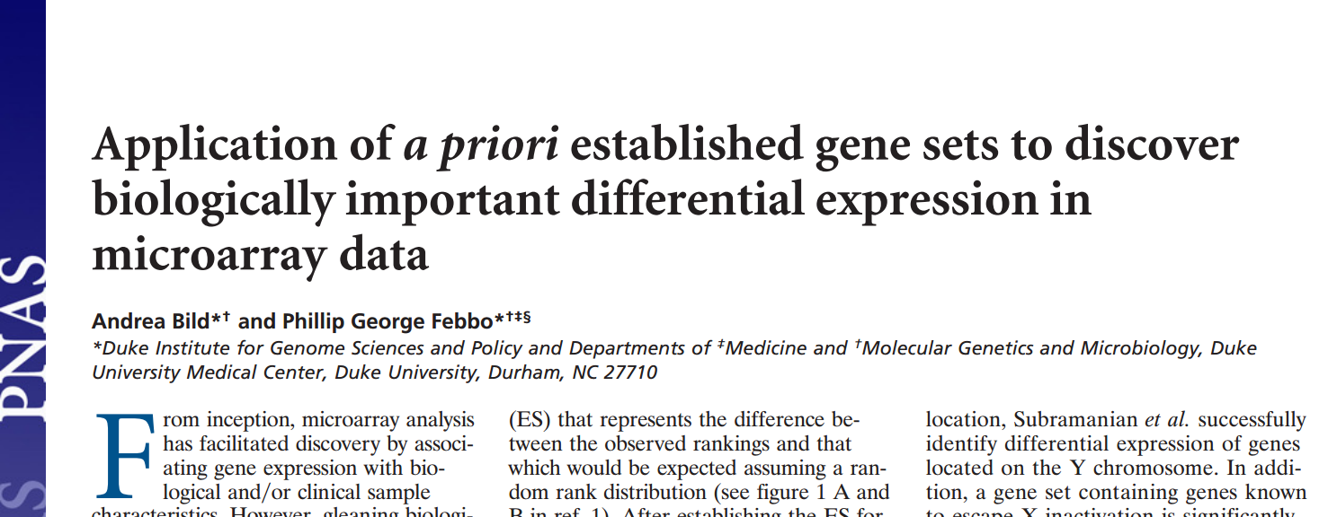
Advantages over Single-Gene Analysis
A small list of enriched pathways may be easier to interpret than a large list of associated genes

Slide 7
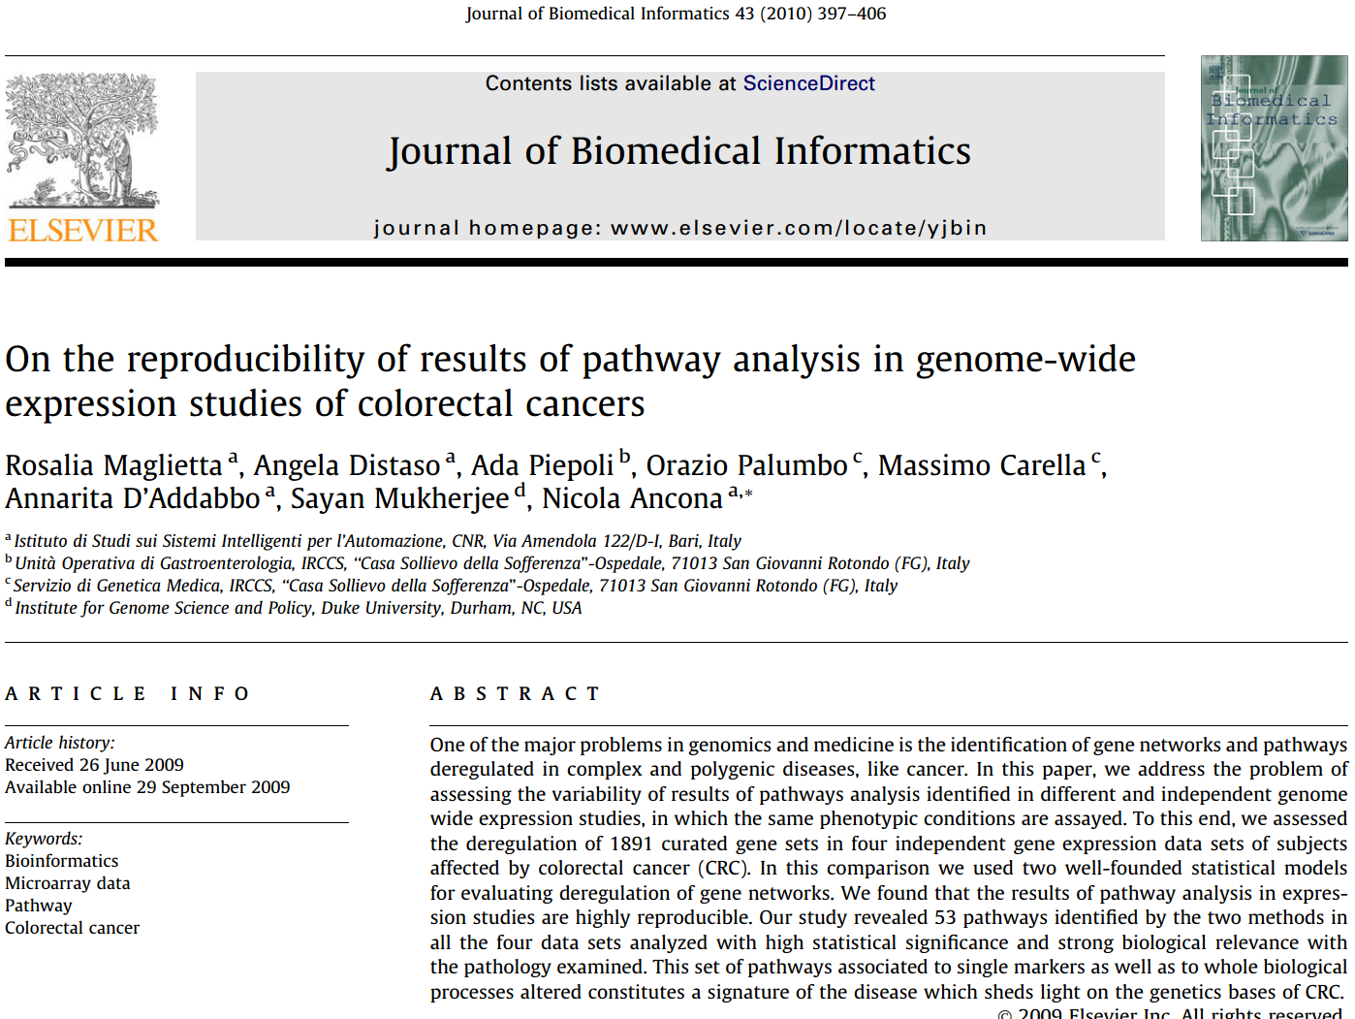
Advantages over Single-Gene Analysis
Pathways results from different studies may overlap better than single-gene results

Slide 8
Gene Expression Pathway Analysis
Data: Gene expression data for samples in two groups (disease vs. control, treatment vs. no treatment, etc.)
Biological Question: Which pathways are impacted by the condition or treatment?
Statistical Question: Which pathways have more differentially expressed genes than expected by chance?

Slide 9
Required Data
Gene expression data set
Collection of gene sets

Slide 10
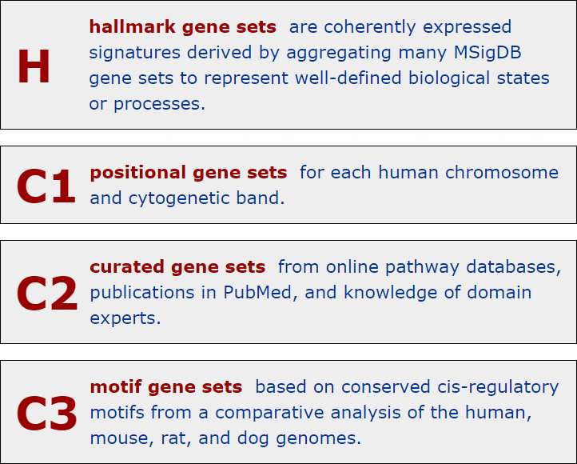
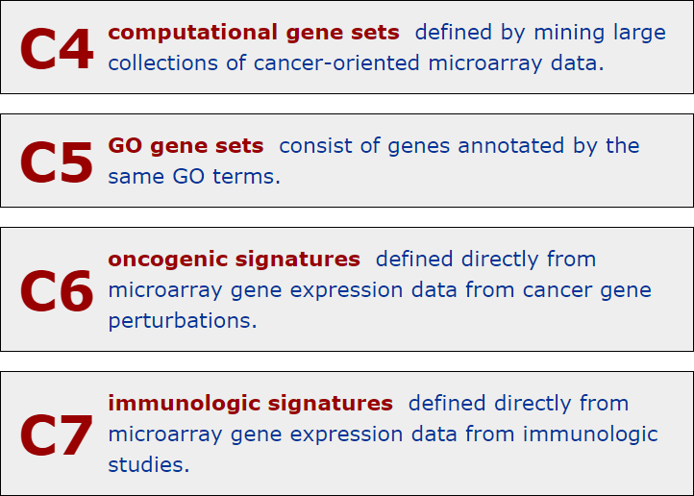
Molecular Signatures Database (MSigDB)
Free database (http://www.broadinstitute.org/gsea/msigdb)

Slide 11
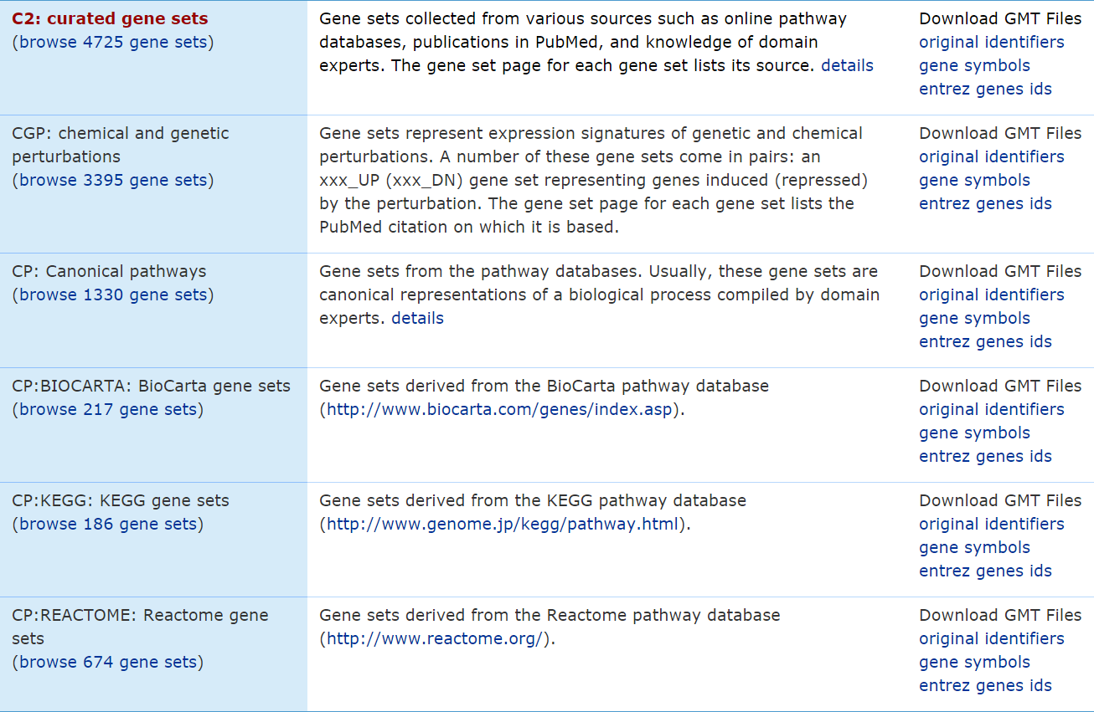
Molecular Signatures Database (MSigDB)

Slide 12
Hypergeometric Test (Right-tailed)
Parametric method
Can also use Fisher’s Exact (FE) test
Required data:
List of DEGs (along with the number of total genes)
A gene set
If the proportion of DEGs within the gene set if sufficiently higher than the proportion within the entire set, the gene set is considered significantly enriched

Slide 13


Hypergeometric Test (Right-tailed)
Full data
Gene set
k = total DEGs = 1000
N = total overall genes = 10000
(10% are DEGs)
x = total DEGs in gene set = 60
m = total genes in gene set = 100
(60% are DEGs)

Slide 14
Hypergeometric Test (Right-tailed)
x = total DEGs in gene set = 60
m = total genes in gene set = 100
k = total DEGs = 1000
N = total overall genes = 10000
R code:
phyper( x-1, m, N-m, k, lower.tail=FALSE )
fisher.test( matrix(c(x,k-x,m-x,N-m-k+x),2,2), alternative='greater' )$p.value
P-value = 5.4 x 10⁻³⁵

Slide 15
Hypergeometric Test (Right-tailed)
Used in Ingenuity Pathway Analysis (IPA)
Commercial software (http://www.ingenuity.com/products/ipa)
Pros:
Great source of clean, expertly curated gene sets
Cons:
Not free
Throws away information by only using DEG list

Slide 16
Hypergeometric Test (Right-tailed)
Used in Database for Annotation, Visualization and Integrated Discovery (DAVID)
Free software (https://david.ncifcrf.gov)
Pros:
Easy to use (web-based)
Large collection of gene sets
Cons:
Gene sets are not as clean
Throws away information by only using DEG list

Slide 17
Kolmogorov–Smirnov (KS) Test
Nonparametric method
Required data:
Ranked list of genes sorted by differential expression (includes all genes)
A gene set
If the genes in the gene set tend to fall near either end of the ranked list, the gene set is considered significantly enriched

Slide 18
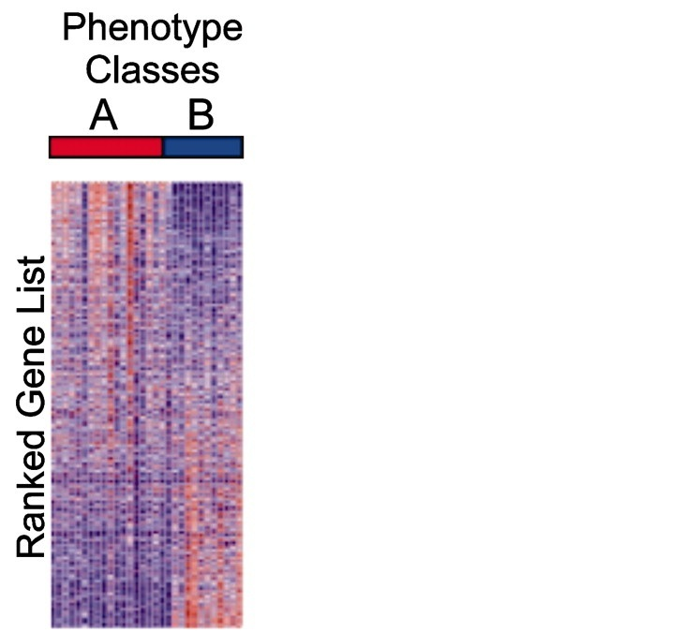
Kolmogorov–Smirnov (KS) Test
(upregulated)
(downregulated)

Slide 19
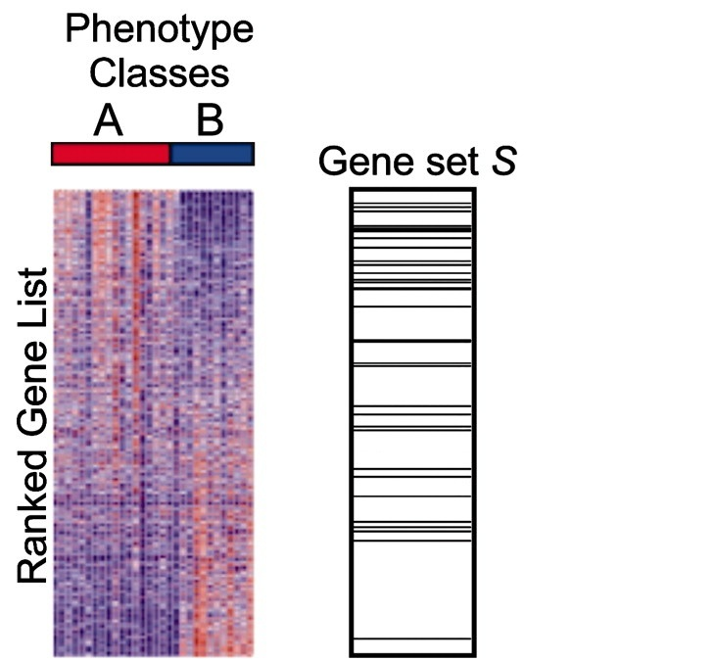
Kolmogorov–Smirnov (KS) Test
(upregulated)
Large, positive enrichment score
(downregulated)

Slide 20
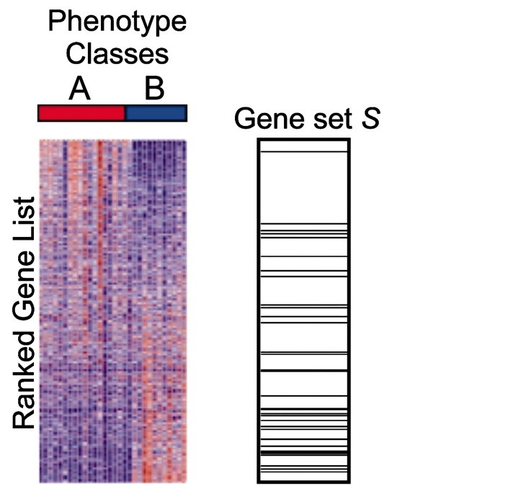
Kolmogorov–Smirnov (KS) Test
(upregulated)
Large, negative enrichment score
(downregulated)

Slide 21
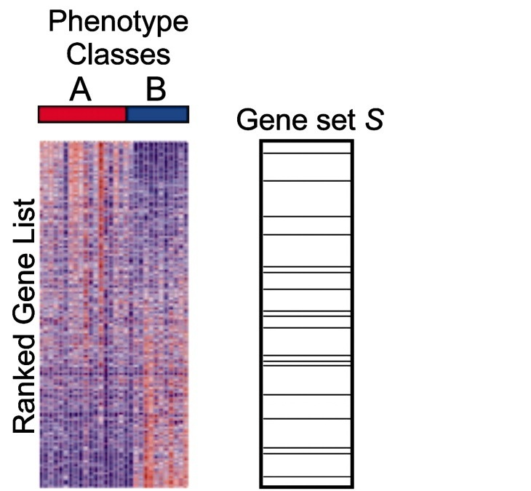
Kolmogorov–Smirnov (KS) Test
(upregulated)
Near zero enrichment score
(downregulated)

Slide 22
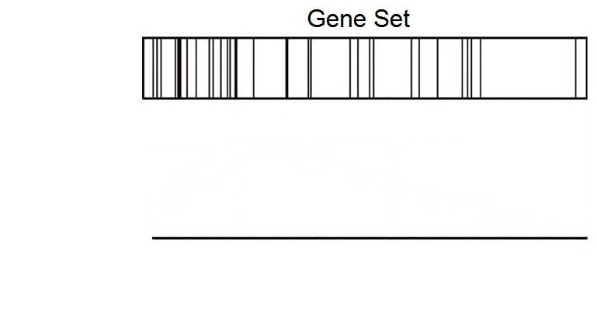
Kolmogorov–Smirnov (KS) Test
(upregulated)
(downregulated)

Slide 23
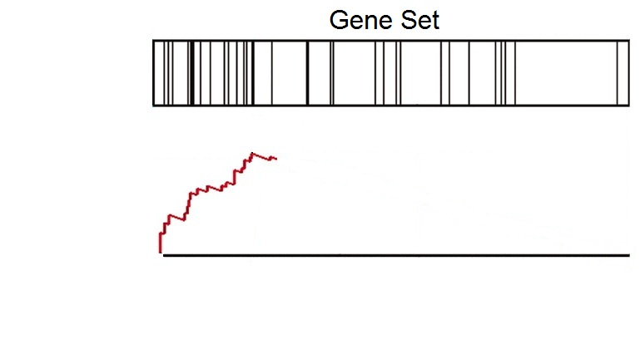
Kolmogorov–Smirnov (KS) Test
(upregulated)
(downregulated)

Slide 24
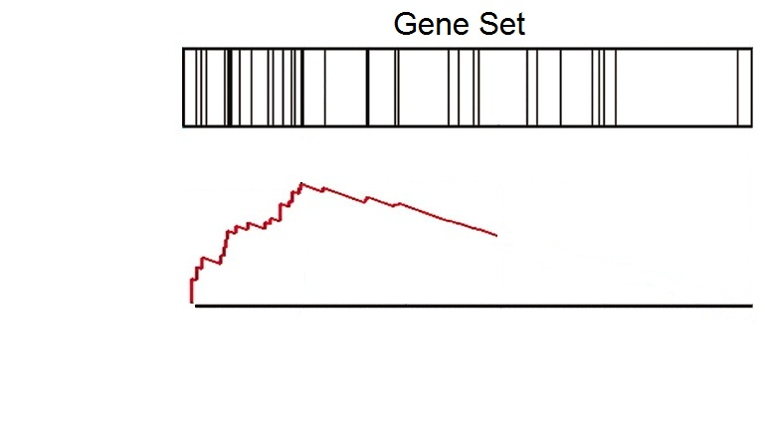
Kolmogorov–Smirnov (KS) Test
(upregulated)
(downregulated)

Slide 25
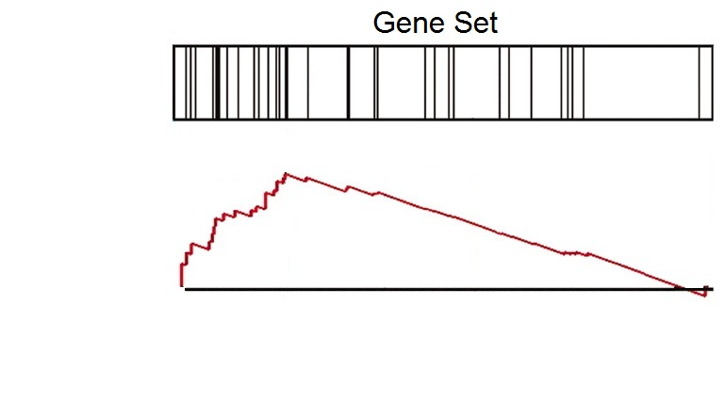
Kolmogorov–Smirnov (KS) Test
(upregulated)
(downregulated)

Slide 26
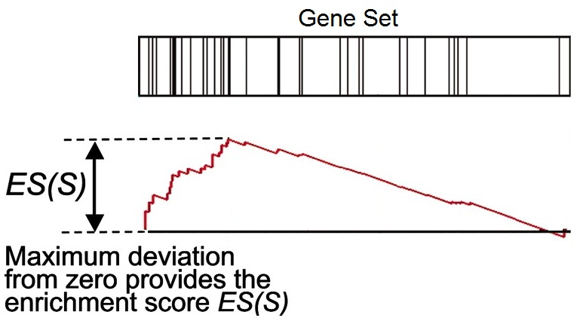
Kolmogorov–Smirnov (KS) Test
(upregulated)
(downregulated)

Slide 27
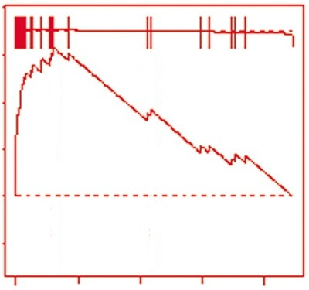
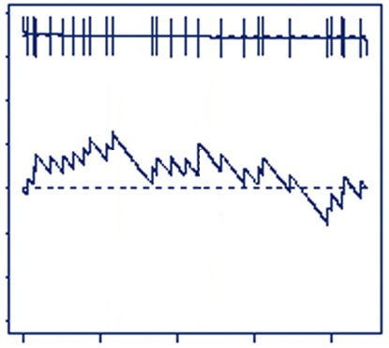
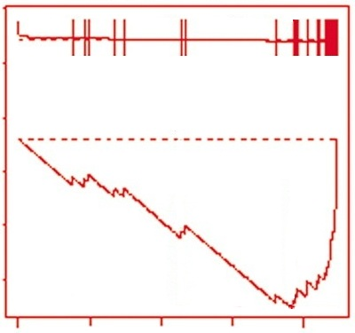
Kolmogorov–Smirnov (KS) Test
Many genes
upregulated
Genes
randomly distributed
Many genes
downregulated
Large positive
enrichment score
Near zero
enrichment score
Large negative
enrichment score

Slide 28
Kolmogorov–Smirnov (KS) Test
Generate a null distribution of permuted ESs by shuffling the class labels
Calculate normalized enrichment score (NES)
This adjusts for gene set size and correlation bias
Divide the original ES by the mean of permuted ESs with the same sign
Calculate p-value
Compare the original ES to the distribution of permuted ESs (one-tailed)
Calculate the percentage of permuted ESs that are higher than the original ES

Slide 29
Kolmogorov–Smirnov (KS) Test
Used in Gene Set Enrichment Analysis (GSEA)
Free software (http://www.broadinstitute.org/gsea)
Pros:
Large collection of gene sets
Uses more information than methods that only use DEG list
Enrichment plot improves interpretability
Cons:
Permutation-based p-values
Gene sets are not as clean

Slide 30
Additional Processing
Apply a multiple comparison correction (FDR)
Interpret p-values cautiously
Filter out gene sets that are too small or too big
Explore key drivers in significant pathways
Experimentally validate or follow up on significant gene sets

Slide 31
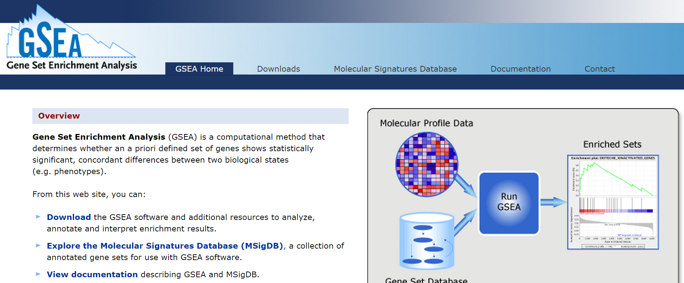
GSEA Example
http://www.broadinstitute.org/gsea

Slide 32
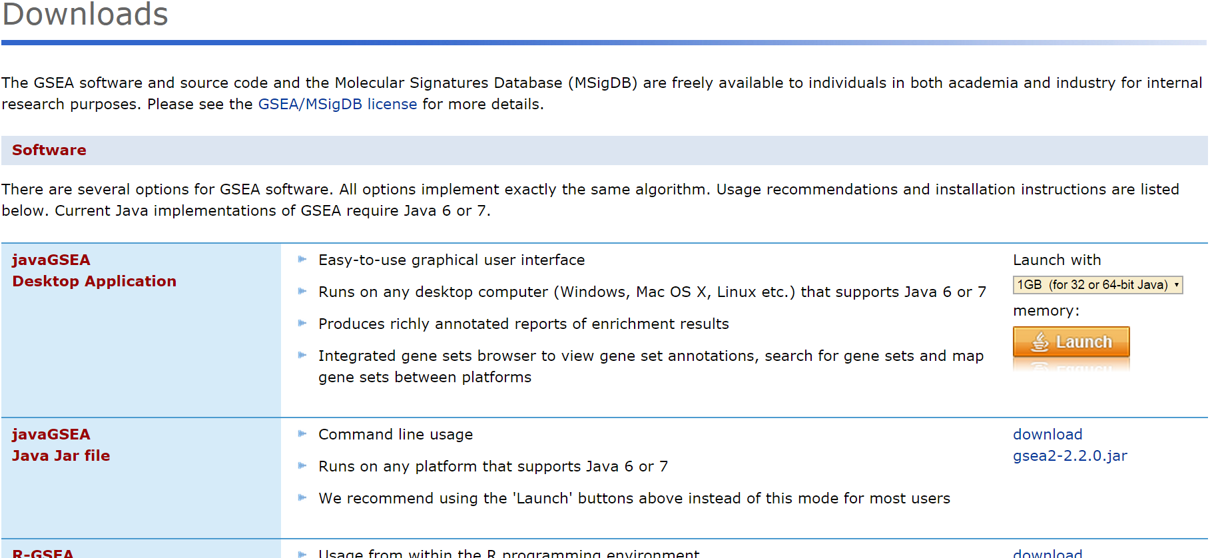
GSEA Example

Slide 33
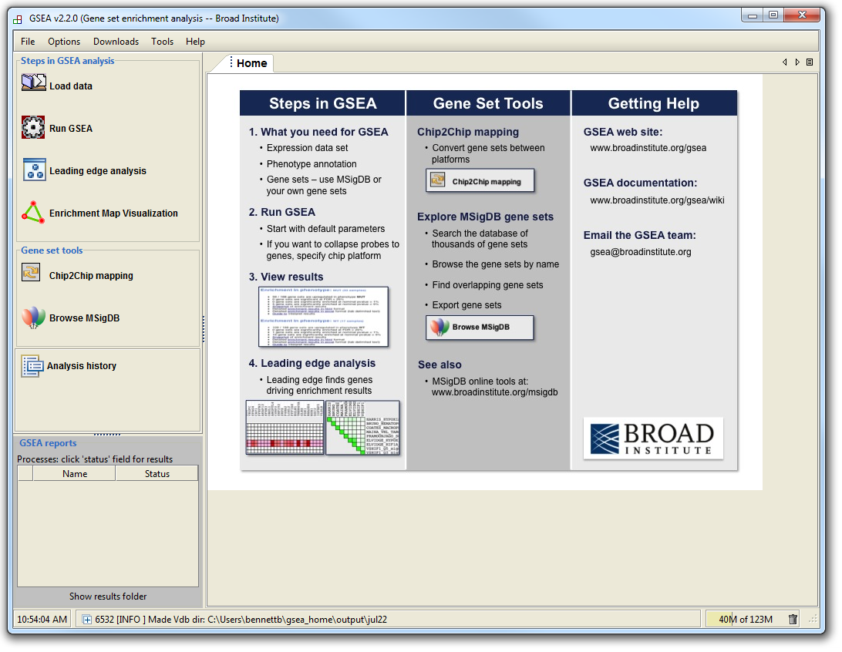
GSEA Example

Slide 34
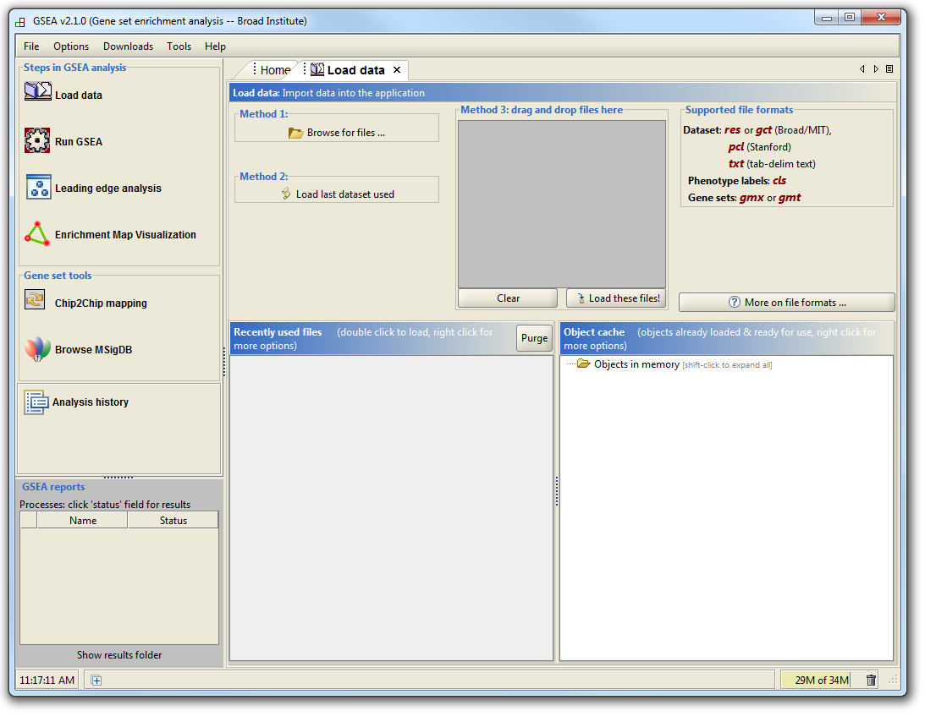
GSEA Example

Slide 35
GSEA Example
Supported file types:
http://www.broadinstitute.org/cancer/software/gsea/wiki/index.php/Data_formats
Required:
Expression data file
Class label file
Optional:
Gene set file

Slide 36
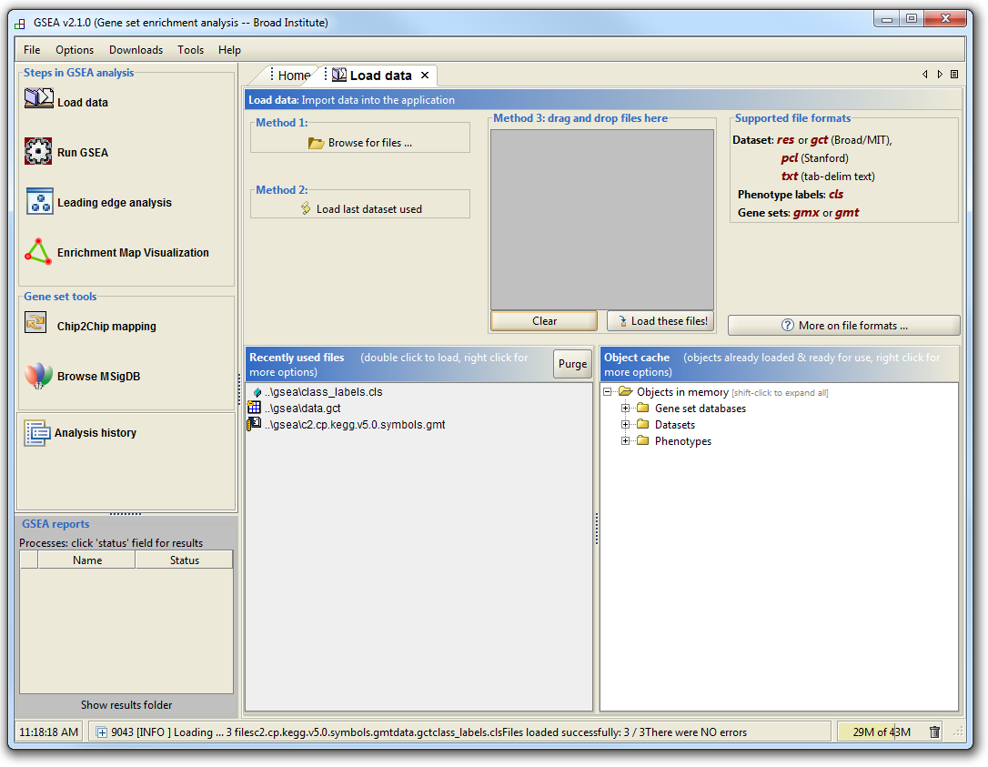
GSEA Example

Slide 37
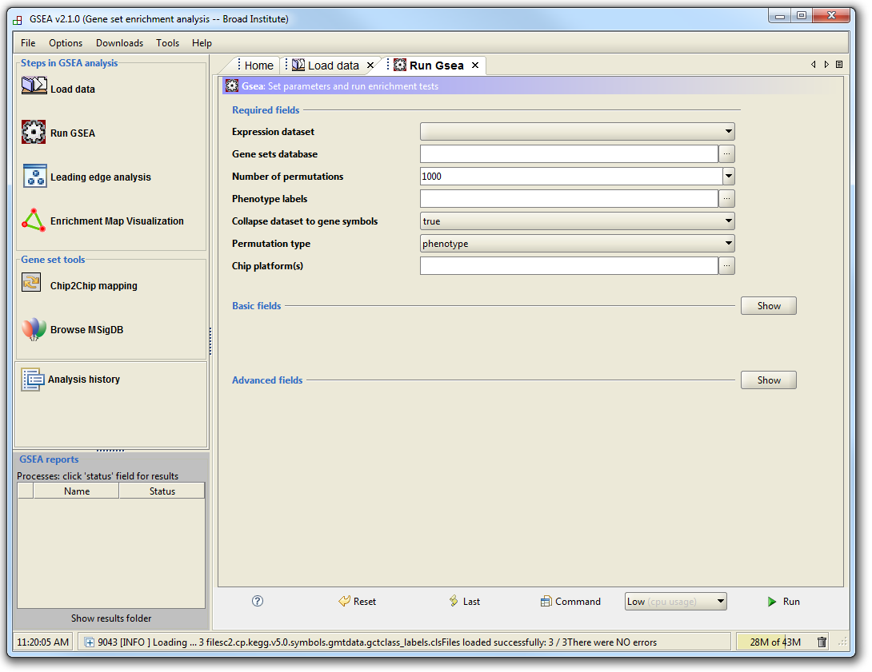
GSEA Example

Slide 38
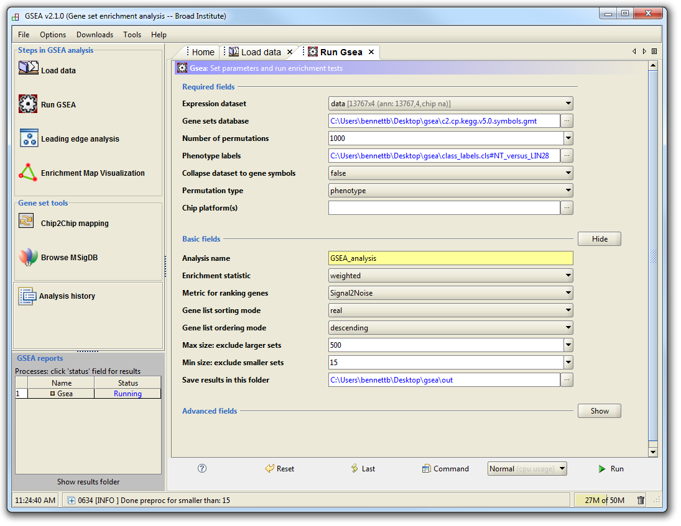
GSEA Example

Slide 39
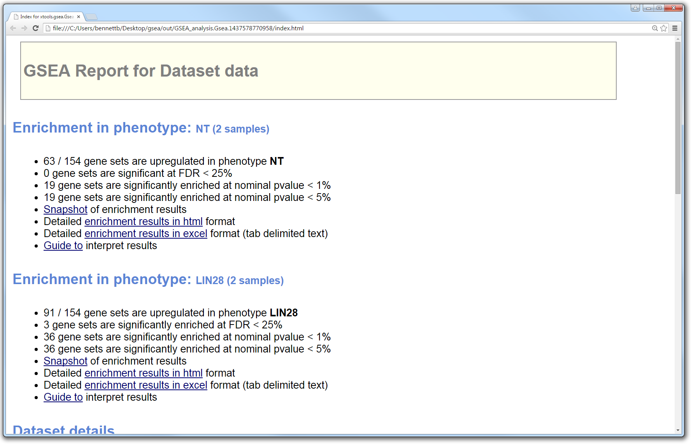
GSEA Example
Within output directory: index.html

Slide 40
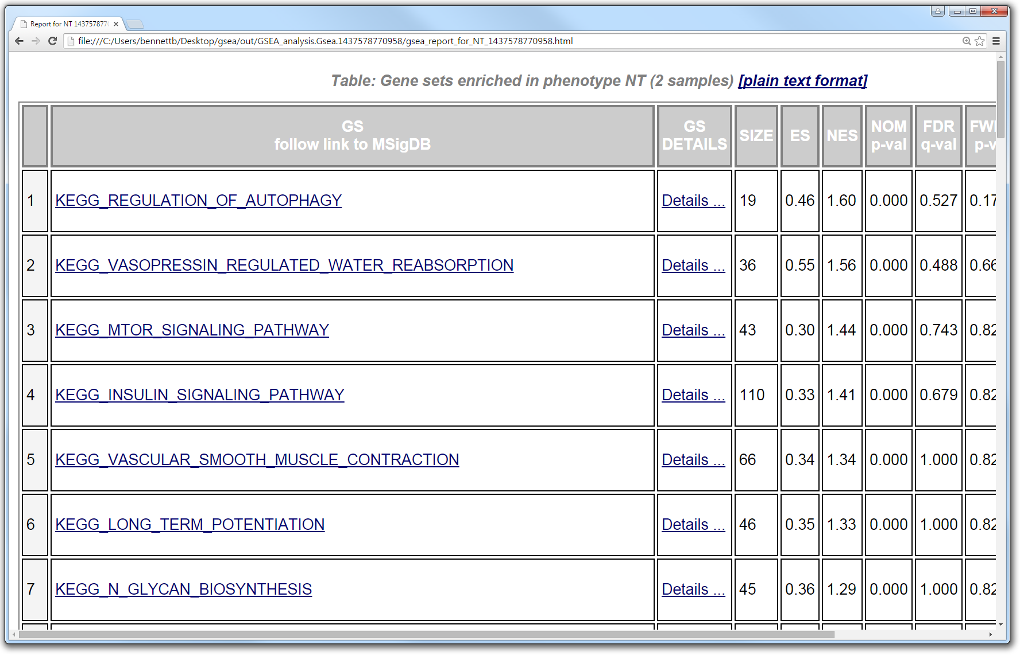
GSEA Example

Slide 41
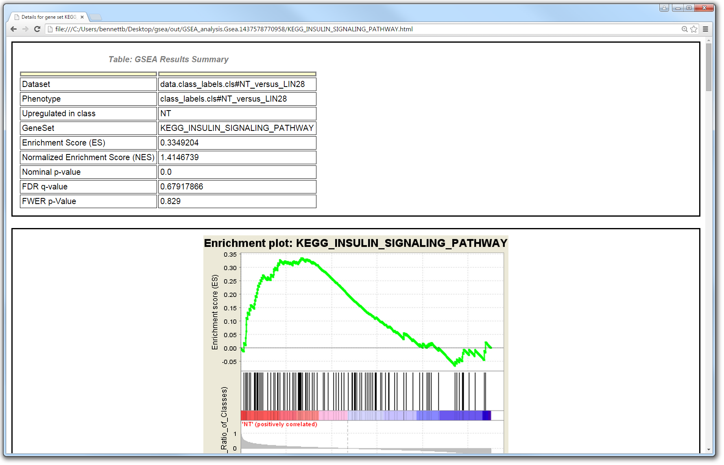
GSEA Example

Slide 42
Other Types of Pathway Analysis
Other data types (genotype, copy number, etc.)
Other types of gene lists (genes from proteomics, ChIP targets, etc.)
Custom gene sets (genes of interest, DEGs from another analysis, etc.)

Slide 43
Resources
Pathway analysis tools
Gene Set Enrichment Analysis (GSEA)
http://www.broadinstitute.org/gsea
Ingenuity Pathway Analysis (IPA)
http://www.ingenuity.com/products/ipa
Database for Annotation, Visualization and Integrated Discovery (DAVID)
https://david.ncifcrf.gov
Gene Ontology Enrichment Analysis Software Toolkit (GOEAST)
http://omicslab.genetics.ac.cn/GOEAST

Slide 44
Resources
Gene set and pathway databases
Molecular Signatures Database (MSigDB)
http://www.broadinstitute.org/gsea/msigdb
Kyoto Encyclopedia of Genes and Genomes (KEGG)
http://www.genome.jp/kegg
BioCarta
http://www.biocarta.com
Gene Ontology (GO)
http://geneontology.org
PANTHER GO-slim
http://www.pantherdb.org/panther/ontologies.jsp

