Slide 1
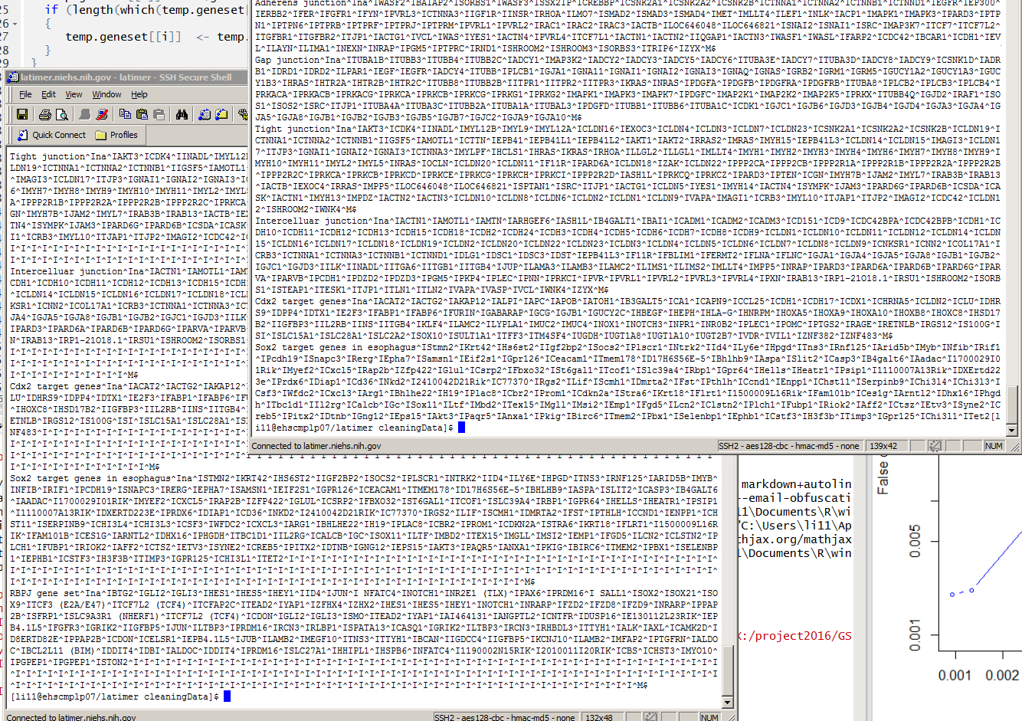
Here was initial gene list, a.k.a (20140627)
Please look at the end of the file “Tet2”
Here was the second gene list, a.k.a (20161005)

Slide 2
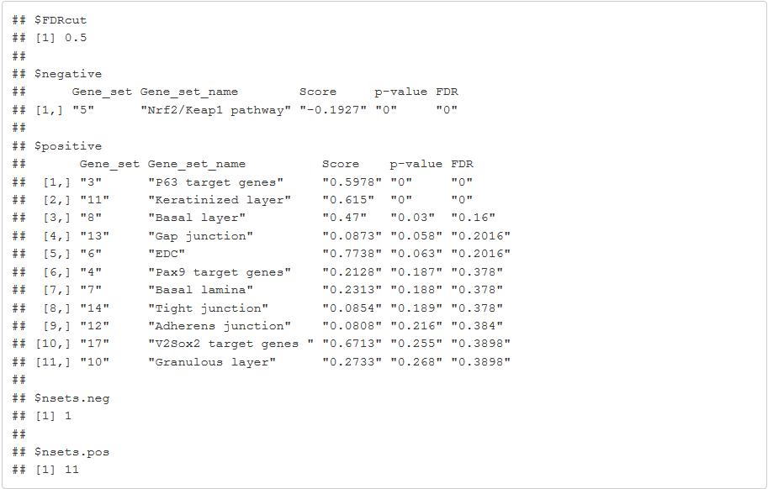
Rename the last gene list
Add, “na” as the category

Slide 3
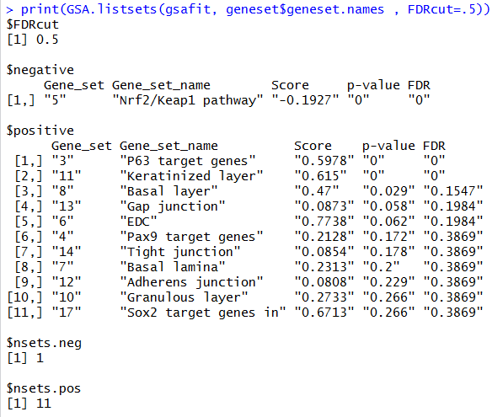
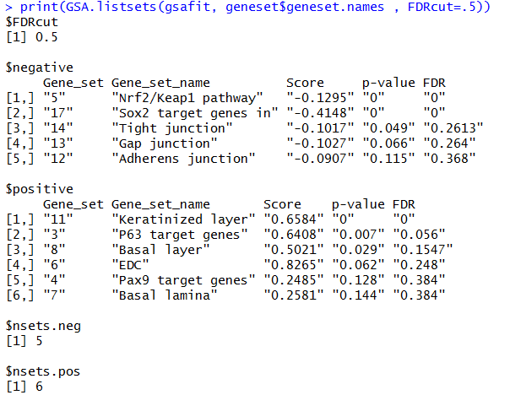
With gene-set collection “20140627”
Initial gene sets
Gene sets all capitalized

Slide 4
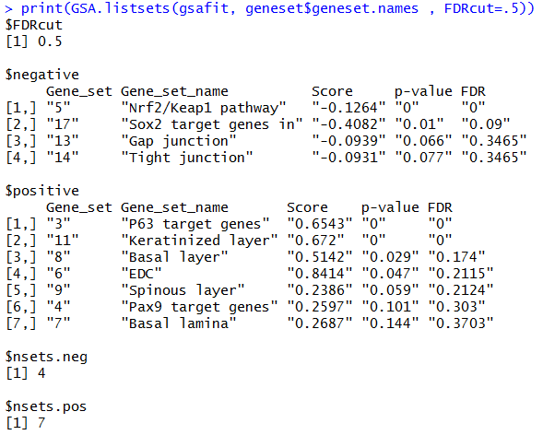
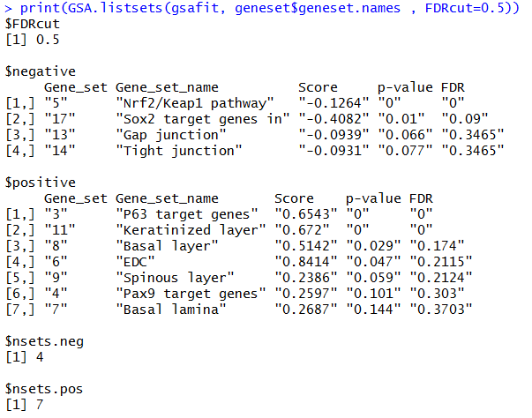
With gene-set collection “20161005”
Initial gene sets
Gene sets all capitalized

Slide 5
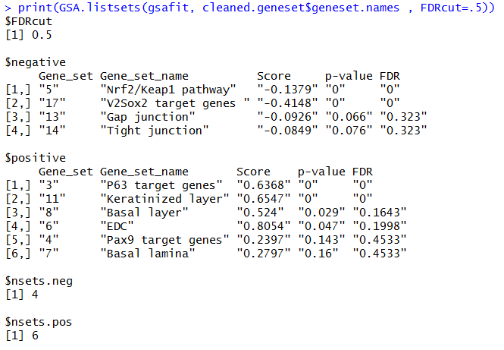
With gene-set collection “20161005”
Gene sets all capitalized
Gene sets cleaned and capitalized

Slide 6
With capitalized gene-set collections
20140627 -- capitalized
20161005 – cleaned & capitalized

Slide 7
Temporary conclusion
Gene sets need to be cleaned before feeding to the model
Module provided in the updated R program
The program is “case-sensitive”
Therefore, it is highly recommended
All gene sets “symbols” need to be capitalized
Gene symbols from the array data need to be capitalized
Unseen characters
The program is definitively sensitive to “unseen characters”
It is recommended that the gene sets being generated using “ascii-based” program, i.e. notepad in windows,
Will provide extra filtering model to deal with this.
There are more to investigate on the program itself
Not a very clean implementation
Stay tune

Slide 8
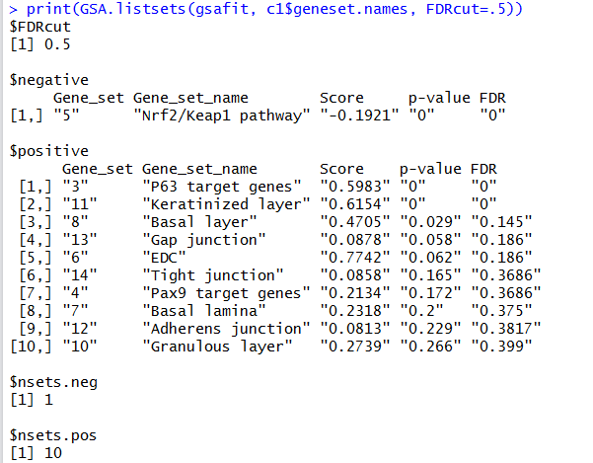
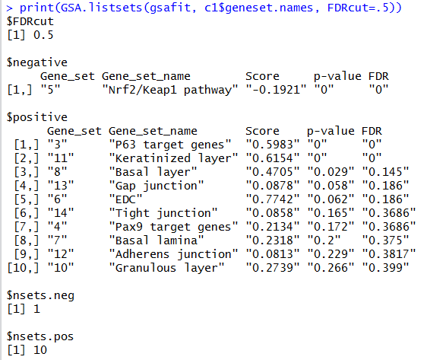
20140627 – removed the questionable gene set
20161005 – removed the last TWO gene sets

