Slide 1
Data mining tutorial
Kaggle competition

Slide 2
Objectives
A kaggle.com competition as an example
Refresh/sharpen your programming skills
Learning Random Forest modeling
Bonus
Github repository
Wing-100 IDE for python programming

Slide 3
Kaggle competition – Titanic project

Slide 4
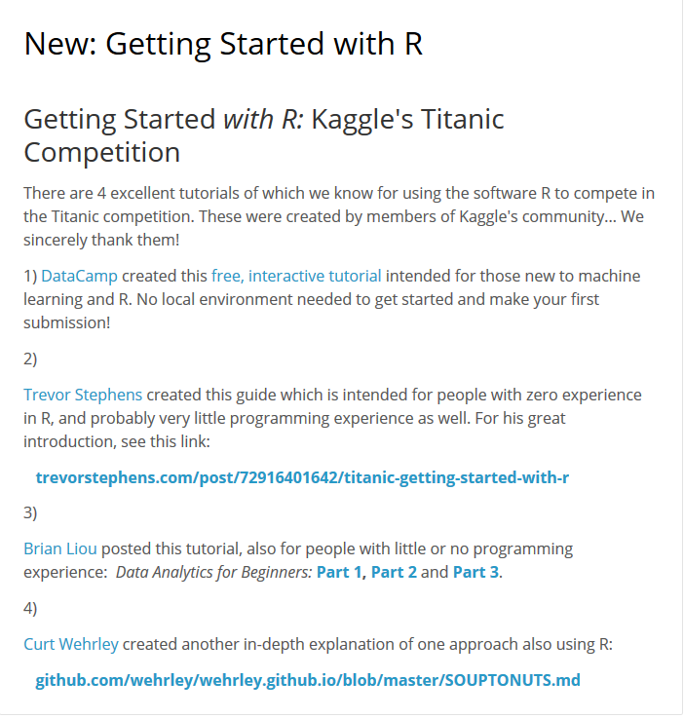
Only if one wants to learn

Slide 5
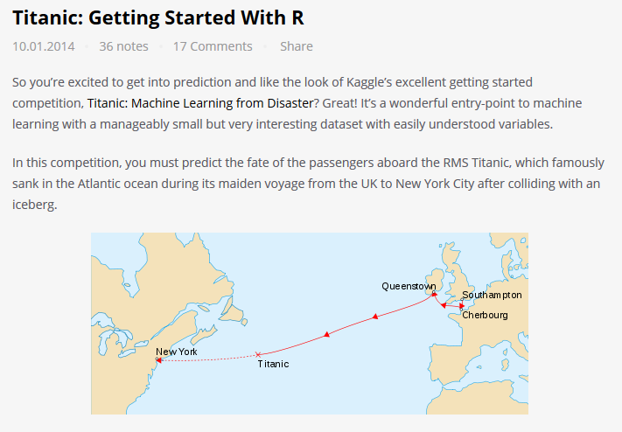

A solution for Titanic with R

Slide 6
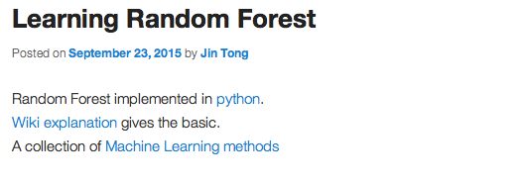
An online note
http://sites.duke.edu/workblog/2015/09/23/learning-random-forest/

